Slide 1
HEROES FROM THE WORLD

Slide 2
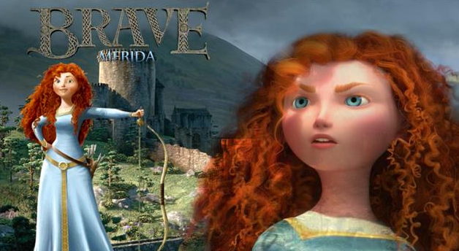
PRINCESS MERIDA BRAVE
Do you like the film ? I think it’s incredible
I do , but I prefer ……

Slide 3
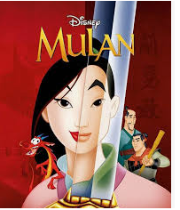
MULAN
She is so c…………………….!
You’re …………………She is awesome !

Slide 4
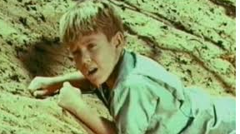
DIRKIE LOST IN THE DESERT
He’s the hero of an old film, that’s why we don’t know him .

Slide 5
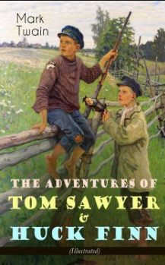
TOM SAWYER AND HUCKLEBERRY FINN
I recognize him .They’re so f……..! I really
……………….this ……………

Slide 6
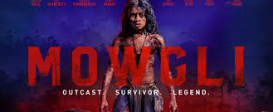
MOWGLY
He’s so y…………and cute !
And he’s v.......... s................. !

Slide 7

OLIVER TWIST
He ‘s the ……………..of
a ……………BY CHARLES
DICKENS .
So sad !

Slide 8


