Slide 1
GUY FAWKES
THE GUNPOWDER PLOT

Slide 2
SITUATION IN ENGLAND IN THE 17TH CENTURY

Slide 3
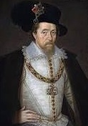
JAMES 1ST
The protestant King

Slide 4
PRESSURE AGAINST THE CATHOLICS
CATHOLICS

Slide 5
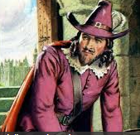
THE REVENGE OF GUY FAWKES, A CATHOLIC SOLDIER

Slide 6
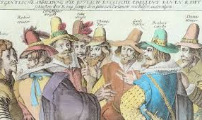
GUY FAWKES AND HIS FRIENDS, THE CONSPIRATORS

Slide 7
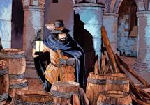
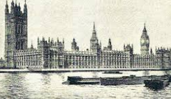
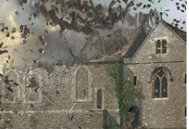
THEY WANTED TO BLOW UP THE PARLIAMENT

Slide 8
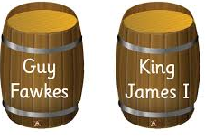

THEY USED BARRELS FULL OF POWDER

Slide 9
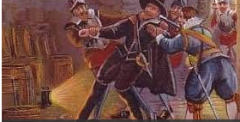
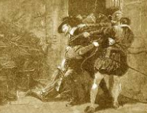
HE WAS CAPTURED AND KILLED

