Slide 1
Disclaimers
We hope you find the information on our website and resources useful.
Animations
This resource has been designed with animations to make it as fun and engaging as possible. To view the content in the correct formatting, please view the PowerPoint in ‘slide show mode’. This takes you from desktop to presentation mode. If you view the slides out of ‘slide show mode’, you may find that some of the text and images overlap each other and/or are difficult to read.
To enter slide show mode, go to the slide show menu tab and select either from beginning or from current slide.
Sensitive content
Sensitive and/or upsetting topics may emotionally impact your students due to past experiences.
You should consider whether this content is appropriate and ensure adequate support is available for anyone affected.
Controversial people
Please note: although Andrew is a notable member of the Royal Family as one of Queen Elizabeth II's children, we would advise against allowing your class to freely research more about his life, as he is a controversial figure who has been accused of behaviour that you may not find appropriate to discuss with children.
You may wish to delete this slide before beginning the presentation.

Slide 2
21st April 1926 – 8th September 2022

Slide 3
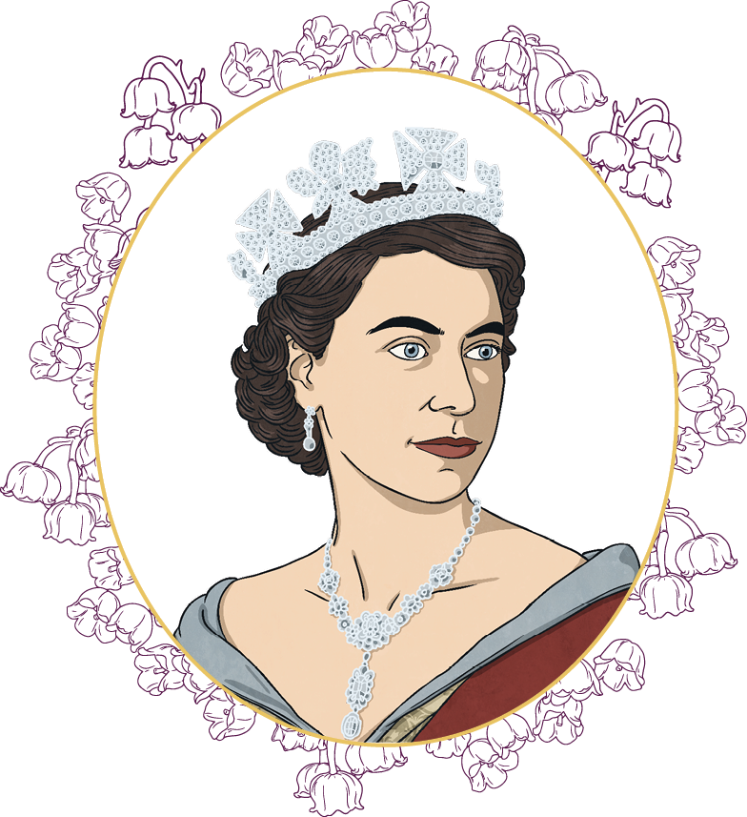
Who Was Queen Elizabeth II?
Princess Elizabeth, later to become Queen Elizabeth II, was born on 21st April 1926 in Mayfair, London.
She was the first child of The Duke and Duchess of York, who later became King George VI and Queen Elizabeth.
Queen II’s birthday was officially celebrated in Britain on the second Saturday of June each year. This special day was referred to as ‘The Trooping of the Colour’.
Queen Elizabeth II was known as the British Sovereign.
“Title of Image Used” by [Author] is licensed under CC BY 2.0

Slide 4
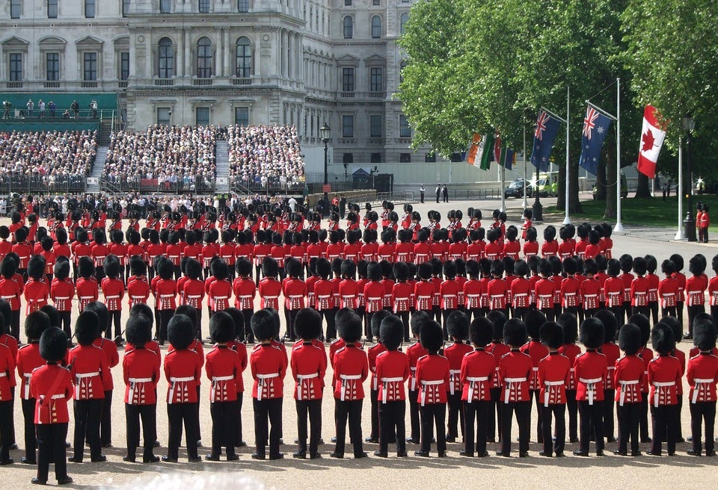
Trooping of the Colour
“Title of Image Used” by [Author] is licensed under CC BY 2.0

Slide 5

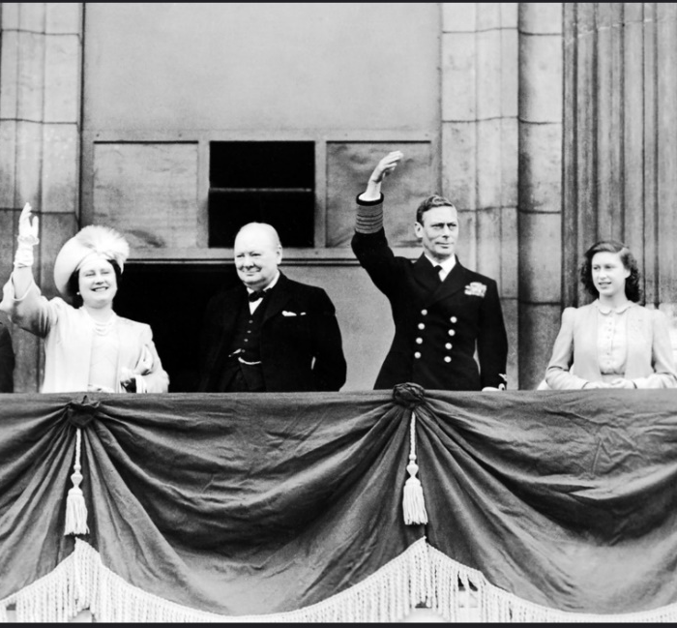
Queen Elizabeth II’s Family
In 1936, King Edward VIII stepped down from the throne.
Princess Elizabeth, along with her sister Margaret, became princesses when King George VI, their father, was crowned. Their mother became Queen Elizabeth.
Discuss It
Do you know the name of the other man in this photograph?
Answer
Sir Winston Churchill. He was the British prime minister from 1940-1945 and 1951-1955.
“Title of Image Used” by [Author] is licensed under CC BY 2.0

Slide 6
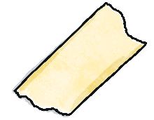
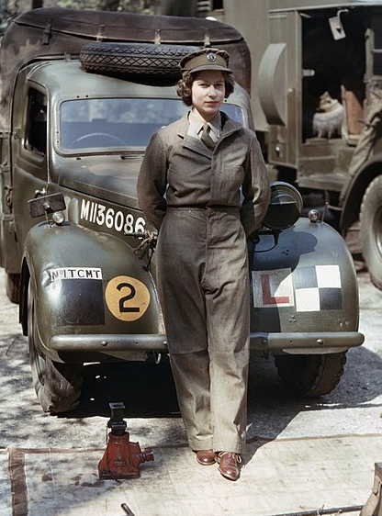
Princess Elizabeth’s Youth
Princess Elizabeth was taught at home, not at school. She studied art and music and enjoyed drama and swimming.
When she was 11, she joined the Girl Guides.
She undertook her first public engagement on her 16th birthday, when she inspected the soldiers of the Grenadier Guards. They guard the royal residences.
During the Second World War, she served in the army as a mechanic.
“Title of Image Used” by [Author] is licensed under CC BY 2.0

Slide 7
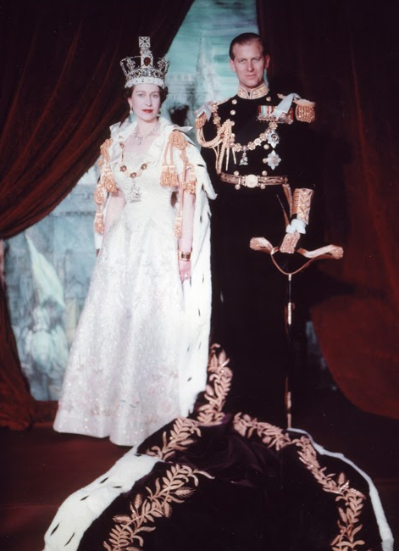

The Royal Family
Princes Elizabeth got married in Westminster Abbey on 20th November 1947, when she was 21 years old.
She married Prince Philip, also known as the Duke of Edinburgh, who was the son of Prince Andrew of Greece.
In 1948, their first child, The Prince of Wales (King Charles III), was born.
Two years later, The Princess Royal (Princess Anne), was born. Queen Elizabeth II went on to have two more children: The Duke of York (Prince Andrew) in 1960 and The Earl of Wessex (Prince Edward) in 1964.
“Title of Image Used” by [Author] is licensed under CC BY 2.0

Slide 8
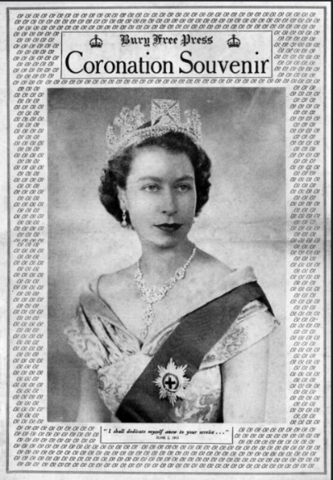
A New Queen
In 1952, when she was just 25, Princess Elizabeth’s father, King George VI, died. Princess Elizabeth was in Kenya when she heard the sad news. She immediately returned home and was proclaimed Queen Elizabeth II two days later.
Her Majesty Queen Elizabeth II’s coronation took place in 1953 at Westminster Abbey in London.
In 2012, she celebrated her Diamond Jubilee which marked 60 years since her accession to the throne. In 2022, she celebrated her Platinum Jubilee, marking 70 years as monarch.
Discuss It
How do you think Princess Elizabeth felt when she became Queen?
proclaim – Make something official.
coronation – Ceremony of crowning a king or queen.
“Title of Image Used” by [Author] is licensed under CC BY 2.0

Slide 9
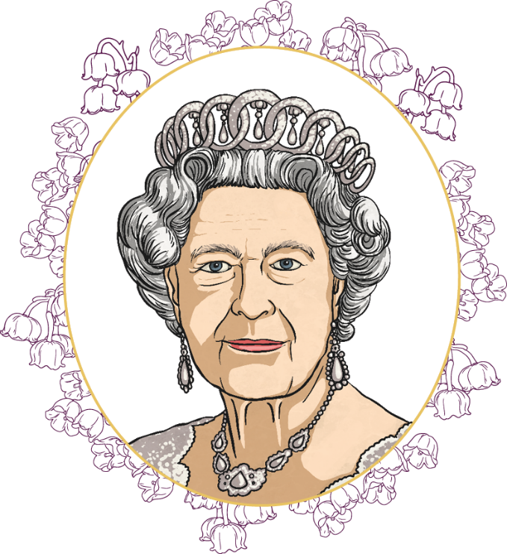
The Role of Queen Elizabeth II
Queen Elizabeth II carried out many important tasks on behalf of the nation.
Queen Elizabeth II was Head of the Church of England. She appointed bishops and archbishops on the advice of the prime minister.
Queen Elizabeth II was Head of the Armed Forces.
She was the only person who could declare and end war with other countries.
Queen Elizabeth II had to be impartial in matters of government and was never allowed to vote. However, she met weekly with the prime minister and opened parliament, amongst other duties.
appoint - To arrange who will take the position.
impartial - Not supporting any particular side.
“Title of Image Used” by [Author] is licensed under CC BY 2.0

Slide 10
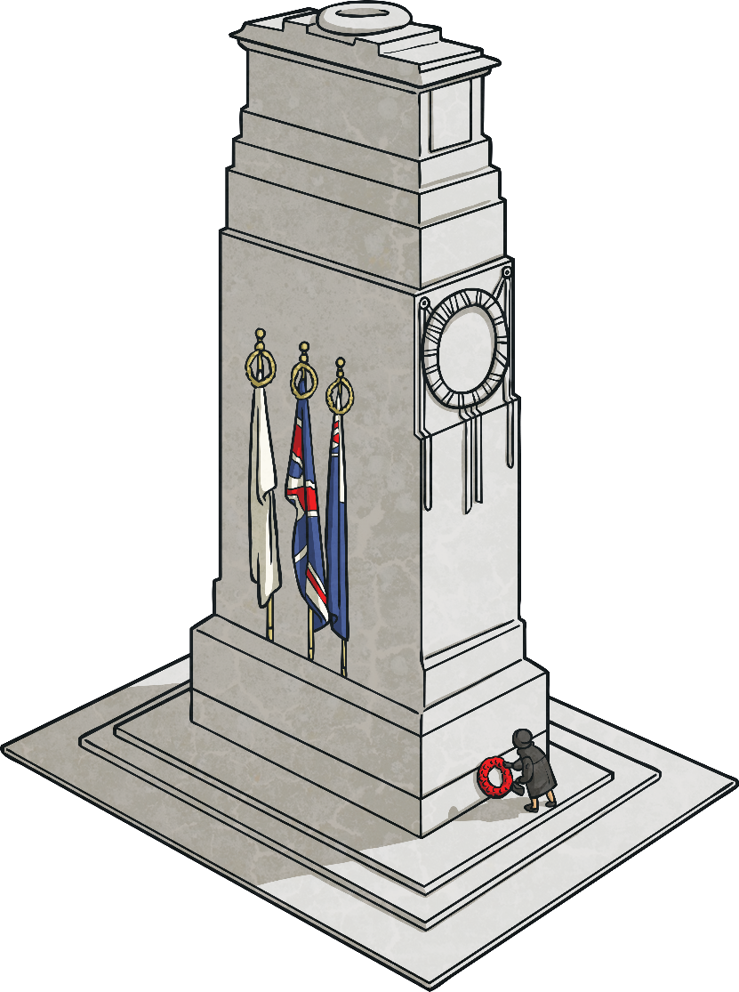
Representing the Country
As Head of State, Queen Elizabeth II travelled abroad on official state visits. She also invited other Heads of State from around the world to visit the UK.
Queen Elizabeth II represented the country at times of celebration or sorrow. One of her most important duties was on Remembrance Sunday, when she laid a wreath at the Cenotaph in London to remember members of the armed forces who had died fighting for their country.
Discuss It
Has anyone in your family fought for their country?
“Title of Image Used” by [Author] is licensed under CC BY 2.0

Slide 11
Queen Elizabeth II and the Commonwealth
The Commonwealth is a group of 56 countries, almost all of which were formerly under British rule as part of the British Empire.
After becoming independent, many countries decided that they still wanted to remain within the Commonwealth. Queen Elizabeth II was Head of the Commonwealth and made visits to Commonwealth countries during her reign.
“Title of Image Used” by [Author] is licensed under CC BY 2.0

Slide 12
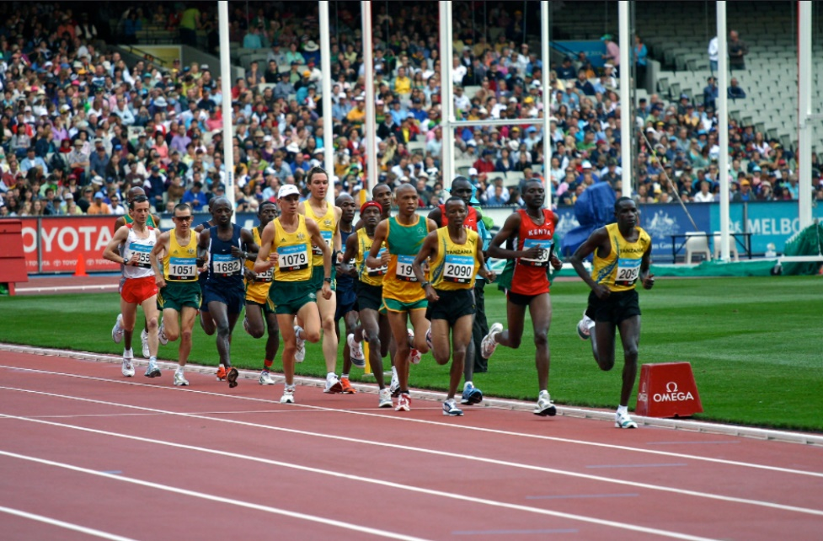
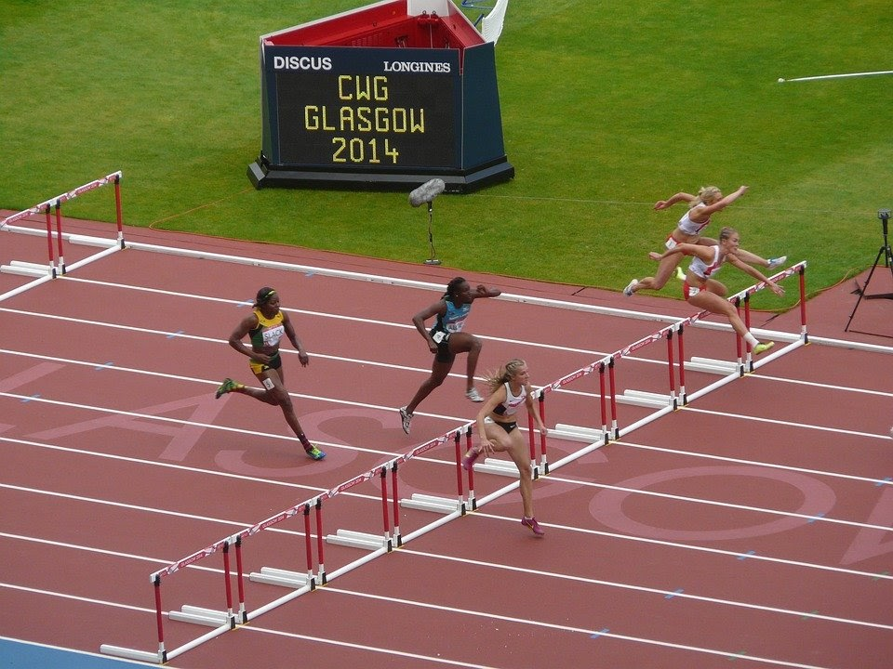
Commonwealth Games
“Commonwealth Games marathon events” by Jimmy Harris is licensed under CC BY 2.0
The Commonwealth Games is an international, multi-sport event which involves athletes from Commonwealth countries. Queen Elizabeth II often attended the games to open or close them.
“Title of Image Used” by [Author] is licensed under CC BY 2.0

Slide 13
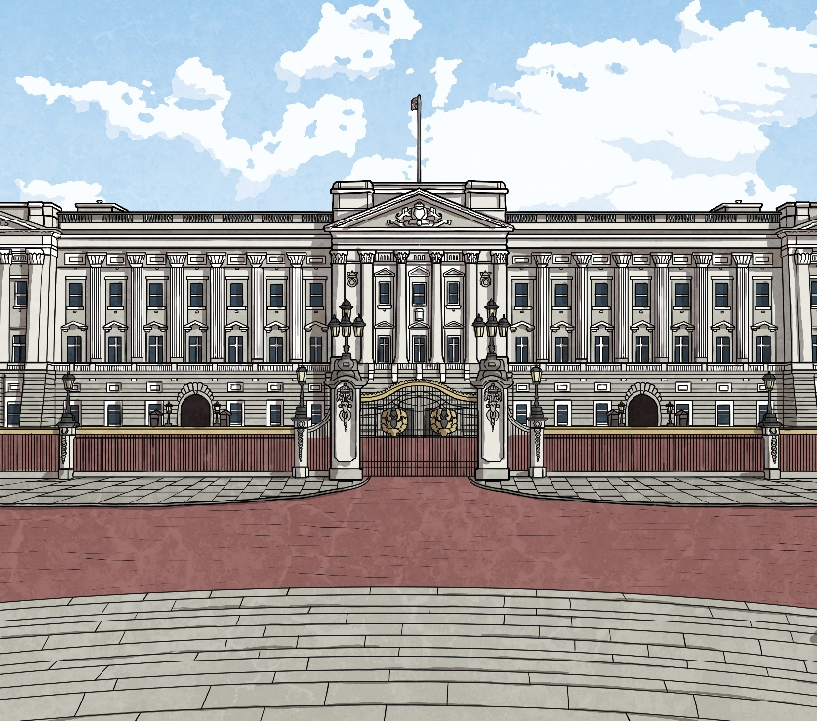
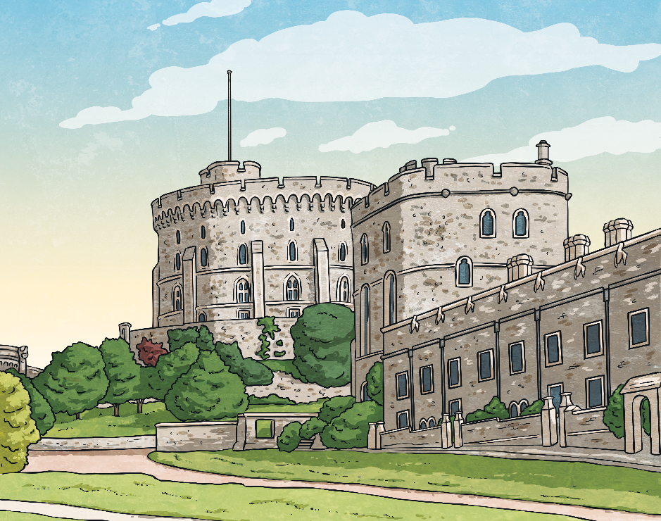
Queen Elizabeth II’s Homes
Her Majesty's official London residence was Buckingham Palace but she also spent lots of time at Windsor Castle.
The Royal Family chose to use the name ‘Windsor’ as their surname after Windsor Castle.
“Title of Image Used” by [Author] is licensed under CC BY 2.0

Slide 14
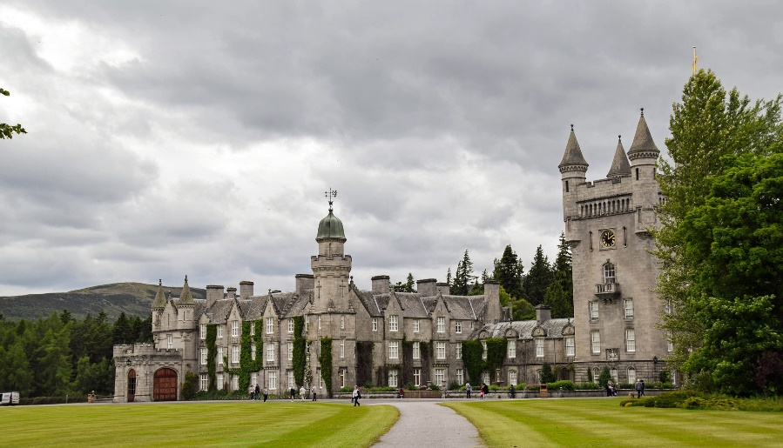
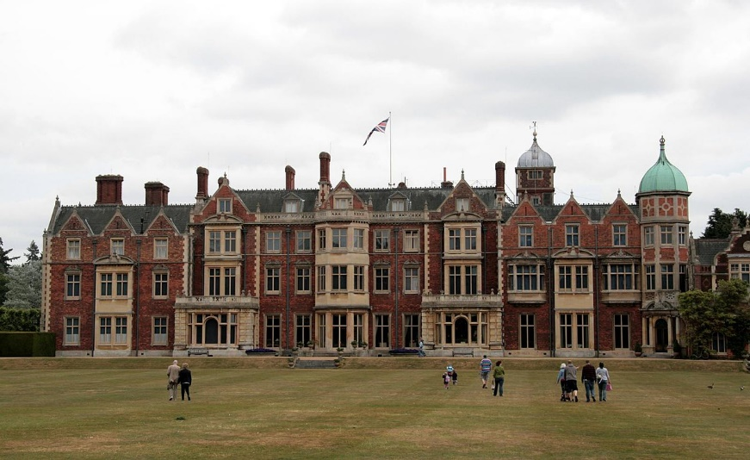
Favourite Places
Queen Elizabeth II loved Scotland. She spent her summers at Balmoral Castle. Her official residence in Scotland was The Palace of Holyrood House in Edinburgh.
Balmoral
Sandringham
Queen Elizabeth II also enjoyed spending time at Sandringham House in Norfolk, which she inherited from her father.
“Title of Image Used” by [Author] is licensed under CC BY 2.0

Slide 15
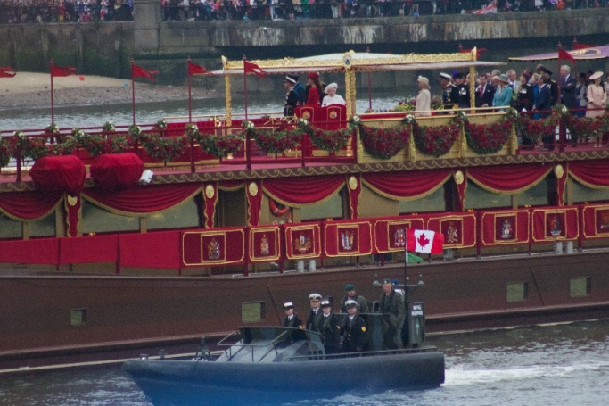
The Platinum Jubilee
In 2022, Queen Elizabeth II celebrated her Platinum Jubilee. The occasion marked 70 years since she became Queen of the United Kingdom and the Commonwealth of Nations. She was the first British monarch to reach this milestone.
Celebrations included:
Trooping the Colour
the Platinum Party at the Palace
the Platinum Pudding Competition
The majority of events took place during a special bank holiday weekend to allow people across the country to join the celebrations.
“IMG_2516” by Ian Patterson is licensed under CC BY 2.0
“Title of Image Used” by [Author] is licensed under CC BY 2.0

Slide 16
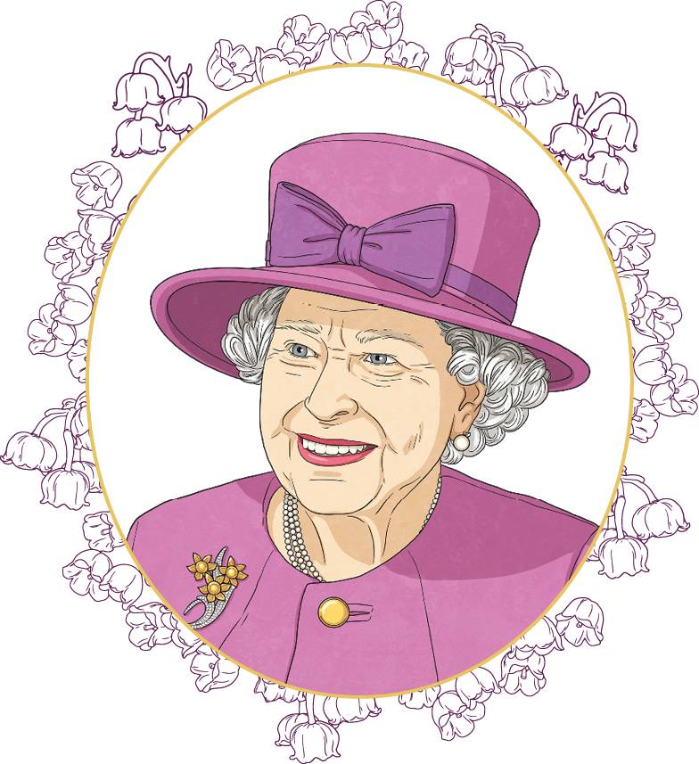
Long-Reigning Monarch
Queen Elizabeth II was the UK's longest-reigning monarch. She surpassed her great-great-grandmother, Queen Victoria, who reigned for 63 years and seven months.
During her lifetime, she had 8 grandchildren and 12 great-grandchildren.
At the time of her death, she had reigned for 70 years.
Discuss It
Did you ever see, or meet, Queen Elizabeth II?
“Title of Image Used” by [Author] is licensed under CC BY 2.0

Slide 17
Events in the Life of Queen Elizabeth II
1964
Queen Elizabeth II’s youngest child is born.
1992
A fire destroys part of Windsor Castle.
1936
Her father becomes King.
2015
Queen Elizabeth II becomes the UK’s longest-reigning monarch.
2021
Prince Philip dies.
1920
1930
1940
1950
1960
1970
1980
1990
2000
2010
2020
2030
1926
Princess Elizabeth Alexandra Mary is born.
1952
King George VI dies and she becomes Queen.
1977
Queen Elizabeth II’s Silver Jubilee.
2002
Princess Margaret and The Queen Mother die.
2016
Queen Elizabeth II turns 90.
2022
Queen Elizabeth II dies.
“Title of Image Used” by [Author] is licensed under CC BY 2.0

Slide 18
Where on this timeline would you put the following events?
1997 – Princess Diana is killed in a road accident.
1990 –The Princess Royal is nominated for the Nobel Peace Prize.
1973 – Queen Elizabeth II opens the Sydney Opera House.
1953 – Princess Elizabeth is crowned Queen Elizabeth II at Westminster Abbey.
2012 – Queen Elizabeth II celebrates her Diamond Jubilee.
2015
Queen Elizabeth II becomes the UK's longest-reigning monarch.
1936
King George VI is crowned.
1964
Queen Elizabeth II’s youngest child is born.
1992
A fire destroys part of Windsor Castle.
1926
Princess Elizabeth Alexandra Mary is born.
1952
King George VI dies and Princess Elizabeth becomes Queen.
1977
Queen Elizabeth II’s Silver Jubilee.
2002
Princess Margaret and The Queen Mother die.

Slide 19
Fun Facts About Queen Elizabeth II
She had nine thrones; six at Buckingham Palace!
She was the first, and so far the only, female member of the Royal Family to serve in the armed forces.
In 1954, she became the first serving monarch to circumnavigate the globe on a six month round-the-world tour with her husband.
Corgis were her favourite dogs. She owned more than 30 of them during her reign. She also liked Dorgis – a cross between a Corgi and a Dachshund.
For her 6th birthday, she was given a miniature Welsh cottage.
She was 5'4" (160cm) tall.
She sent cards to congratulate people when they reached the age of 100.
She ‘sat’ for her portrait to be painted over 130 times!
“Title of Image Used” by [Author] is licensed under CC BY 2.0

Slide 20

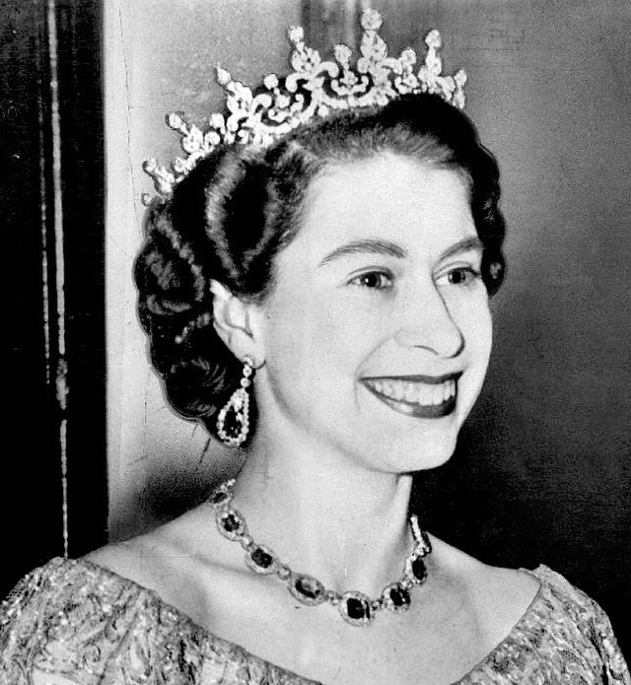
Reflection
For most British people, Queen Elizabeth II has been the only monarch of their lifetime.
You may be feeling shocked and saddened by her death. You might like to speak with an adult after the lesson.
You may want to pay your respect by taking a moment of silence to remember Queen Elizabeth II.
“Title of Image Used” by [Author] is licensed under CC BY 2.0

