Slide 1
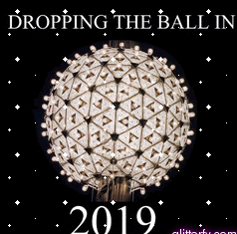
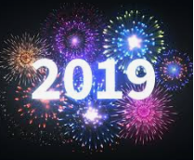
NEW YEAR’S EVE IN NEW YORK AND LONDON

Slide 2
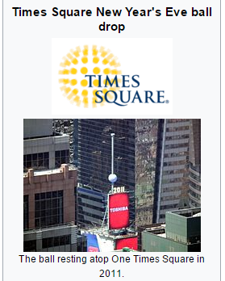
How they celebrate New Year’s Eve in New York

Slide 3
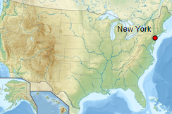
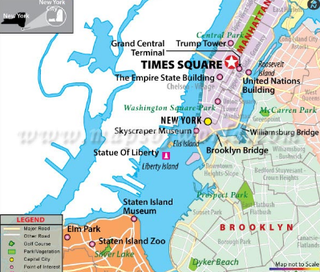
NEW YORK CITY

Slide 4
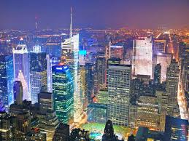
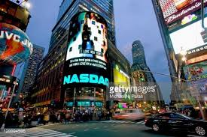
TIME SQUARE

Slide 5
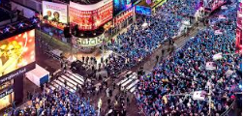

Slide 6
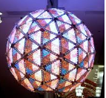
THE BALL DROP

Slide 7
TIMES SQUARE BALL
TIME BALL
LOCATED IN TIMES SQUARE
REFERRED TO AS THE BALL DROP

Slide 8
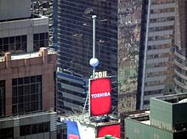
THE BALL FROM ABOVE

Slide 9
The ball descends 43 metres in 60 seconds
It begins at 11:59:00
It rests at midnight to signal the start of the New Year

Slide 10
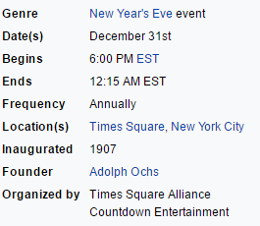

Slide 11
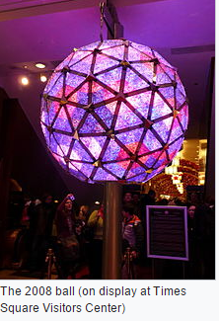

Slide 12
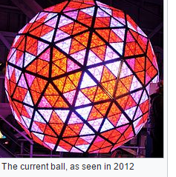

Slide 13
IMPACT OF THE EVENT
2 million people attend this celebration
Lots of people watch it on T.V
It is one major event

Slide 14
NEW YEAR’S EVE IN LONDON
New Year's Eve in London, a New Year's Eve firework display, is celebrated along the Victoria Embankment and South Bank areas of the River Thames where the London Eye and Big Ben are situated. The countdown is accompanied by the chimes of Big Ben, and a digital countdown timer projected onto the Shell Centre. The fireworks are launched off the London Eye and from barges in the River Thames at midnight. The display is organised by Jack Morton Worldwide^{[1]}, with Titanium Fireworks responsible for the pyrotechnics

Slide 15
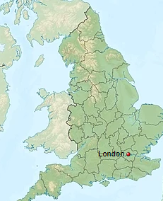
LONDON

Slide 16
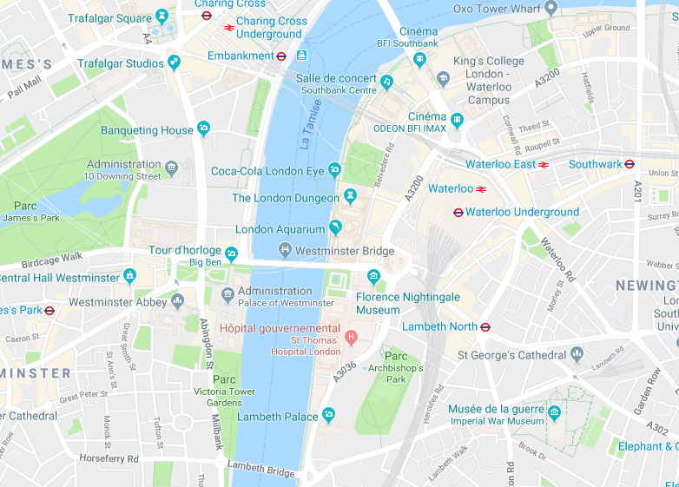
VICTORIA EMBANKMENT / BIG BEN AND THE LONDON EYE

Slide 17
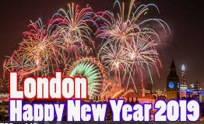
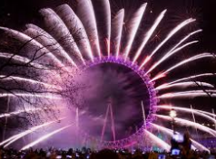
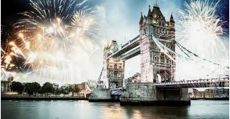
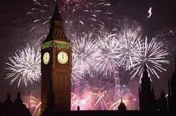
FIREWORKS OVER LONDON

Slide 18
ORIGINS OF THE EVENT
It was initially planned to celebrate the YEAR 2000 .
After several disputes and interruptions , huge fireworks were fired again .
It has been the tradition ever since .
Themes are different every year.

Slide 19
IMPACT OF THE EVENT
There is a show on BBC News which is entitled NEW YEAR’S EVE FIREWORKS
Even International channels take live coverage of the event , such as CNN in the United States .
It’s an extremely popular event which is an important tourist event .

Slide 20
