Slide 1

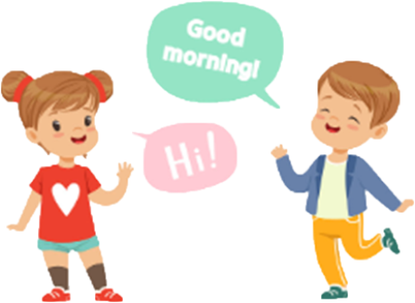
ENGLISH GREETINGS !

Slide 2


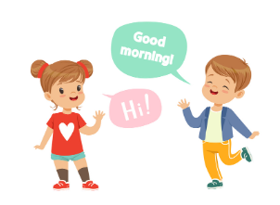
STEP ONE : READ THE EXPRESSIONS OUTLOUD
HOW ARE YOU TODAY ?

Slide 3

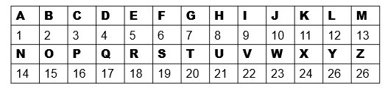
STEP TWO :COMPLETE THE SONGS
Good morning , good …………….
Good……………………….(1/6/20 /5/18/14/15/15/14 )
Good evening , …………. ……………….. (5/22/5/14/9/14/7)
Good ……………. , good …………(14/9/7/8/20)
Nice to ………..you (13 /5/5/20)
Nice to meet you ………(20/15/15)
Good ……….., ……………………………. (7/15/15/4 2/26/5)
See you !
See you later !
Hello,………..what ‘s your …………? (8/5/12/12/15 14/1/13/5)
What ‘s y….. n………,w………’s y……….n………? (26/15/21/18 )
Hello,………..what ‘s your …………?
My ………..is P………….(16/5/20/5/18)
(13/15/18/14/9/14/7)
Check the spelling

Slide 4
STEP TWO : COMPLETE THE SONGS
Good morning , good …………(13/15/18/14/9/14/7)
Good……………………….(1/6/20 /5/18/14/15/15/14 )
Good evening , good ………………..(5/22/5/14/9/14/7)
Good ……………. , good …………(14/9/7/8/20)
Nice to ………..you (13 /5/5/20)
Nice to meet you ……… (20/15/15)
Good ……….., …………………………….(7/15/15/4 2/26/5)
See you !
See you later !
Hello,………..what ‘s your …………? (8/5/12/12/15 14/1/13/5)
What ‘s y….. n………,w………’s y……….n………?(26/15/21/18 )
Hello,………..what ‘s your …………?
My ………..is P………….

Slide 5








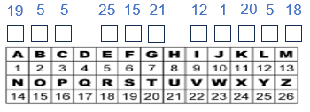

STEP THREE : DO THE EXERCISES
3.Match the two columns ( fuote les mots de la partie droite correspondant à la partie droite de la même couleur)
What part of the day is it ? (Indique le moment de la journée
en anglais ):
Pour dire :
Bonjour le matin
Bonjour l’après-midi
Bonsoir
Bonne nuit
Au revoir
A plus tard
Salut /Coucou
Je formule les phrases suivantes:
Good night.
See you later.
Good bye.
Good evening.
Hello / Hi /Hey / Hi there.
Good morning.
Good afternoon.
7:00 M…………………………
3:00 A…………………………
DID YOU
KNOW ?
Courtoisie et politesse sont les piliers de la
Société
Anglaise .Le savoir vivre en communauté est fondamental !
9:00 E…………………………
11:00 N…………………………
4.Put the letters in the right order (place les lettres dans le bon ordre)
2. Note down greetings according to the time of the day (Note les salutations en fonction du moment de la journée):
Quelles sont les autres salutations que tu connais ?
a) ELLHO……………..
e) GODO ORNINGM…………………………
b) IH………..
f) OODG TERAFONO………………………..
c) EYH……….
g) DOOG NIGNEVE……………………….
G…….m………….
In the m…………..
d) IH ERETH………
…............
h) GODO GHTIN…………………….
G……. a………….
In the a…………..
G…… e………….
In the e…………..
G……. n………….
At …………..
5.The snake letters : separate the words to find back the sentence ( sépare les mots et retrouve la phrase ).
……………………………………………………………………………………
…….………….
……………….
………………..
Peu importe le moment de la journée / Plus familier.
Comment dit-on « Comment ça va ? »
…………………………………………….
G…… b…….
It is time to go .
6.Crack the code !
( décrypte le code !)
GRAMMATICAL TIP !
In the + moment of the day
EXCEPTION = AT + NIGHT

Slide 6
FINAL STEP : NOTE DOWN THE LESSON
Thursday, September
WELCOME TO MIDDLE SCHOOL !
The document is a video, song.
It is /’s the greetings ( hello ) song.
Good afternoon ! My name is …………………….and I’m happy today !
What about you ? What’s your name ? How are you today ?
LEXICAL TIP
Greetings = salutations
Good morning = bonjour le matin
Good afternoon = bonjour l ’après –midi
Good evening = bonsoir
Hello = Hi /ai / = Hey /ei/ = Hi there = coucou, salut ! ( plus familier )
GRAMMATICAL TIP
A = ONE (1) + nom commençant par une consonne
THE = le, la , les
It is = C’est ( forme pleine/ complète )
It’s = c’est ( forme contractée / brève )

