Slide 1
Disclaimer/s
We hope you find the information on our website and resources useful.
Animations
This resource has been designed with animations to make it as fun and engaging as possible. To view the content in the correct formatting, please view the PowerPoint in ‘slide show mode’. This takes you from desktop to presentation mode. If you view the slides out of ‘slide show mode’, you may find that some of the text and images overlap each other and/or are difficult to read.
sensitivity
Sensitive and/or upsetting topics may emotionally impact your students due to past experiences. You should consider whether this content is appropriate and ensure adequate support is available for anyone affected.
To enter slide show mode, go to the slide show menu tab and select either from beginning or from current slide.

Slide 3
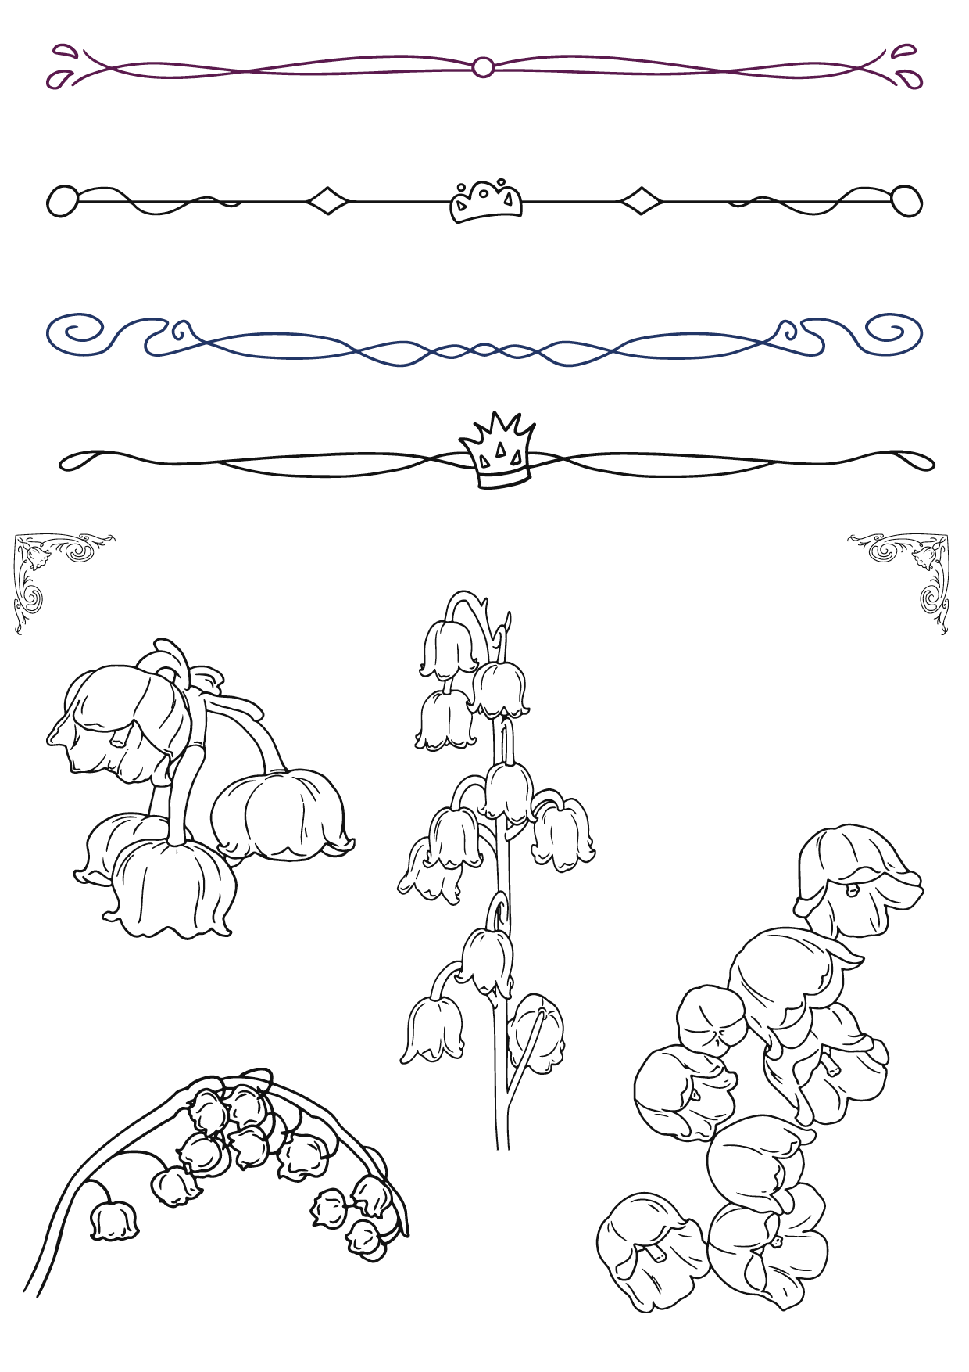
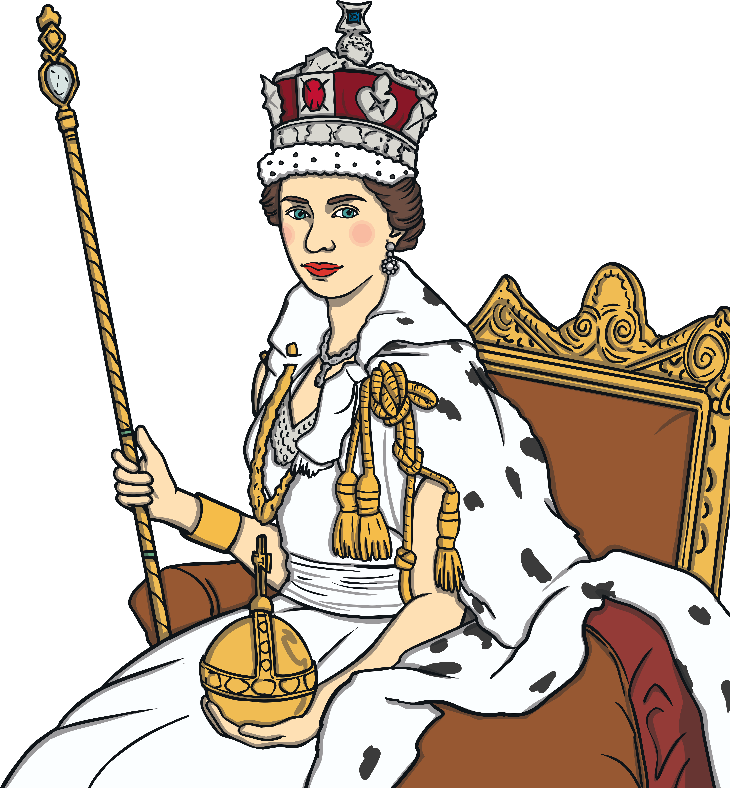
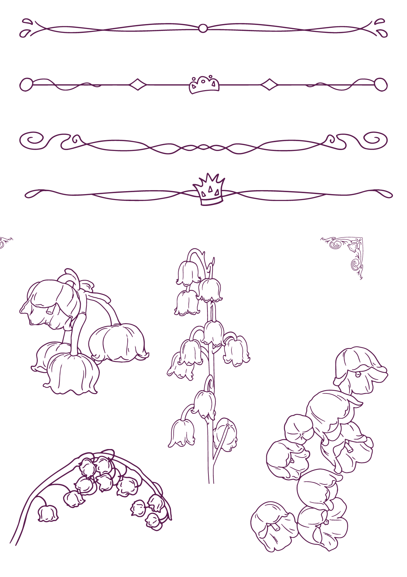
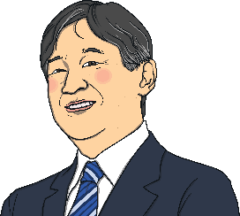
What Is a Monarch?
Depending on where you are in the world, a male monarch can be called a king or an emperor. A female monarch can be called a queen or an empress. A monarch usually reigns for their entire life.
Usually, when a monarch dies, their oldest son or daughter becomes the next monarch. Not all countries have a monarch.
Queen Elizabeth II
Did You Know…?
Even today, some countries only let men rule. What do you think about this?
Emperor Naruhito of Japan

Slide 4
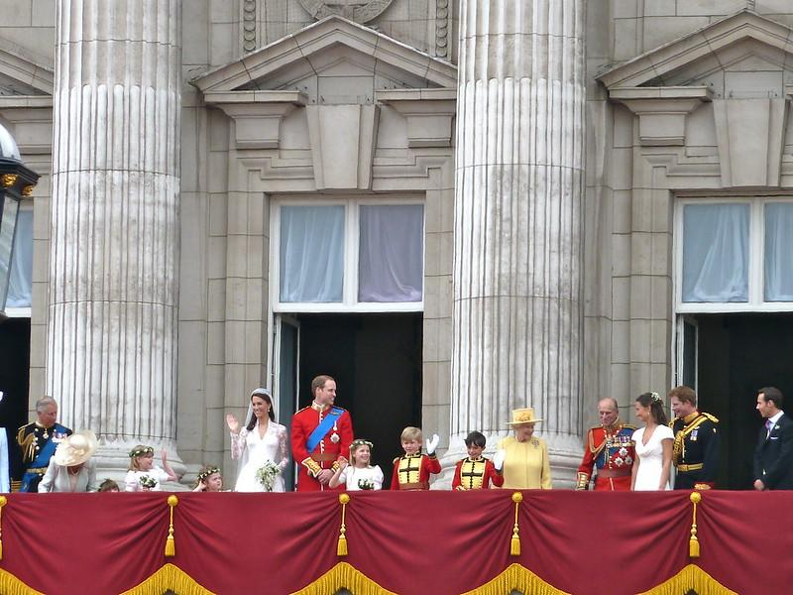
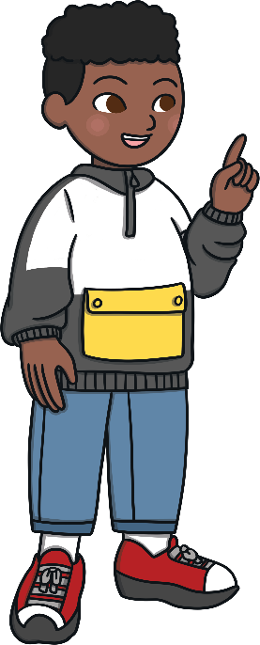
The British Monarchy
A monarch is someone who is the head (leader) of the monarchy.
The British monarchy is known as the Royal Family.
Can you name any of the people in this photograph?
Did You Know…?
Queen Elizabeth II was the UK's longest-reigning monarch.

Slide 5
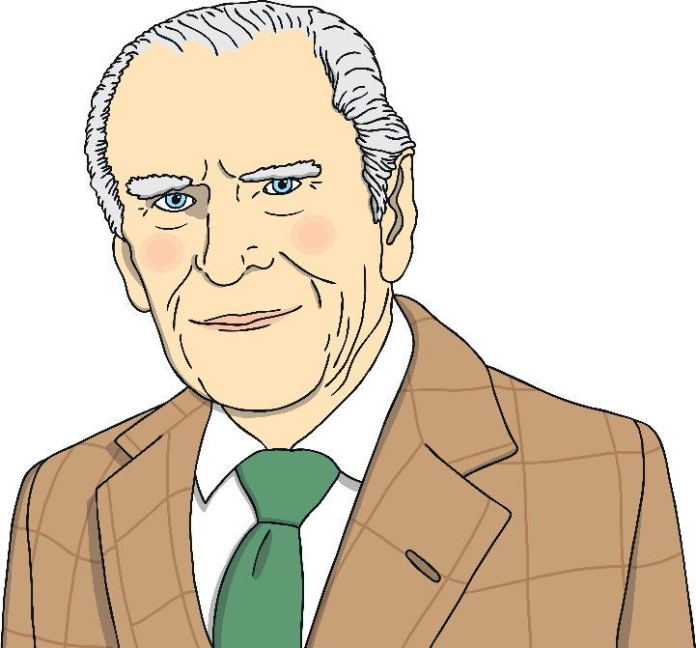
When a British Monarch Dies
When a monarch dies, it can be a very sad time for the Royal Family. It will affect people in Britain, the UK and around the world.
The plan for a monarch’s death, or the death of their husband or wife, is given a special code name. For Queen Elizabeth II’s husband, Prince
Philip, the plans were called Operation
Forth Bridge.
The plans are practised every year to make sure that everyone is prepared.

Slide 6

Sharing the News
When a British monarch dies, their private secretary will tell the prime minister.
This news will then be passed on to the 14 other countries where the British monarch is head of state and to the other 55 countries in the Commonwealth.
head of state – A person who leads the country, e.g. a king, queen or president.
Commonwealth – Almost all of these countries used to be under British rule. The British monarch is head of the Commonwealth.

Slide 7
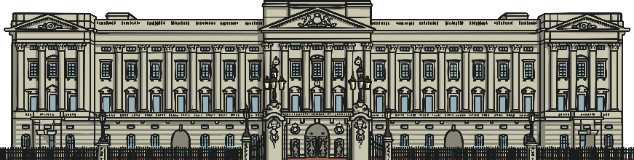
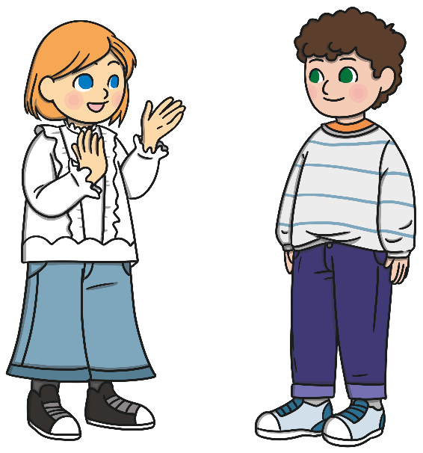
The Next Steps
A notice is placed on the gates of Buckingham Palace – the London home of the British king or queen. The people who work at the palace wear a black band on their left arm.
Next, news reporters are told the news. This helps to spread the information to people all over the world.
Newsreaders wear black clothes. Radio stations will play quiet, serious songs. There will be programmes on television about the monarch’s life.
Discuss It
Why do you think people wear black?

Slide 8
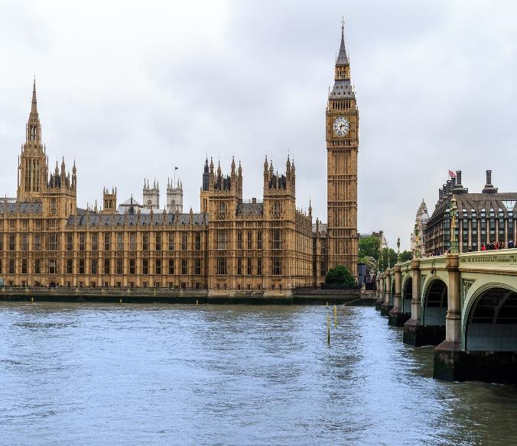
Paying Respects
Across the UK, the Union Flag will be lowered to half mast. People may travel to the monarch’s home to lay flowers.
There are usually 10 days between a British monarch’s death and the funeral. The monarch’s body is placed inside a coffin and moved to Westminster Hall where they will lie in state for about four days so that people can visit to show their respect and give thanks for the monarch.
lie in state – The coffin is placed on view for visitors.

Slide 9
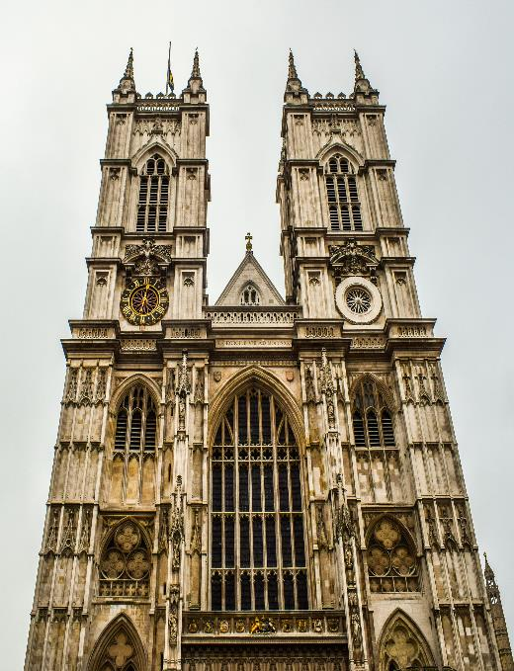

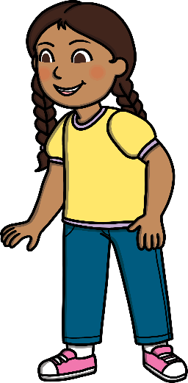
A British Monarch’s Funeral
A British monarch has a state funeral. State funerals may be held in St Paul’s Cathedral or Westminster Abbey. Important people from around the world will attend.
A state funeral is a public funeral ceremony which is usually only for monarchs. Sometimes, people who have done something very special for their country can also be given a state funeral.
The last state funeral for a British monarch was for King George VI in 1952.
Sir Winston Churchill, the prime minister during the Second World War, was also given a state funeral.

Slide 10
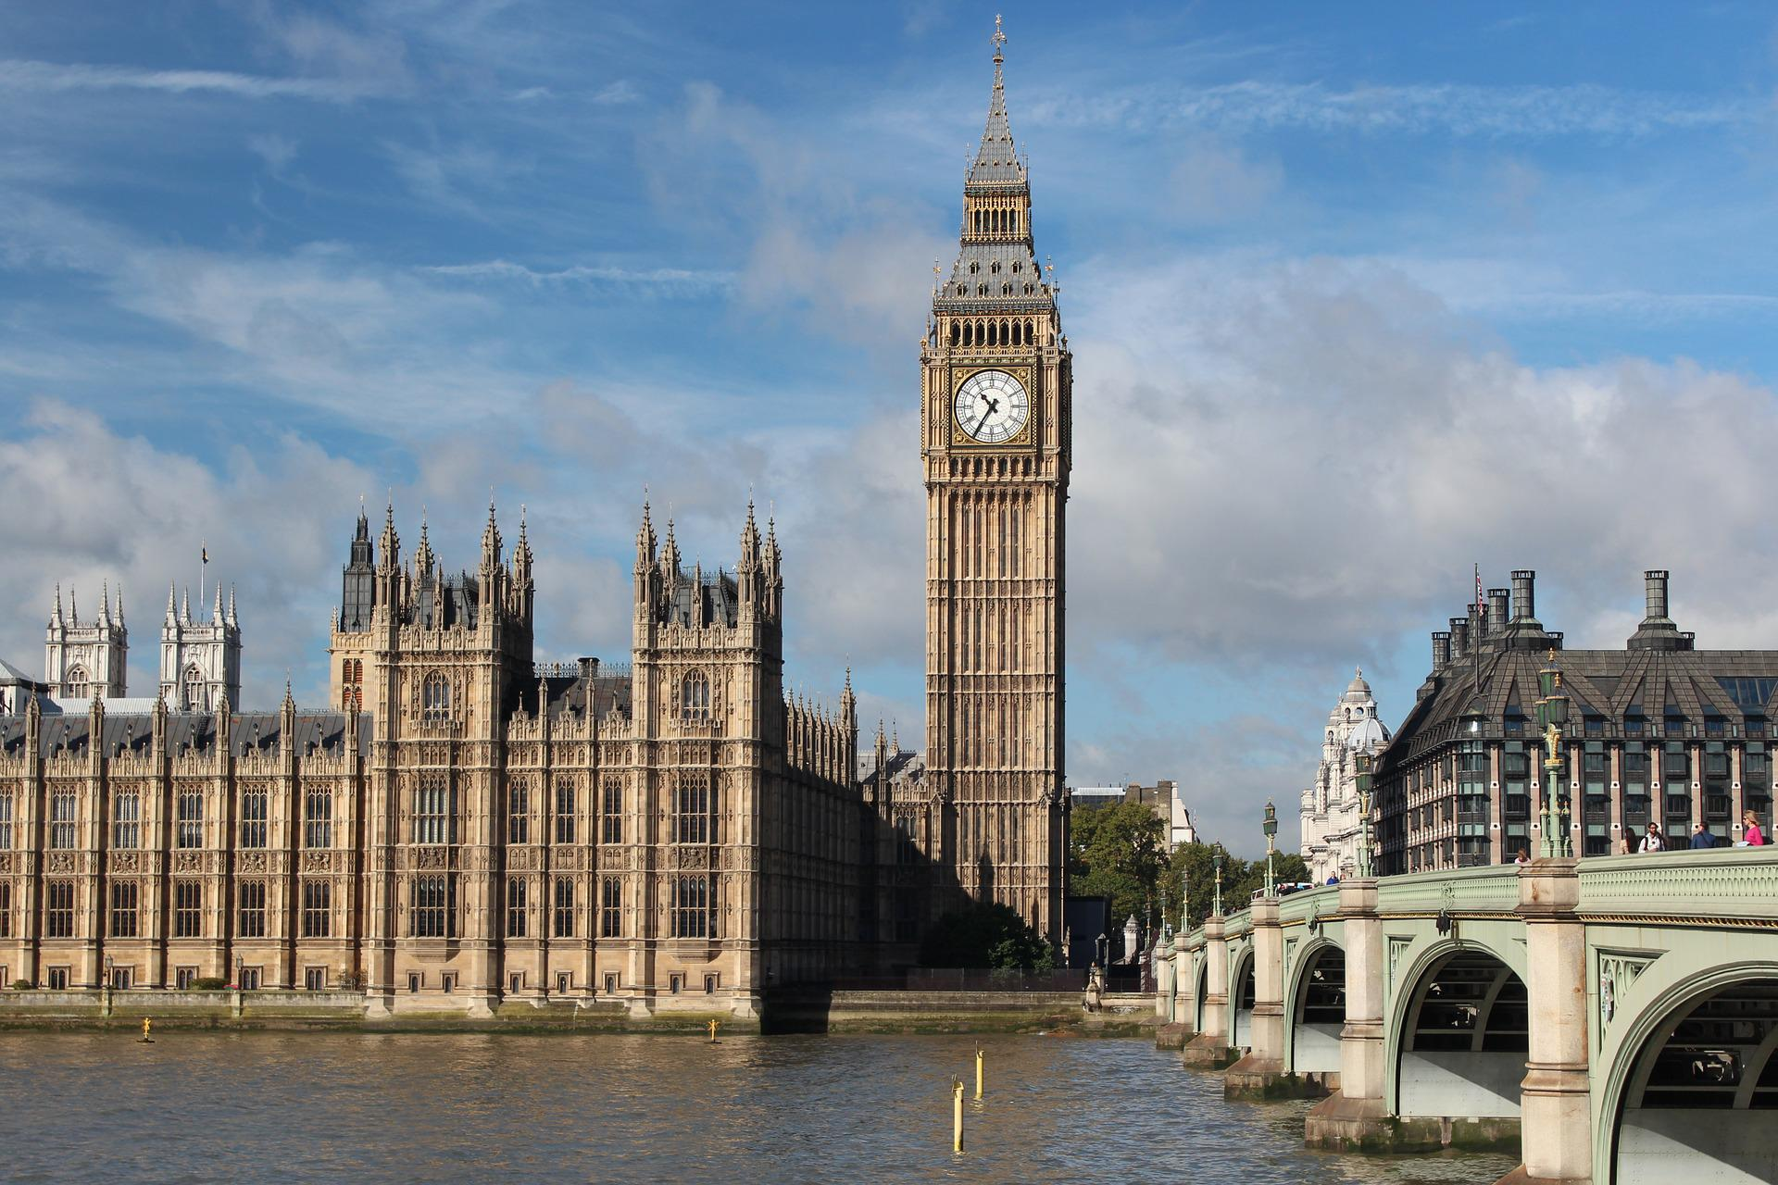
On the Day
On the day of a British monarch’s funeral, the country is usually given a national day of mourning and Big Ben chimes.
Did You Know…?
Many people call this clock tower Big Ben but that isn’t correct. It’s actually called the Elizabeth Tower.
Big Ben is the name of one of the bells inside the tower.
The State Gun Carriage of the Royal Navy usually carries the coffin from Westminster Hall to the church. Some of the monarch’s family may walk with the carriage.
During the funeral, there is usually a period of silence in the UK.
mourning – A time to think about the person who has died.

Slide 11
