Slide 1


WOMEN’S RIGHT
IT’S JUST LIKE CHESS : THE QUEEN SAVES THE KING

Slide 2
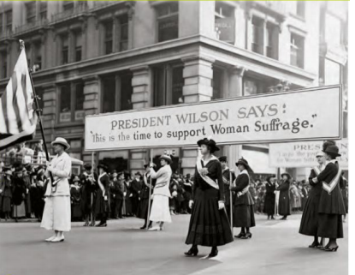
Women’s demonstration for the right to vote

Slide 3
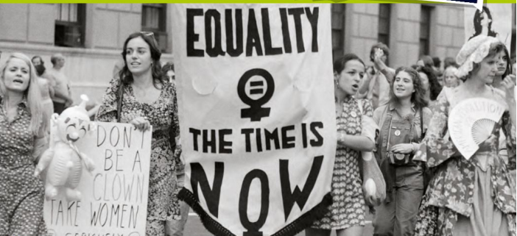
1971 / Demonstration on Fifth Avenue

Slide 4
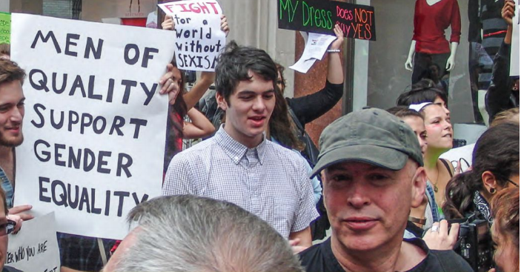
2011 /New - York

