Slide 1

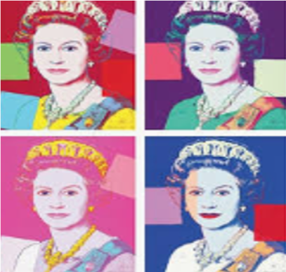
THE RAINBOW QUEEN

Slide 2

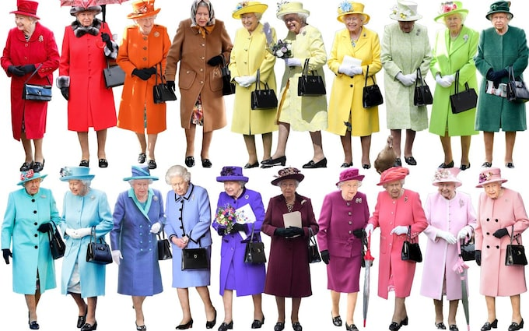
Queen
Rainbow

Slide 3
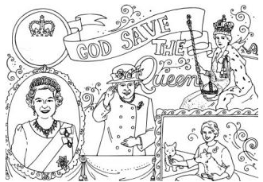
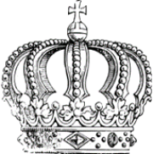
Her hat
The sceptre
The crown
Her ermine coat
Her blouse
Her coat
Her earrings
Her brooch
Her necklace
Her blouse
Her dress
Her sash
Her gloves
Her skirt

Slide 4
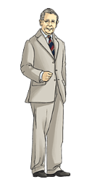
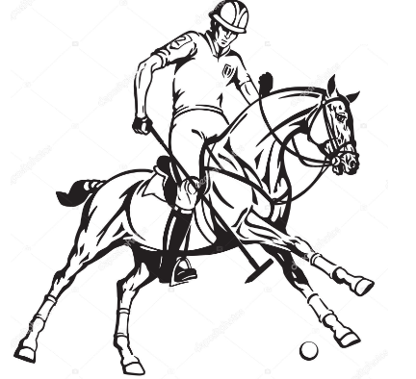
CHARLES III ( the third )
His helmet
His T.shirt
His shirt
His tie
His suit
His jacket
His boots
His trousers
His shoes

Slide 5
