Slide 1
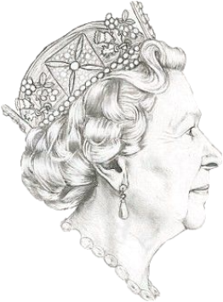
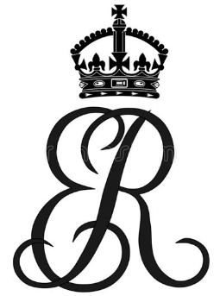
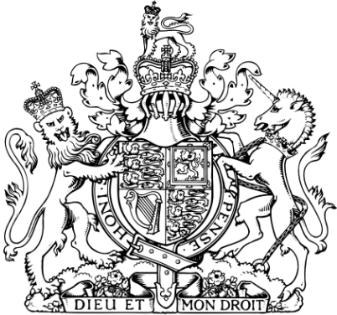
HER LATE MAJESTY
IDENTITY CARD
DID YOU KNOW IT ?
Name………………………………………………………….
Date of birth…………………………………………………
Parents……………………………………………...
……………………………………………….
Brothers and sisters ( siblings )……….
Family : Husband : ………..
Children ………………………………….
………………………………
……………………….
………………………..
Date of coronation………………….
HER LATE MAJESTY HAD NO
IDENTITY CARD , PASSPORT OR DRIVING LICENSE !

Slide 2
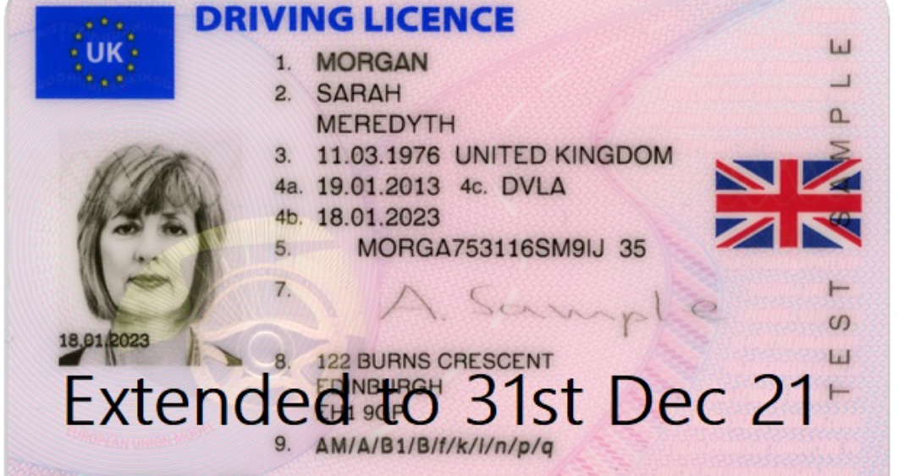
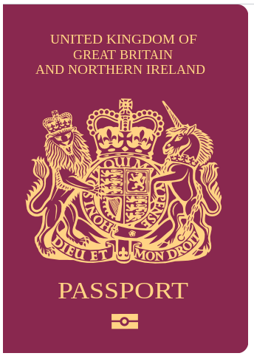
Facts about the queen

Slide 3
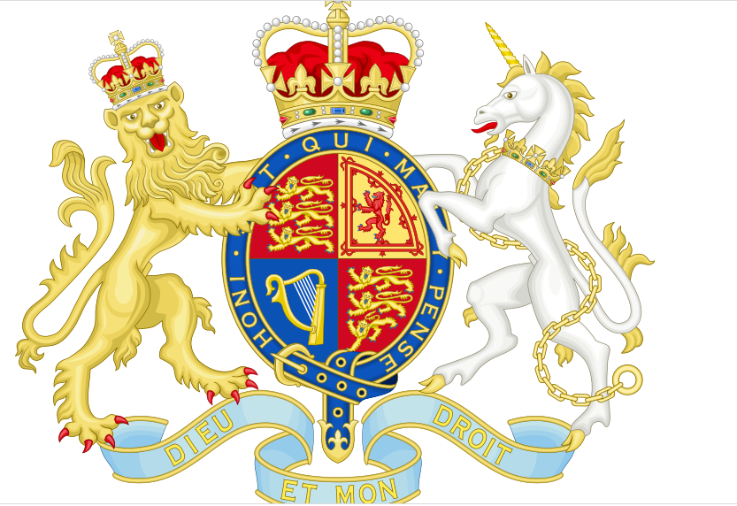
Facts about Her Late Majesty the Queen
the rampant lion and double tressure fleury-counter-fleury of Scotland .
the three passant guardant
lions of England
the harp for Ireland.
The Royal Coat of Arms of the United Kingdom OR Arms of Dominion is the official coat of arms of the British monarch, currently Charles III

Slide 4
HER MAJESTY THE QUEEN IN NUMBERS
LET’S RECAP !
1.Her Late Majesty had ……………………..husband ( Prince Philip ) and they were married for ……………………………...years.
2.She was Queen at the age of ……………………………………………
3.She was number …………………………………….after her grandfather and her father in succession to the throne.
4.She had ………………..….children ,………………………………. grandchildren and …………………….….great grandchildren.
5.…………………………………………...British Prime Ministers have served during Queen Elizabeth's reign, the first being Winston Churchill.
6.She met ……………………………………..American Presidents .
6.………………………………………….…is the number on Bruton Street, London where the Queen was born.
7.Queen Elizabeth is Head of State of ………………………………………….. STATES ( The Commonwealth )
…………………………………………………….different countries have her image on their banknotes .
9. The Queen is NUMBER ………………………. as a monarch since William the Conqueror .
10.Her reign of ……………………………..years was the longest !
11.She died at the age of ………………………………………………………………………….

Slide 5
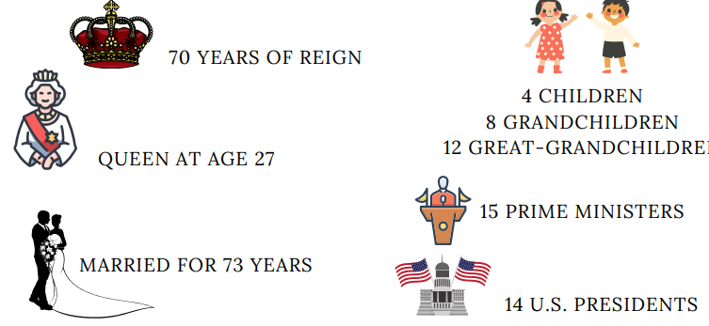
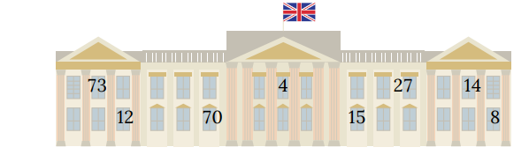
Facts about the queen

Slide 6
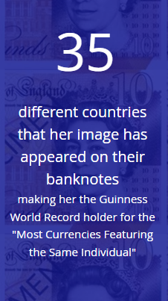
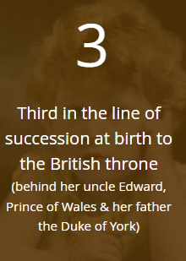
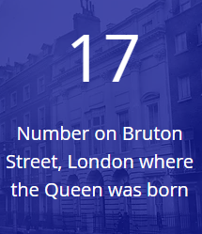
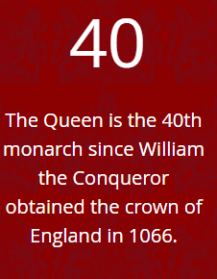
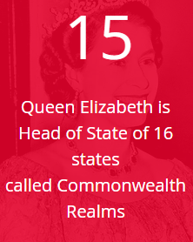
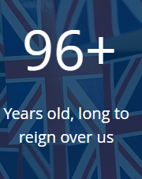
Facts about the queen

Slide 7
A CONSTANT PRESENCE IN A CHANGING WORLD(1926-2022)
https://www.youtube.com/watch?v=xQywJVW0Twc
1.Watch the video and complete the sentences below with the following numbers: 4 - 8 - 12 - 14 - 15 - 27 - 70 - 73
Queen Elizabeth II was Britain’s longest-serving monarch. For ………………….. years, she was a constant point in a changing world. Elizabeth was crowned at Westminster Abbey, aged just ………………….. . She was married to Prince Philip, Duke of Edinburgh for …………… years. The couple had ……………………… children, ………………………. grandchildren and ………………………………….. great-grandchildren. Her reign spanned ………………………….. prime ministers and ……………….. US presidents. She witnessed enormous historical and social change and she faced challenging moments.
She was the first British monarch ever to visit Northern Ireland. Prince Philip died in April 2021. The Queen reduced her duties but joined in with celebrations for her Platinum Jubilee.
2.Find back the answers
1.……………………..……………………………………..…………. ? -She was queen for 70 years.
2 …………………………………………………………..…. ? -She was 27 when she was crowned.
3 ………………………………………………………………..…. ? -She got married to Prince Philip.
4 ……………………………………………….……………………………..…. ? -They had 4 children.
5 ………………………….…………………………………….……. ? -She knew 15 Prime ministers.
6 ………………………….…………………………………...…. ? -She met 14 American presidents.
7 ………..…………………………………………………………. ? -Prince Philip died in April 2021.

Slide 8
Facts about the queen

Slide 9
Facts about the queen

