Slide 1
A beautiful place THEIR PALACE IN LONDON

Slide 2
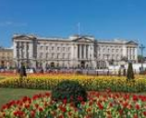
SOME FACTS ABOUT BUCKINGHAM PALACE

Slide 3
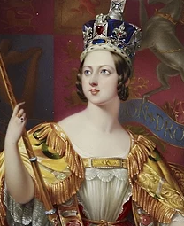
IT WAS BUILT IN 1703
QUEEN VICTORIA FIRT LIVED IN THIS PALACE IN 1837

Slide 4
SOME FIGURES
775 ROOMS
19 STATE ROOMS
52 ROYAL AND GUESTS BEDROOMS
118 ROOMS FOR THE STAFF
78 BATHROOMS
92 OFFICES
………………..

Slide 5
IT IS 108 METRES LONG
IT IS 120 METRES DEEP
IT IS 24 METRES HIGH

Slide 6
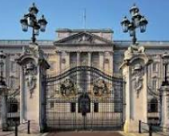

Slide 7
