Slide 1

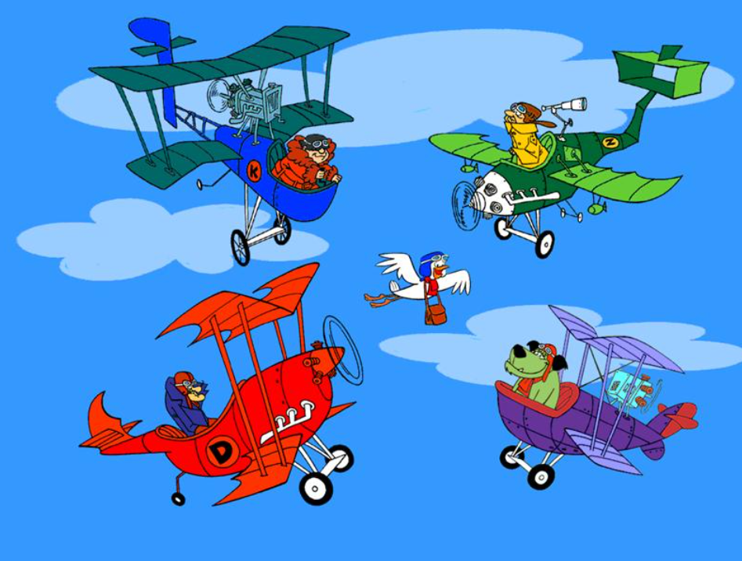
ORDINALS NUMBERS

Slide 2


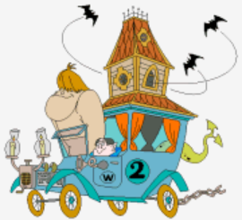





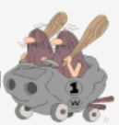
one

Slide 3
HOW MANY CONTESTANTS ?
one
Two

Slide 4

HOW MANY CONTESTANTS ?
Four
The
two
Three
one

Slide 5
HOW MANY CONTESTANTS ?
Four
The
two
three
one

Slide 6
HOW MANY CONTESTANTS ?
four
one
two
three

Slide 7

ARRIVAL ORDER / RANK ?
the third
the first
the fourth
the second

Slide 8
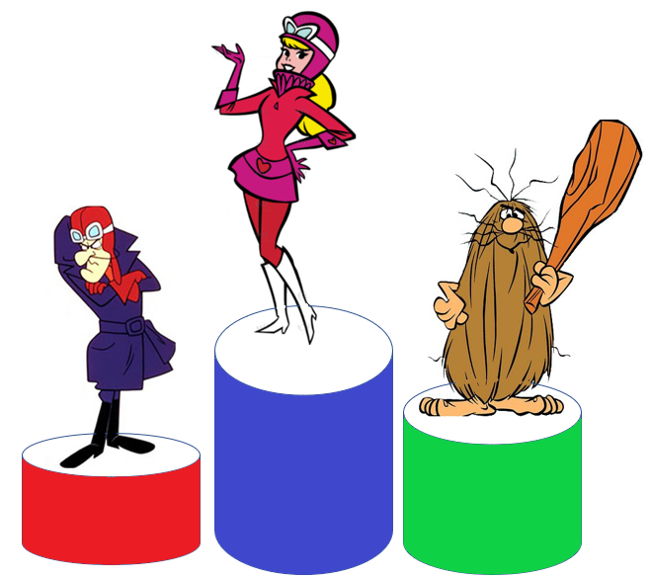

ARRIVAL ORDER / RANK ?
1ST
3RD
2ND

Slide 9



ARRIVAL ORDER / RANK ?

Slide 10
ARRIVAL ORDER / RANK ?
ONE CHAMPION

Slide 11

ARRIVAL ORDER / RANK ?
The First

Slide 12
ARRIVAL ORDER / RANK ?
The First
1st

Slide 13
ARRIVAL ORDER / RANK ?
The First
ONE
1st

Slide 14
ARRIVAL ORDER / RANK ?
The first
1st

Slide 15
ARRIVAL ORDER / RANK ?
The first
1st

Slide 16

Good job…NEXT !

Slide 17
ORDER / RANK
The second
TWO
2nd

Slide 18
ORDER / RANK
The second
2nd

Slide 19
ORDER / RANK
The second
2nd

Slide 20
ORDER / RANK
The third
3rd

Slide 21
ORDER / RANK
The third
3rd
The fourth
4th

Slide 22
ORDER / RANK
The third
3rd
The fifth
The fourth
4th
5th

Slide 23
ORDER / RANK
The third
3rd
The sixth
The fourth
4th
The fifth
6th
5th

Slide 24
ORDER / RANK
The third
3rd
The fourth
4th
The fifth
5th
The sixth
6th
………..

Slide 25
ORDER / RANK
The third
The ninth
3rd
The fourth
4th
9th
The fifth
5th
The sixth
6th
………..

Slide 26
ORDER / RANK
The third
The ninth
The twelfth
3rd
9th
The fourth
12th
4th
The fifth
5th
The sixth
6th
………..

Slide 27
ORDER / RANK
The third
The ninth
The twentieth
3rd
9th
The fourth
The twelfth
4th
12th
20th
The fifth
………..
5th
The sixth
6th
………..

Slide 28
QUANTITY
QUANTITY
Twenty - one

Slide 29
QUANTITY
Twenty - one

Slide 30
ORDER / RANK
The twenty
21st

Slide 31
first
ORDER / RANK
The twenty
21st

Slide 32
ORDER / RANK
The twenty
first
21st

Slide 33
-
ORDER / RANK
The twenty
first
21st

Slide 34
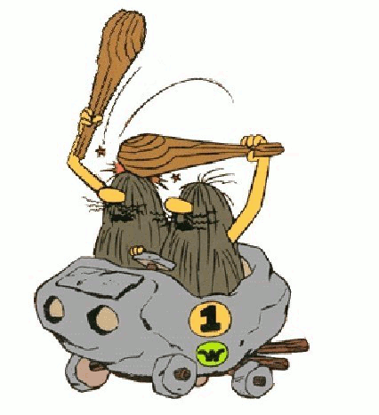
This lesson makes me crazy !

Slide 35

The first
The second
The third
The fourth
The fifth
The sixth
The seventh
The eighth
The ninth
1St
2nd
3rd
4th
5th
6th
7th
8th
9th
The tenth
The eleventh
The twelfth
The thirteenth
The fourteenth
The fifteenth
The sixteenth
The seventeenth
The eighteenth
10th
11th
12th
13th
14th
15th
16th
17th
18th
The nineteenth
The twentieth
The twenty-first
The twenty-second
The twenty-third
The twenty-fourth
The twenty-fifth
The twenty-sixth
The twenty-seventh
19th
20th
21St
22nd
23rd
24th
25th
26th
27th
The twenty-eighth
The twenty-ninth
The thirtieth
The thirty-first
The thirty-second
The thirty-fourth
The fortieth
The fiftieth
The sixtieth
28th
29th
30th
31St
32nd
34th
40th
50th
60th
The seventieth
The eightieth
The ninetieth
The hundredth
The one hundred AND FIRST
The one hundred AND second
The two hundred AND twenty-fourth
The three hundred AND sixty-fifth
The thousandth
70th
80th
90th
100th
101st
102nd
224th
365th
1,000th

