Slide 1
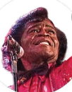
James Brown's pride
In 1968: James Brown sings his pride of blackness.
“Now we demand a chance to do things for ourselves
We're tired of beatin' our head against the wall
And workin' for someone else We're people, we're just like the birds and the bees
We'd rather⁽¹⁾ die on our feet
Than be livin' on our knees
Say it loud, I'm black and I'm proud⁽²⁾.”
James Brown, Say It Loud - I'm Black and I'm Proud, 1968

