Slide 1
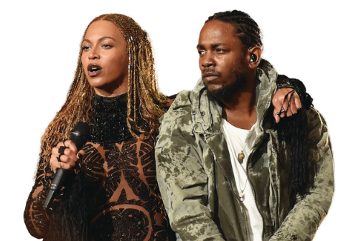
The Black Lives Matter movement started in 2013 and began with a social media hashtag, #BlackLivesMatter. At first, the movement fought against racism in the USA but it has become a worldwide protest to eradicate racism.
“I can't breathe” (George Floyd's last words) remains perhaps the most disturbing⁽¹⁾ phrase in modern American history. Countless musicians have pledged⁽²⁾ their support to the Black Lives Matter cause, addressing racism, violence and disillusionment in a way that hasn't been heard in decades. Beyoncé made one of the most striking⁽³⁾ political statements of her career with “Freedom.” [Kendrick Lamar] did not set out to create an anthem⁽⁴⁾ for protestors with his hopeful exploration of black pride, but it ended up being adopted by many who would chant “We gon' be alright!” during protests. “It's a chant of hope and feeling,” he said.
Adapted from rollingstone.com

