Slide 1
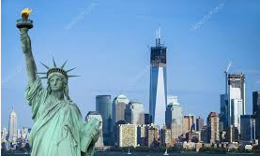
LET’S VISIT MANHATTAN

Slide 2
It is one of the five boroughs on New York It was discovered by a man called LENAPE in 1524.
LET’S VISIT MANHATTAN
It was mapped by the Englishman Henry HUDSON .He came across Manhattan Island and people started living there from 1609, and along the river which carried his name.

Slide 3
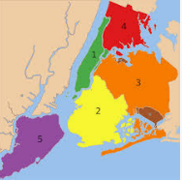
LET’S VISIT MANHATTAN
Bronx
Manhattan
Queens
Brooklyn
Staten Island

Slide 4
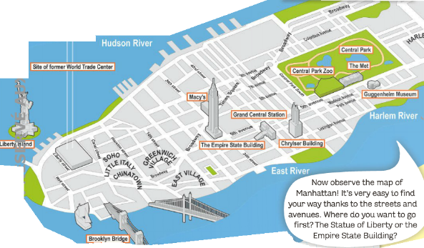
LET’S VISIT MANHATTAN

Slide 5
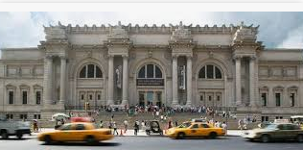
LET’S VISIT MANHATTAN
Do you like museums ?
This is the Metroplitan Museum Art , called the Met .It is extremely famous.

Slide 6
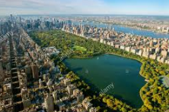
LET’S VISIT MANHATTAN
How about going to Central Park ? You can forget you are in a city ; you can’t hear any cars or any city noise.There are many activities you can do : ice-skating, jogging, picnicas, shopping, naps under a tree or a row-boat ride on a lake .

Slide 7
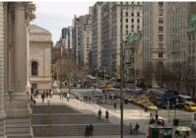
LET’S VISIT MANHATTAN
What about doing some shopping or going to a restaurant ?
If you want luxury products, Fifth Avenue is for you ?You can also find boutiques in Soho .
Lots of New Yorkers don’t have the time for lunch and prefer eating snacks .

Slide 8
LET’S VISIT MANHATTAN
QUIZZ TIME
How many boroughs are there?
Who has a crown with seven rays ?
Where can you find an ice-rink ?
What can you do on Fifth Avenue or in Soho ?
Give the name of an American type of bread .

