Slide 1


Slide 2


Slide 3
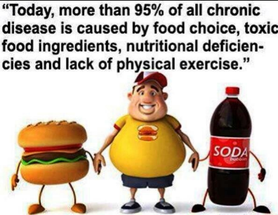

Slide 4
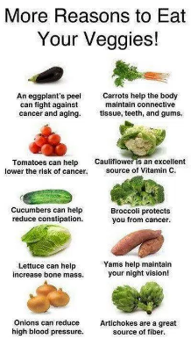

Slide 5
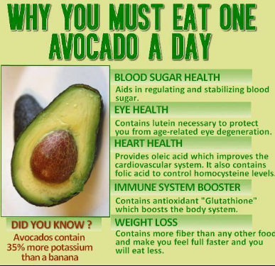

Slide 6
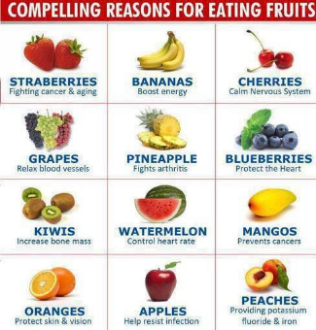

Slide 7
WHAT IS NECESSARY TO EAT TO BE IN GOOD HEALTH ?

Slide 8
WHAT MUST YOU EAT ?

Slide 9


Slide 10
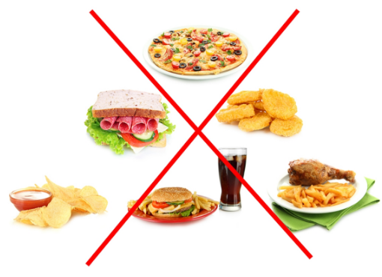

Slide 11
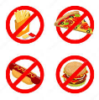

Slide 12
WHAT IS FORBIDDEN ?

Slide 13
WHAT MUSTN’T YOU EAT?

Slide 14
AND NOW RECAP !

