Slide 1

RULES AND MANNERS AT HOME

Slide 2


What are you allowed to do?
What can you do?
What aren’t you allowed to do?
What can’t you do?

Slide 3
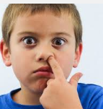





pick your nose!
fart!
Suck my thumb
Drink alcohol
smoke

Slide 4
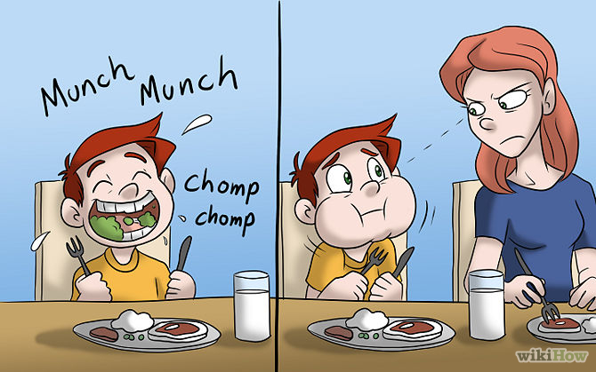
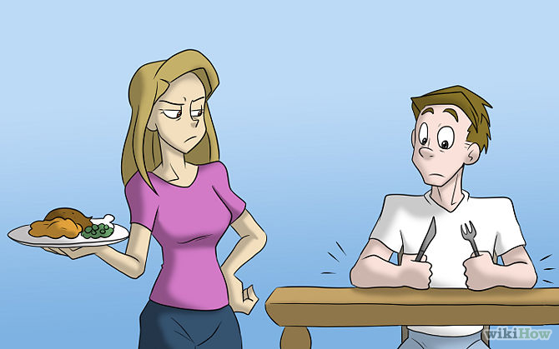
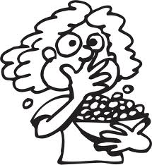
Eat with
your mouth open
Put your elbows
on the table
Eat with your fingers

Slide 5
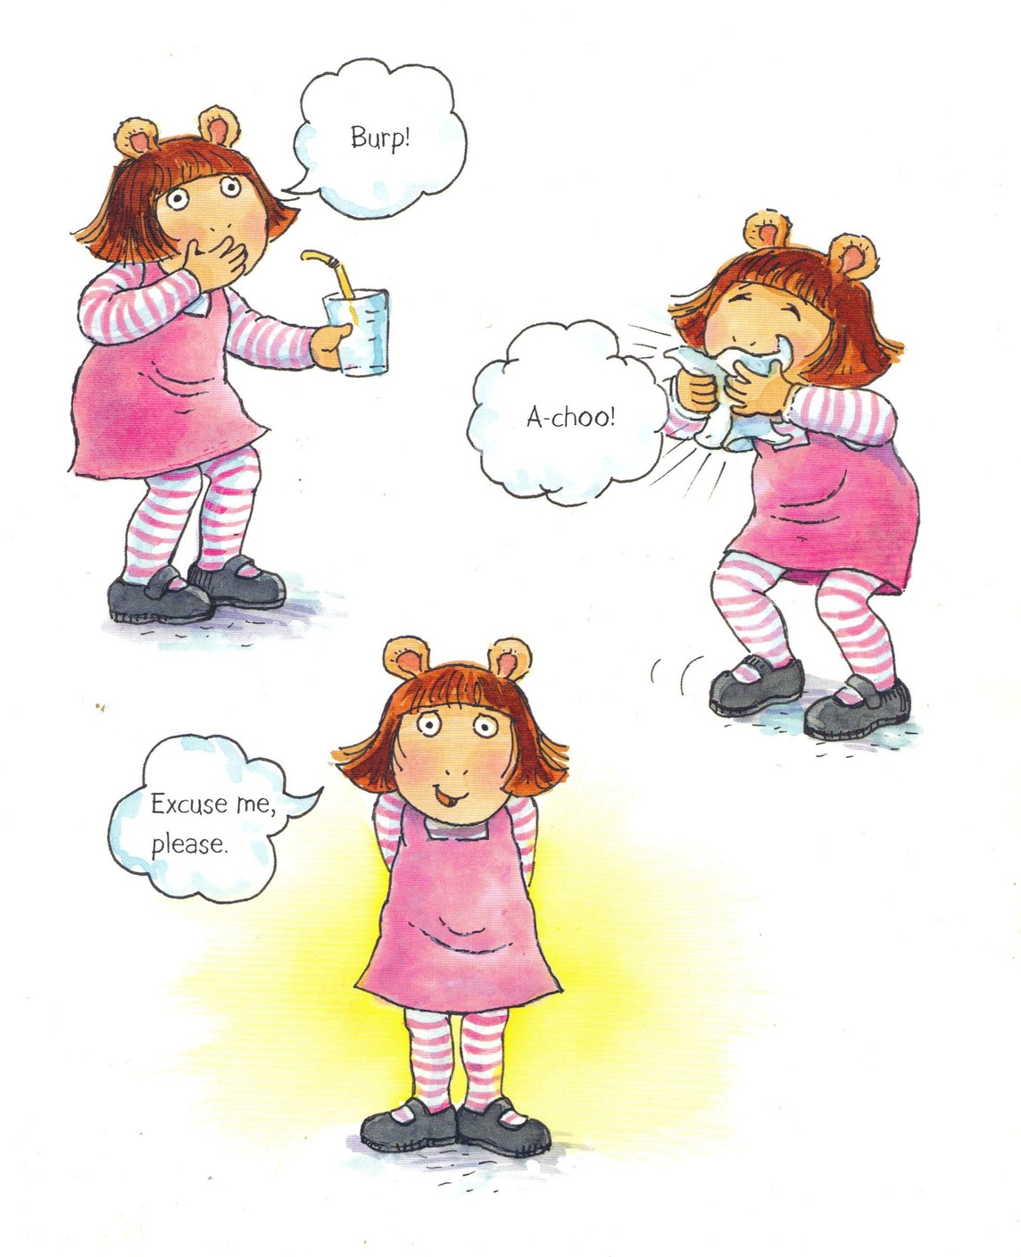
burp
sneeze

Slide 6
The end!

