Slide 1

If you go to Australia…
What will you be able to do and see?
What will you have to do?

Slide 2
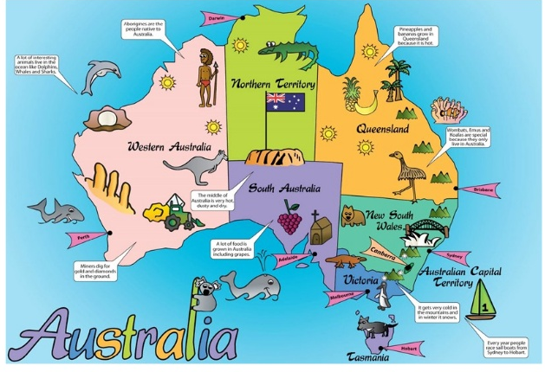
In Australia, I will be able to see dolphins!
In Australia, I will be able to eat bananas and pineapples!
In Australia, I will be able to see kangaroos!
In Sydney, I will be able to visit the Opera House!

Slide 3
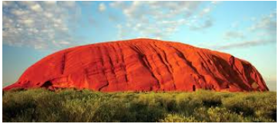
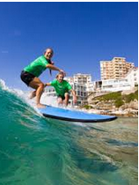
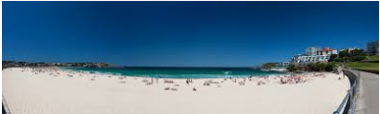
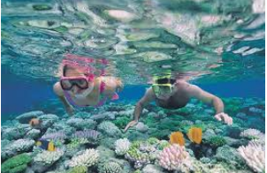
In Australia, I will be able to …….

Slide 4
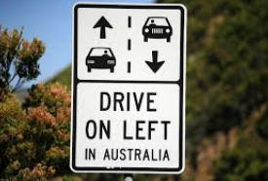
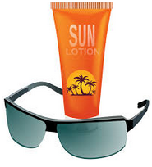
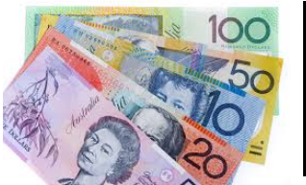

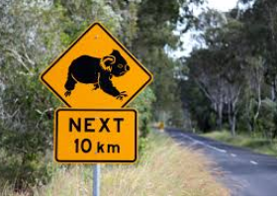
In Australia, I will have to…….

