Slide 1

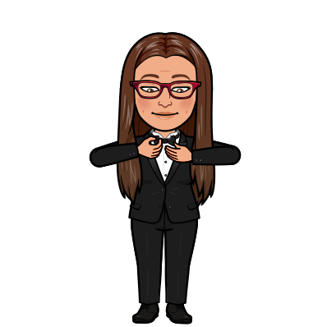
1. Evolution of fashion 2. DRESS CODE/ SCHOOL UNIFORMS

Slide 2
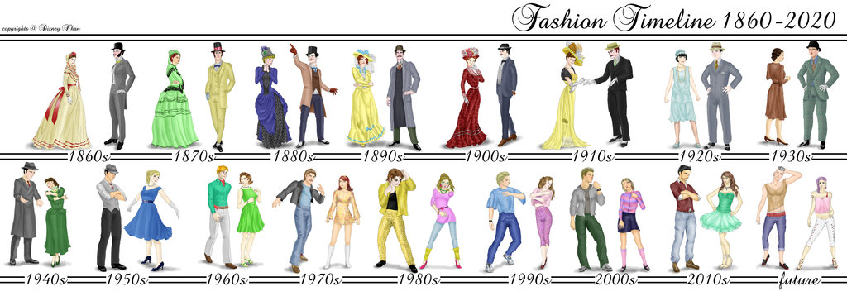
What did people use to wear through the decades?
did men use to wear caps in the 1860s?
did they use to wear suits?
did women use to wear suits?
did they use to wear hats in the 1910s?

Slide 3
What did people use to wear?
They used to wear……
They didn’t use to wear……

Slide 4
Leçon n°14. The evolution of fashion
In the 1940s, men used to wear hats, and women used to wear long dresses.
In the 1960s, women used to wear shorter skirts
In the 1970s, men used to wear bell bottomed/flared trousers
In the 1990s, people didn’t use to wear hats
Pour parler de ce qui était vrai autrefois, on utilise l’expression USED TO + base verbale

Slide 5


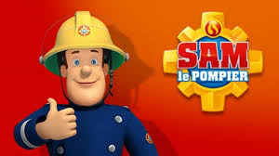
What about you? What did you use to wear when you were 10 years old?
Did you use to watch Sam le pompier?
Did you use listen to Louane and Kendji Girac?

Slide 6
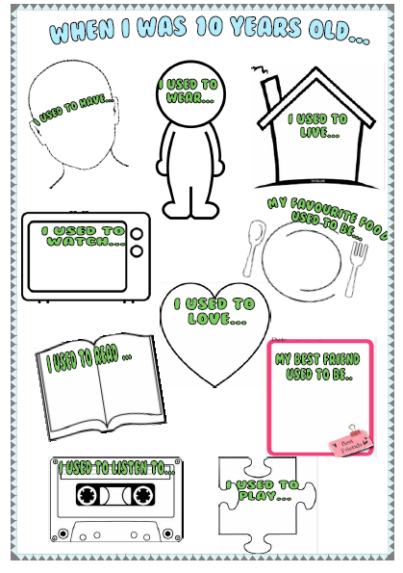

Slide 7

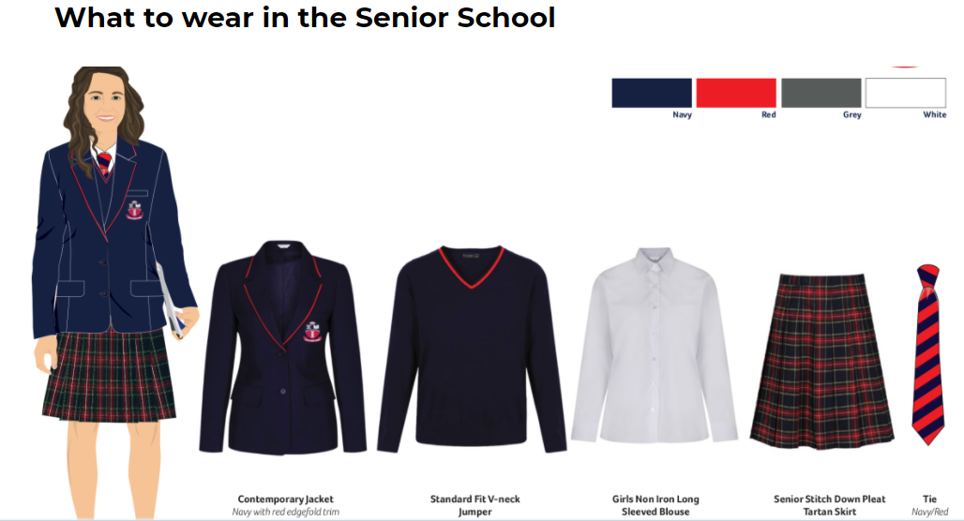
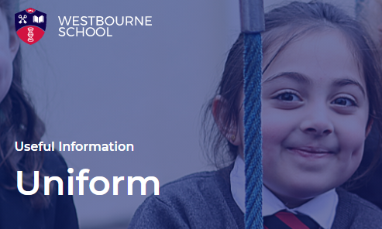

Slide 8
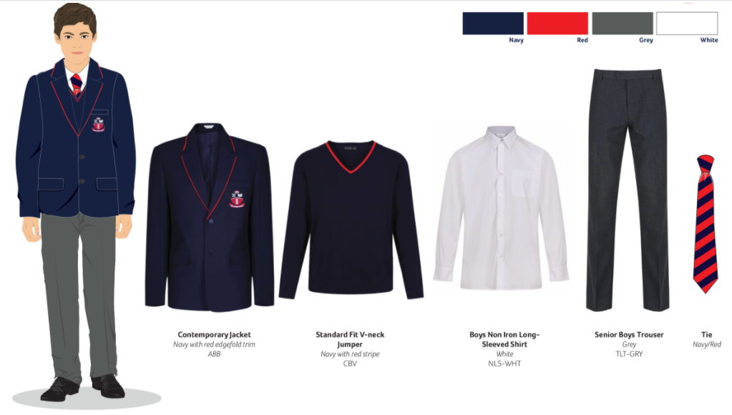

Slide 9
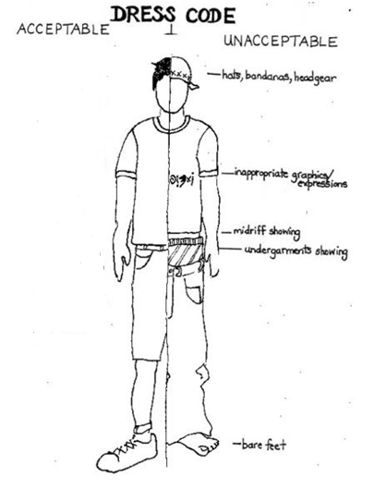


What is he wearing?

Slide 10



Right or wrong?
YOU CAN
you can wear baggy jeans
you mustn’t wear hats or caps
YOU MUST
you must wear shoes
you can wear shorts
you mustn’t wear underwear
YOU MUSTN’T
you must wear a belt
you can show your underwear

Slide 11
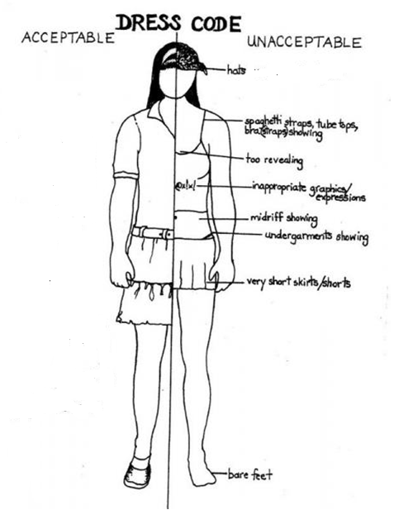
Make sentences!
YOU CAN
A hat?
A skirt?
A short skirt?
YOU MUST
A t-shirt?
A tank top ?
shoes?
YOU MUSTN’T
A Plunging neckline?

