Slide 1
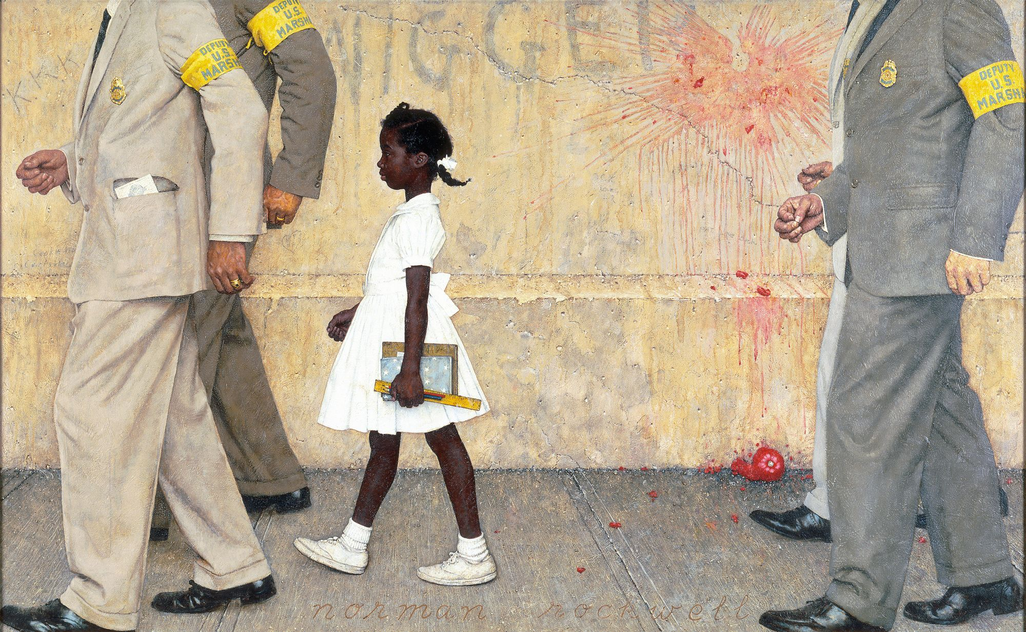
What type of document is it?
A drawing
A painting
A photograph
A mural

Slide 2

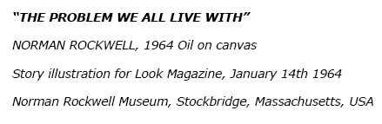

Memorize this!

Slide 3
Who was it painted by?
Picasso
Edward Hopper
Grant Wood
Norman Rockwell

Slide 4
When does it date back to?
1964
1864
1962
1978

Slide 5
Where did this illustration appear?
In a book
In a museum
In a newspaper
In a magazine

Slide 6

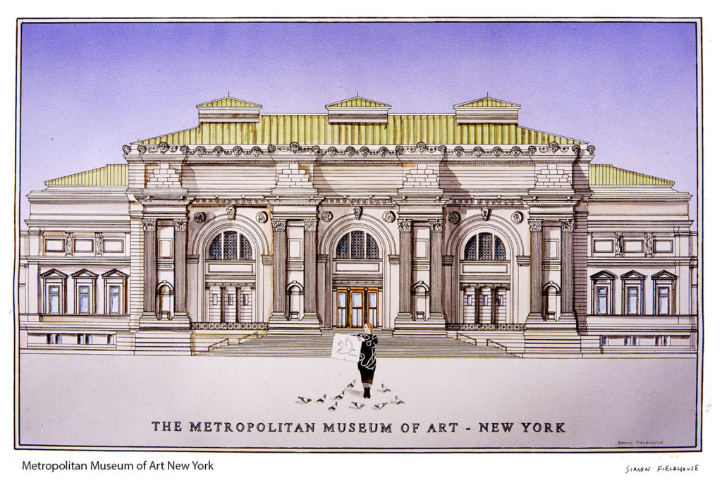

Where can you see it today?

Slide 7
The layout (la disposition)
The problem we all live with, Norman Rockwell, 1964

Slide 8
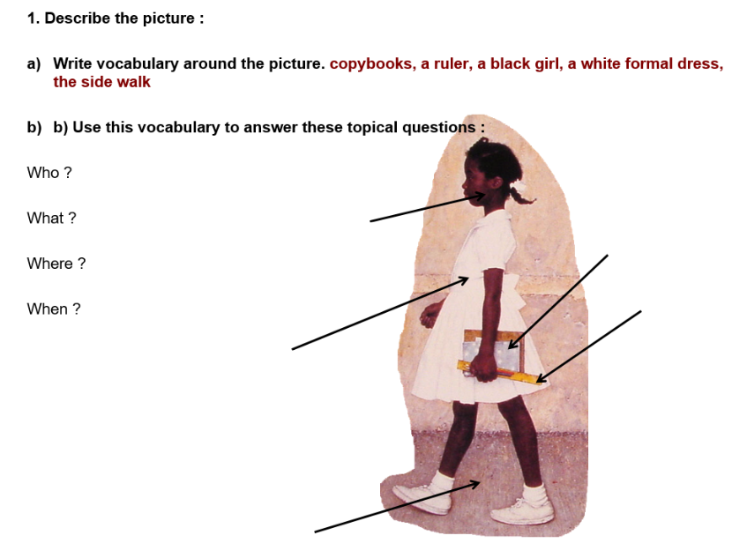

Slide 9
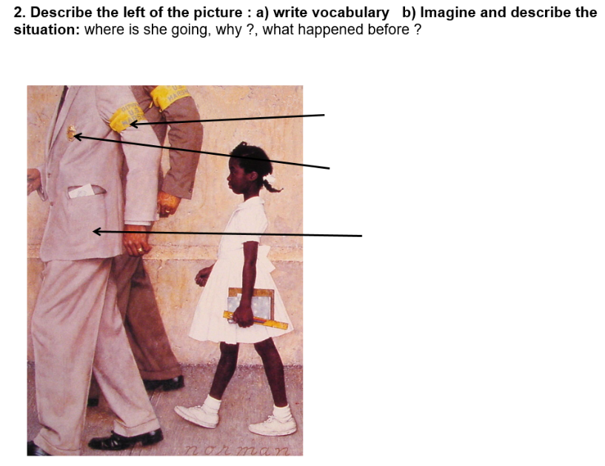

Slide 10
