Slide 1
British and American painters

Slide 2
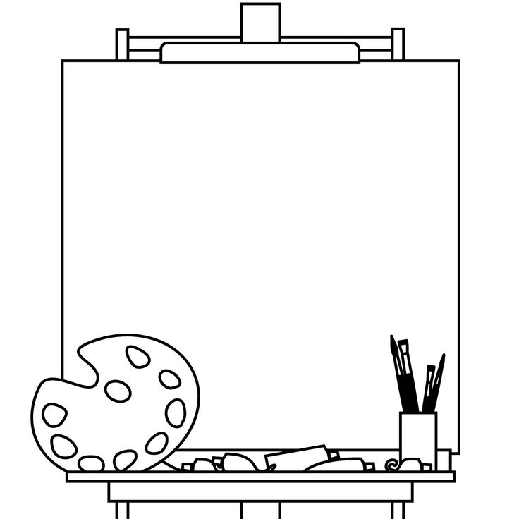
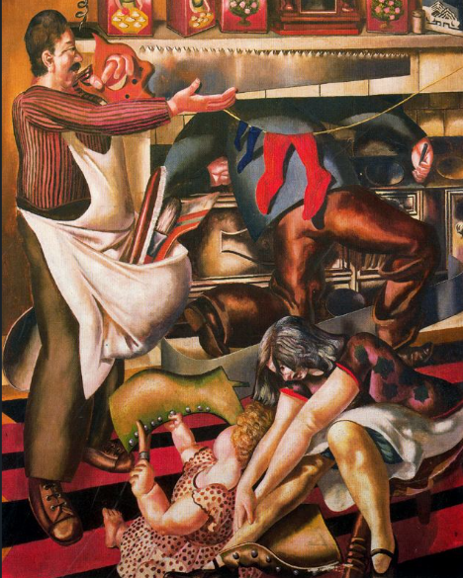

Workmen in the house
By Stanley Spencer
Information about the painter
Stanley Spencer was a British painter.
He was born in 1891, and he died in 1959
Description of the character(s)
We can see 4 characters..
The man on the left is standing and holding a saw. He is probably working.
He has got short brown hair, a brown moustache and a round nose.
He looks concentrated.
He is wearing a red shirt with balck stripes, large brown trousers and brown shoes.
He is also wearing a white apron.

Slide 3
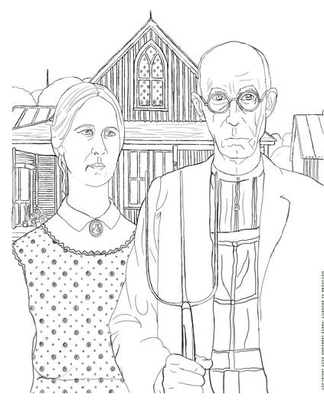
American Gothic
Information about the painter
By Grant Wood
Description of the character(s)

Slide 4
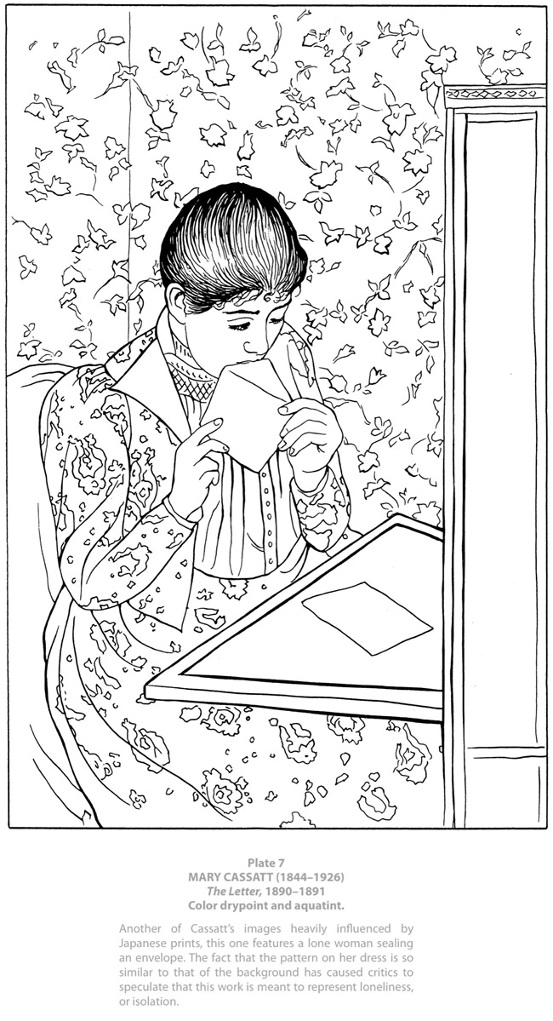
The Letter
Information about the painter
By Mary Cassatt
Description of the character(s)

Slide 5
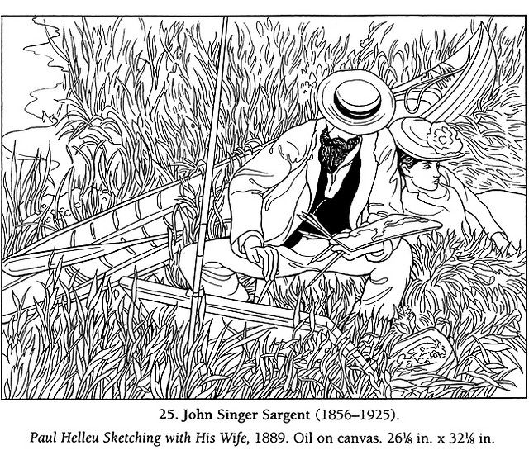
Paul Helleu sketching
with his wife
Information about the painter
By John Singer Sargent
Description of the character(s)

Slide 6
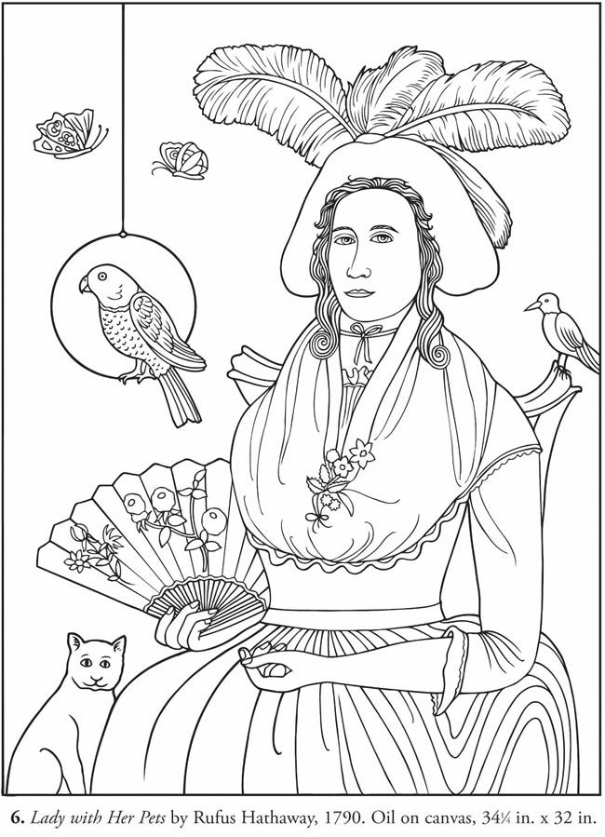
Lady with her pets
Information about the painter
By Rufus Hathaway
Description of the character(s)

Slide 7
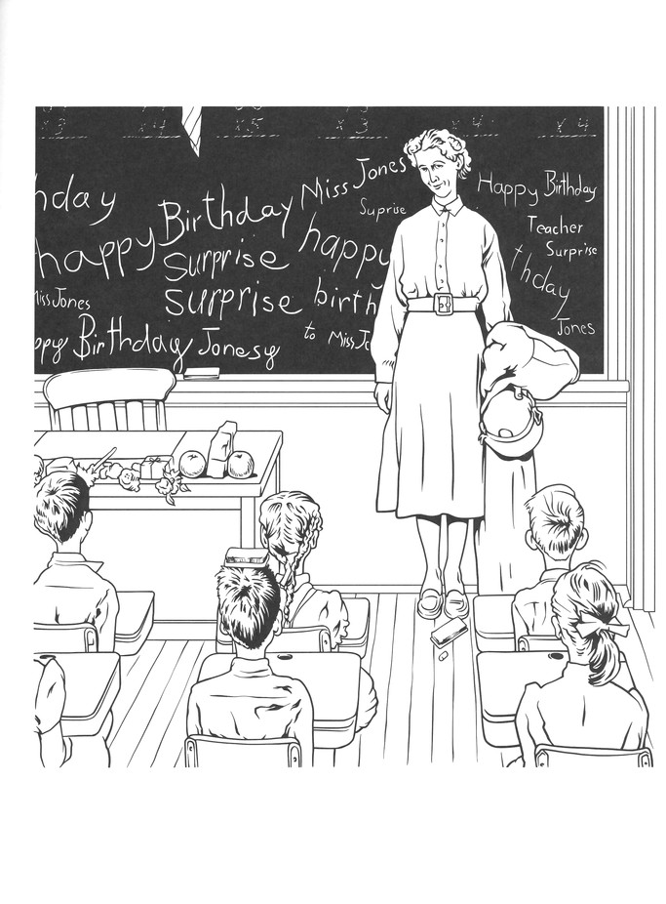
Teacher’s birthday
Information about the painter
By Norman Rockwell
Description of the character(s)

Slide 8
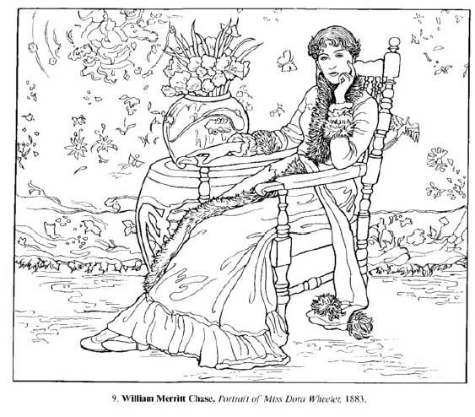
Portrait of Miss Wheeler
Information about the painter
By William Meritt Chase
Description of the character(s)

Slide 9
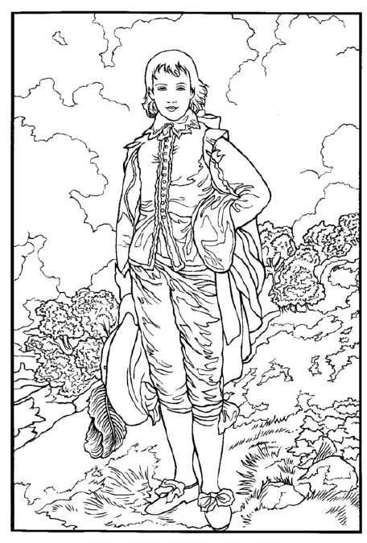
The Blue boy
Information about the painter
By Thomas Gainsborough
Description of the character(s)

Slide 10
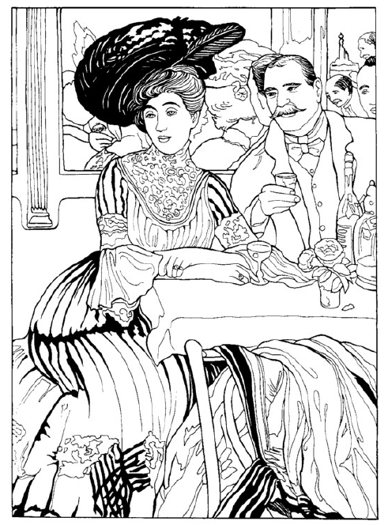
Chez Mouquin
Information about the painter
By William Glackens
Description of the character(s)

Slide 11
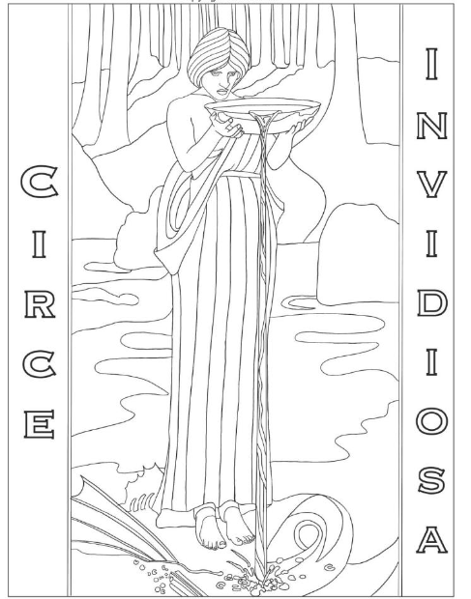
Circe Invidiosa
Information about the painter
By John William Waterhouse
Description of the character(s)

Slide 12
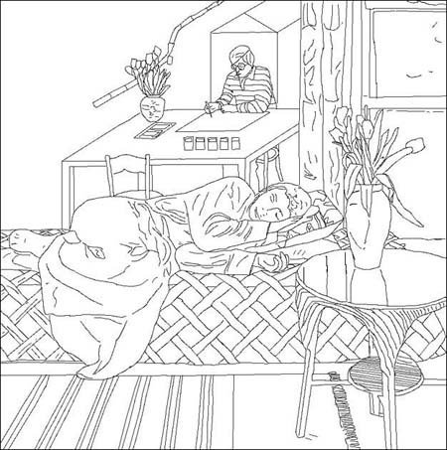
Information about the painter
By David Hockney
Description of the character(s)

Slide 13
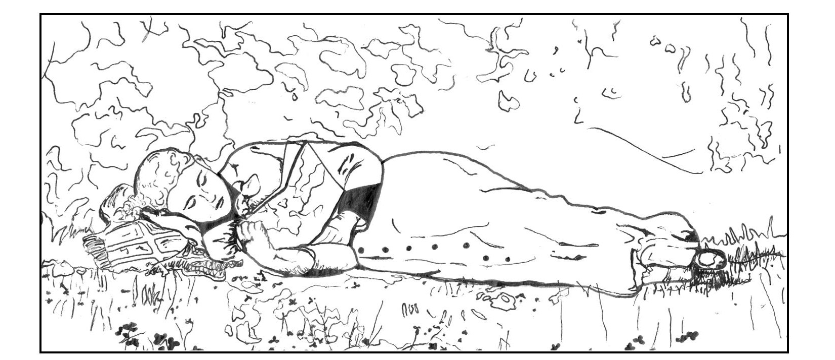
The new novel
By Winslow Homer
Information about the painter
Description of the character(s)

Slide 14
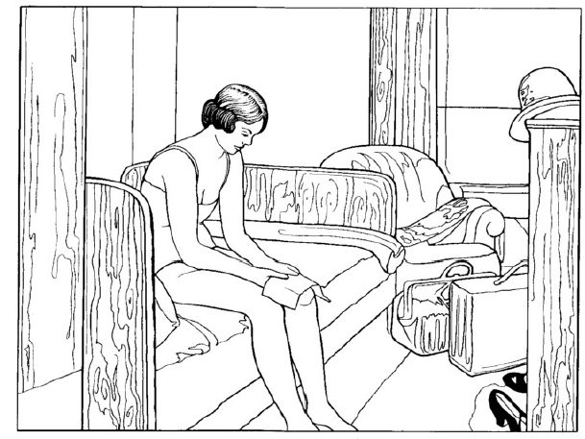
Hotel Room
By Edward Hopper
Information about the painter
Description of the character(s)

