Slide 1

Simply Australian… guess the dates!

Slide 2
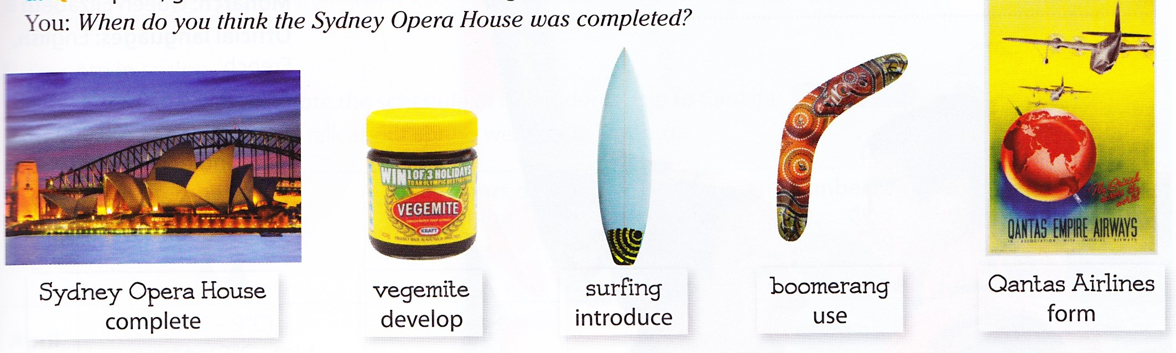
guess the dates!

Slide 3
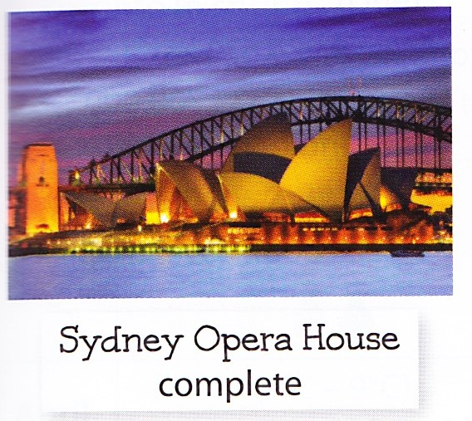
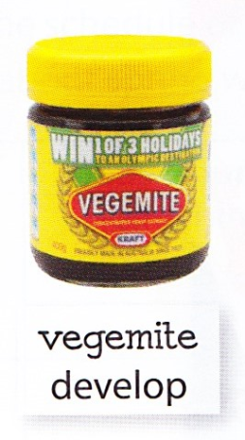

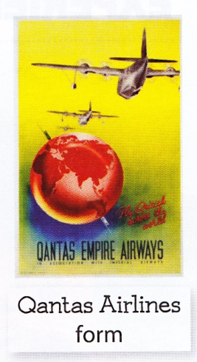
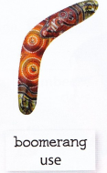
The Sydney Opera house was completed in 1973
Vegemite was developed in 1923
Surfing was introduced in 1914
The boomerang was first used in 8000BC!.
The Quantas airlines Company was formed in 1920.

