Slide 1
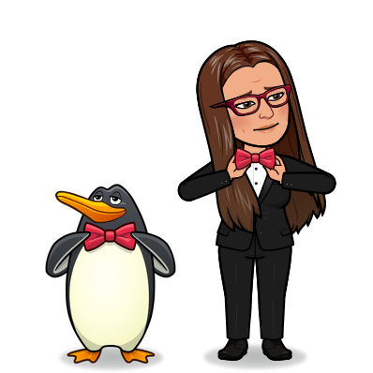
Fashion: past and present
Present :
What are you wearing now?
What is Madonna wearing now?
PAST:
What did Madonna Use to wear in the 1980s?

Slide 2



What are you wearing today?
Write your description, and draw what you are wearing today
(clothes + 2 Adjectives)
Listen and guess who it is!

Slide 3
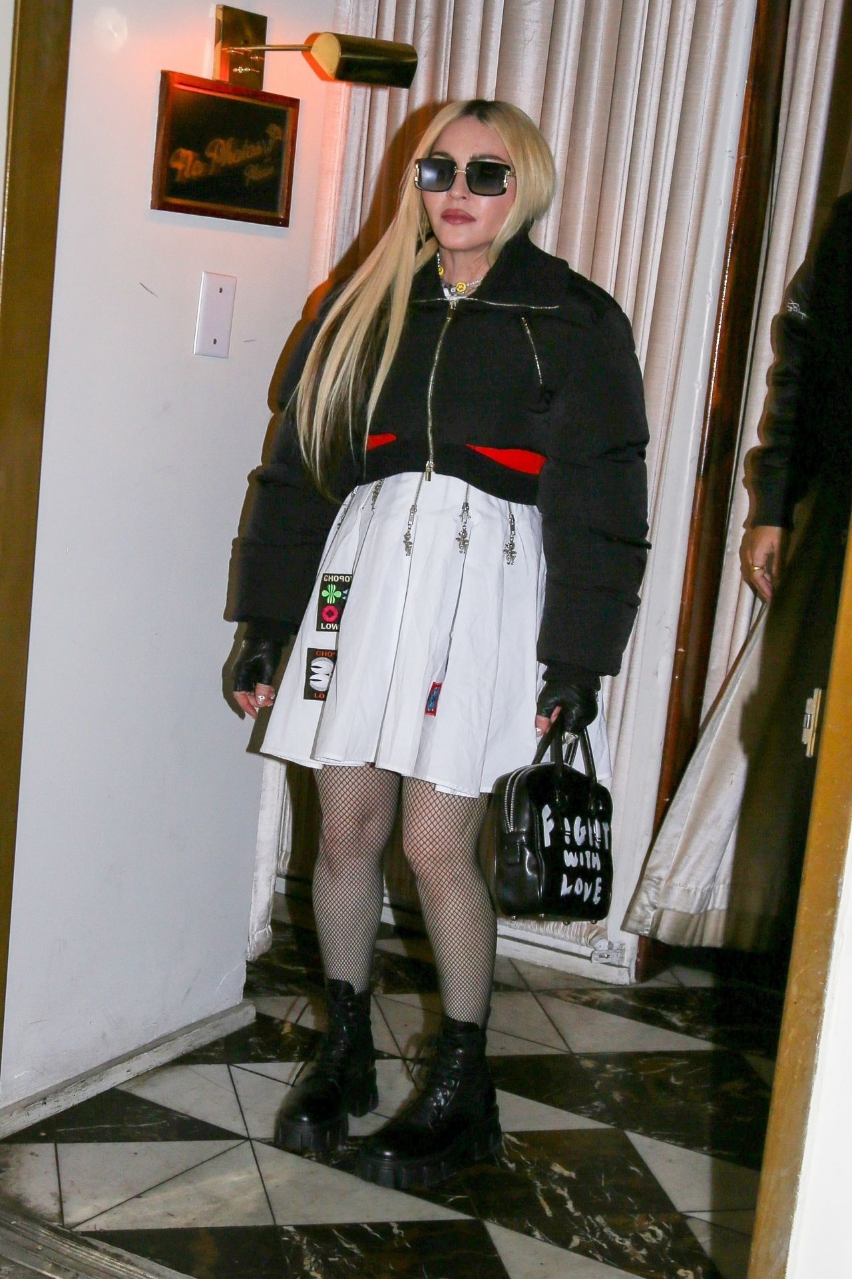
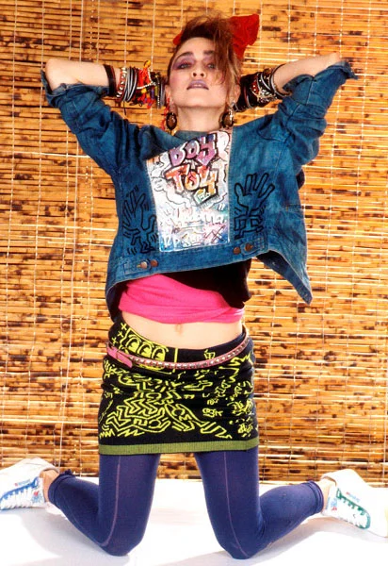

What is Madonna wearing on the photo?
What did she use to wear in the 1980s?
Did she use to wear white shirts?
Did she use to wear colourful skirts?
Did she use to have blonde hair?
Did she use to wear bracelets?

Slide 4
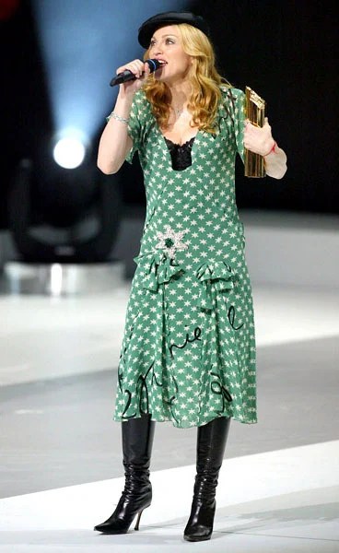
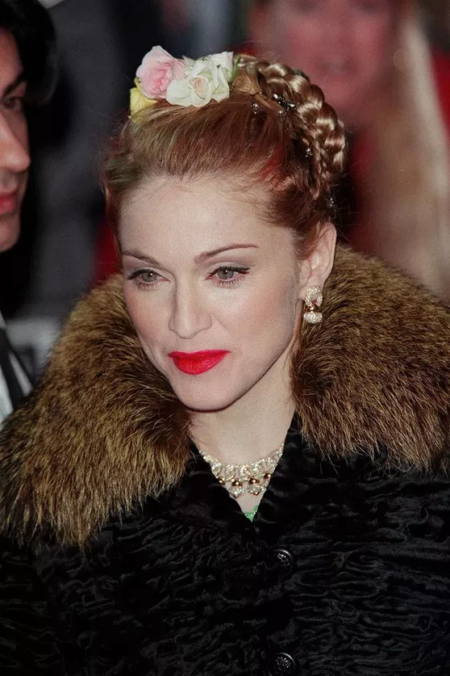
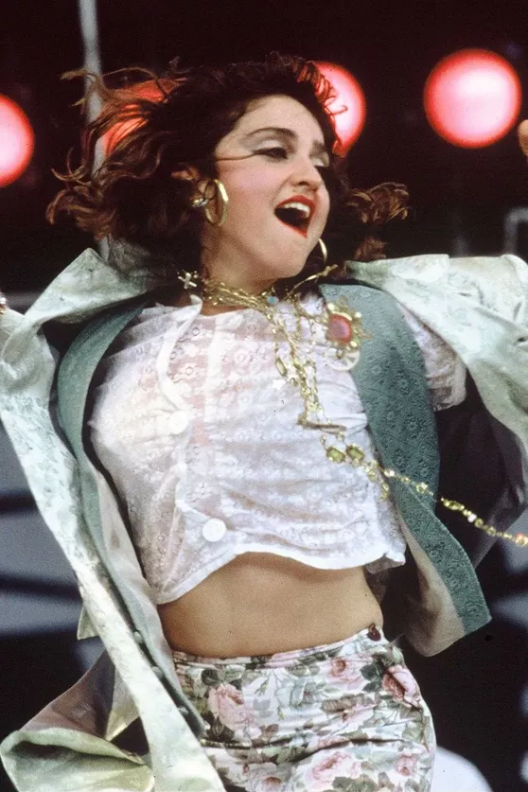
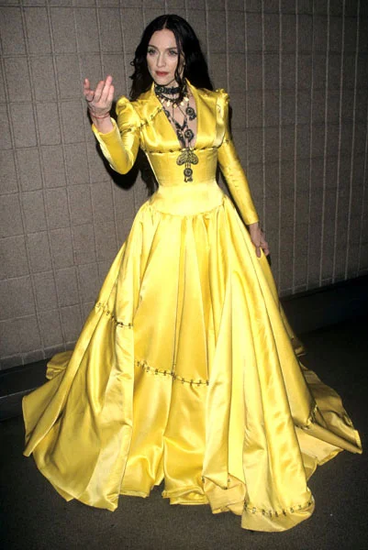
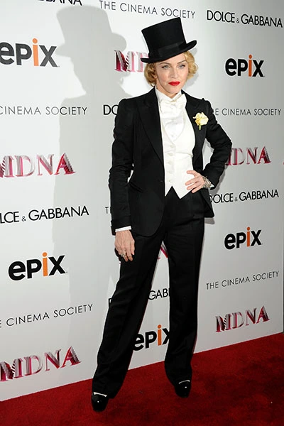
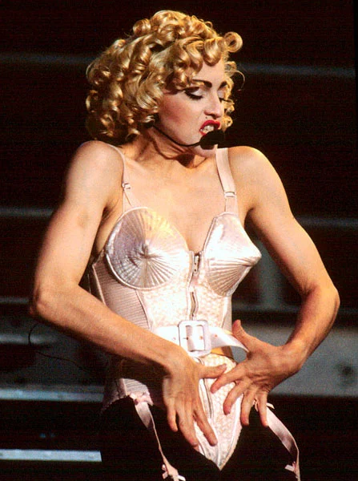
What did she use to wear through the years?
1987
1998
2013
1996
1990
2004

Slide 5
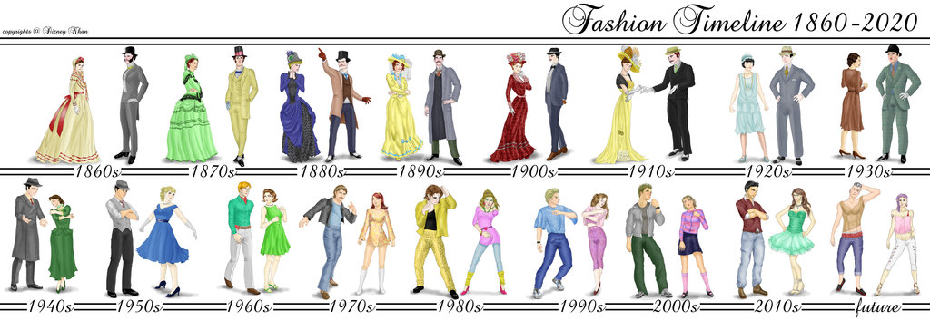
What did people use to wear through the decades?

Slide 6
Leçon n°20. The evolution of fashion
In the 1940s, men used to wear hats, and women used to wear long dresses.
In the 1960s, women used to wear shorter skirts
In the 1970s, men used to wear bell bottomed/flared trousers
In the 1990s, people didn’t use to wear hats
Pour parler de ce qui était vrai autrefois, on utilise l’expression USED TO + base verbale

Slide 7

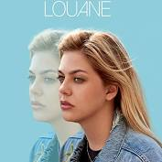
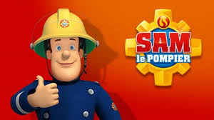
What about you? What did you use to wear when you were 10 years old?
Did you use to watch Sam le pompier?
Did you use listen to Louane and Kendji Girac?

Slide 8
