Slide 1
Describing People
What are they doing?
What are they wearing?

Slide 2
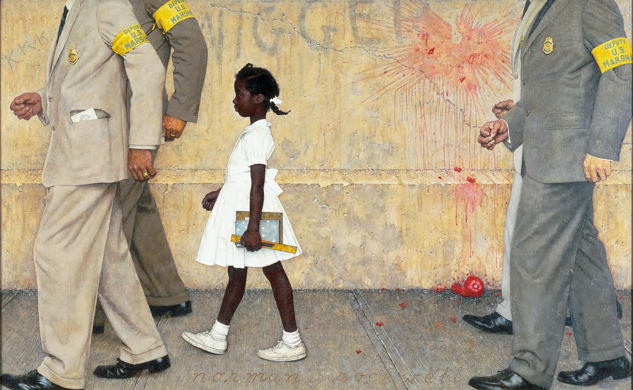
The girl and the four men are walking.
The men are wearing grey suits, and black shoes.
The girl is wearing a white dress, white sock and white shoes.
Cette photo par Auteur inconnu est soumise à la licence CC BY-SA-NC

Slide 3
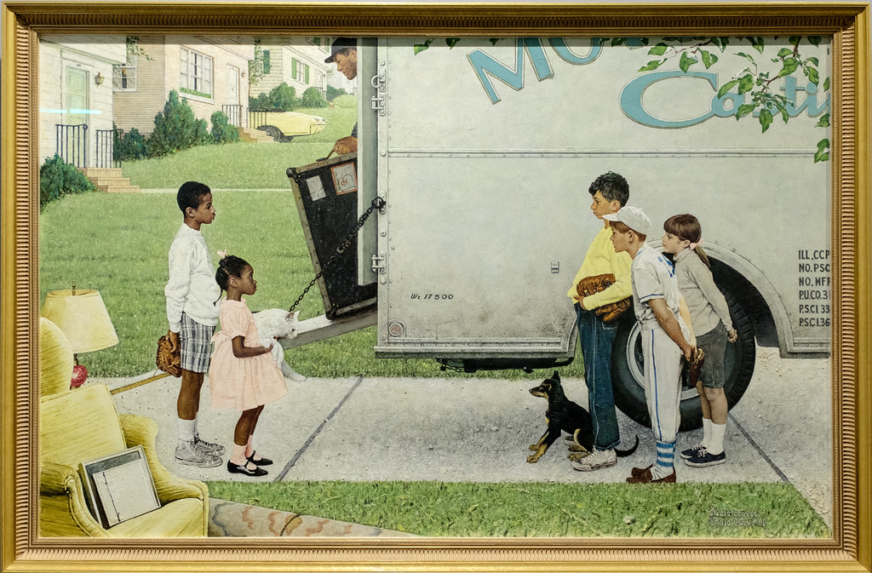
The 5 kids are standing and looking at each other.
The boy on the left is wearing a white sweater, checked shorts,white socks and grey trainers(UK) /sneakers (US).
The tall boy on the right is wearing a yellow sweater, blue jeans and white trainers/sneakers. He is holding a beaseball glove.
Cette photo par Auteur inconnu est soumise à la licence CC BY-NC-ND

Slide 4
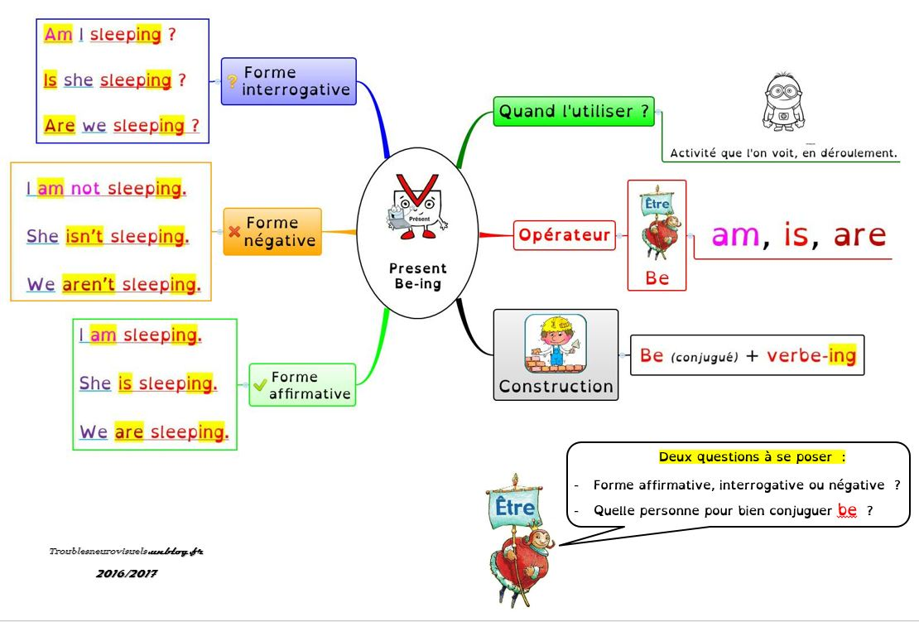

Slide 5
Let’s revise vocabulary!

Slide 6
