Slide 1
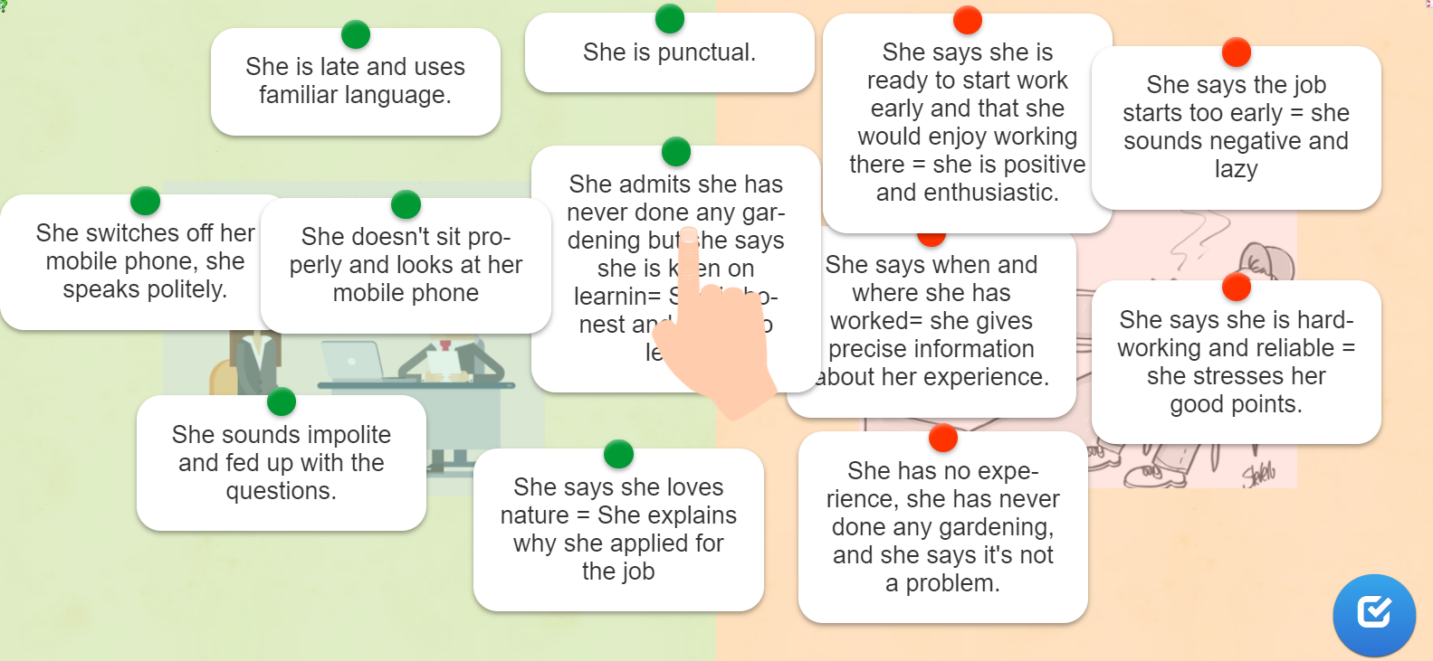
Job interviews
Activity 1 : watch Jasmine’s interview n°1
Do you think she’ll get the job? (is it a succesful or a failed interview?)
……………………………………………………………………………………………………………………………………………………………………
Why? Write 3 reasons.
______________________________________________________________________________________________________________________________________________________
_________________________________________________________________________
Activity 2 : watch Jasmine’s interview n°2
Look at the statements below, and write them into 2 columns in your notebook
succesful interview | failed interview

Slide 2
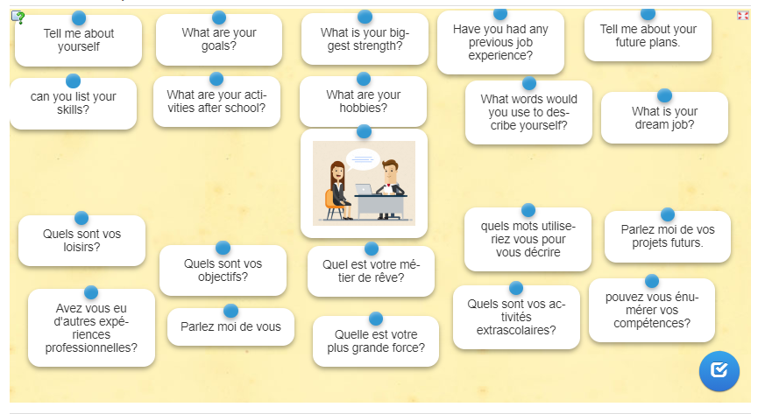
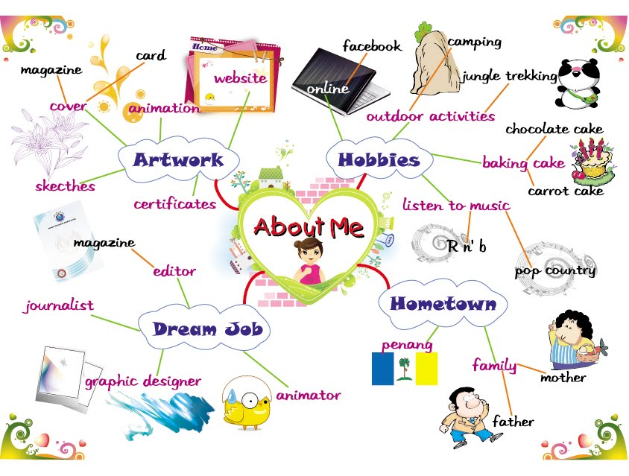
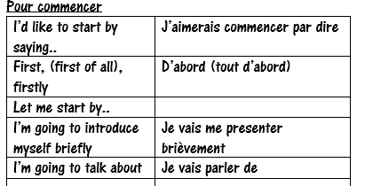
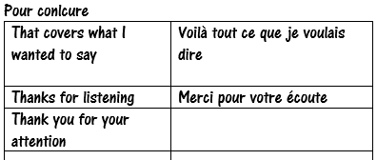
Activity 3 : Questions
Match the questions in English to the questions in French!
Activity 4 : Answer 5 questions about yourself!

