Slide 1
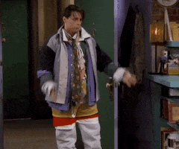
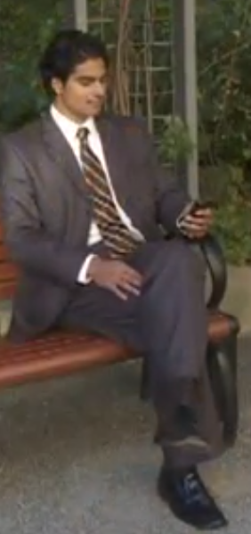
Description and Adjective Order
He is wearing a grey striped jacket
He is wearing black leather shoes.
He is wearing a brown checkered tie.
has got a nice formal grey suit

Slide 2
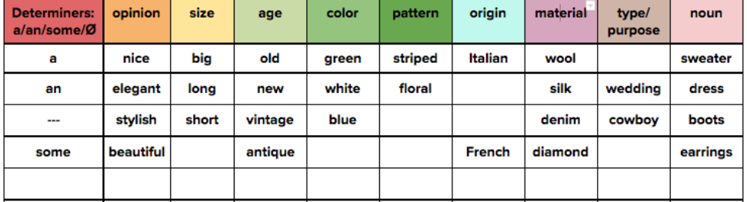
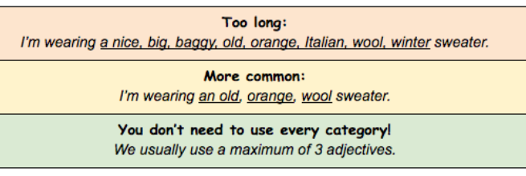

Slide 4
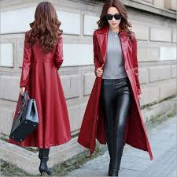
a
brown
long
leather
coat

Slide 5
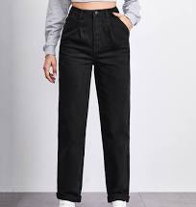
black
A pair of
expensive
trousers
denim

Slide 6
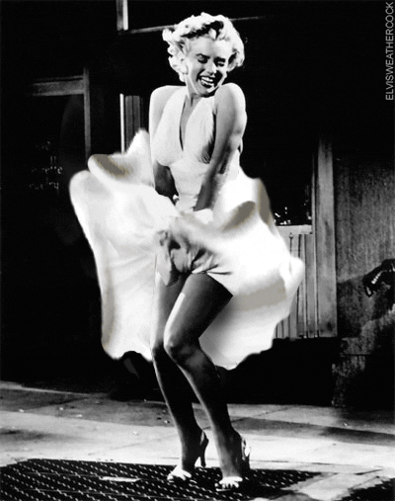
white
a
dress
lovely
silk

Slide 7
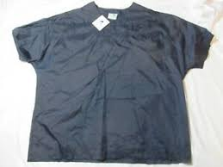
an
nylon
old
black
shirt

Slide 8
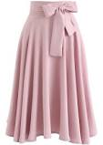
a
pink
loose
cotton
skirt

Slide 9
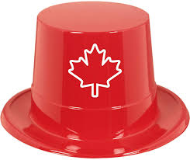
red
a
hat
big
plastic

Slide 10
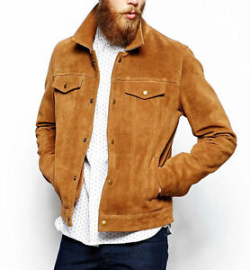
jacket
brown
a
trendy
suede

Slide 11
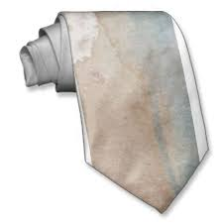
a
cotton
dirty
old
tie

Slide 12
a
long
brown
leather
coat
A pair
of
expensive
denim
trousers
a
lovely
white
silk
dress
nylon
shirt
an
old
black
a
loose
pink
cotton
skirt
a
trendy
brown
suede
jacket

Slide 13
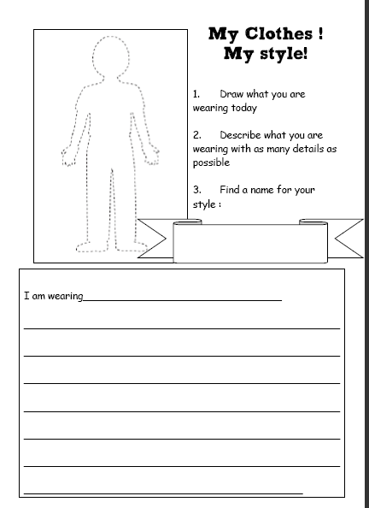

Slide 14
