Slide 1
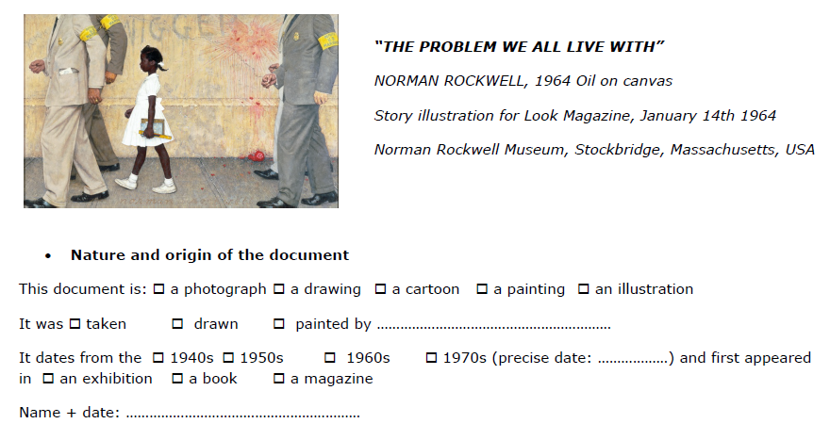

Slide 2
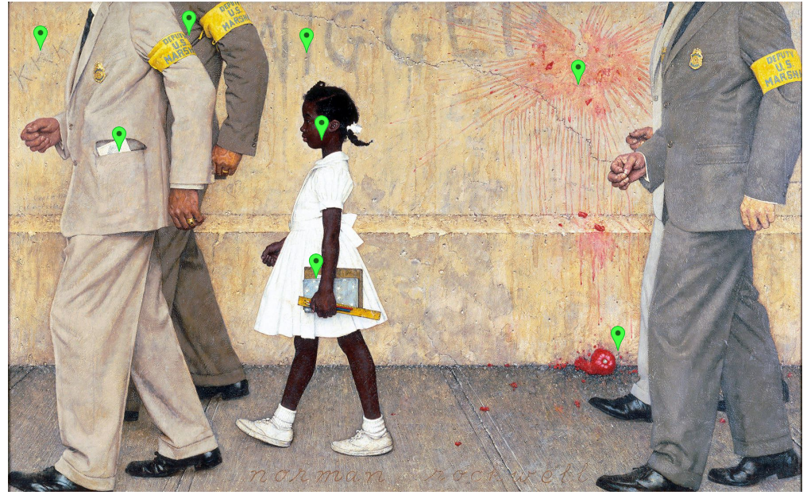
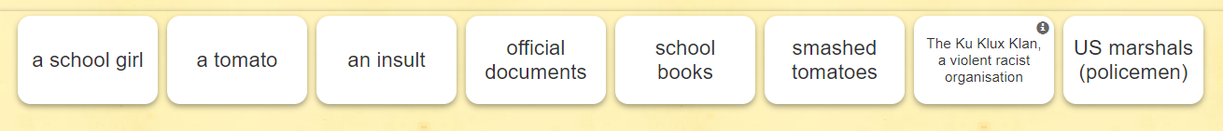

Slide 3
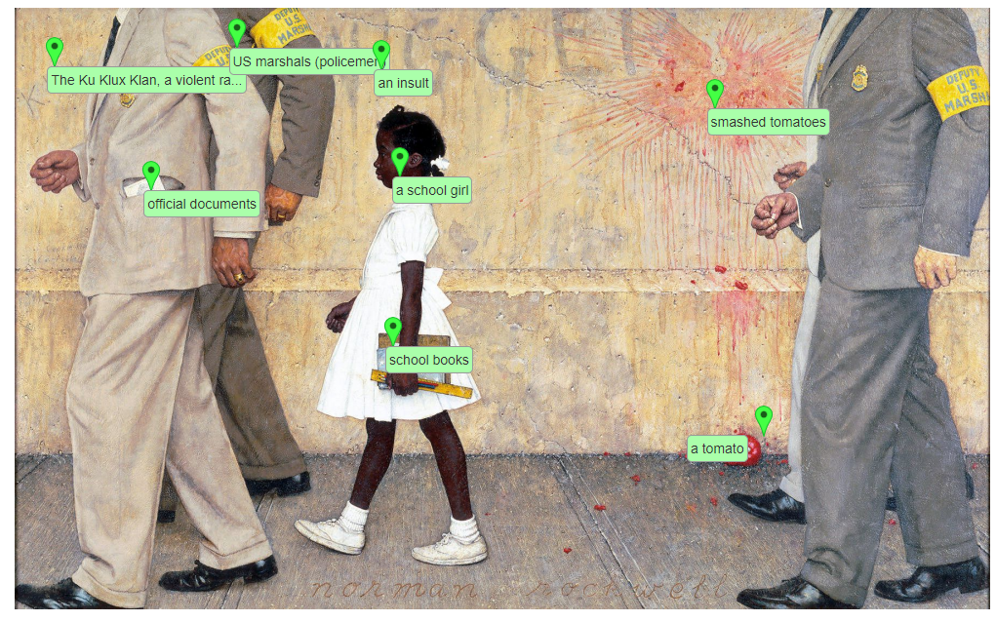
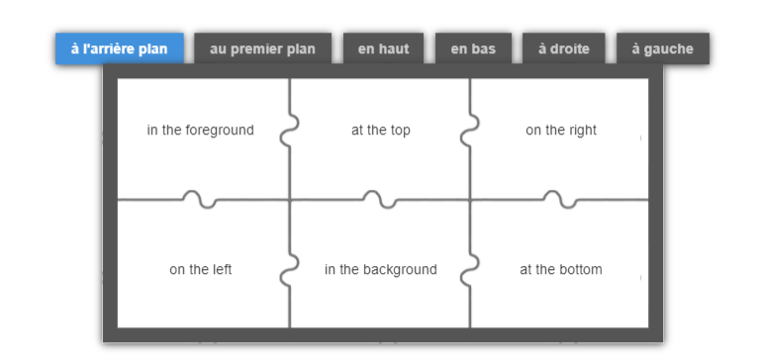

Slide 4
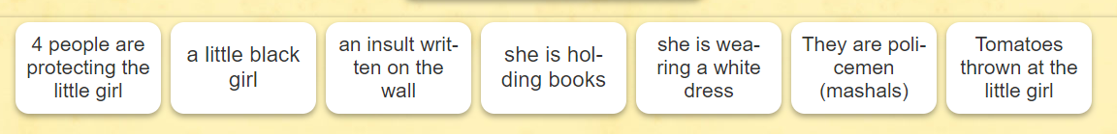

Slide 5
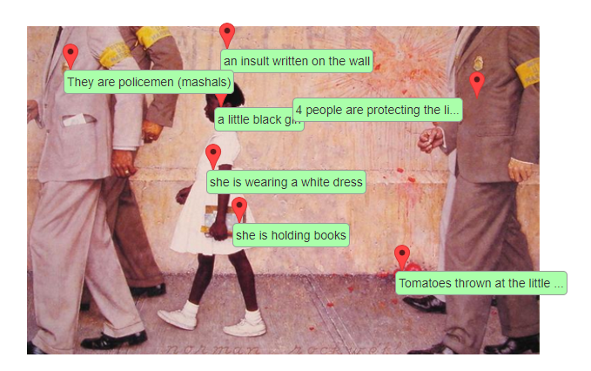

Slide 6
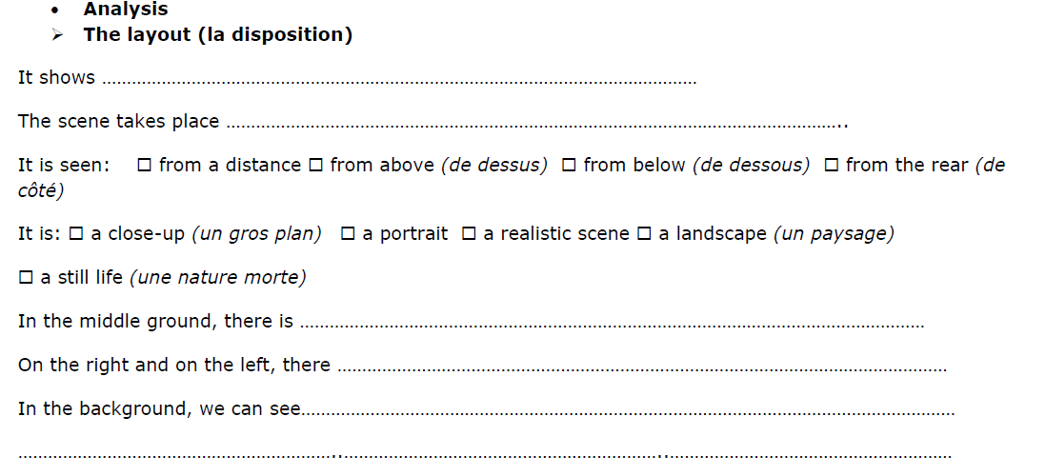

Slide 7
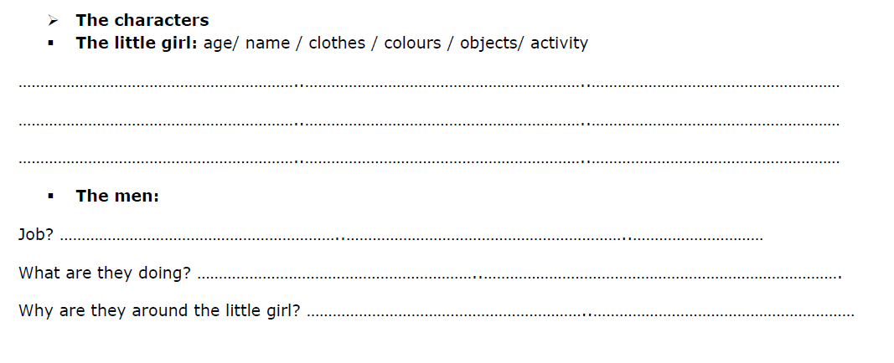
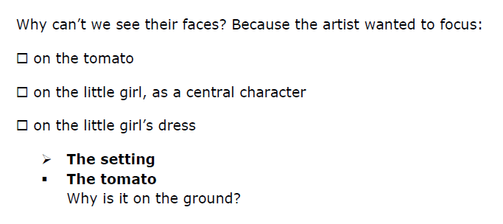

Slide 8
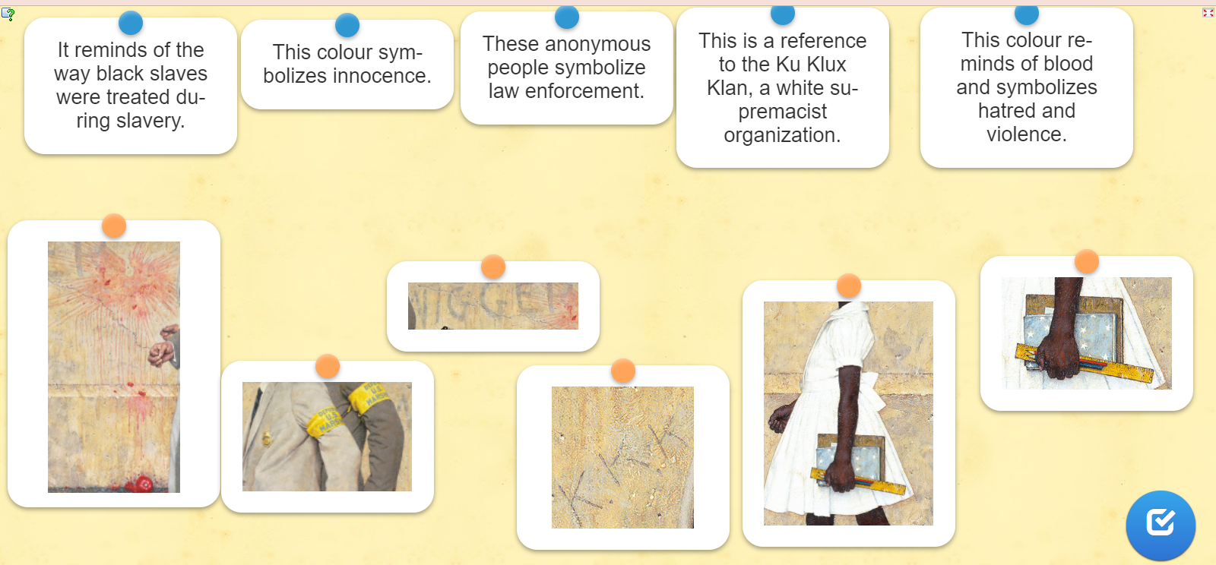

Slide 9
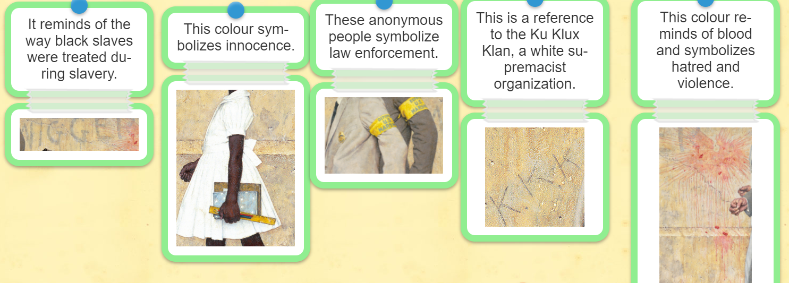

Slide 10
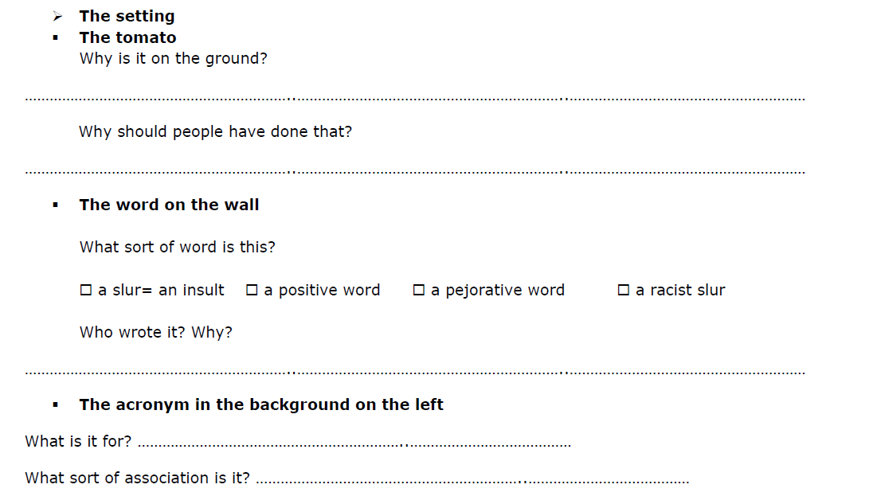

Slide 11
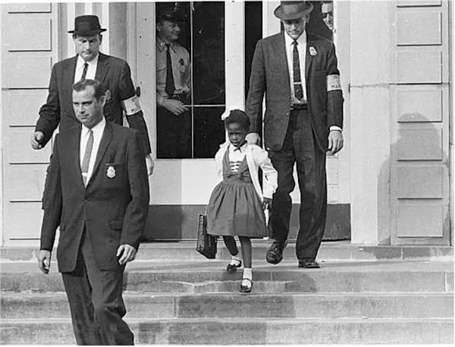

Ruby Bridges

Slide 12
The painting is very realistic, it looks like a photo.
It represents Ruby Bridges who was the first black girl to integrate a white school in New Orleans (a Southern State)in 1960
In the middle ground, we can see Ruby wearing a white dress. The colour white symbolises purity.
In the background, There is a tomato, smashed on the wall. The colour red symoblizes blood, and violence.
On the wall, are written the words "nigger" and "KKK“ : it shows that a lot of white people didn’t want to integrate Blacks in their schools.
We can’t see the white protesters, because we see the scene from their point of view.
The girl and the 4 marshals have clenched hands, it shows their determination . They are determined to go to school despite the threats.

Slide 13
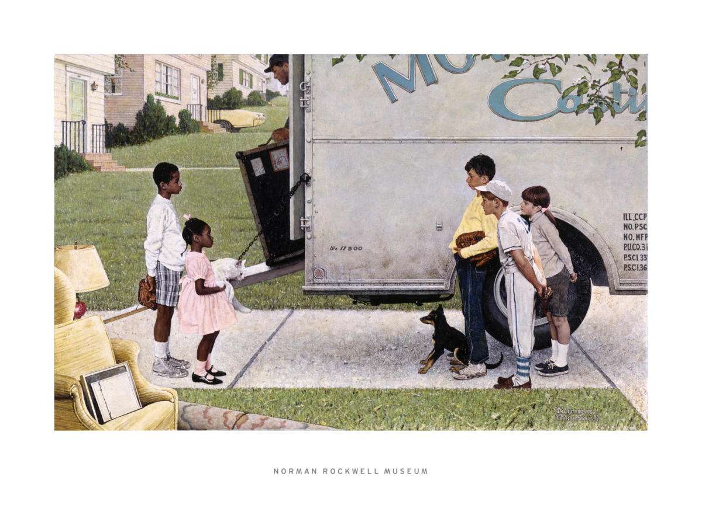
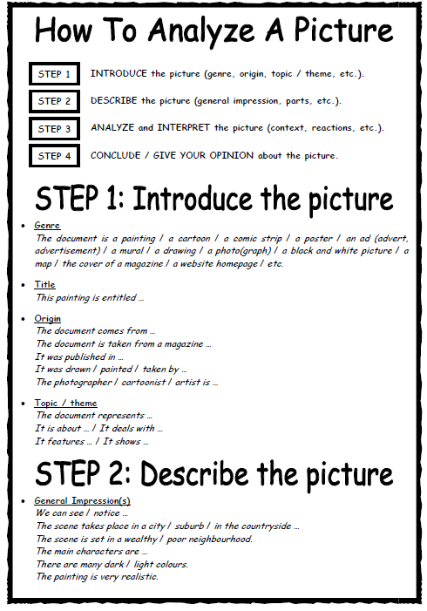
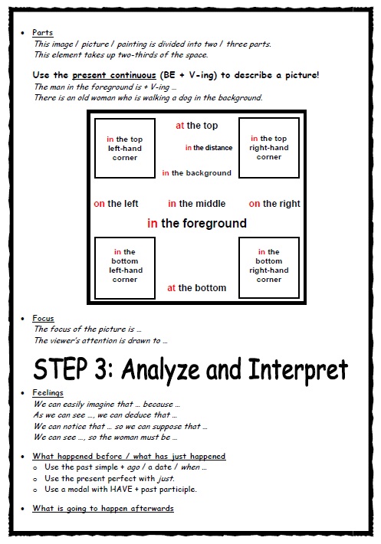
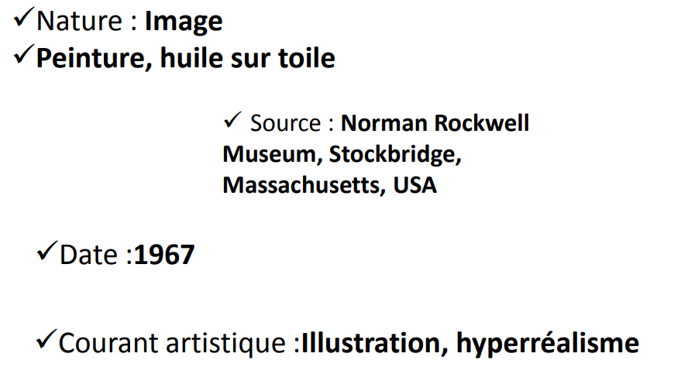
Write an analysis of another painting

