Slide 1

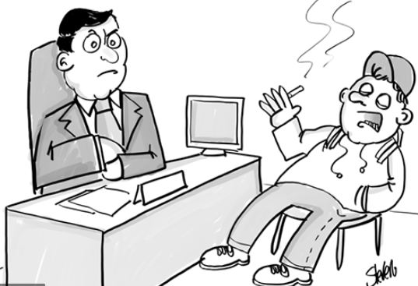
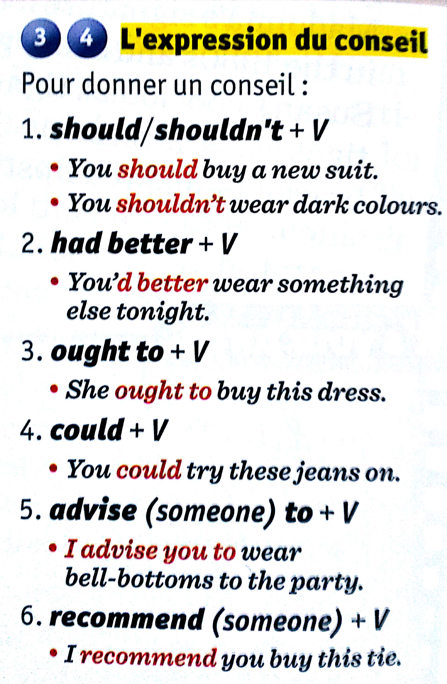
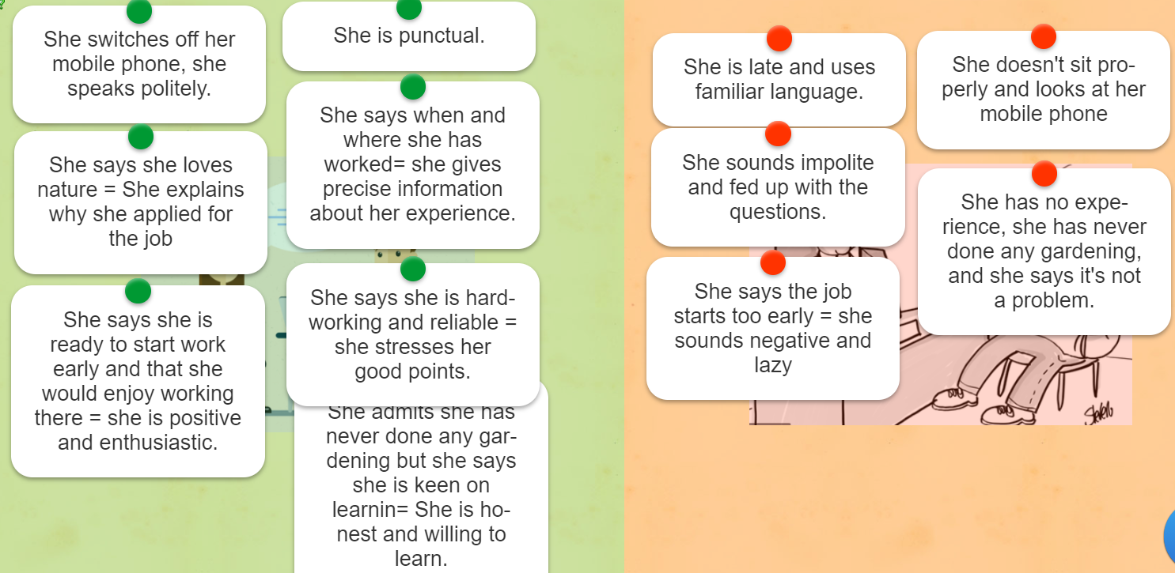
You ought to speak politely

Slide 2
Leçon n° : exprimer un conseil
For a job interview,
You should speak politely.
You ought to arrive on time.
I advise you to sit correctly.
I recommend you be positive and enthusiastic.
You had better be honest.
You shouldn’t smoke.
I advise you not to wear shorts.

Slide 3
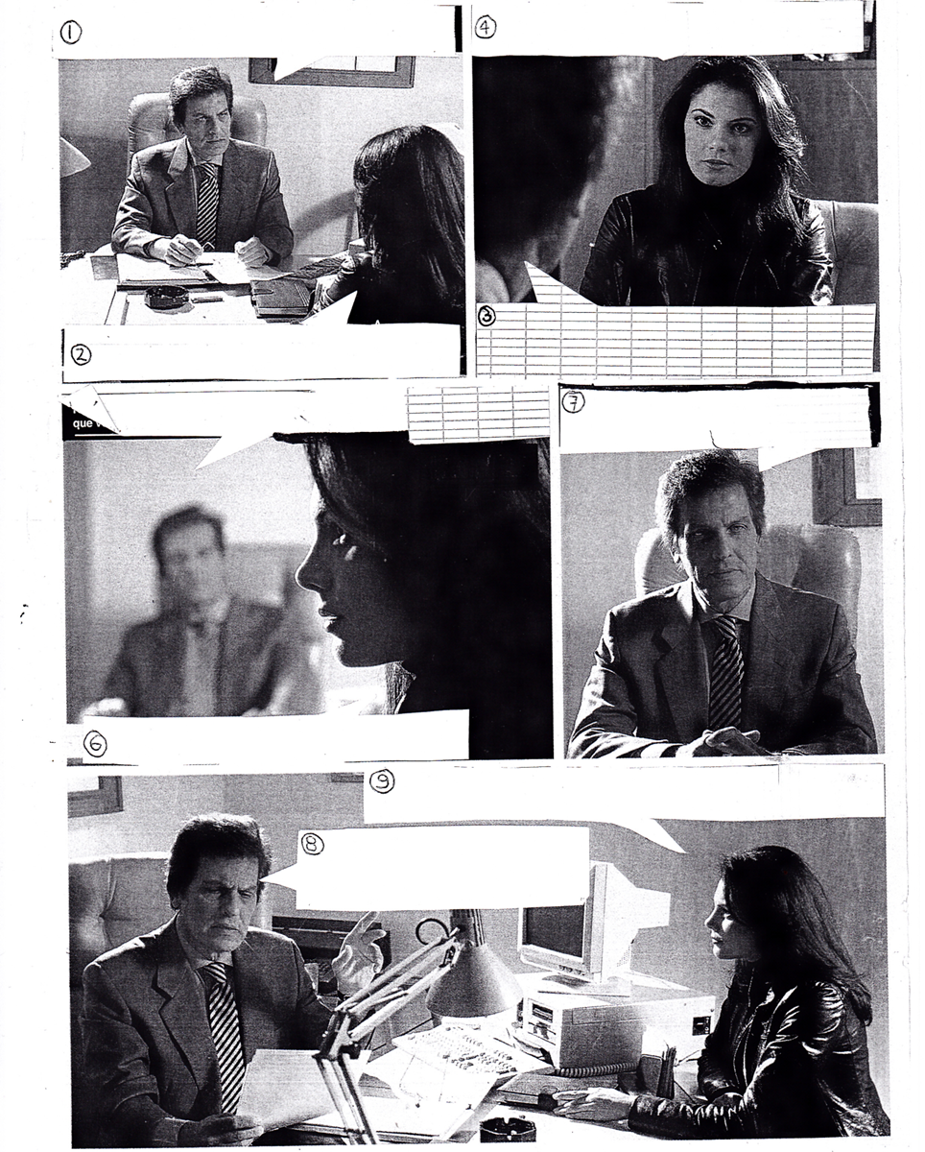
Invent a dialogue!
Par 2, inventez un dialogue > entretien d’embauche ou oral d’examen
Le chef d’entreprise/ chef d’établissement /prof/ parent donne des conseils au candidat!

