Slide 1


A road trip to the USA
MR Aurelien Imbert – Collège Robert Morel, arles
edith charbonnier – collège ambrussum, lunel

Slide 2
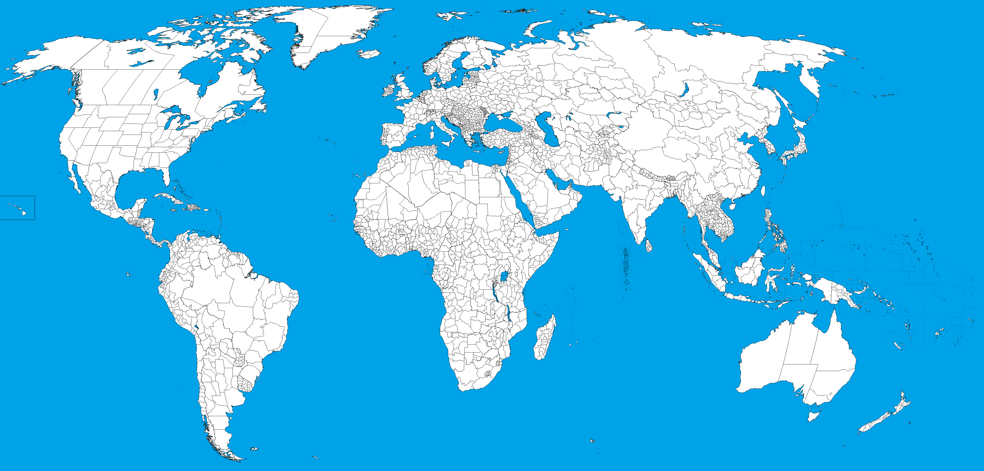


Where IS the USA ??
Click on the right place!

Slide 3
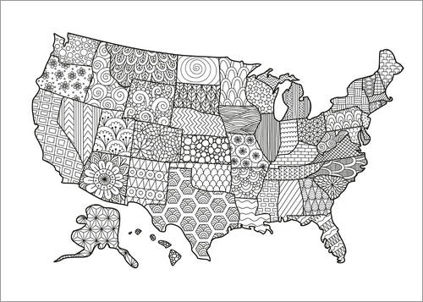
Welcome to the USA !
United States of America
There are 50 states in the US
Do you know any?
Make a list in team and get green points!
BE CAREFUL!!!
States ≠ Cities

Slide 4
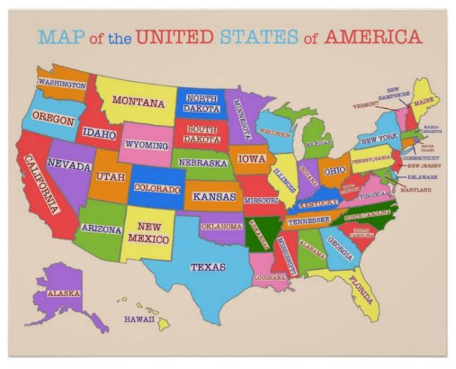
Welcome to the USA !
United States of America
There are 50 states in the US

Slide 5
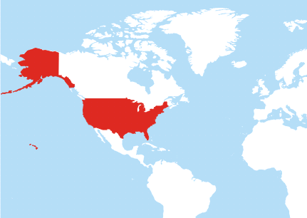
Welcome to the USA !
United States of America
There are 50 states in the US, and 2 of them are quite far from the others
Do you know them ?
Alaska
Hawaï

Slide 6
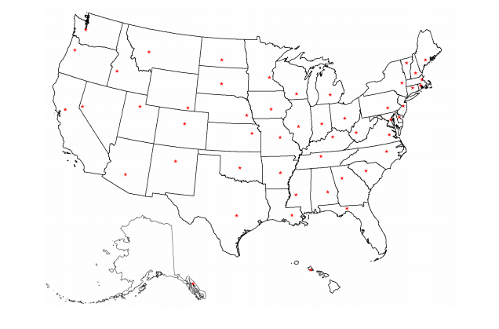
Welcome to the USA !
United States of America
There are a lot of famous cities in the US:
Can you name some?
Make a list in team and get green points!

Slide 7
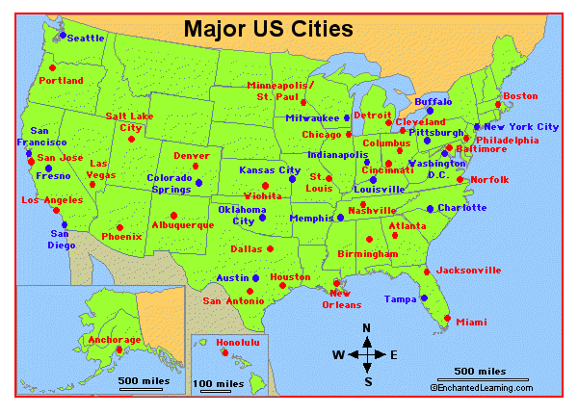
Welcome to the USA !
United States of America
There are a lot of famous cities in the US:

Slide 8
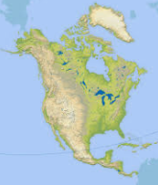

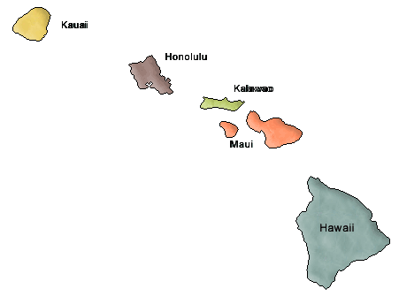
Recap ! Fill the blanks
The USA is in North America
There are 50 states. Alaska and Hawaï are separated from the other states.
Other famous states are: Texas, California, Florida …
Some cities are also very famous: New York, Los Angeles, Chicago, Miami, Washington DC…

Slide 9
WELCOME TO THE USA
Now complete your worksheet in team!

Slide 10
Welcome to the USA !
United States of America
There are a lot of famous monuments in the US:
Can you name some?

Slide 11
Welcome to the USA !
United States of America
There are a lot of famous monuments in the US:
Can you name some?

Slide 12
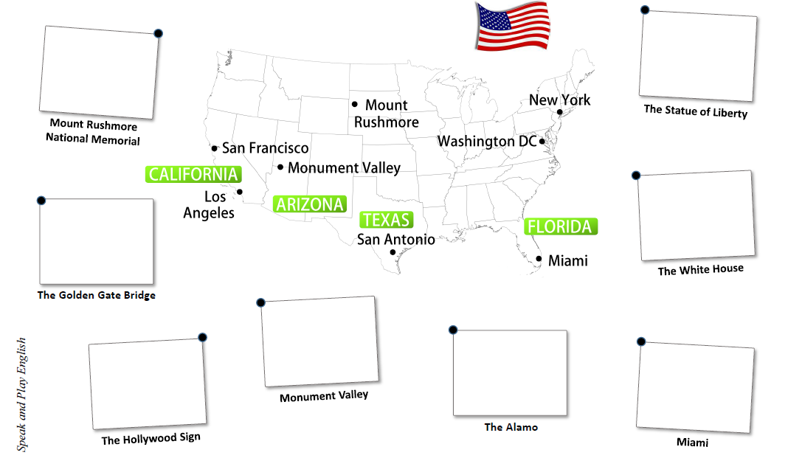
WELCOME TO THE USA
Now complete your worksheet in team!

Slide 13
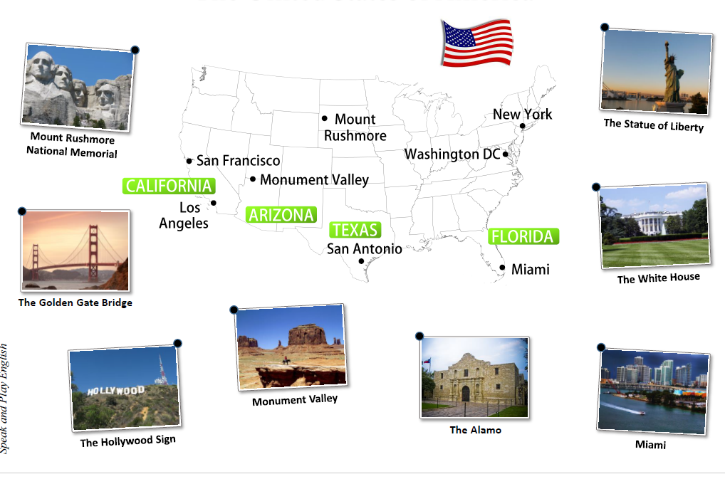
WELCOME TO THE USA
Famous Monuments

Slide 14
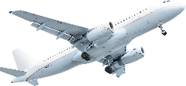
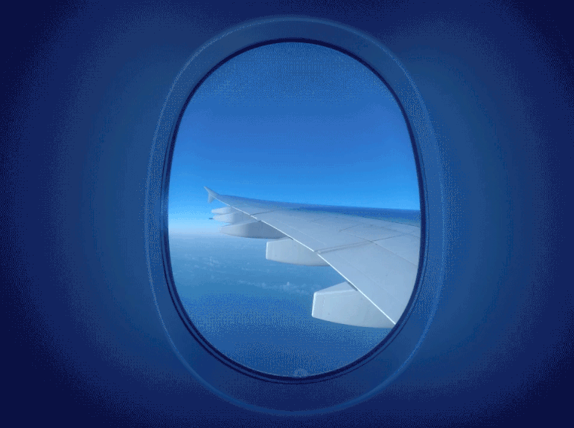
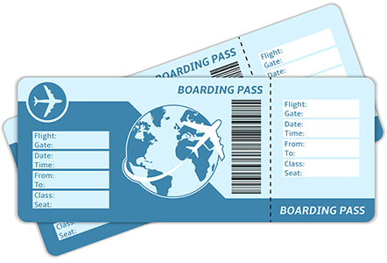
Today we take a plane to the USA !
BUT…

Slide 15
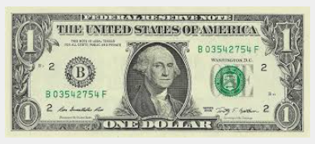
What do you need to go to the US?
Money → Dollars
1 dollar = 0,82 euro

Slide 16
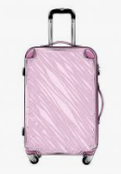
What do you need to go to the US?
A suitcase…
What else?

Slide 17
What do you need to go to the US?
A plane ticket…

Slide 18
What time is my flight? What is my boardin gate?
Do the worksheet your teacher gives you

Slide 19

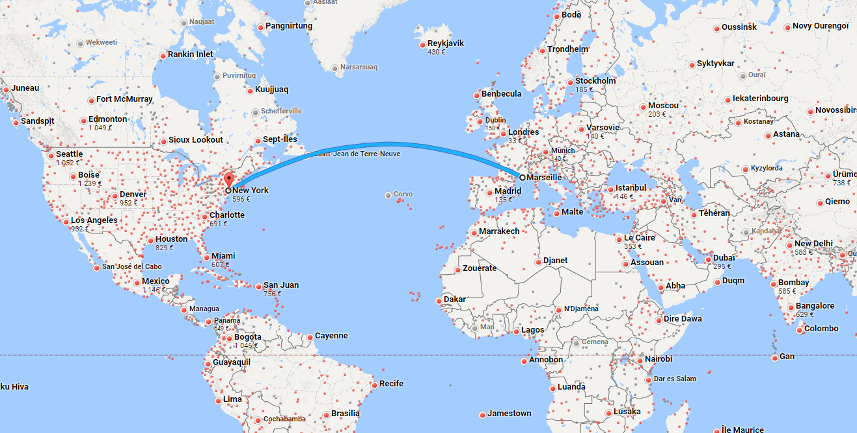
Welcome to the USA !
United States of America
From France, you need 9h to go to the US east coast

Slide 20
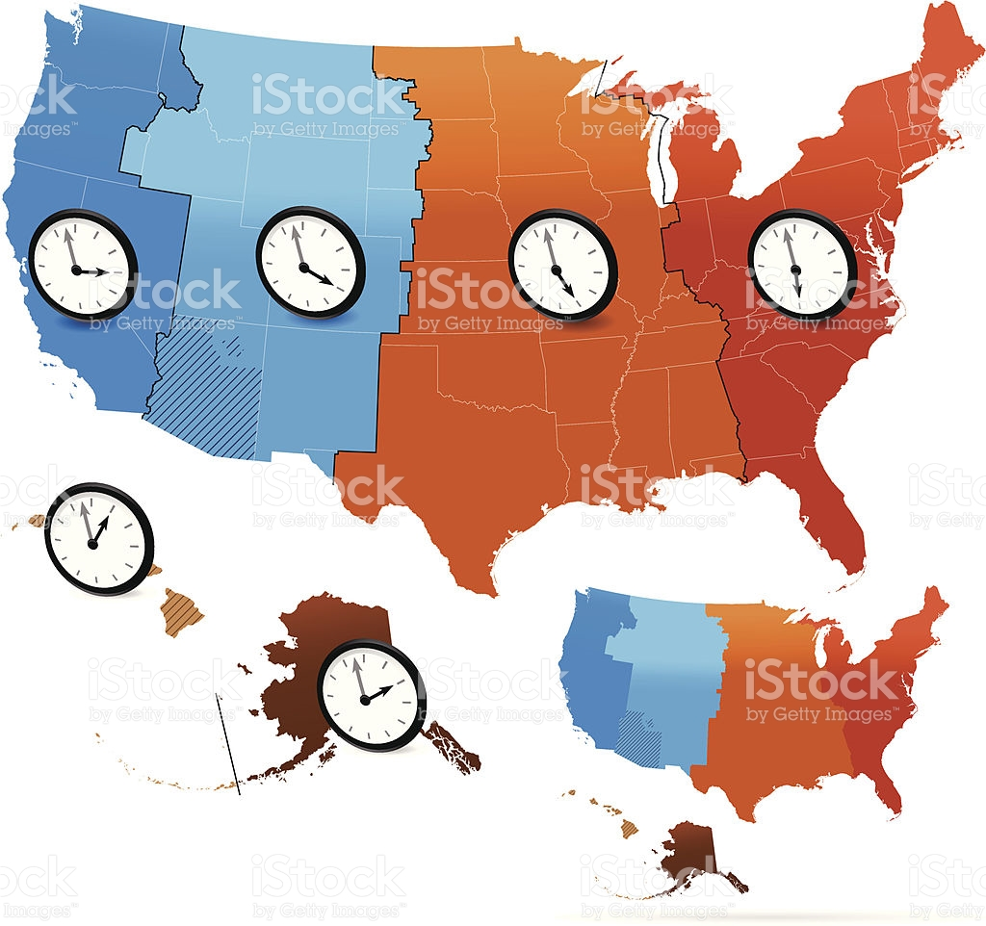

Welcome to the USA !
The country is very big. How many time zones are there?
6 !

Slide 21

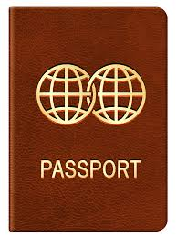

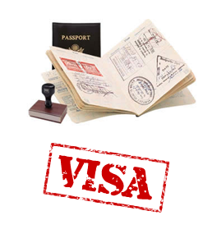
Welcome to the USA !
First, to enter the country, you need :
A passport
A ticket
A visa

Slide 22



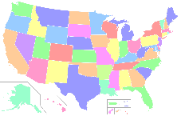

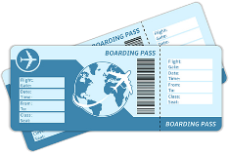
Recap ! Fill the blanks
To go to the USA from France, there are 9 hours by plane.
There are 50 states. Alaska and Hawaï are separated from the other states.
There are 6 different time zones.
To enter the USA, you need a passport, a ticket , a Visa. and money!

Slide 23
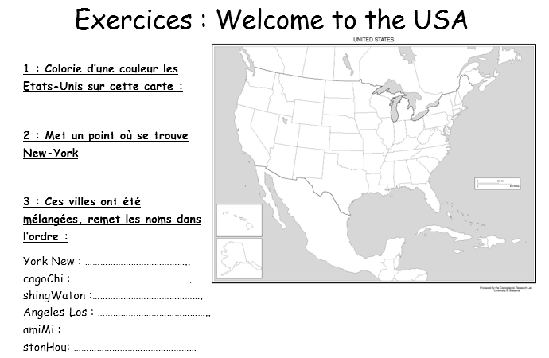

Slide 24
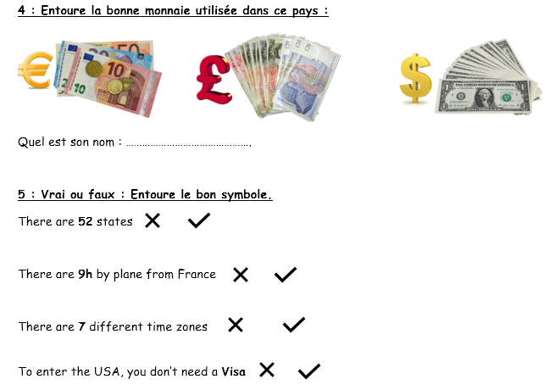

Slide 25




Role play !
Tu travaille à la douane et contrôle les passagers qui arrivent de la France: Un élève joue le rôle du douanier et un élève joue le voyageur
Hello !
Hello ! Where are you going ?
I’m going to New York !
I see, can I see your passport please ?
Yes, here it is !
Thank you, and where is you Visa ?
Oh sorry, it is here.
Thank you, have a nice day.
Goodbye !

Slide 26

First stop…..
... NEW YORK CITY !
Chrysler Building
Empire State Building
Statue of Liberty

Slide 27
New York City is famous for…

Slide 28
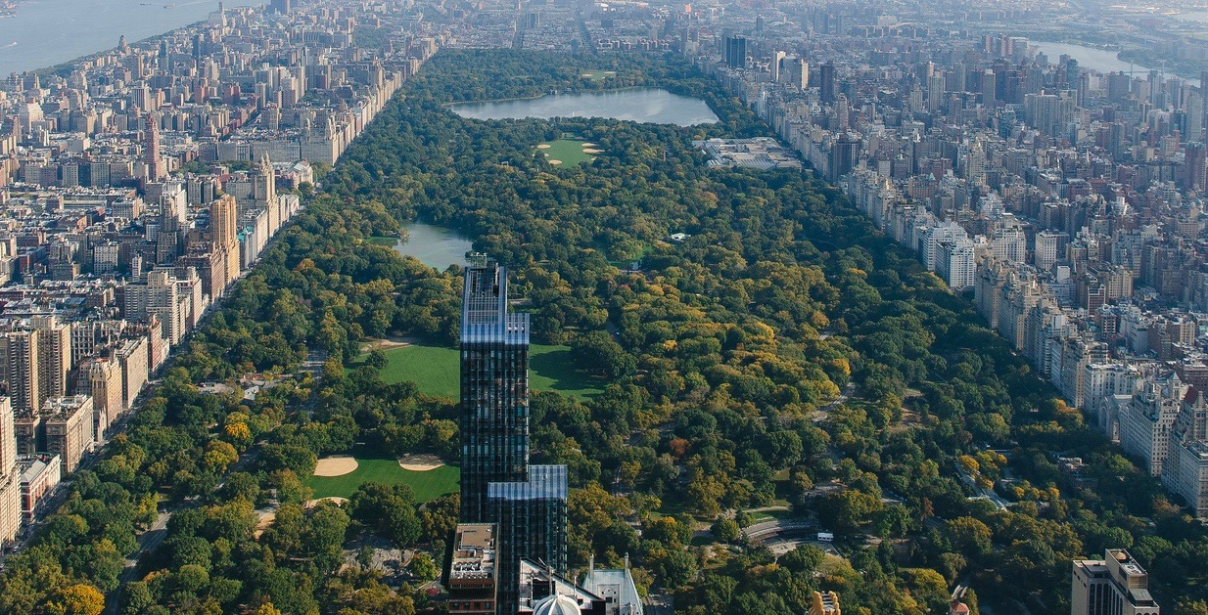
Its park !
1
Central park !

Slide 29
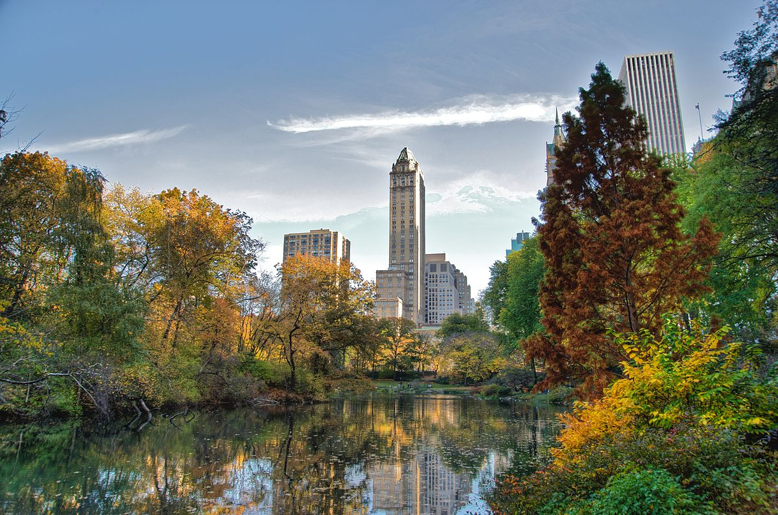

Slide 30
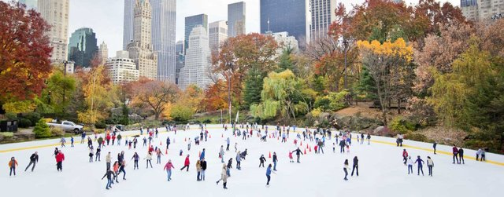

Slide 31
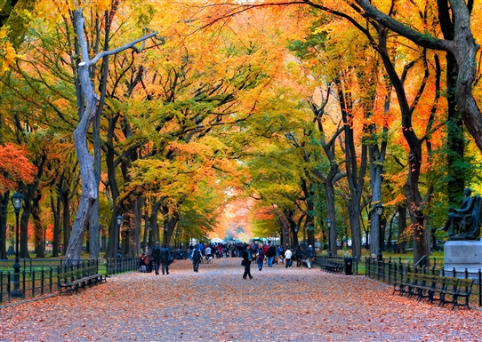

Slide 32
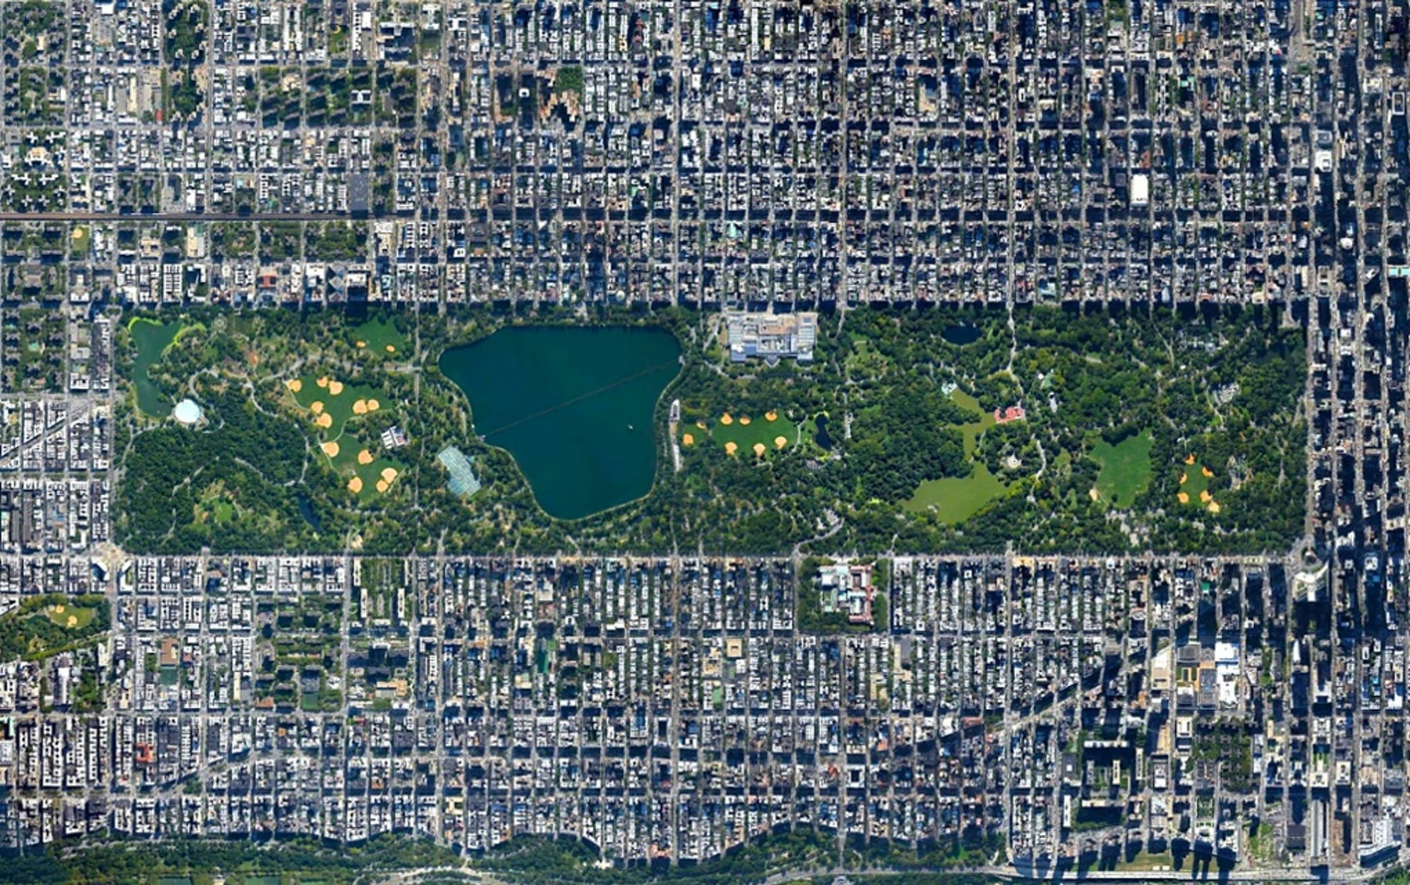

Slide 33



In central park, there are trees, skyscrapers and ponds

Slide 34
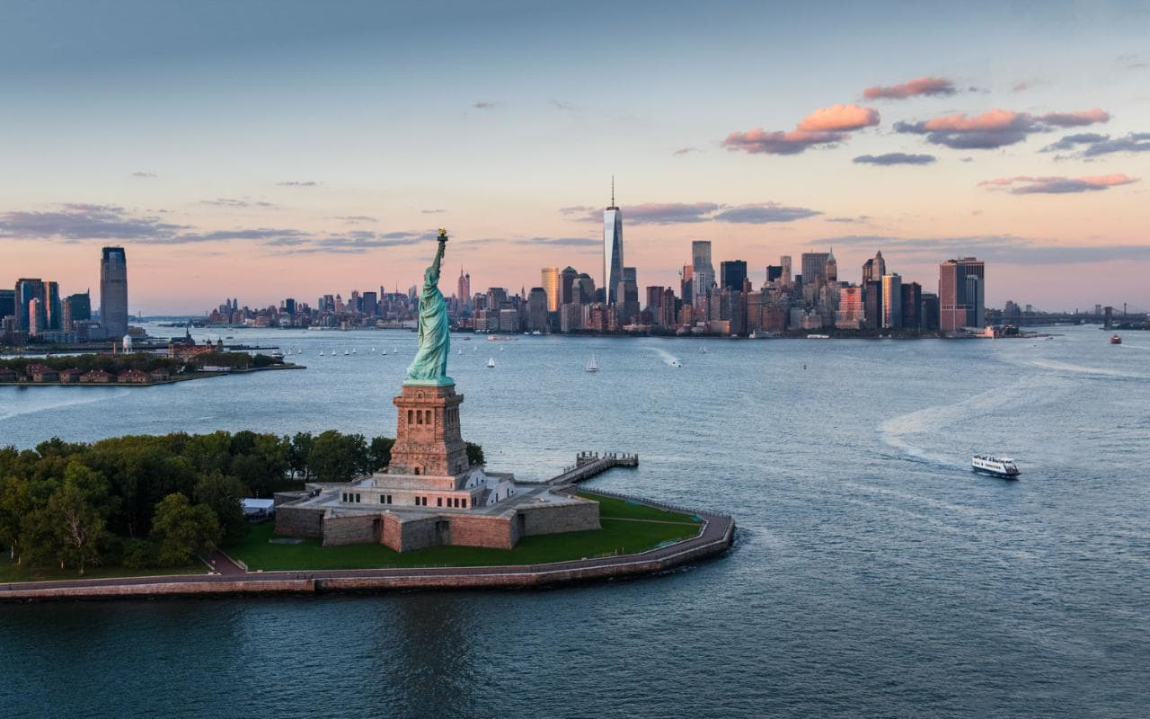
Its statue !
2
Statue of Liberty !

Slide 35


The statue of Liberty is on an island. You can visit it by boat !

Slide 36
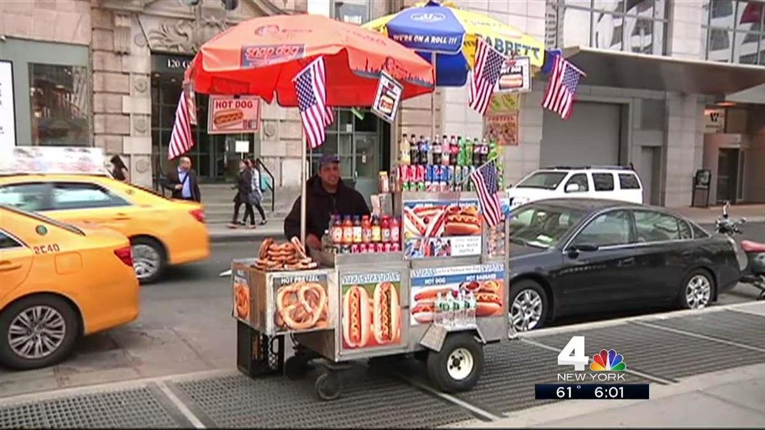
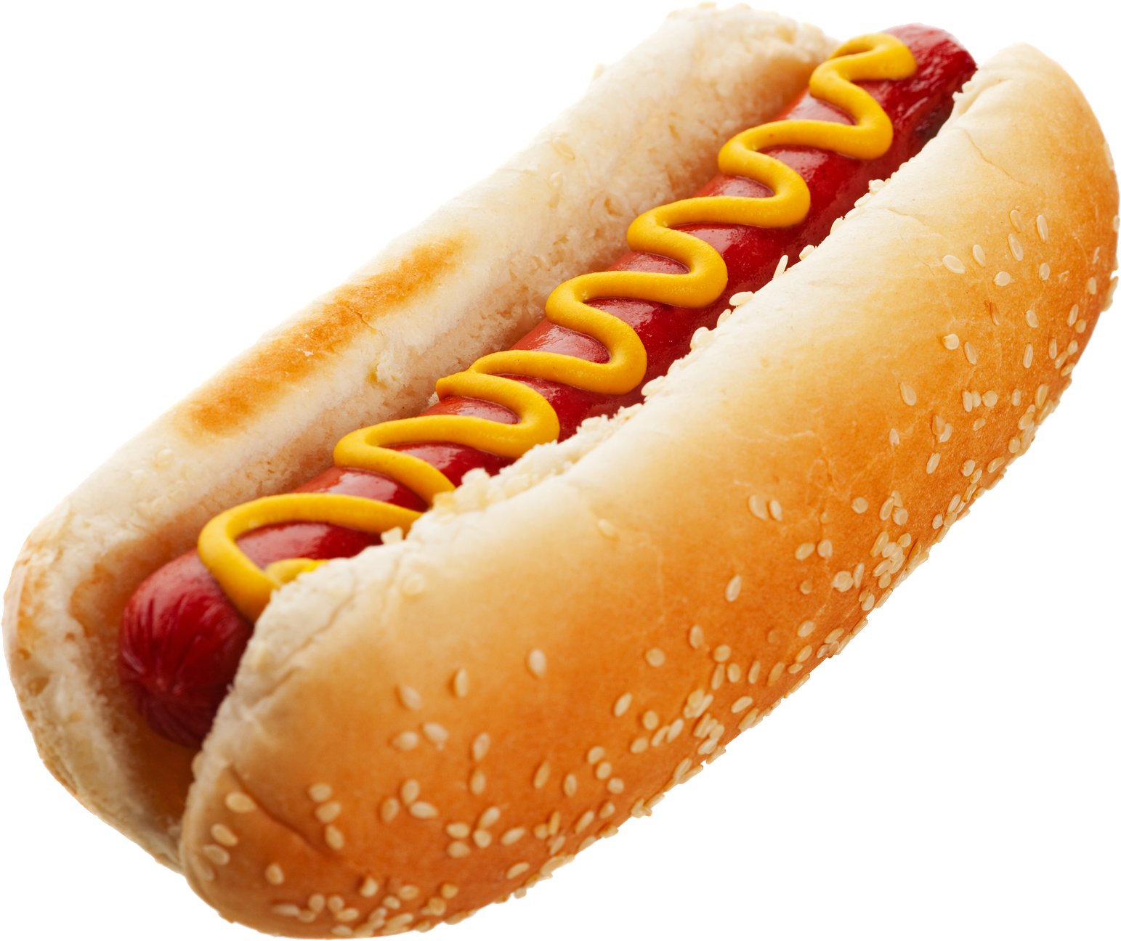
New York food !
1
The Hot Dog !

Slide 37

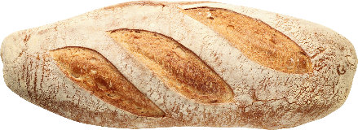

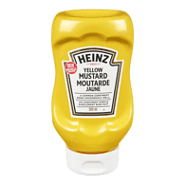

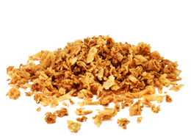
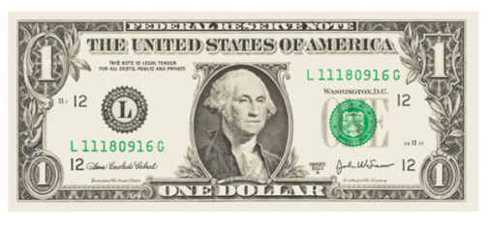
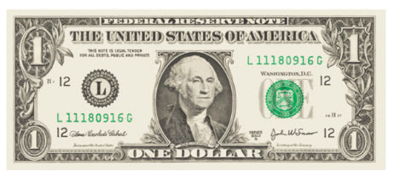
New York food !
1
The Hot Dog !
Ingredients :
A sausage
Bread
Ketchup
Mustard
Fried Onions
Where ?
In brooklyn
Is it cheap or expensive ?

Slide 38
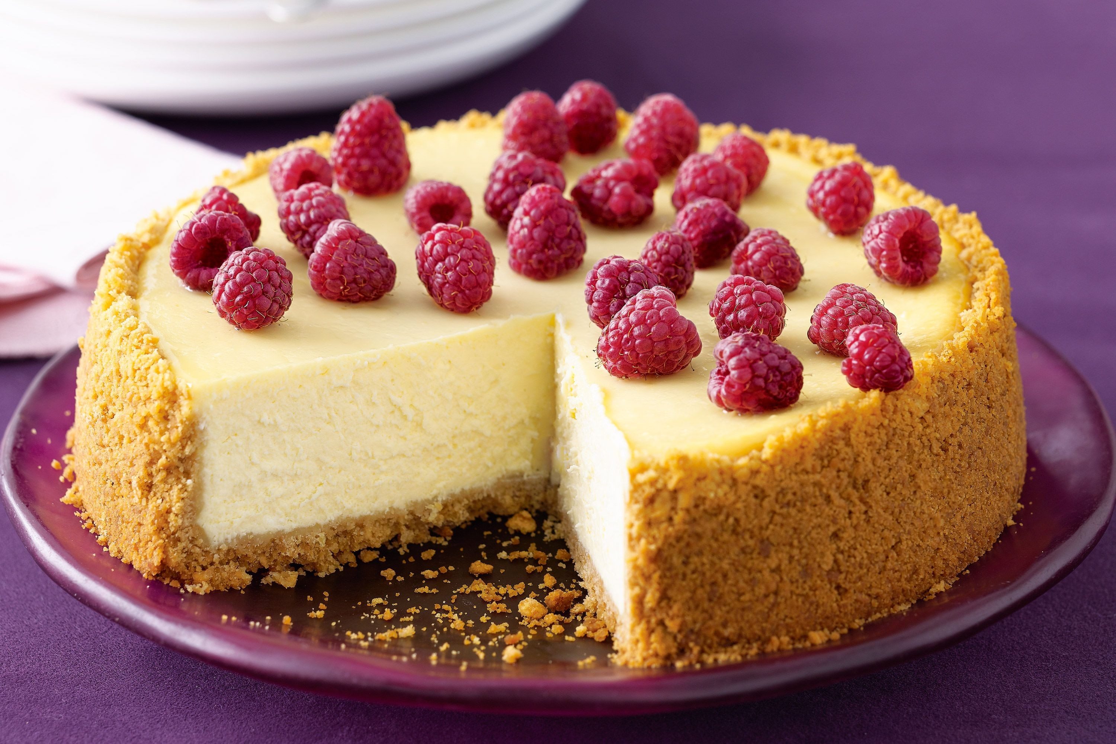
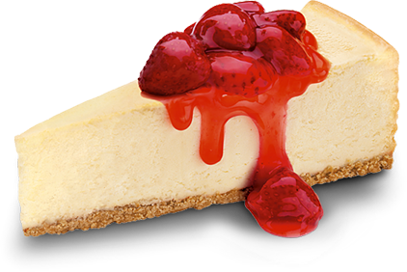
New York food !
2
The Cheesecake!

Slide 39
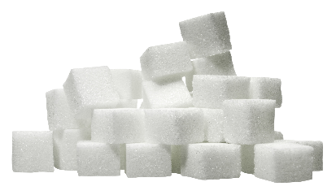
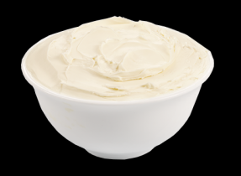

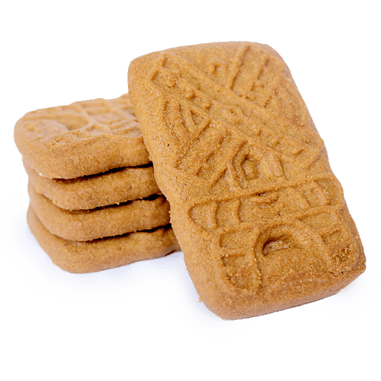
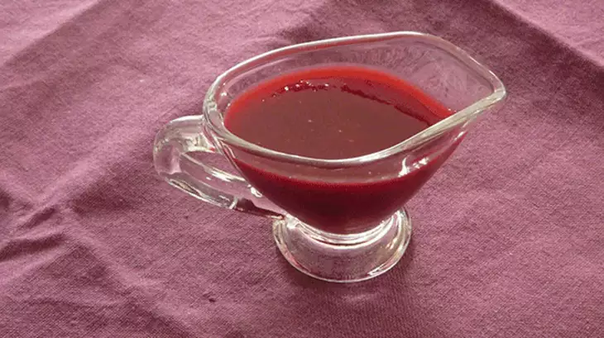
New York food !
2
The Cheesecake!
Ingredients :
Sugar
Cream cheese
Eggs
Speculoos
Fruit coulis
Where ?
In Manhattan
Is it cheap or expensive ?

Slide 40
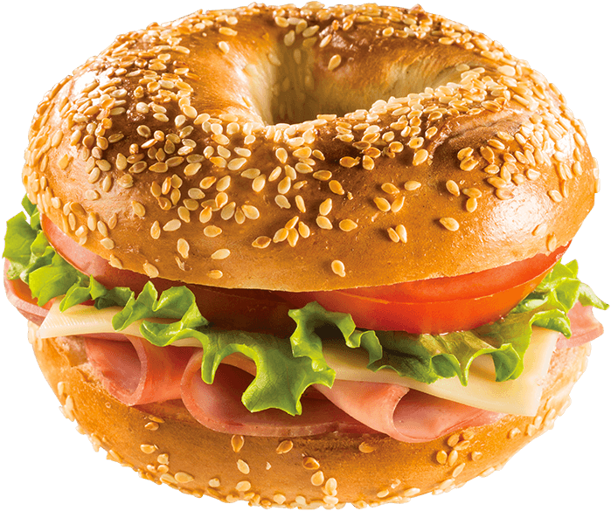
New York food !
3
The Bagel !

Slide 41
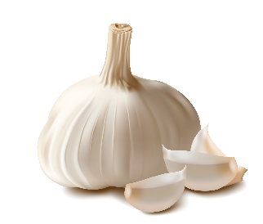
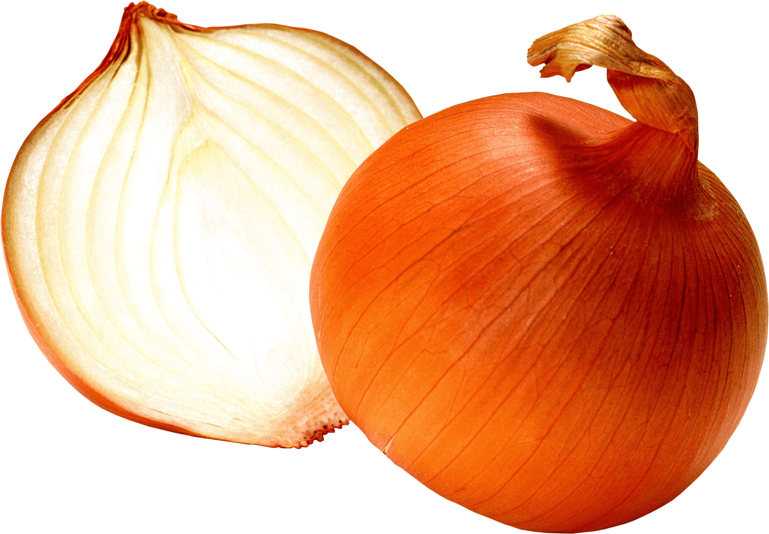
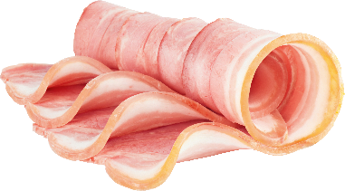
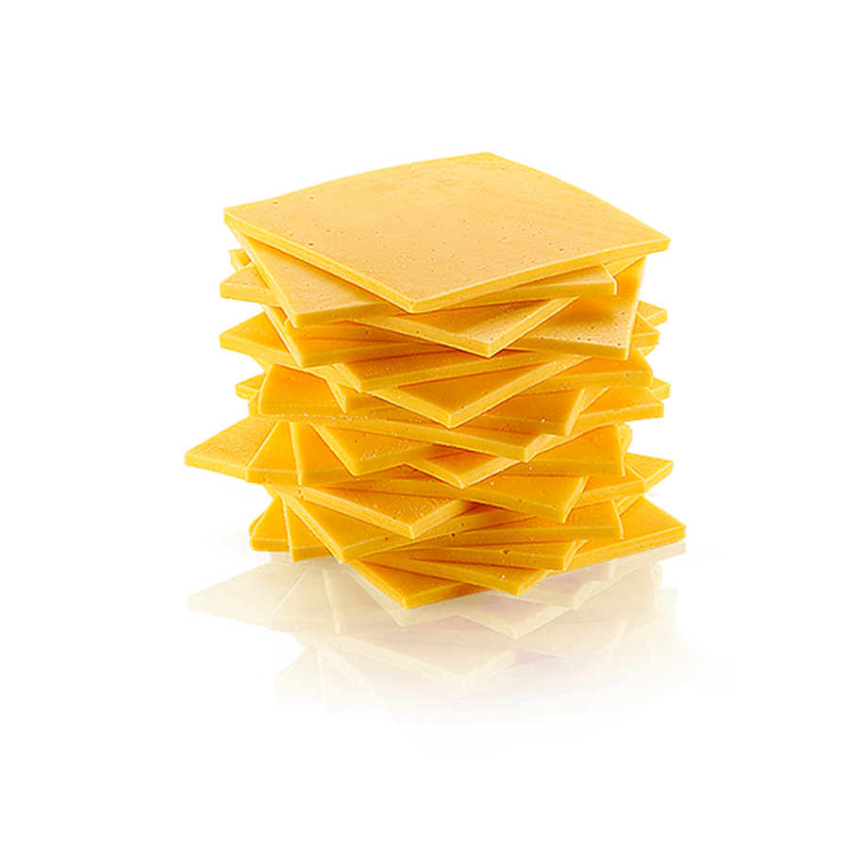
New York food !
3
The Bagel !
Ingredients :
Garlic
Cream cheese
Onions
Ham
Cheddar
Where ?
In Bronx
Is it cheap or expensive ?

Slide 42
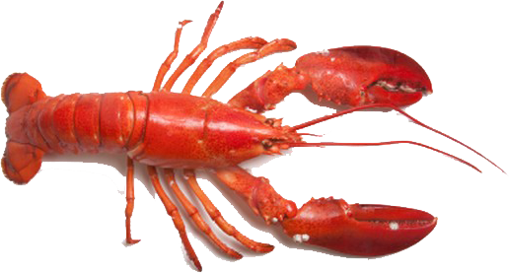
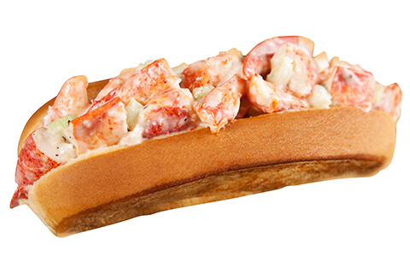
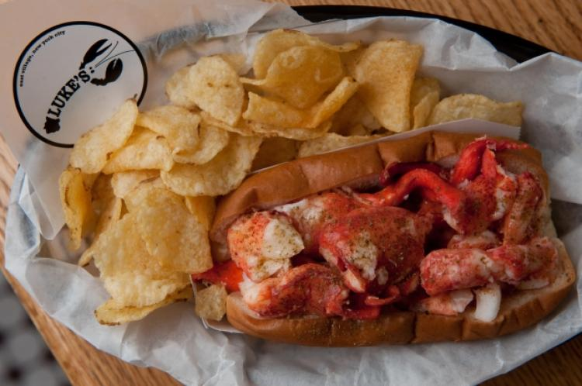
New York food !
4
The Lobster Roll !

Slide 43




New York food !
4
The Lobster Roll !
Ingredients :
Lobster
Mayonnaise
Parsley
Bread
Lemon juice
Where ?
In Staten Island
Is it cheap or expensive ?

Slide 44



New York food !
In New York city, you can eat Hot Dogs, Bagels,
Cheesecakes and Lobster rolls. Each borough has a speciality !

Slide 45


Remember !

Slide 46


Slide 47

Boroughs of New York

Slide 48

Lobster roll recipe !
Fill
Slice
Cut
Boil
Add

Slide 49


Slide 50







Role play !
Tu es à New-York et tu as un petit creux… tu t’arrêtes dans un petit restaurant et prépares ta commande. Un élève joue le serveur et un autre le client.
Good morning sir, what do you want to eat ?
Hmm, I’d like a …..
Of course, it will be ready in 5 minutes !
Here you are Sir !
Thank you, how much is it ?
It is …… $ (dollars)
Okay, have a nice day !

Slide 51
Avant de quitter New-york, réalise un dépliant pour présenter le top 3 des choses incontournables !
1- Colorie et nomme les différents quartiers
2- Colle tes 3 monuments préférés et écrit leurs noms
3- Colle tes 3 plats préférés, illustre avec quelques ingrédients.
4- Ecrit ton nom et soigne ton dépliant !

Slide 52





Help !
Hot-Dog
Lobster Roll
Cheesecake
Bagel
Empire
State
Building
Statue of Liberty
Chrysler building
Central Park

Slide 53


Slide 54


Lost in central park !
Tu es perdu dans Central Park, tu essayes de guider un ami par téléphone jusqu’au Zoo, où tu te trouves.

Slide 55


Goodbye New York city ! Bilan

Slide 56



Roleplay !

Slide 57


Now we take a car to…
Washington D.C !

Slide 58

A long trip !
Il faut environ 5h pour aller de New York jusqu’à Washington en voiture

Slide 59

A long trip !
Il faut environ 3h pour aller de New York jusqu’à Washington en train !

Slide 60



Washington D.C
It is the …………….. of the United States
There are 6 milions people.
D.C = D…………. of C……………

Slide 61

Washington D.C
On utilise le terme D.C pour différencier l’état de Washington et la ville !

Slide 62

What’s the weather like to today in washington D.C ?
It is …………..
The temperature is …………..

Slide 63


Visiting Washington D.C !
The White House
First thing to visit :
The president of the United States lives in the White House

Slide 64






Visiting Washington D.C !
The Lincoln Memorial
Second thing to visit :
This monument was constructed to honor Abraham Lincoln. He was a president of the United States. Inside the memorial, there is a big statue.

Slide 65





Visiting Washington D.C !
The Air and Space Museum
Third thing to visit :
In this museum, you can see the biggest collection of planes and spacecrafts ! You can learn a lot of things about space !

Slide 67

Presidents of the United States
Le grand sceau des Etats-Unis est utilisé pour représenter le gouvernement américain. - les 13 étoiles représentent les …………………………… d’origine - Le rameau d’olivier représente la …………………. - Les …………………….. représentent la défense par la guerre !

Slide 68



Presidents of the United States
1
George Washington 1789-1797
Fait marquant : Premier président des Etats-Unis après l’indépendance

Slide 69





Presidents of the United States
2
Abraham Lincoln 1861-1865
Faits marquants : Guerre de Sécession et abolition de l’esclavage

Slide 70


Presidents of the United States
3
John Kennedy 1961 - 1963
Fait marquant : Assassiné en 1963

Slide 71



Presidents of the United States
4
Barack Obama 2009 - 2017
Faits marquants : Premier président Noir américain. Prix Nobel de la paix.

Slide 72






Timeline of presidents
Chaque barre = ……….. ans

Slide 73



Timeline of presidents
Chaque barre = 10 ans
Theodore Roosevelt
1901-1909
Harry Truman
1945-1953
Donald Trump
2017- ?
Abraham Lincoln
Barack Obama
John Kennedy
George Washington

Slide 74

Révisions

Slide 75

Révisions

Slide 76


Slide 77


Slide 78


