Slide 1
WRITE DOWN :
1. the name of a fruit
2. the name of a vegetable
3. a number between 1 and 200
4. answer to this question : Do you like football?
5. How many pencils and pens do you have?
6. What is the first thing you do every morning ?

Slide 2
These things are actually :
1. Your first name
2. Your family name
3. Your age
4. If you are married or not
5. How many children you have
6. Your job

Slide 3
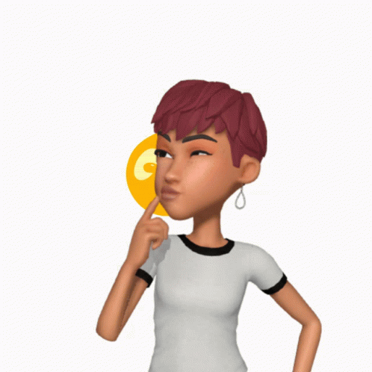
Ask questions to your partner
Example of dialogue :
- How old are you ?
- 150
- Really !

