Slide 1
NRI MARRIAGE BUREAU
ONLINE MATRIMONIAL SERVICES

Slide 2

NRI Marriage Bureau is one of the most trusted and best matrimony sites in the world. Our matrimonial services at nrimb.com is available at 24x7 and paves the way for millions of users worldwide to find the most compatible and perfect match for them on marriage sites.

Slide 3
HOW DOES IT WORK?
Step 1 :
Create a profile
Step 2 :
Browse profiles
Step 3 :
Start Communicating
Step 4 :
Send Requests

Slide 4
NRI MARRIAGE BUREAU SUCCESS STORIES
We help to bring souls together to help them celebrate their happy matrimony made in heaven. NRIMB.com wish you happy married life. We welcome you also to share saga of your joyous union with us and numerous others though us to urge them to emulate you in success. Carry on with your blessed married life and cheering others as more happiness awaits you.

Slide 5

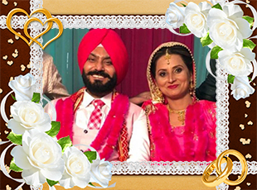



HAPPILY MARRIED COUPLES

Slide 6


