Slide 1

How safe are matrimonial sites in all aspects?

Slide 2
Matrimonial Sites nowadays are playing a crucial role in the matrimonial field. Lakhs of peoples are getting married monthly with the help of matrimonial sites. If we talk about how safe are matrimonial sites in all aspects then we should keep some of the key points in our mind.

Slide 3
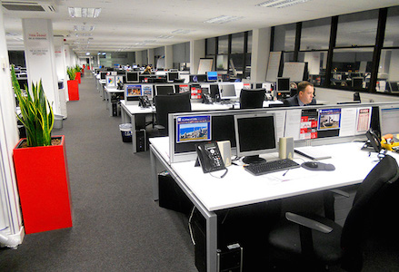
Matrimonial sites should have a registered office

Slide 4
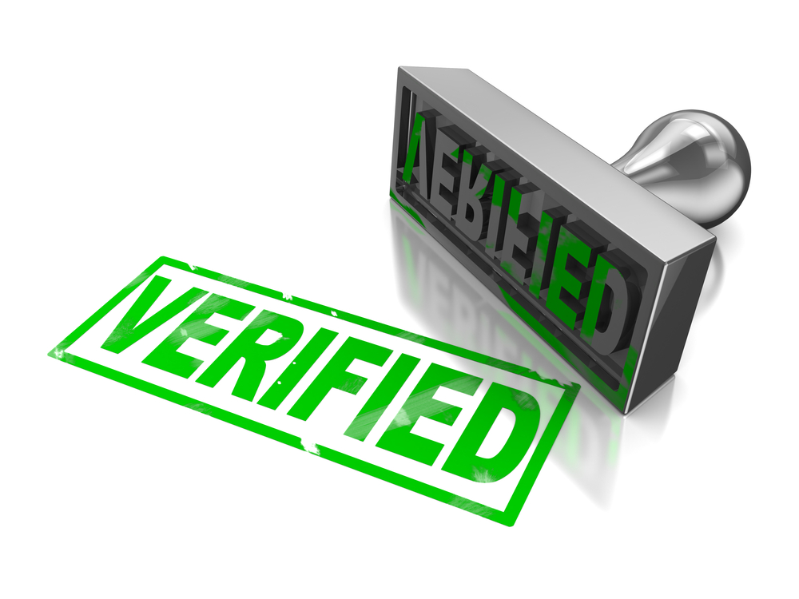
Should have verified matrimonial profiles

Slide 5

Check their Google reviews what people are saying about them

Slide 6

There market value and their past history

Slide 7

Confidentiality of user’s must be a priority

Slide 8

Don’t miss to read the Terms & Conditions

Slide 9

Never miss to read the Refund Policy

Slide 10
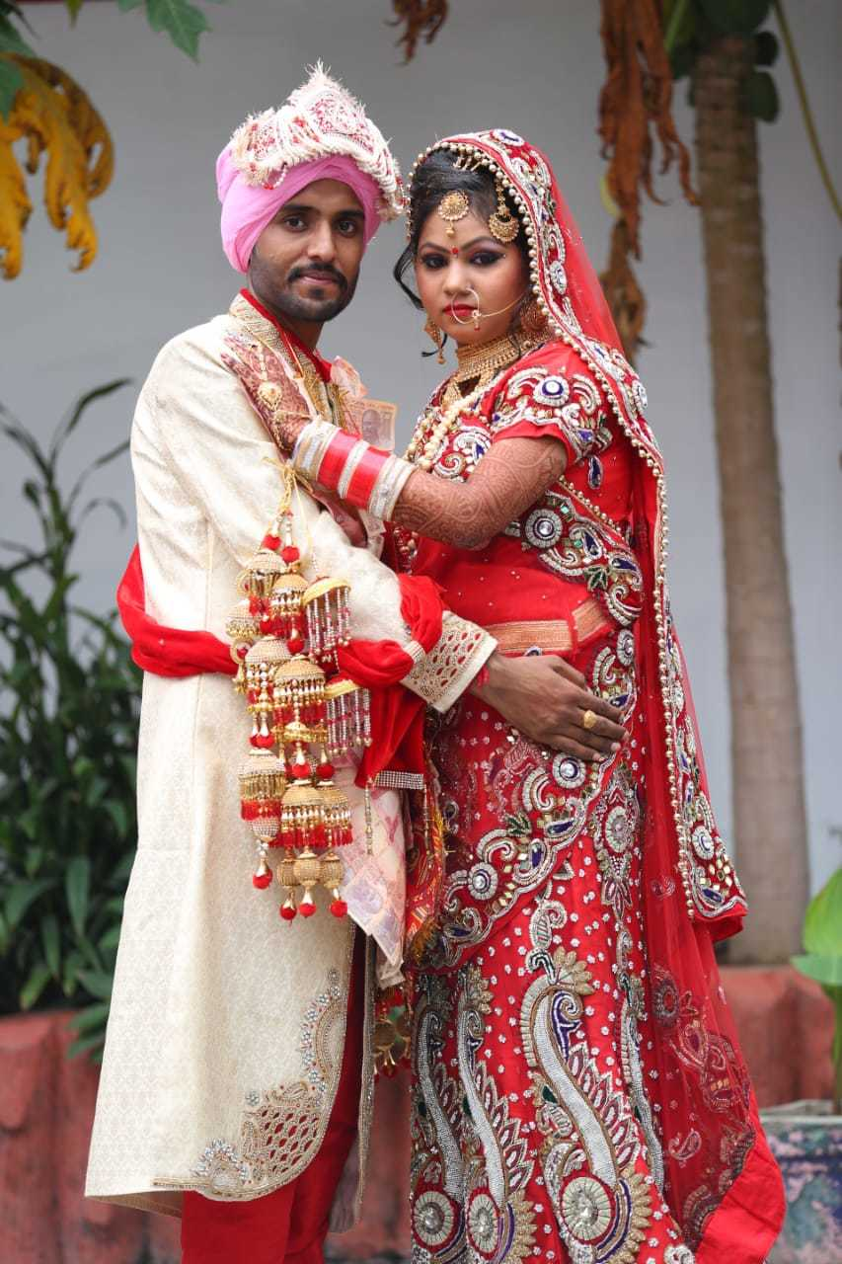
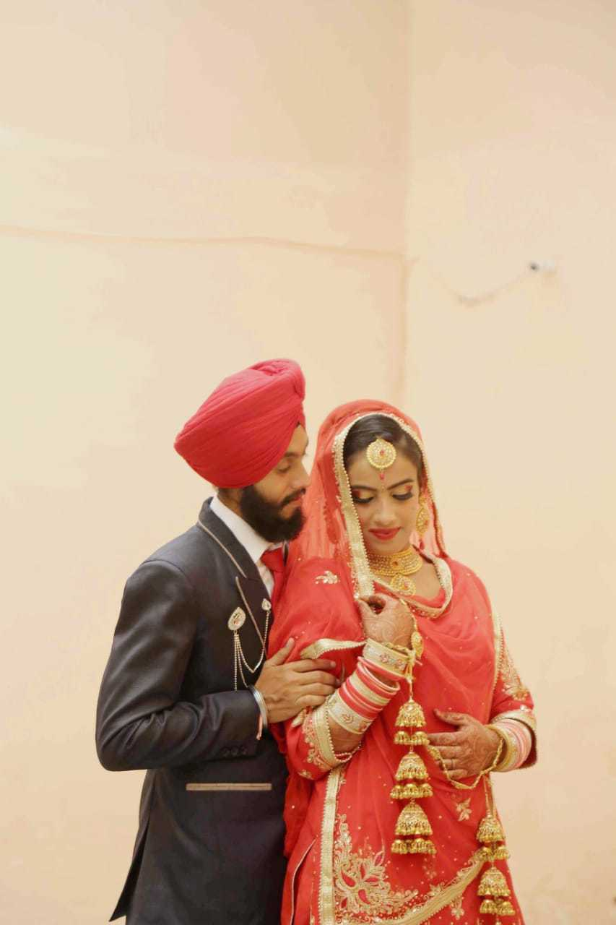
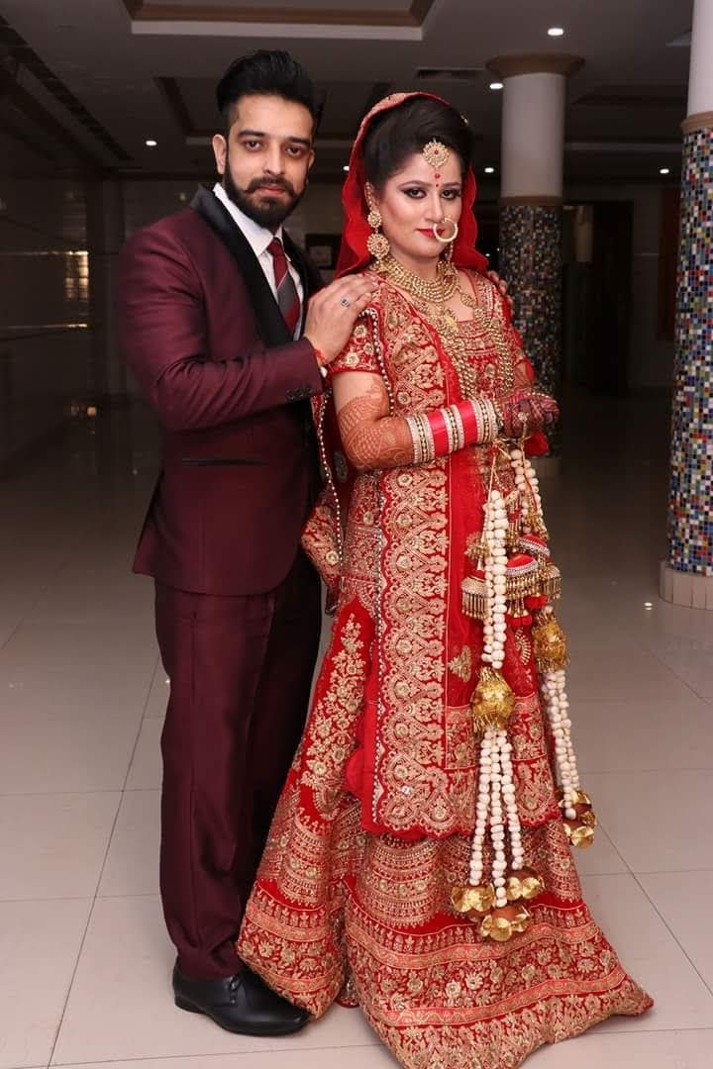
Some of our Happy Married Couples
Browse NRI MARRIAGE BUREAU to read more Happy Matrimony stories

Slide 11


