Slide 1

Telling the Time
Dire l’heure

Slide 2
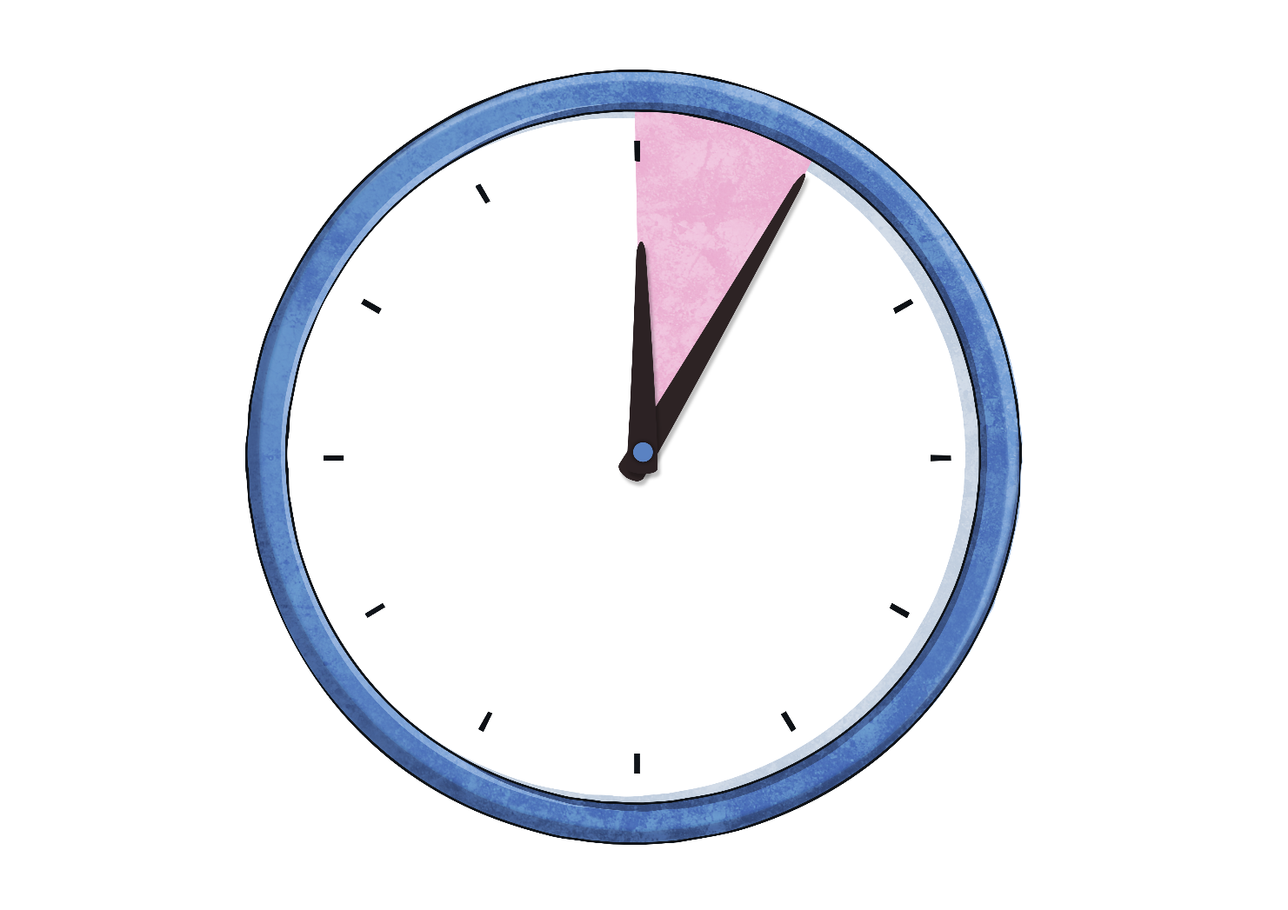
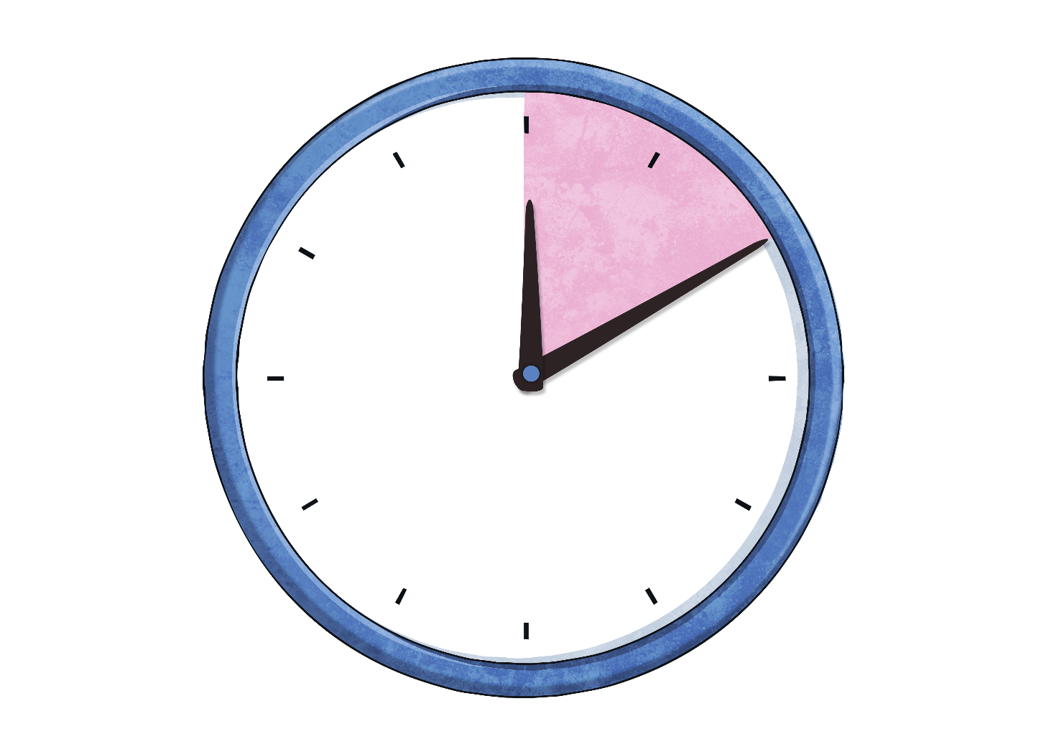
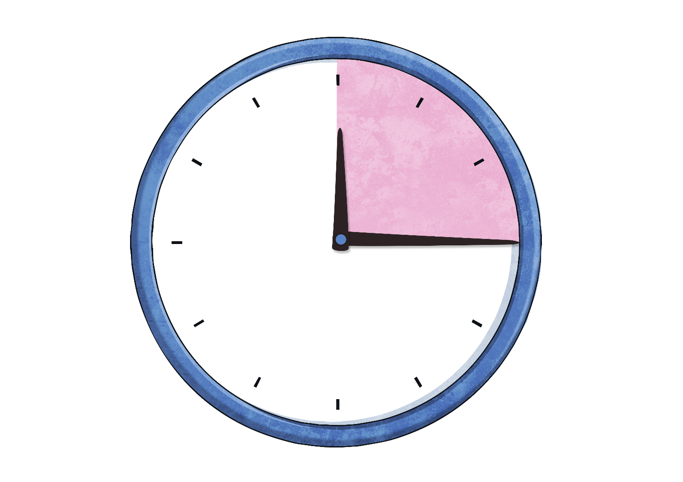
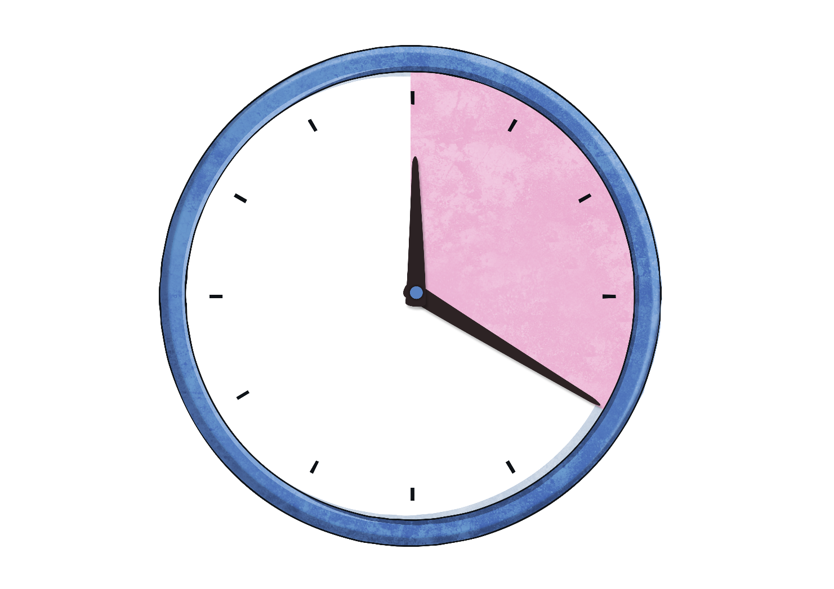
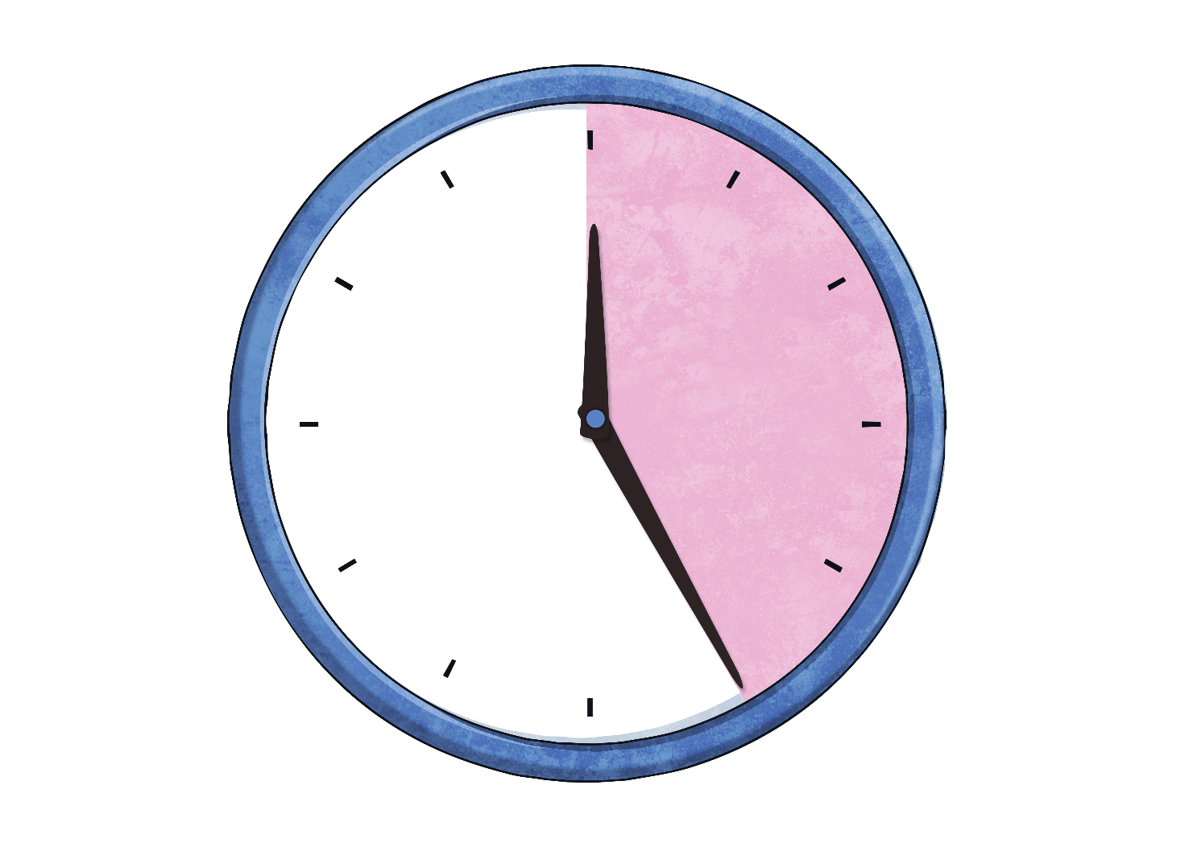
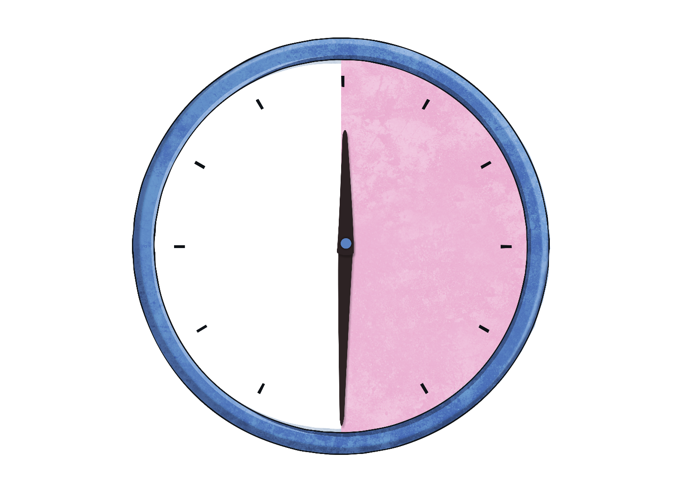
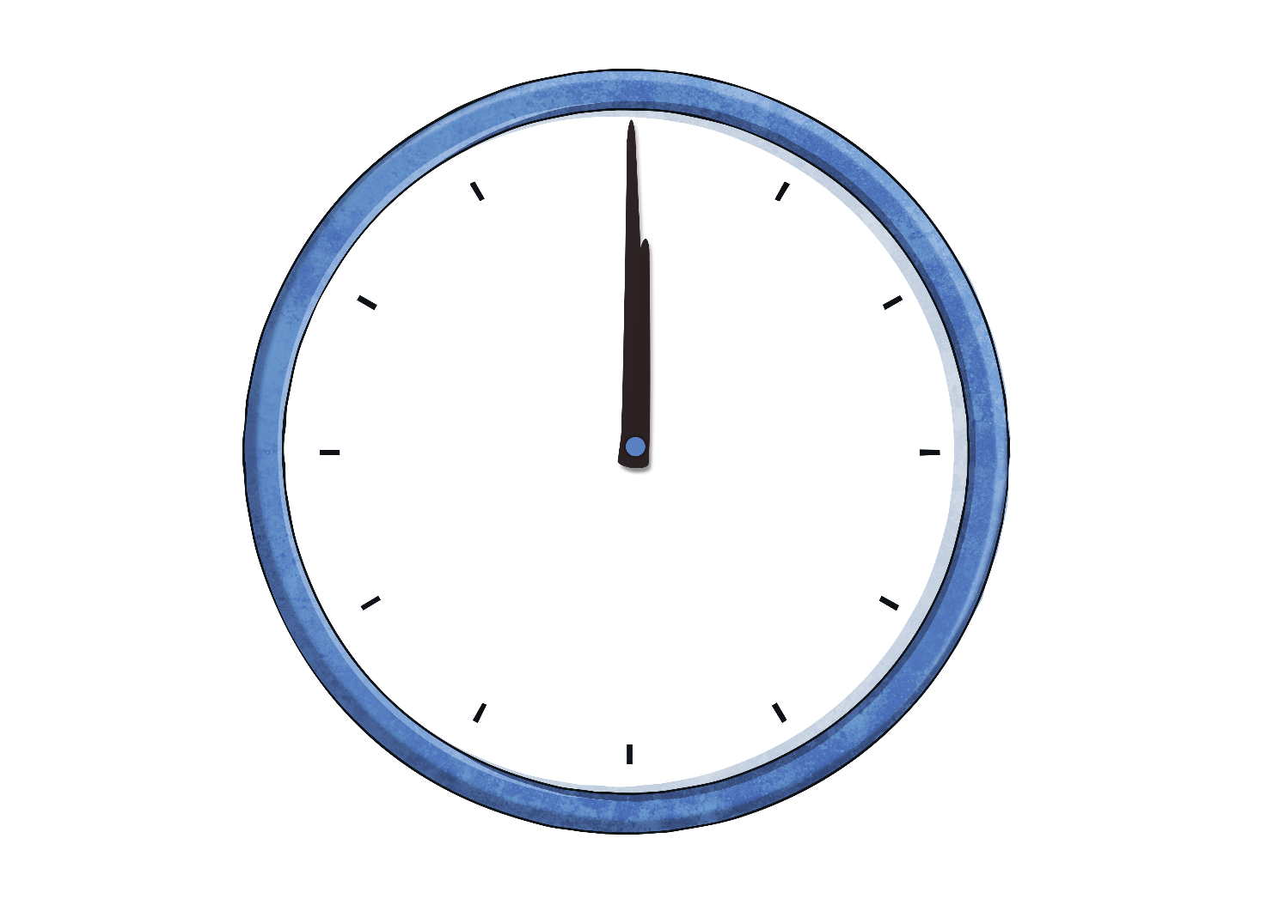
Telling the Time
The big hand (la grande aiguille) counts the minutes and is called the minute hand.
Look at the minutes past the hour.
En anglais, on “coupe” l’horloge en deux. Il y a les minutes après l’heure et les minutes avant l’heure suivante.
20
25
30
5
10
15
minutes
past
minutes
past
minutes
past
minutes
past
minutes
past
minutes
past
o’clock
Commençons par les minutes après l’heure (ici en rose).

Slide 3

When the big hand points to one, it means… Quand la grande aiguille pointe le ‘un’, cela signifie…
5
minutes
past
Click to reveal answer

Slide 4

When the big hand points to two, it means… Quand la grande aiguille pointe le ‘deux’, cela signifie…
10
minutes
past
Click to reveal answer

Slide 5

When the big hand points to three, it means…
15
minutes
past
Click to reveal answer

Slide 6

When the big hand points to four, it means…
20
minutes
past
Click to reveal answer

Slide 7

When the big hand points to five, it means…
25
minutes
past
Click to reveal answer

Slide 8
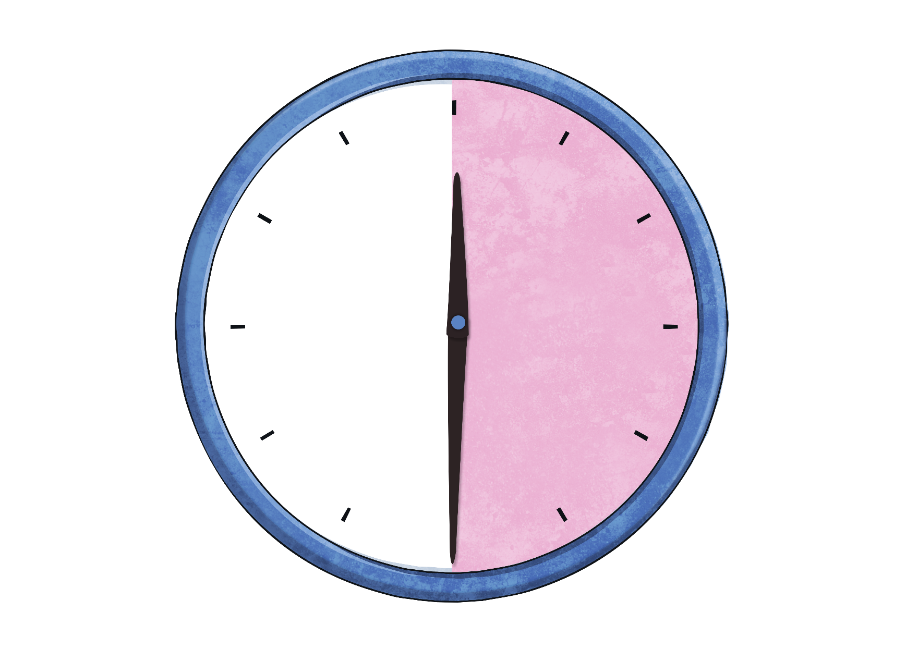
When the big hand points to six, it means…
30
minutes
past
Click to reveal answer

Slide 9
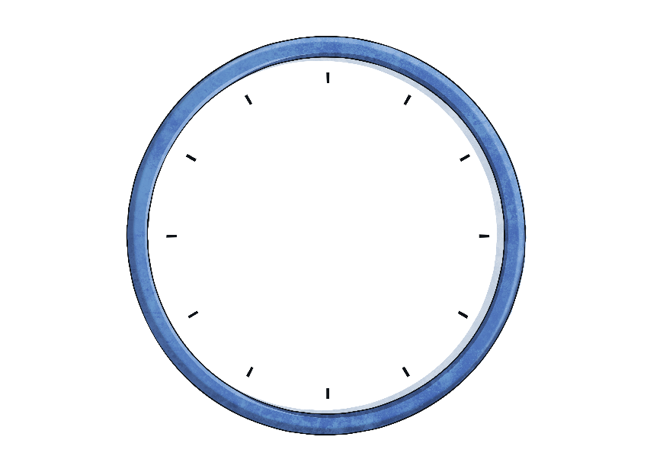


Telling the Time
How many minutes are in an hour?
How do we say 15 minutes?
How do we say 30 minutes?
60
minutes
15
minutes
30
minutes
= an hour
= a quarter
= a half

Slide 10
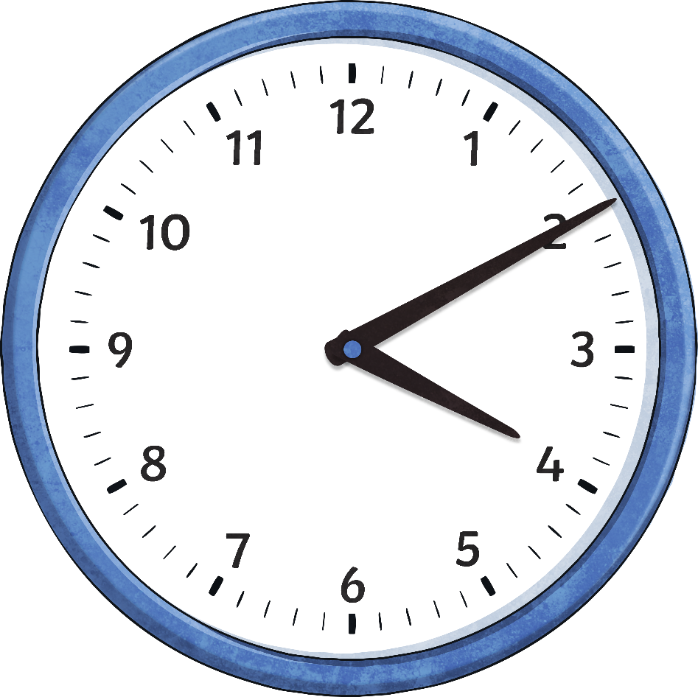
What time is it?
It is ten past four
(or 4:10)

Slide 11
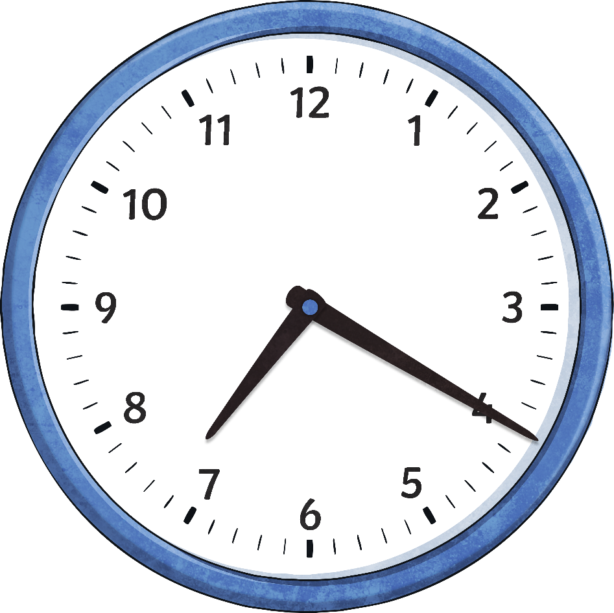
What time is it?
It is twenty past seven
(or 7:20)

Slide 12
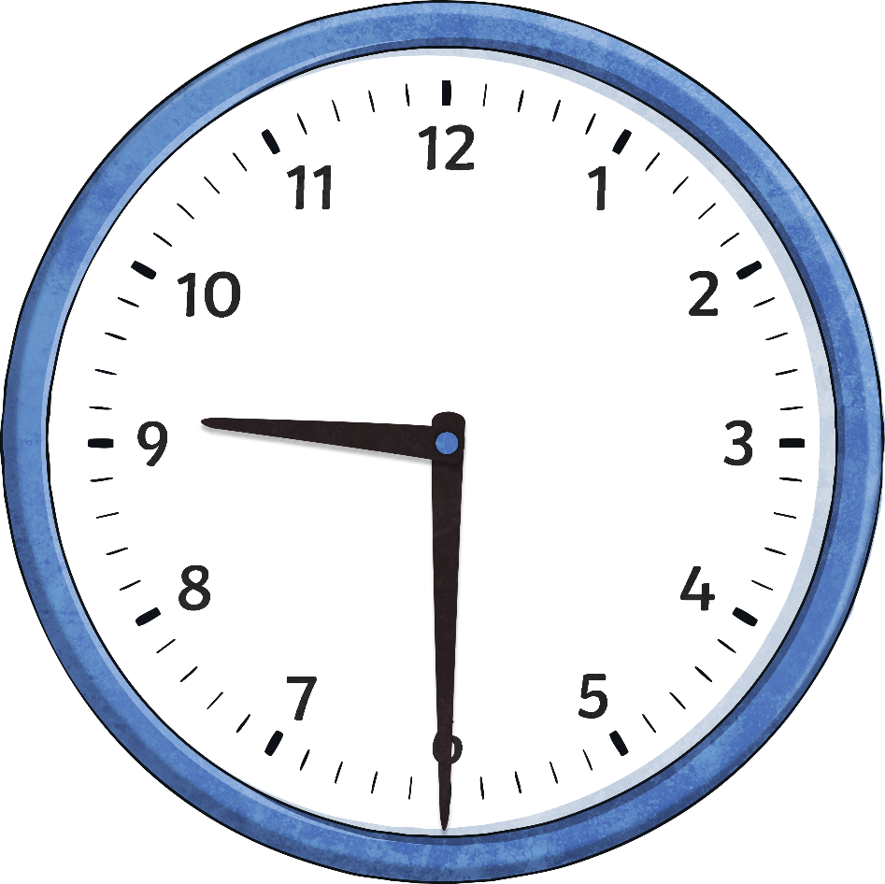
What time is it?
It is half past nine
(or 9:30)

Slide 13
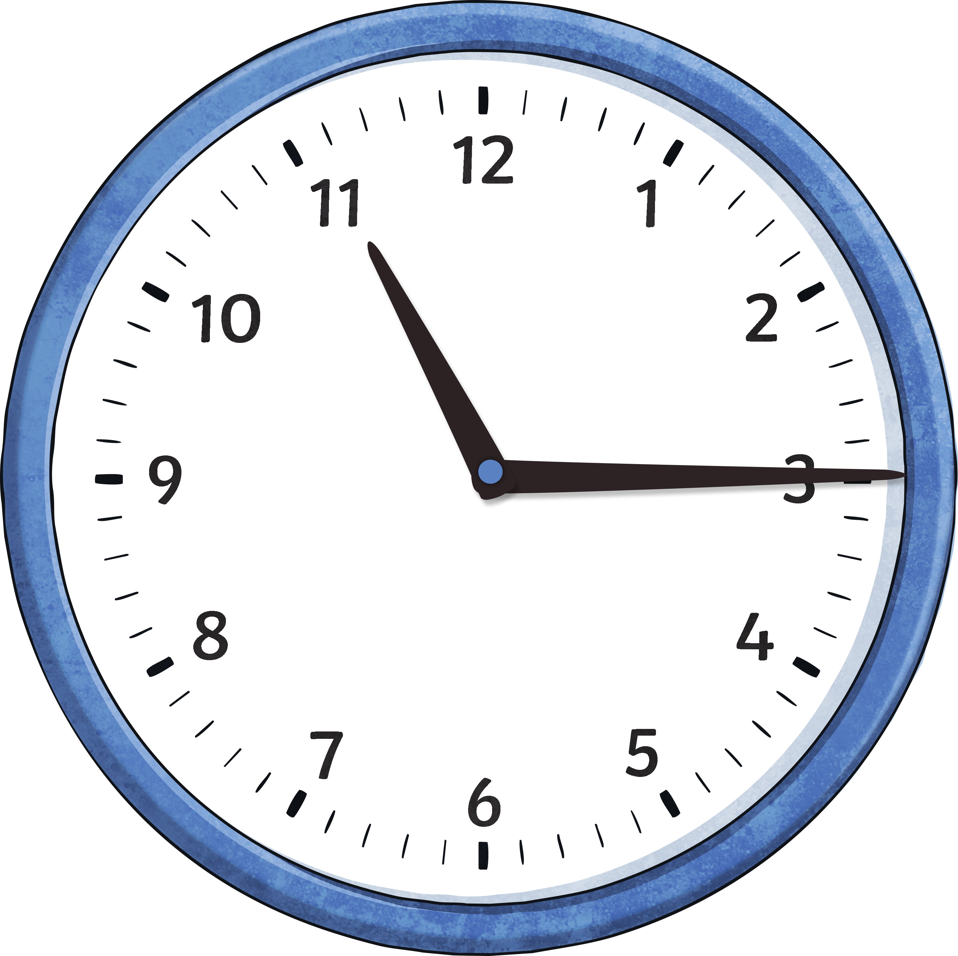
What time is it?
It is a quarter past eleven
(or 11:15)

Slide 14
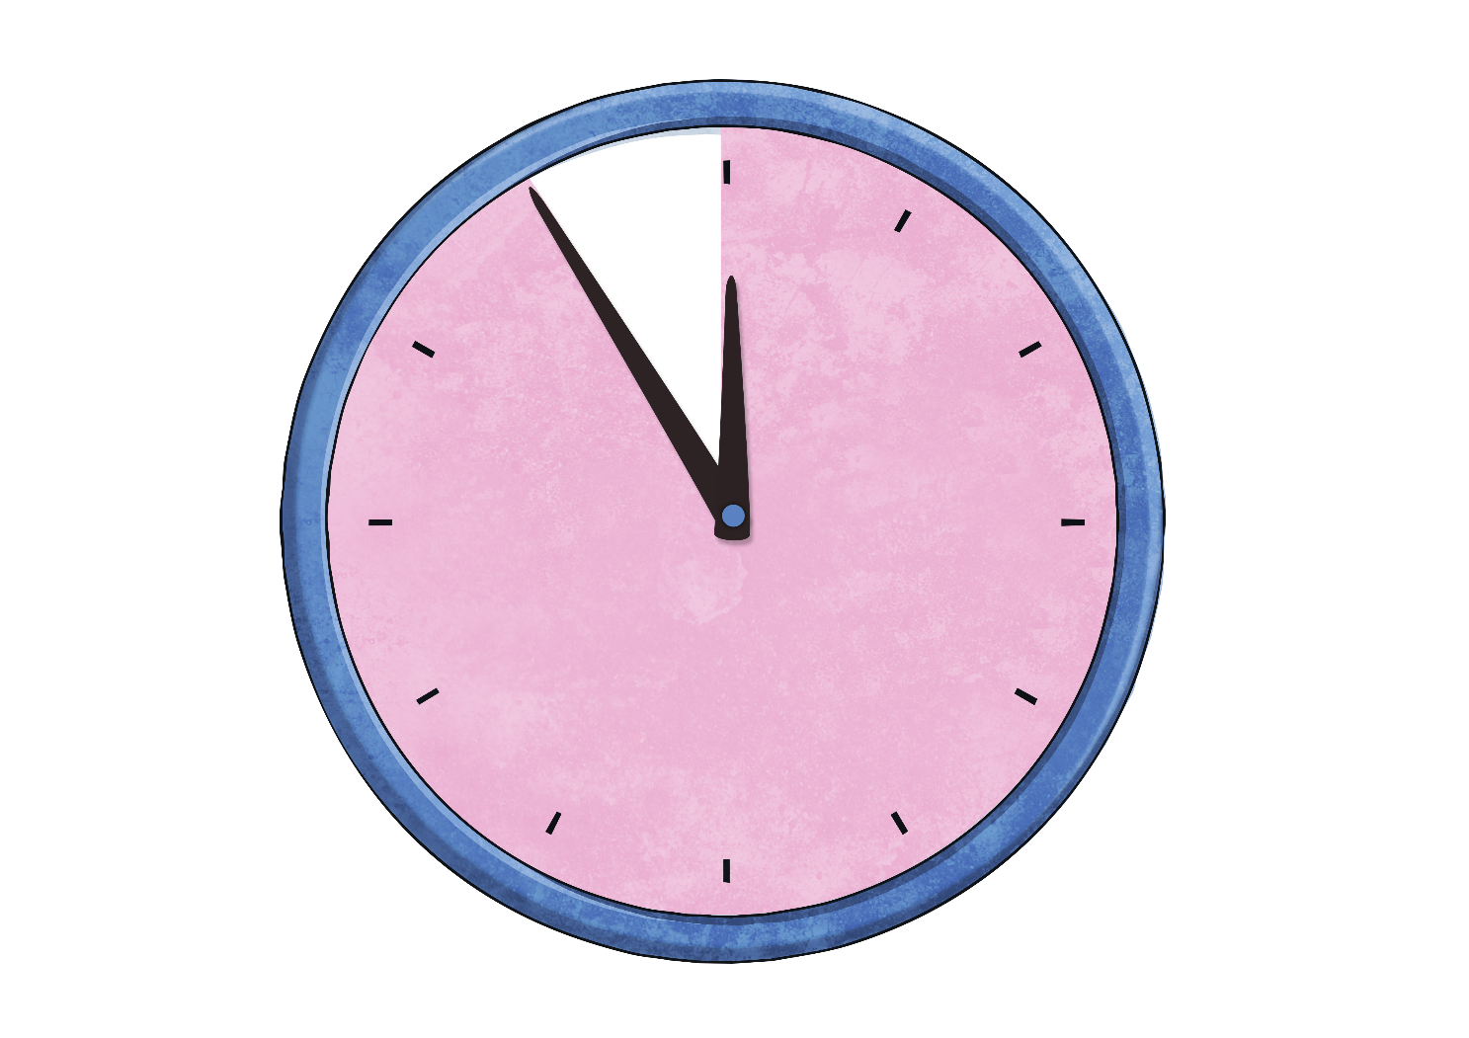
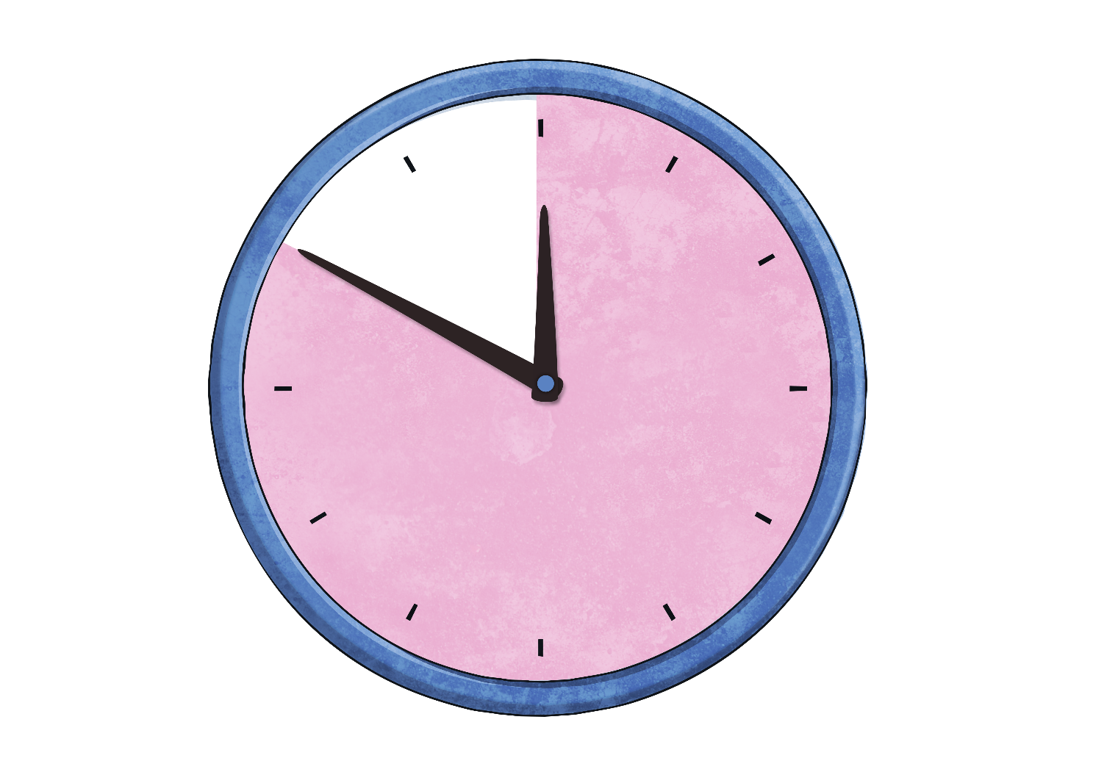
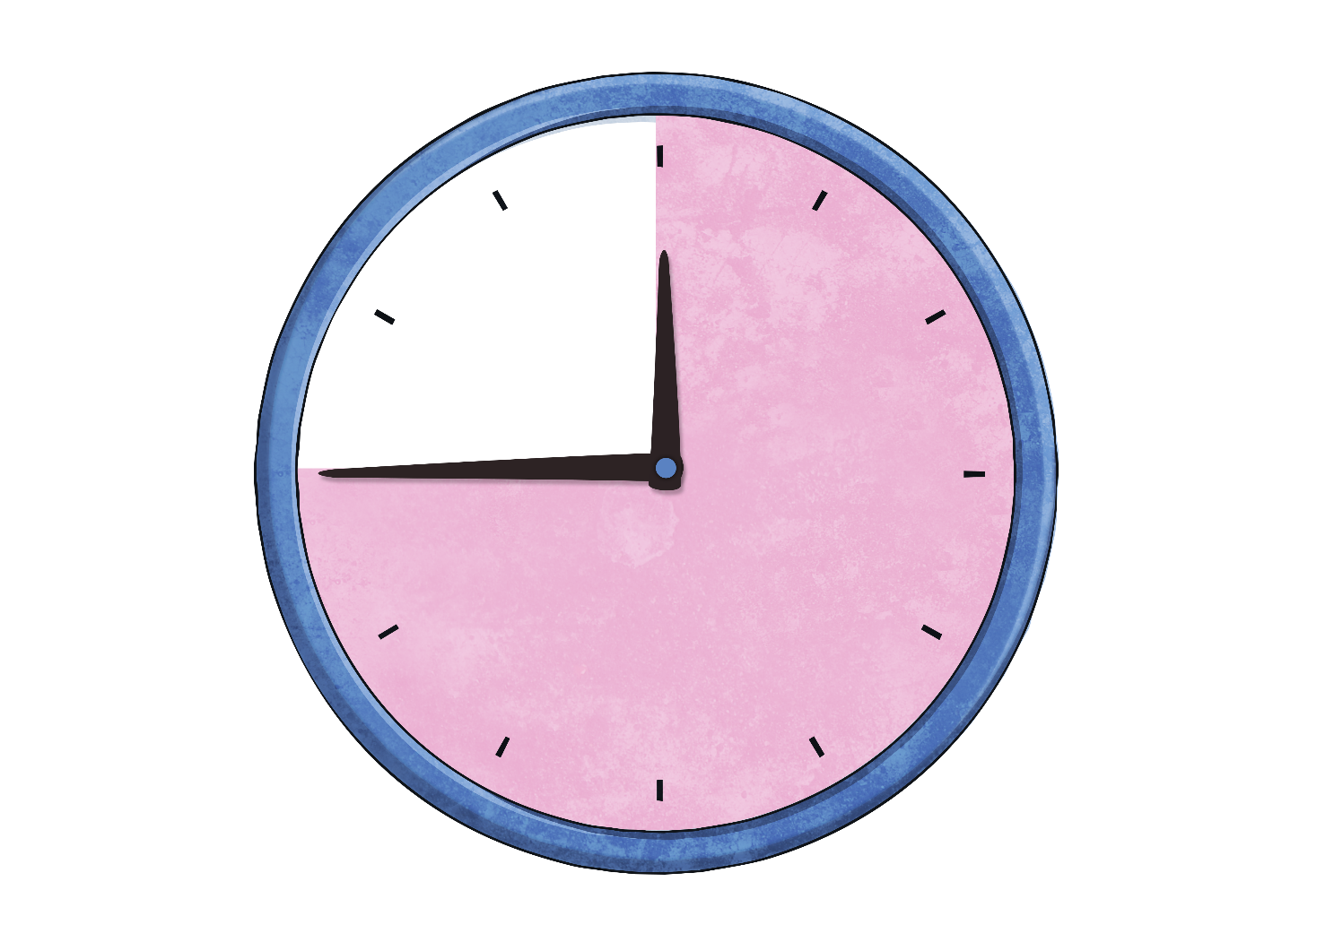
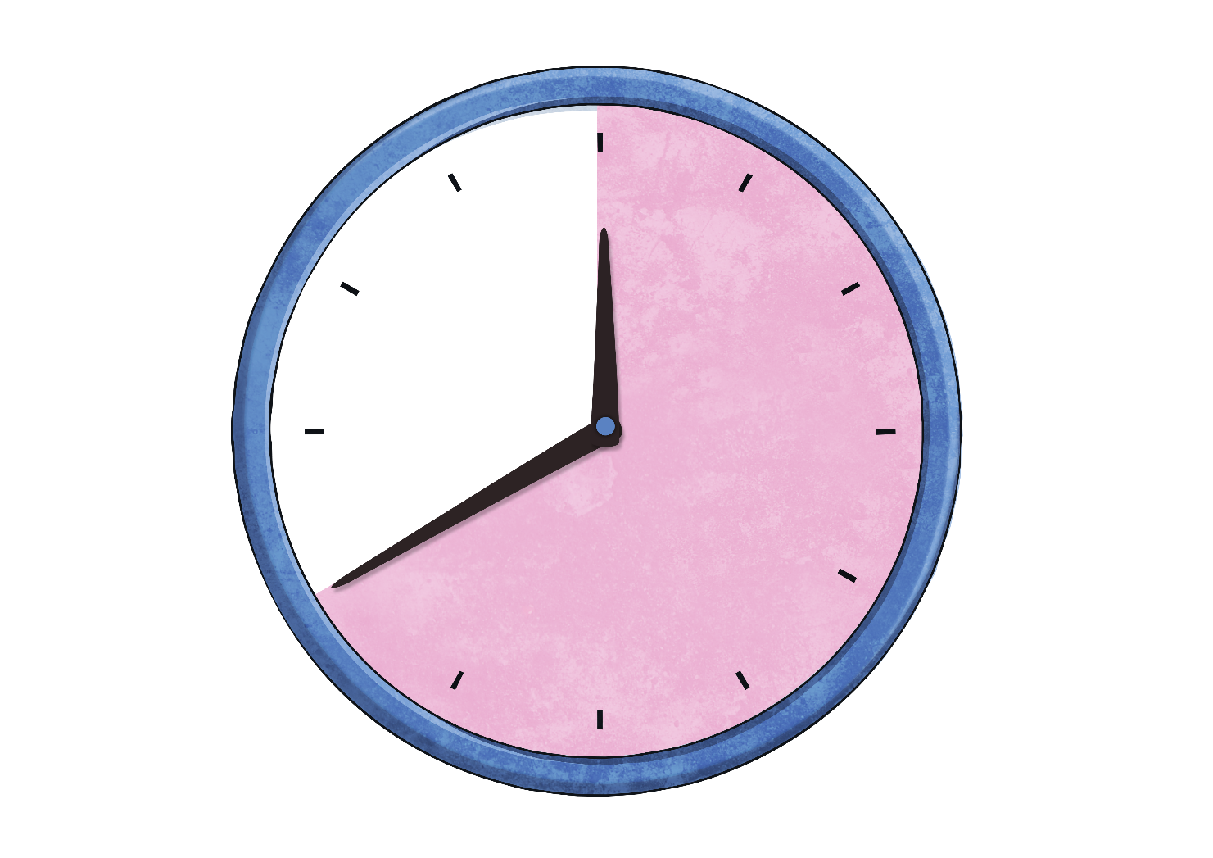
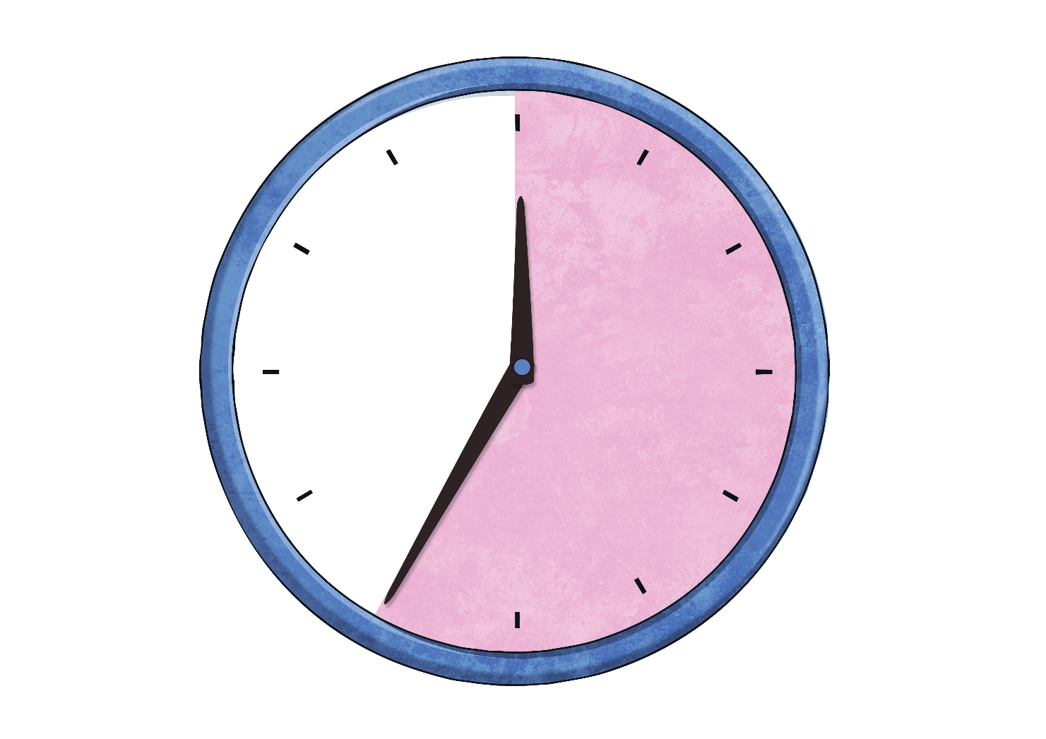
Telling the Time
Maintenant regardons les minutes avant l’heure suivante. We are going to look at the minutes to the next hour.
5
10
15
20
25
minutes
to
minutes
to
minutes
to
minutes
to
minutes
to
o’clock

Slide 15

When the big hand points to seven, it means…
25
minutes
to
Click to reveal answer

Slide 16

When the big hand points to eight, it means…
20
minutes
to
Click to reveal answer

Slide 17

When the big hand points to nine, it means…
15
minutes
to
Click to reveal answer

Slide 18

When the big hand points to ten, it means…
10
minutes
to
Click to reveal answer

Slide 19

When the big hand points to eleven, it means…
5
minutes
to
Click to reveal answer

Slide 20
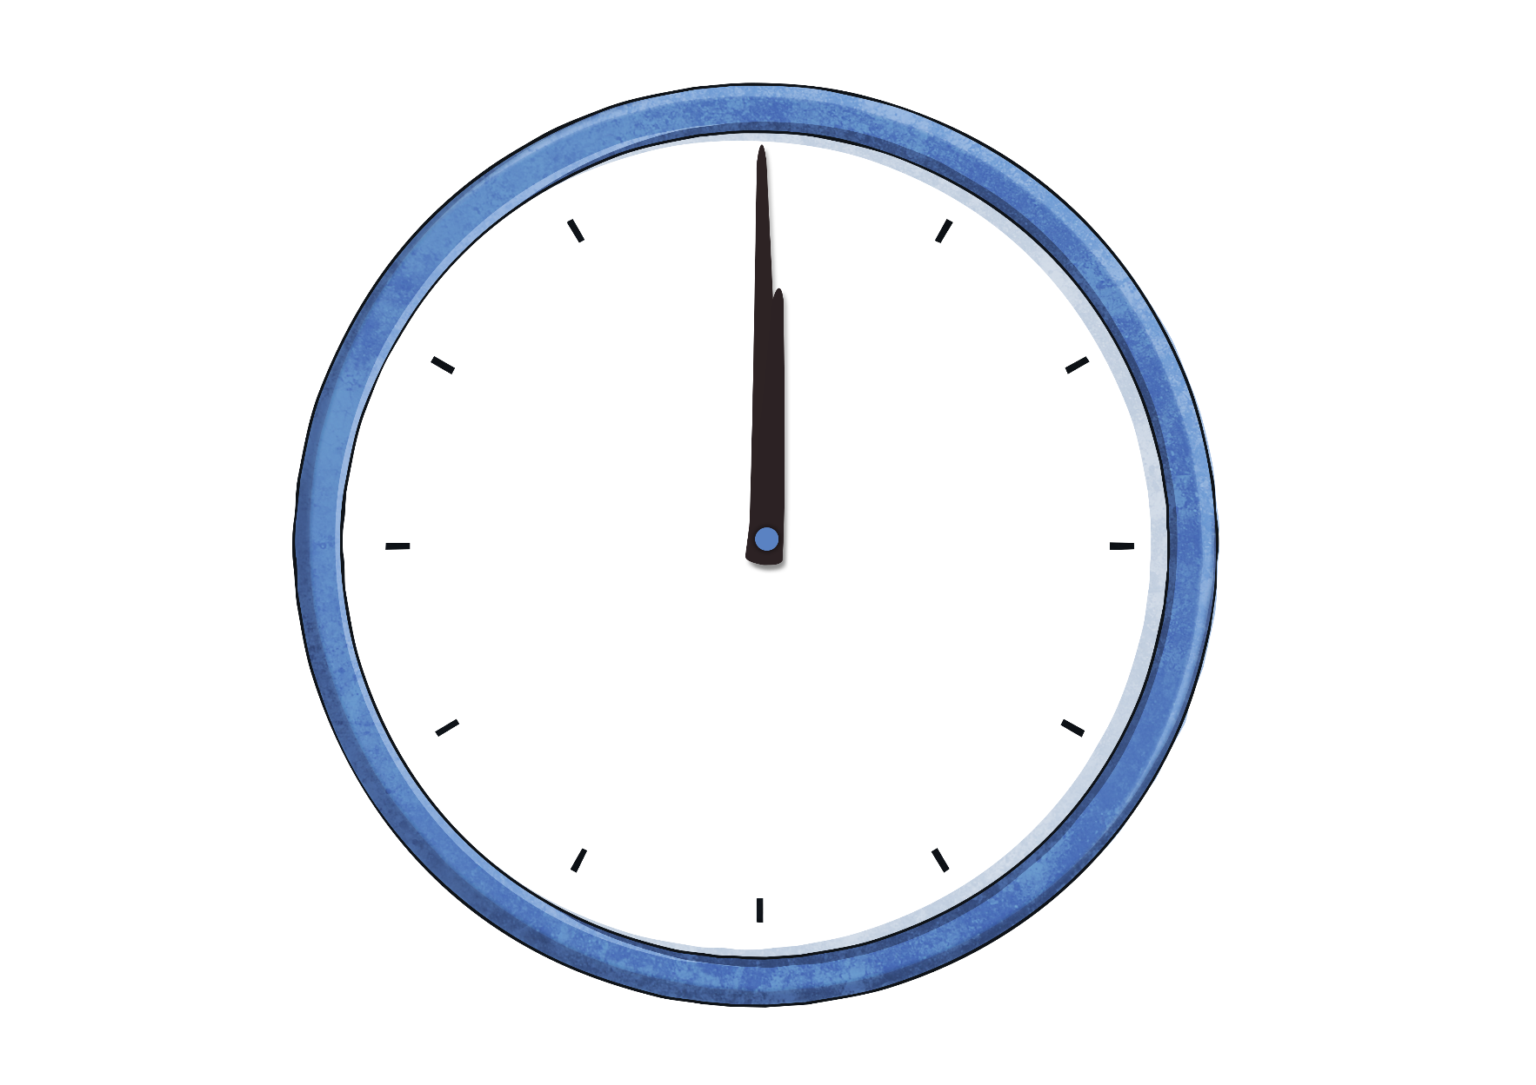
When the big hand points to twelve, it means…
o’clock
Click to reveal answer

Slide 21
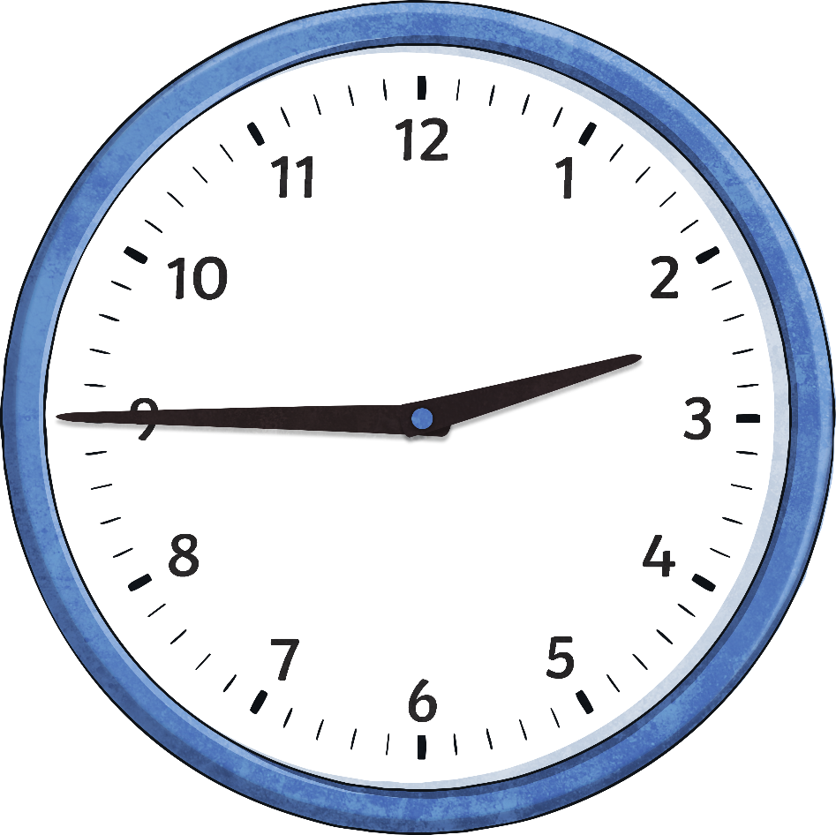
What time is it?
It is a quarter to three
(or 2:45)

Slide 22
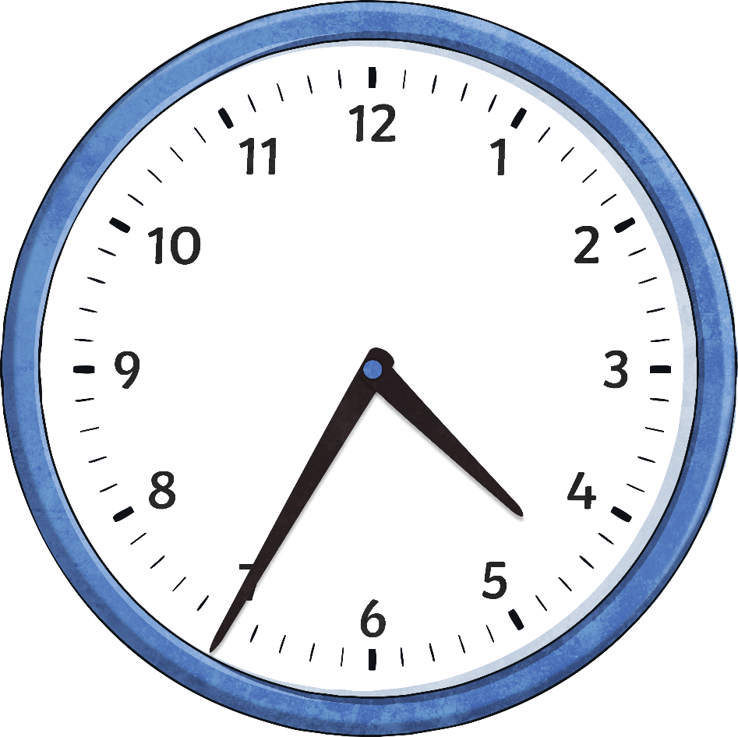
What time is it?
It is 25 minutes to five
(or 4:35)

Slide 23
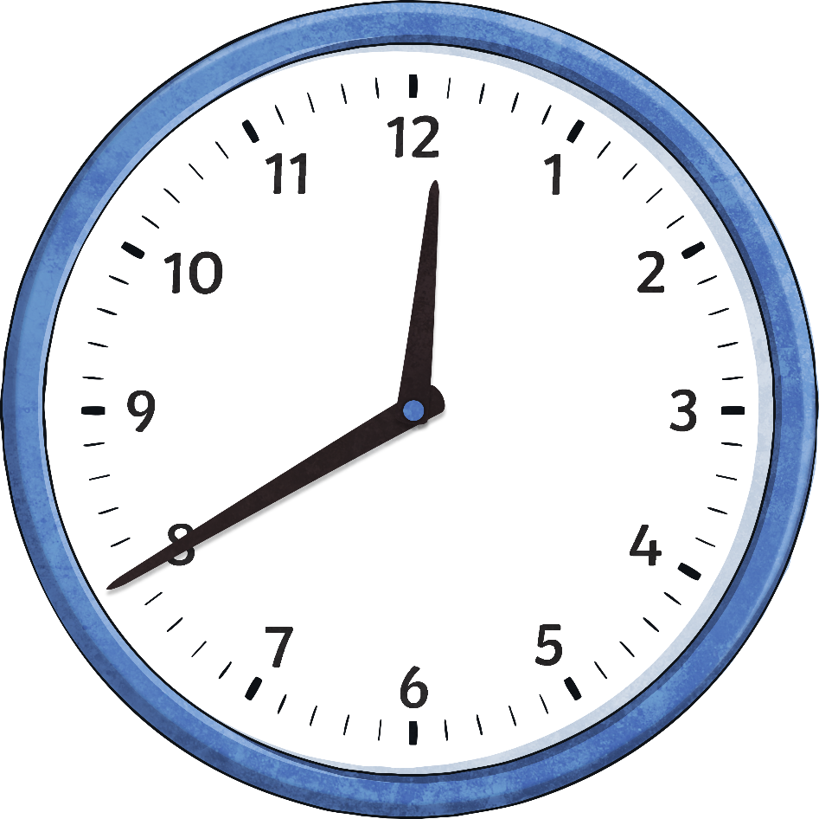
What time is it?
It is 20 minutes to one
(or 12:40)

Slide 24
Pour résumer…
En anglais, on “coupe” l’horloge en deux. Il y a les minutes après l’heure et les minutes avant l’heure suivante.
To…
Past…
De ce côté, on compte les minutes avant l’heure suivante.
De ce côté, on compte les minutes après l’heure.

