Slide 1

Have Shiny Teeth with Laser Teeth Whitening

Slide 2
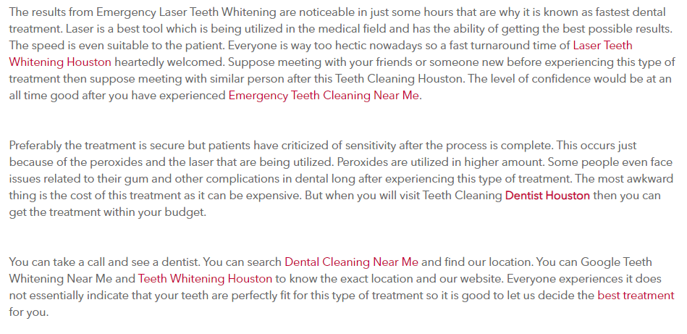

Slide 3
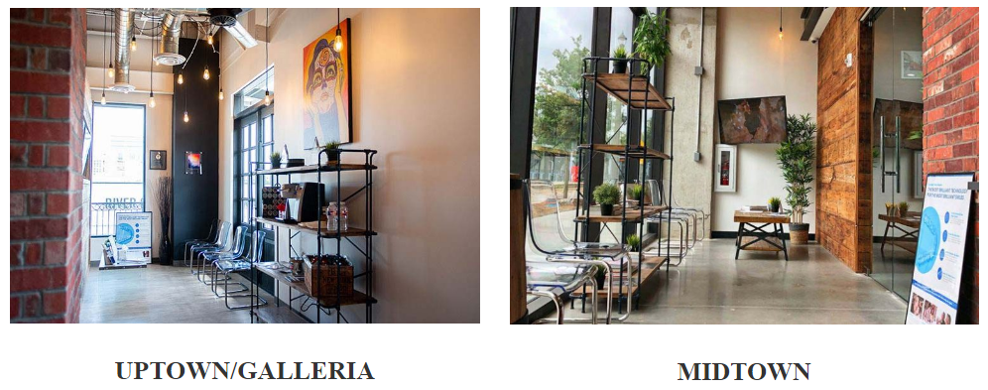
Get out of pain today. Our Emergency Dental Care centers are located in two locations, one in Uptown/Galleria and one in Midtown area of Houston. Our doctors have gone through advanced training at Level 1 Trauma Emergency Hospitals and are on standby to get you the pain relief that you deserve.

Slide 4
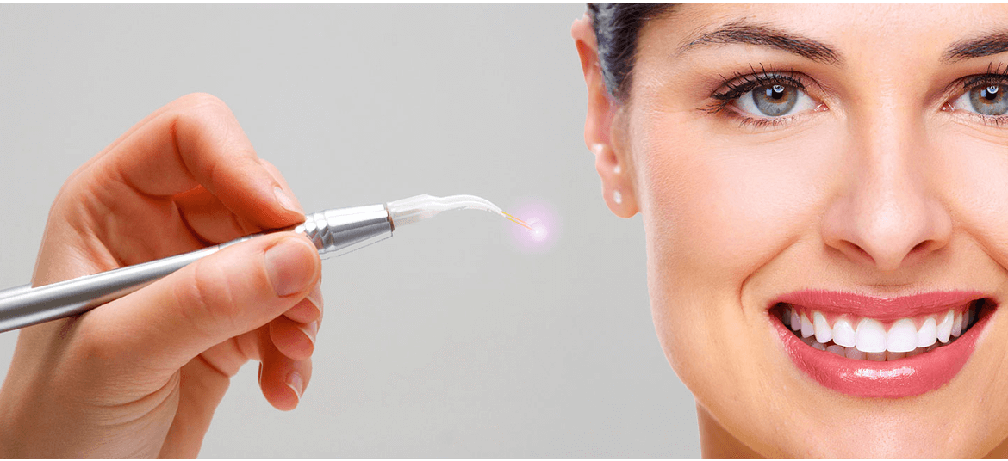
Get Emergency Laser Teeth Whitening done by an expert dentist at Emergency Dentist Houston at affordable price. Visit our clinic near you for Laser Dental Cleaning in Houston. Book an appointment today!

Slide 5
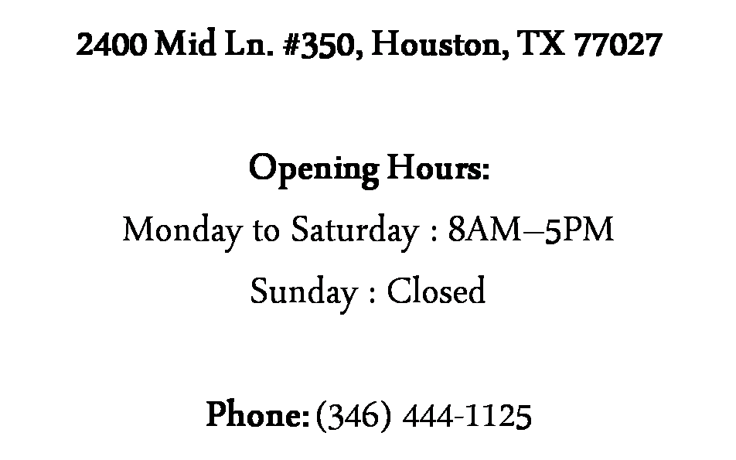
Contact Us
https://emergencydentistinhouston.com/laser-teeth-whitening-cleaning-houston/

