Slide 1





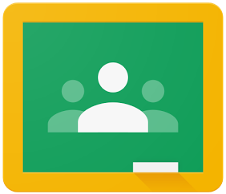

Using practice sets
Google for Education

Slide 2


Table of contents
01
Overview of practice sets
Learn about practice sets and how they elevate Google Classroom capabilities.
05
The student experience
Empower every student to learn in their own unique way.
02
Creating a practice set
Design a practice set from your own lessons or start from scratch.
06
Reviewing student work
Evaluate student comprehension with holistic insights.
03
Send & receive a practice set
Share practice sets with verified teachers within your Google Workspace.
07
Providing feedback
Share your thoughts directly with us – your feedback is important.
04
Assigning a practice set
Deliver a practice set to your whole class, small group, or individual students.
Note: Practice sets are still in the development phase and may experience bugs.

Slide 3
Overview of practice sets

Slide 4

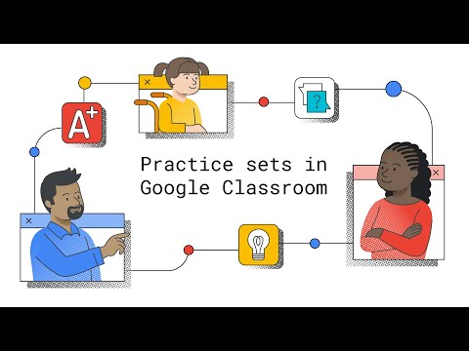
Introducing practice sets
Transform any teaching content into engaging, interactive assignments that give educators better insights and inspire students as they work.
Now in beta
Watch video
Notes:
Classroom PS: One central place for teaching and learning, Google Classroom is an easy-to-use and secure tool that helps educators manage, measure, and enrich learning experiences.

Slide 5
A flexible way to meet the needs of different classrooms
Create for any content area
Create lesson plans for science, math, history, English language arts, music, and more.
Elevate learning for any grade level
Offer relevant support to primary and secondary students.
Practice sets are designed to be used in different learning environments and instructional strategies so students can feel more inspired across the learning continuum.
Leverage the power of Google technology and resources to support your instructional strategies.
With practice sets, you can:
Choose how to differentiate instruction
Assign practice sets to your whole class, small group, or individual students.
Create a flexible strategy
Use practice sets for general lessons, knowledge checks, homework, remediation, and more.
Use practice sets for blended learning
Distribute practice sets for station-rotation, individual rotation “playlists,” and flipped classroom.

Slide 6
How it works
Teachers create a practice set
Teachers sign in to Classroom and create practice sets using their own content, or start from scratch.
Assign the practice set to students
Educators assign practice sets to the whole class, small groups, or individual students to complete. Assignment due dates automatically appear on student calendars and to-do lists when a practice set is assigned.
Students complete the practice set
Students can leverage hints and resources, use the notepad feature to show their work, and self-check their work throughout.
Educators review student work
Educators review holistic and problem-by-problem insights, or individual student work within Classroom.

Slide 7




Practice sets
Getting started
Follow these simple steps to learn how you and your students can easily use practice sets to enrich learning and drive instructional impact.

Slide 8
First, decide how you want to get started with a practice set assignment.
Create a practice set from scratch. Start with these instructions.
Upload a PDF to create a practice set.
Start with these instructions.
OR

Slide 9
Creating a practice set

Slide 10
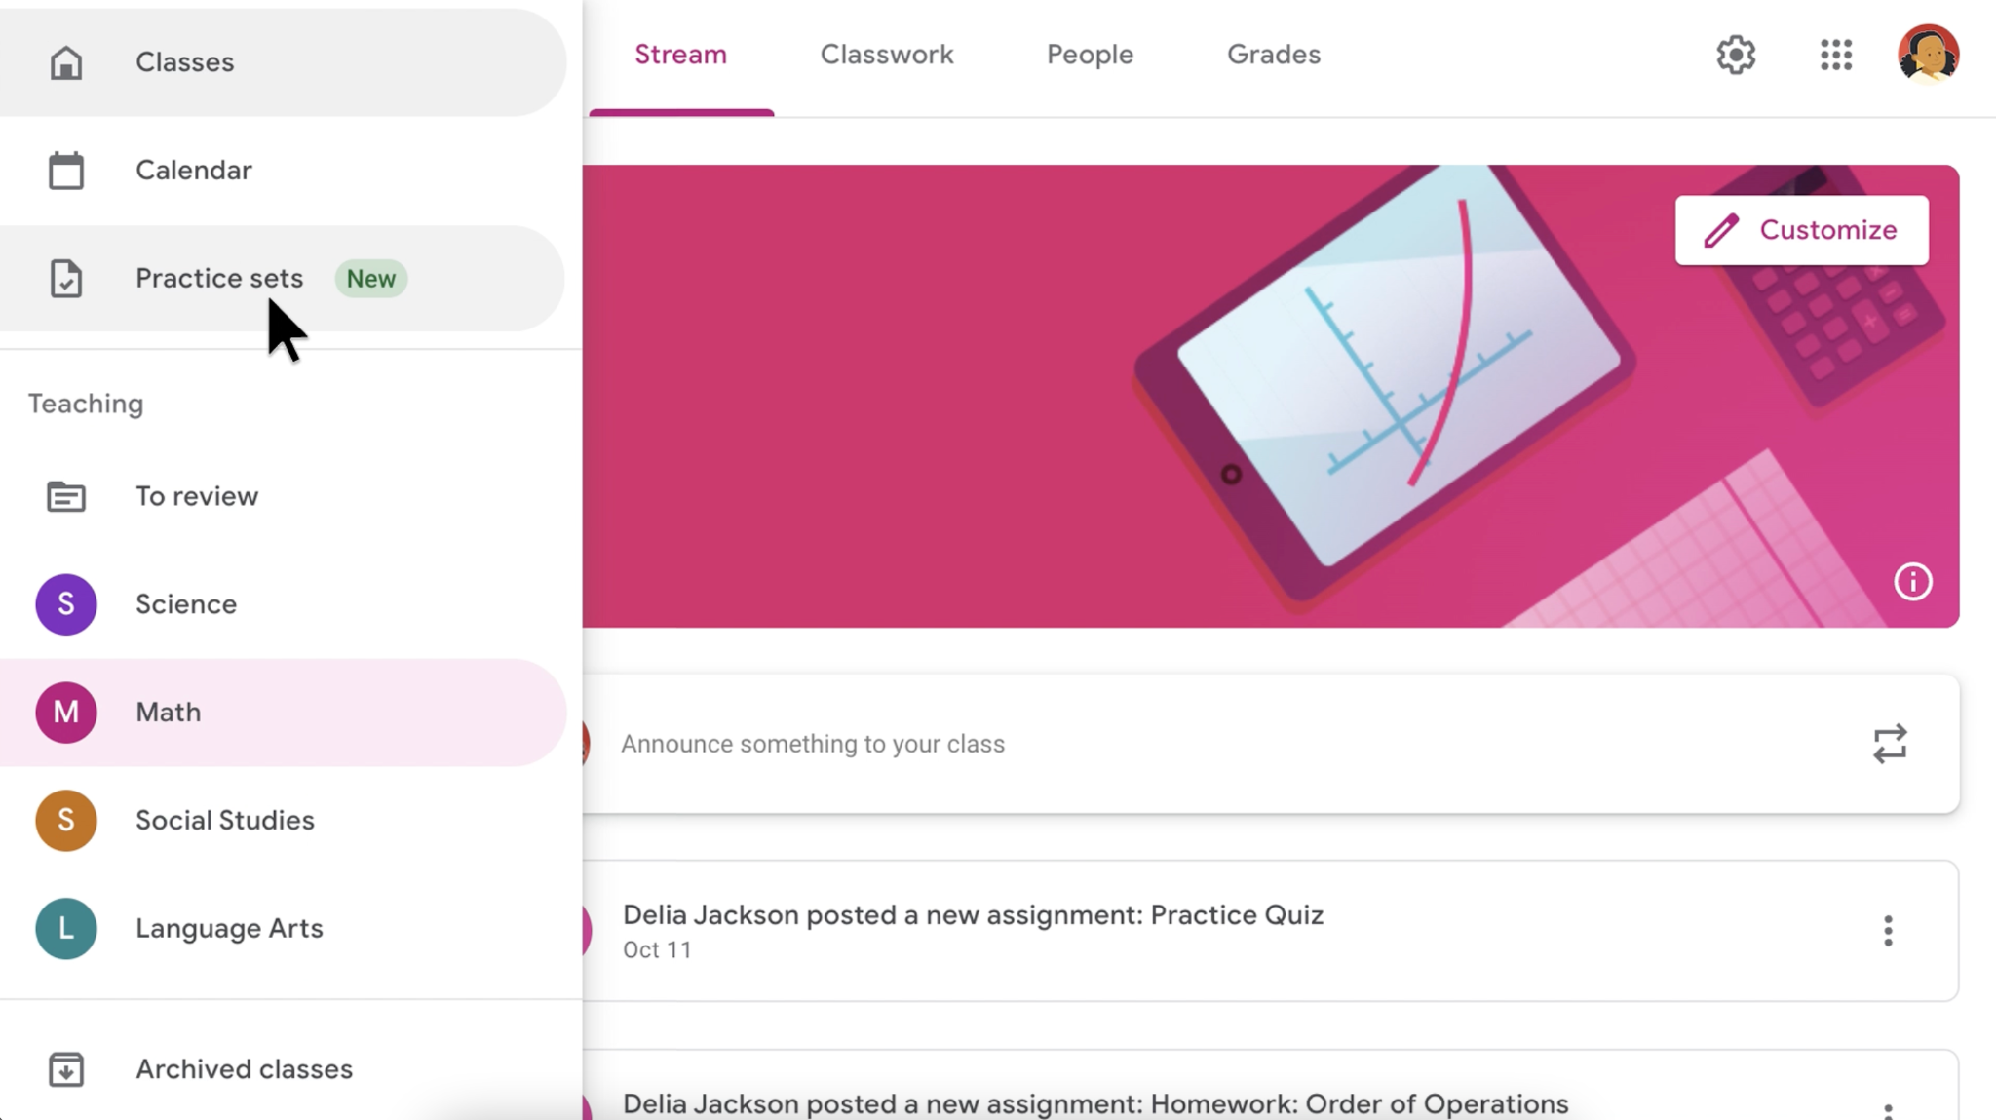
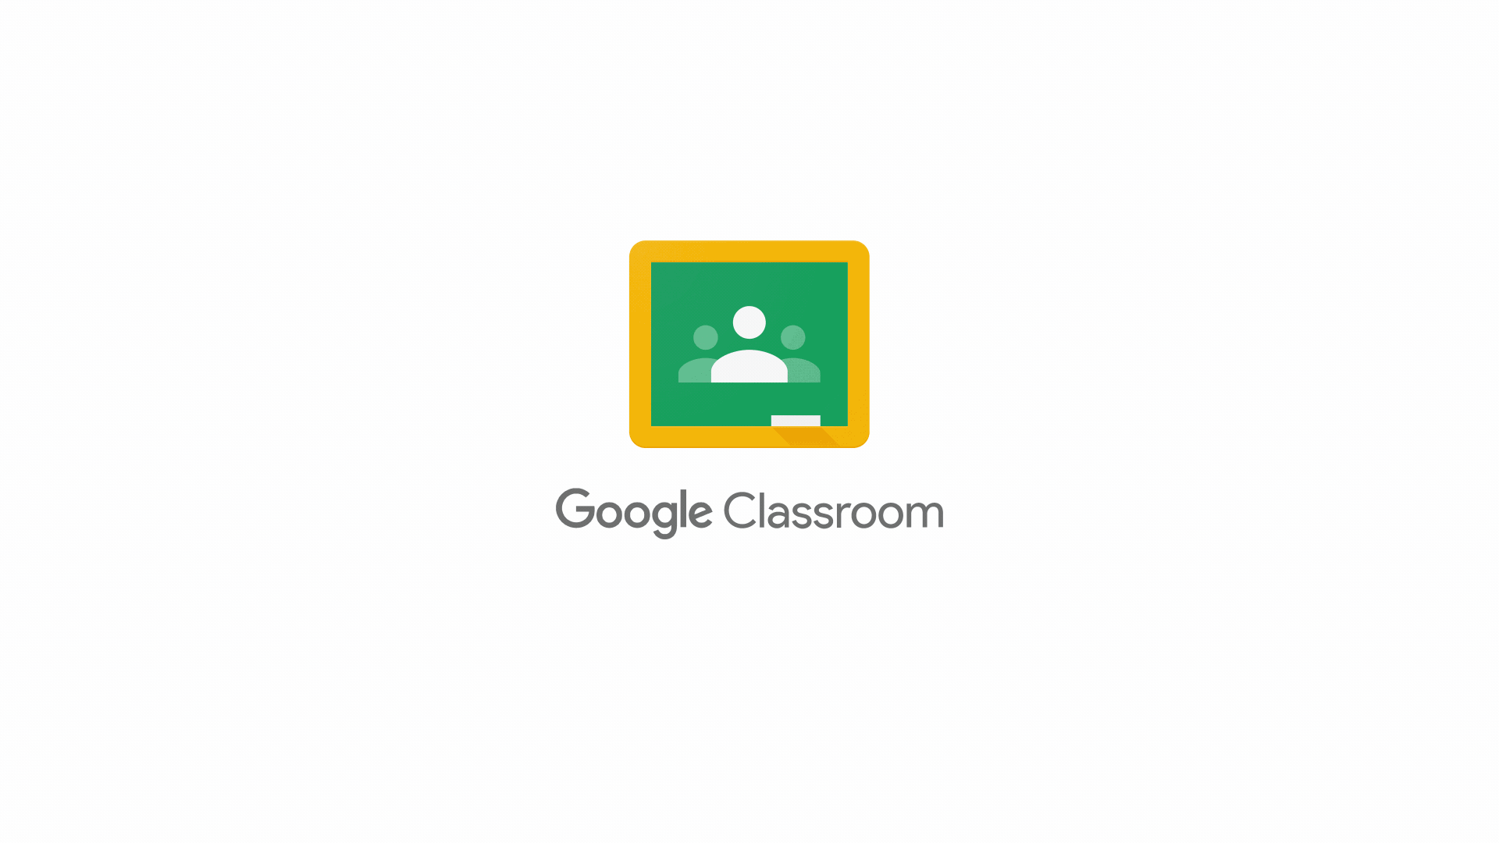


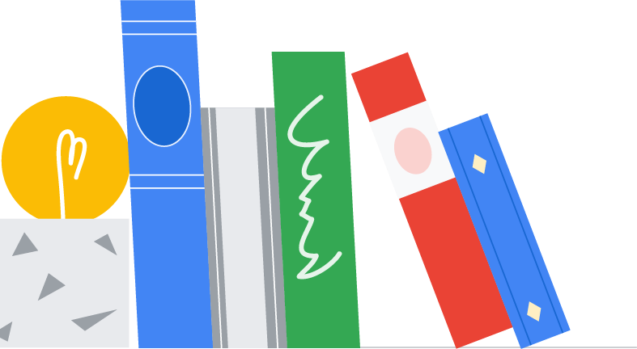
Using practice sets in Classroom
1
Sign in to Google Classroom
Open the hamburger menu in the upper left-hand corner
Click on Practice sets in the main menu
Within My practice sets, click on Create
2
3
4

Slide 11
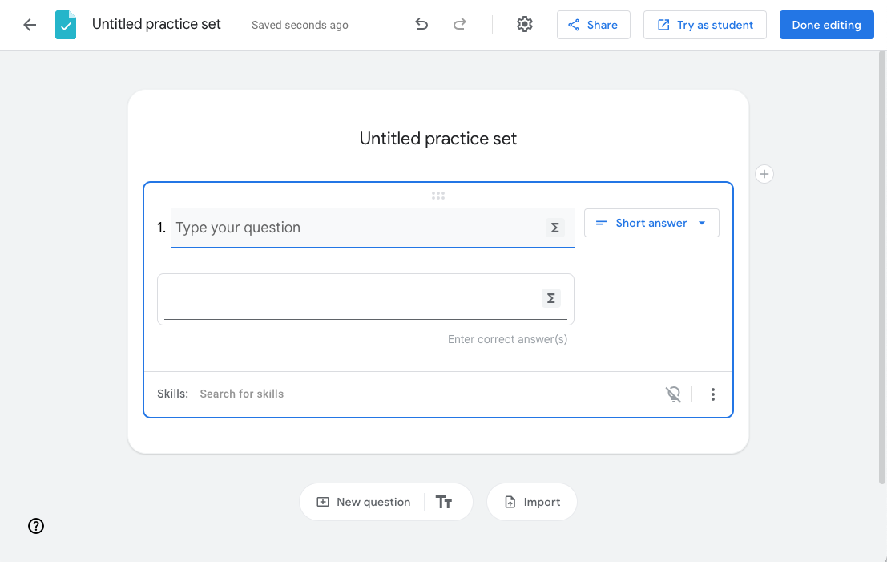
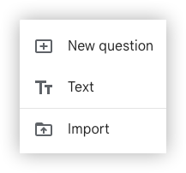
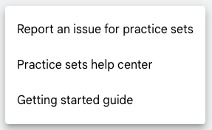
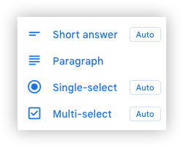
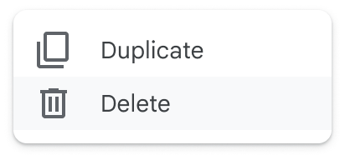
Explore the editor settings and options
Try the practice set in student mode, with autograding and hints
Add new block:
Import an existing PDF of lesson questions
Select answer type:
Auto
Autograded answer types
Link for help center
Add skills to activate hints and resources for students

Slide 12
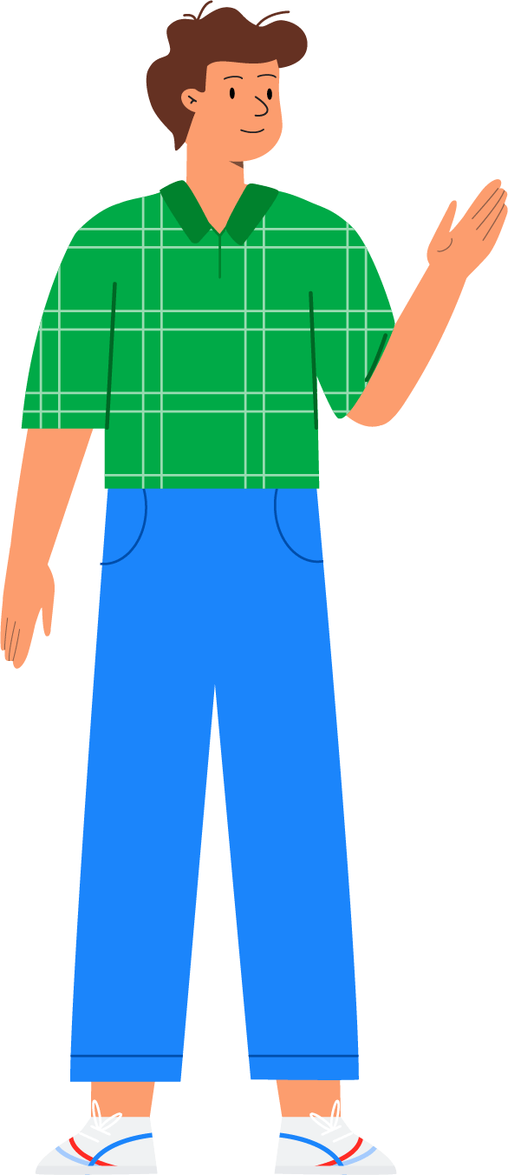
Create a practice set from scratch
1
Create a new practice set and add a title
Select an answer type from the drop-down menu
Type in a question
Add in correct answer(s)
Select the (+) sign to add in additional text above the selected question or add a new question
Repeat these steps for two or more questions
Select Done editing
2
3
4
5
6
7

Slide 13
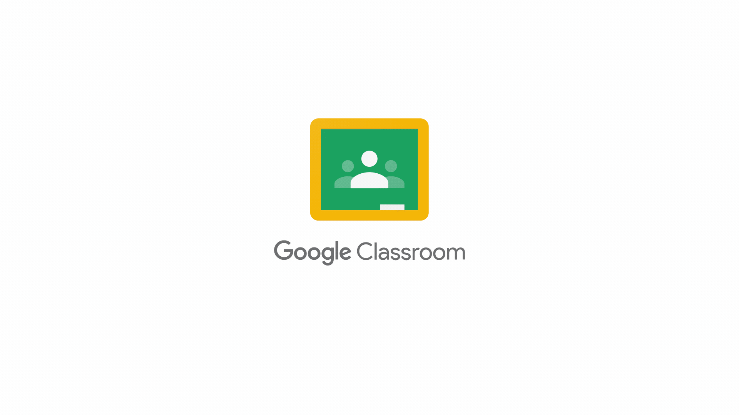
Create a practice set from an existing PDF
1
Create a new practice set and add a title
Click Import below the first question editor or by clicking on the (+) sign and then selecting Import
Select a PDF from your Google Drive and select Import or upload a new file
Drag mouse over the text of each individual problem to select
Once all desired questions are selected, click Import questions
Adjust the size of the imported image by selecting the image and dragging it to fit within the light gray rectangle
2
3
4
5
6

Slide 14
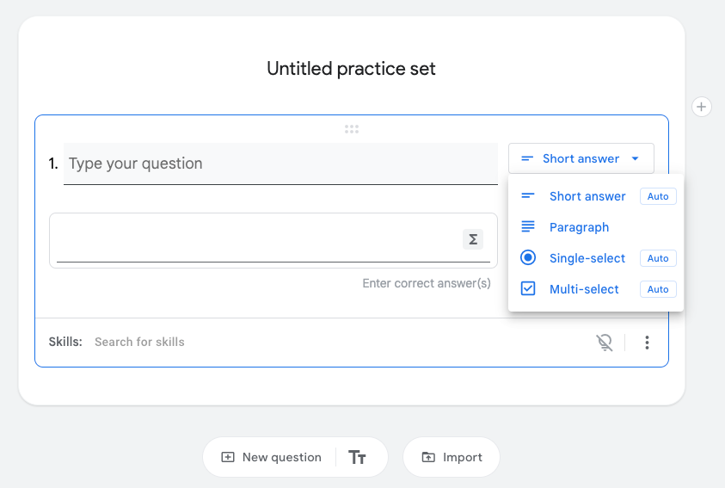

Use autograded questions to boost student engagement
Autograded questions help teachers save time and increase student self-confidence by giving students the ability to check their answers as they work through a problem.
Questions with Auto next to them mean that they’re autograded questions that can provide immediate feedback.
The paragraph question type doesn’t provide immediate feedback and will need to be manually checked by by teachers.

Slide 15
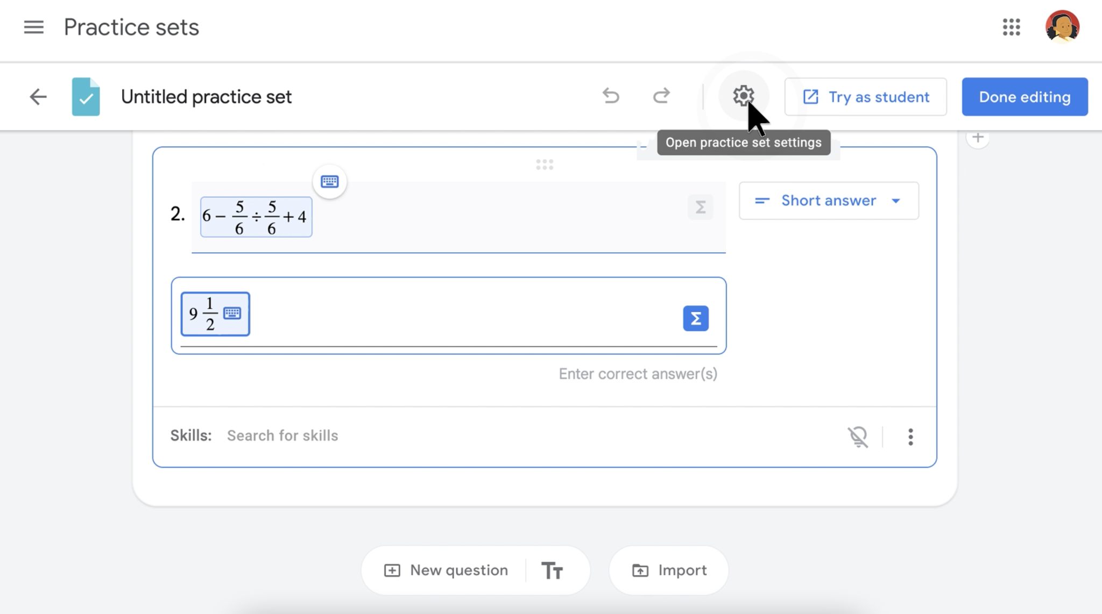


Enable accepting equivalent answers for autograded answers
Use the gear icon to allow for equivalent answers (for example, ¼ and 0.25) and mark an autograded response correct regardless of capitalization (for example, Thursday vs. tHursday).

Slide 16
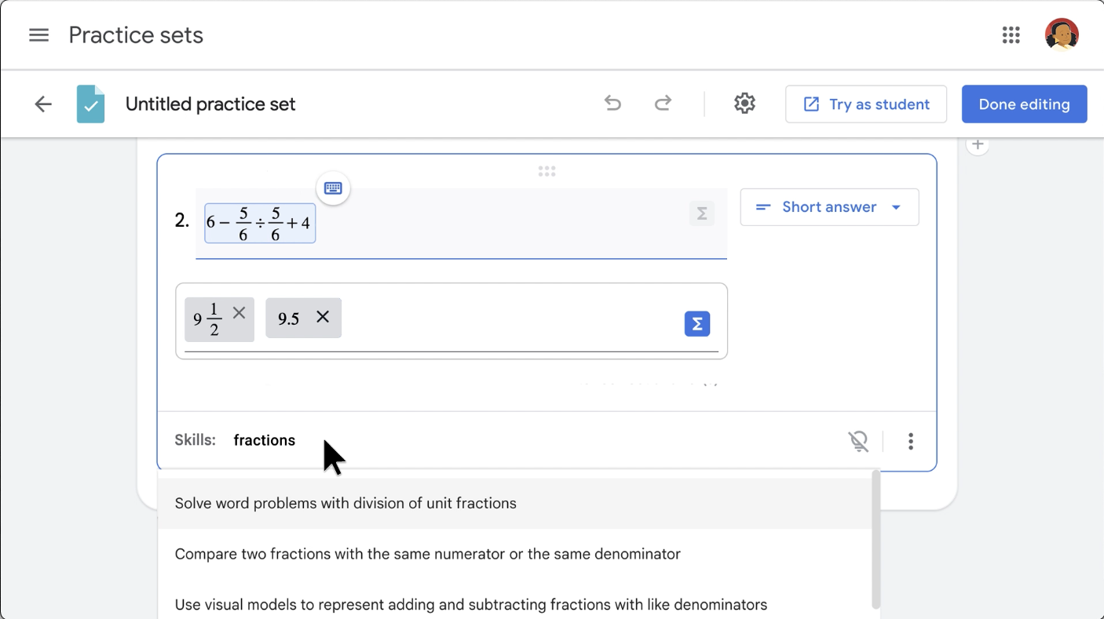
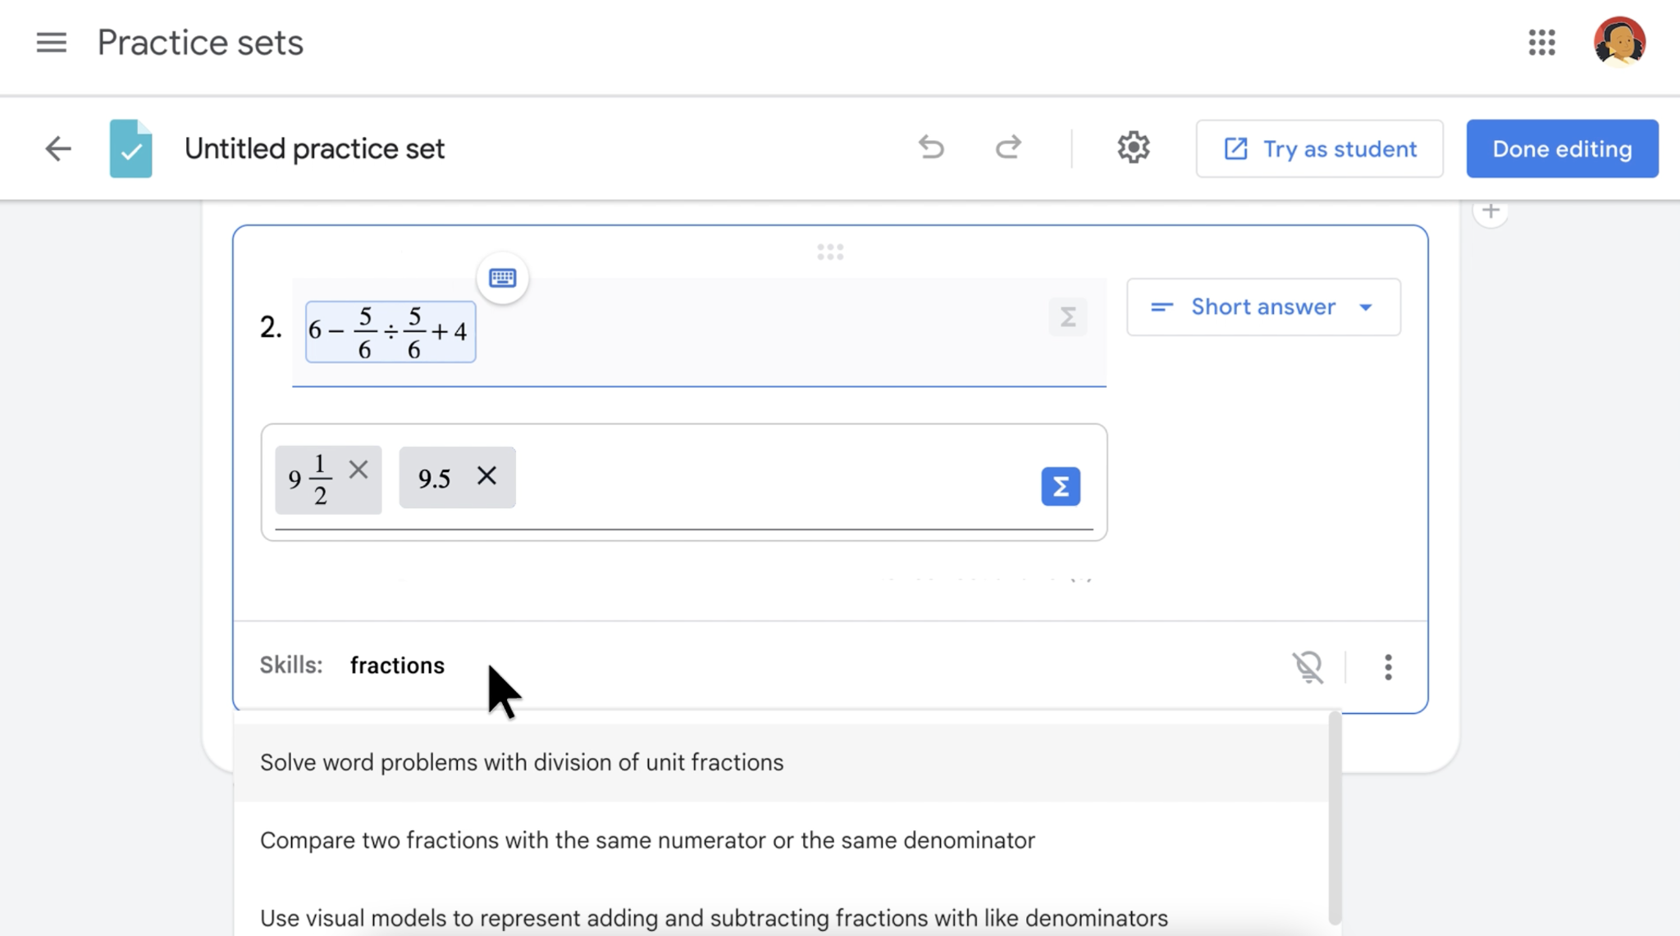
Add learning skills to provide support for students
Educators can give students real-time, point-of-use help on problems using the ‘Skills’ auto-search option, located at the bottom of a problem.
Start typing a word or phrase of the skill you would like to provide as ‘help’ for students. (Help will be provided for students in the form of a skill card or video.)
Select the learning skill to attach it to the problem.
The light bulb will turn yellow when a help resource has been attached. Leave ‘Skills’ blank to skip help on problems.
1
2

Slide 17
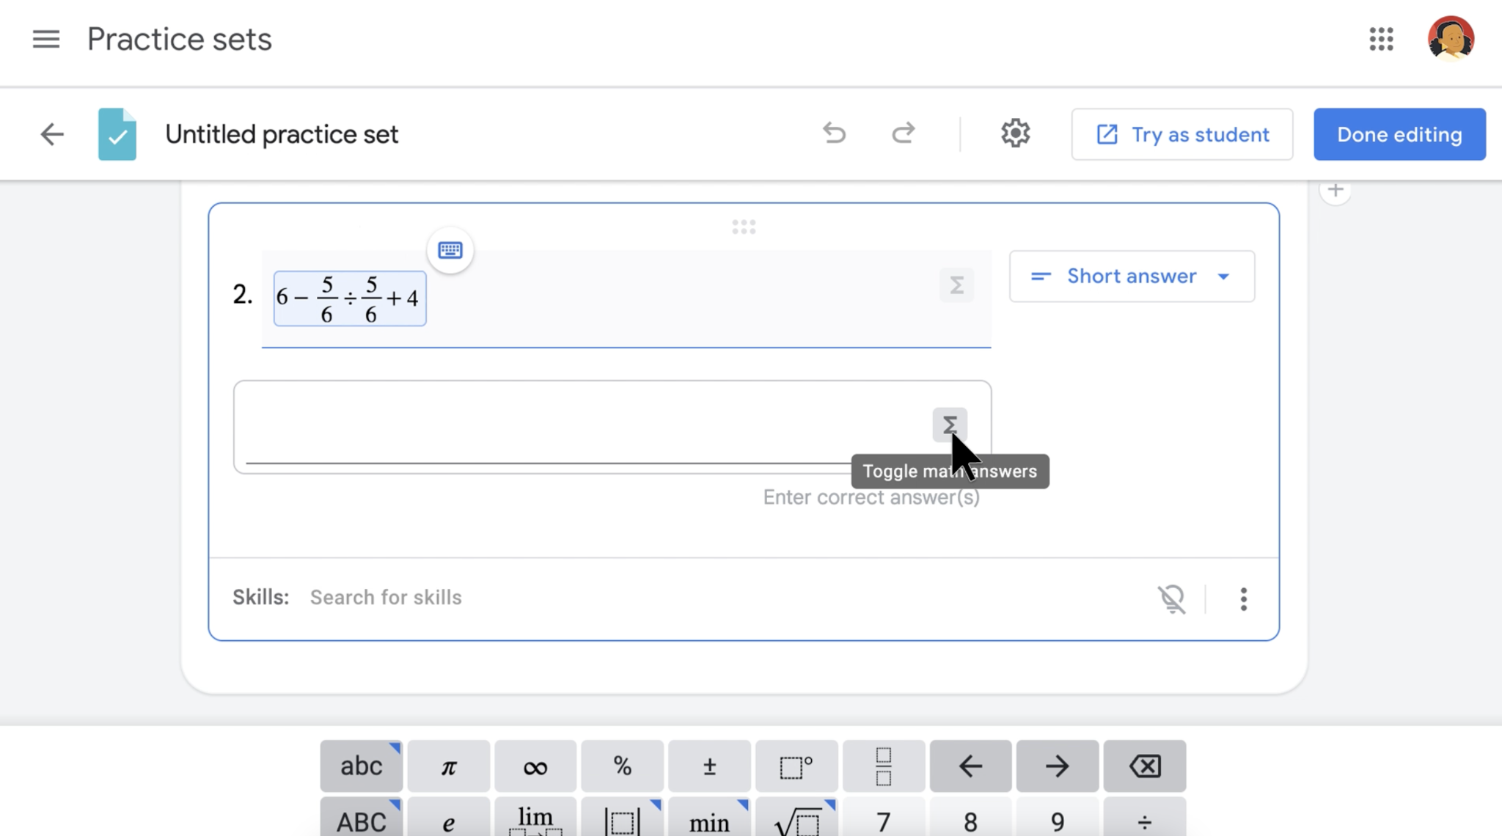
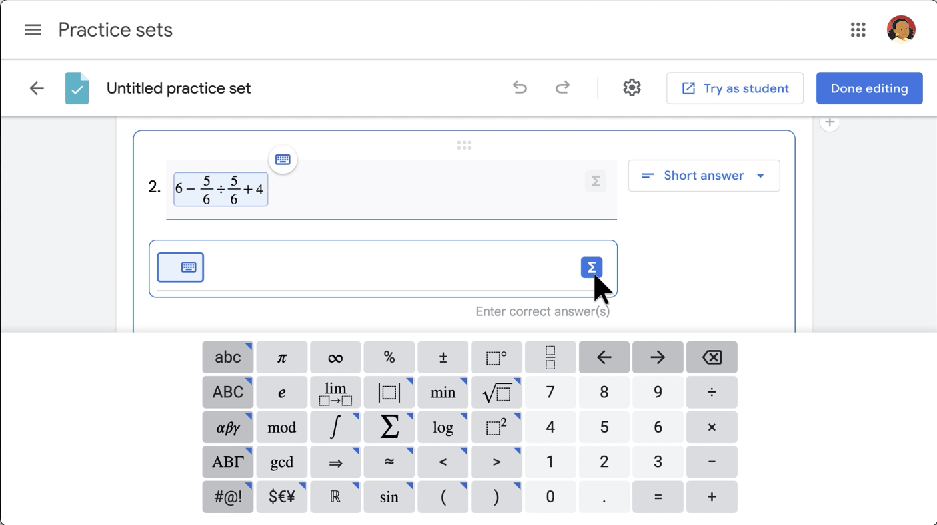

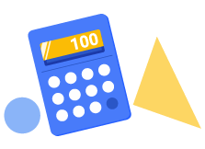
Use the math/science keyboard to create numerical problems
Students can access the icon in the practice set to open the math keyboard.
Note: This keyboard is not a calculator and will not calculate problems for students.

Slide 18
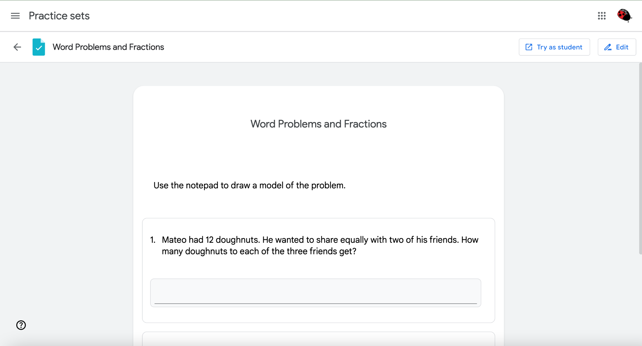

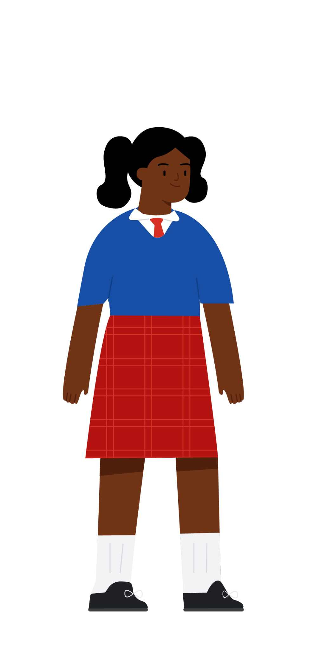
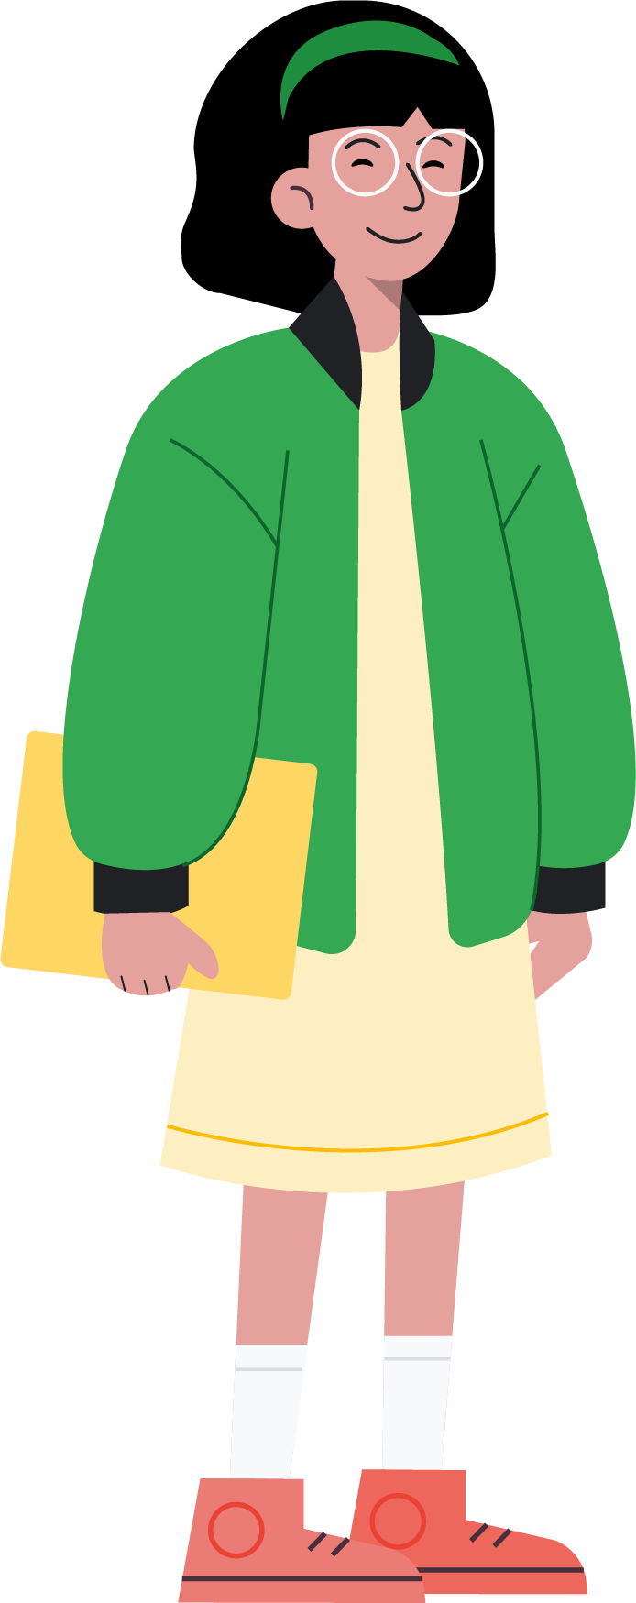
Experience practice sets as a student
Before you assign a practice set, click on Try as student to to preview what your students will experience.

Slide 19
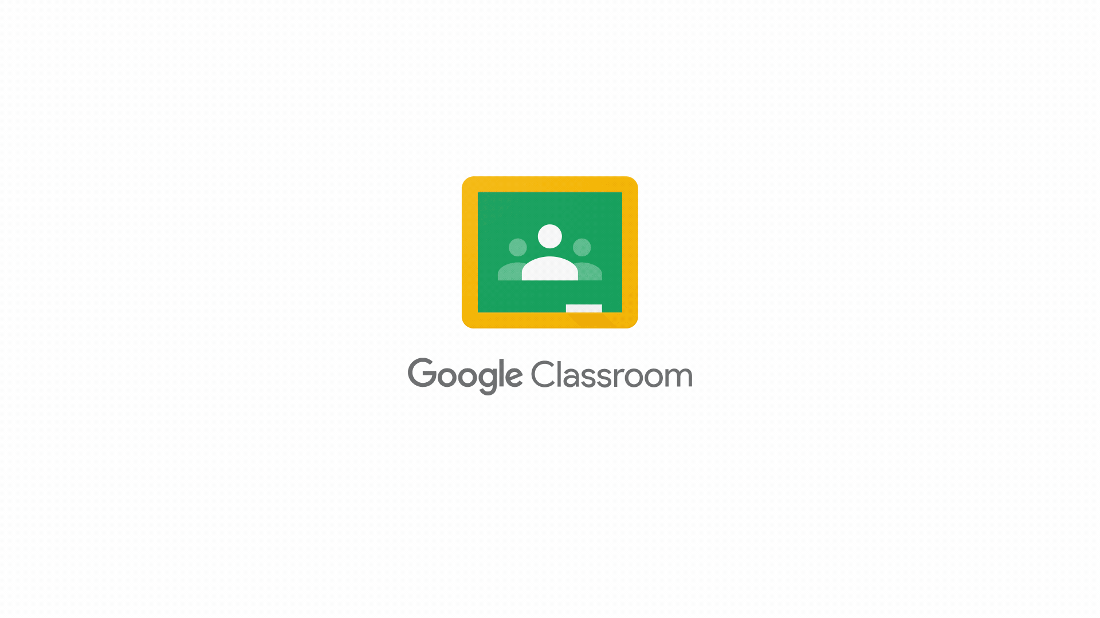



Edit and rearrange questions before assigning
Educators have the opportunity to make changes to a practice set before assigning it.
In the ‘Try as student’ view, click on the Edit button in in the upper-right corner.
Make any edits you’d like – including rearranging the order of problems – by placing your cursor over the drag-and-drop icon located at the top center of every problem. Then, drag the problem to where you would like it.
When you’re finished editing, click the Done editing button in the upper-right corner.
1
2
3

Slide 20
Send & receive a practice set

Slide 21
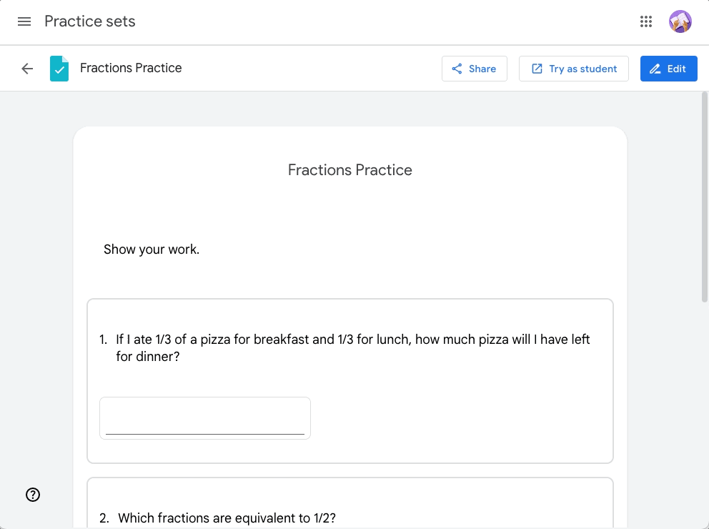

Send practice sets
Practice sets can be shared with other verified teachers within your Google Workspace so that they can preview and make a copy of a practice set.
Select the Share button in the top bar
Turn link sharing on using the toggle, to provide access to that practice set
Copy the link by pressing the button and send or post the link to share the practice set

Slide 22
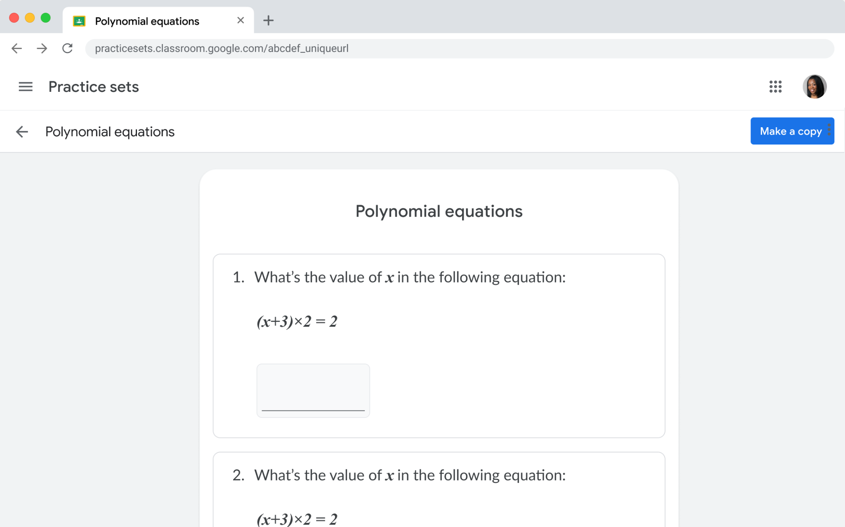
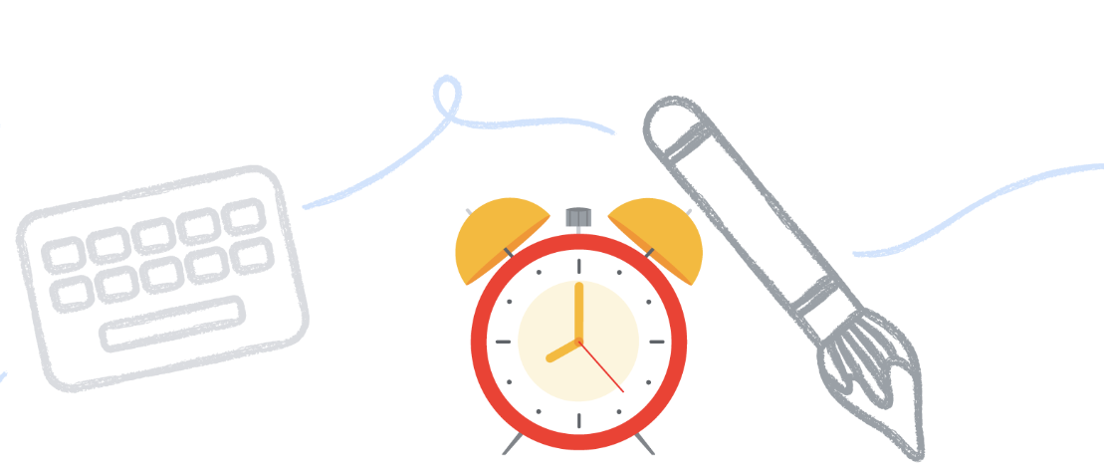
Receive a practice set
When a teacher receives the link to a practice set they are able to preview the content and click the “Make a copy” button to add the practice set to their own library.
Make changes to your copy and assign to students by accessing the practice set library when creating a new assignment.
Note: If you see a no access screen, check that the owner has the share toggle on or talk to your admin about getting added to verified teachers group, so you can receive practice sets.

Slide 23
Assigning a practice set

Slide 24
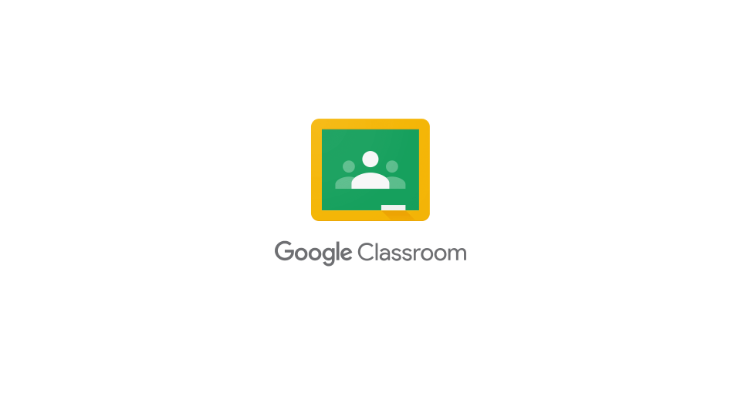
Creating an assignment
1
Sign in to Google Classroom
Select a Class, then go to the Classwork tab, click Create, and choose Assignment
Create an assignment and add a title or instructions (optional)
Within the Attach options, select Practice sets
Select the desired practice set and click Attach. Attach any additional reference materials as needed.
Adjust the assignment title if desired and click the Due drop-down menu to set an assignment due date
Select Assign to finish
2
3
4
5
6
7

Slide 25
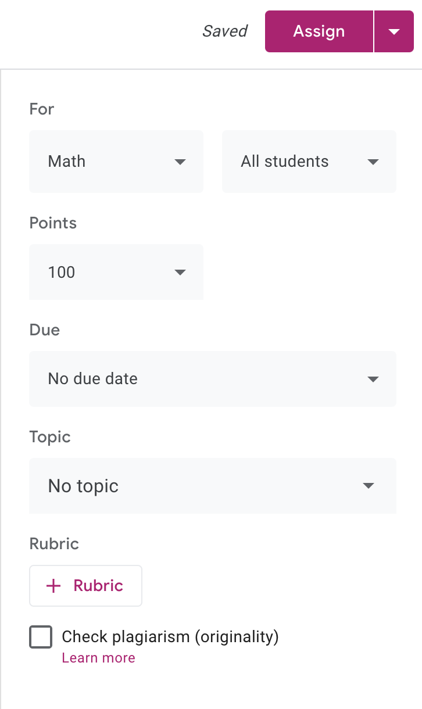
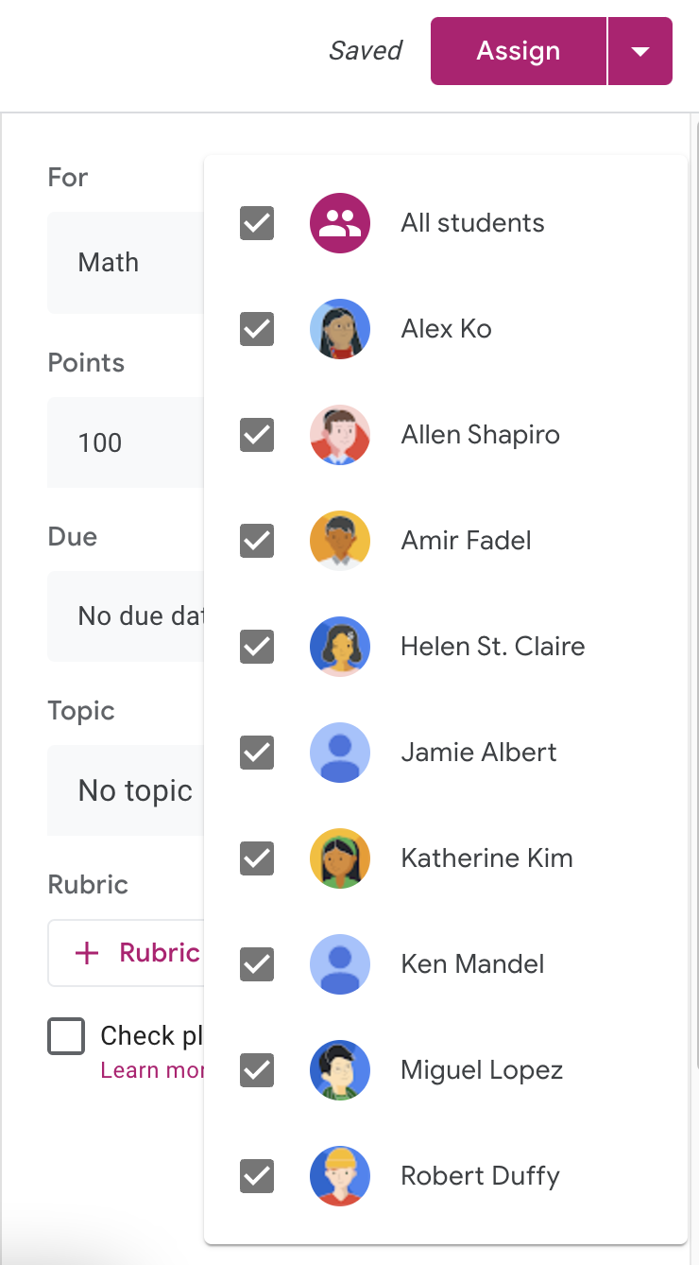
Use differentiation to tailor instruction when distributing assignments
Practice sets can be assigned to your whole class, small groups, or individual students to benefit students across the learning continuum.
Select the All students drop-down option to change from assigning the practice set to the whole class or to other student groups.
Click the Assign button when finished to distribute the assignment to the selected students.

Slide 26
The student experience

Slide 27
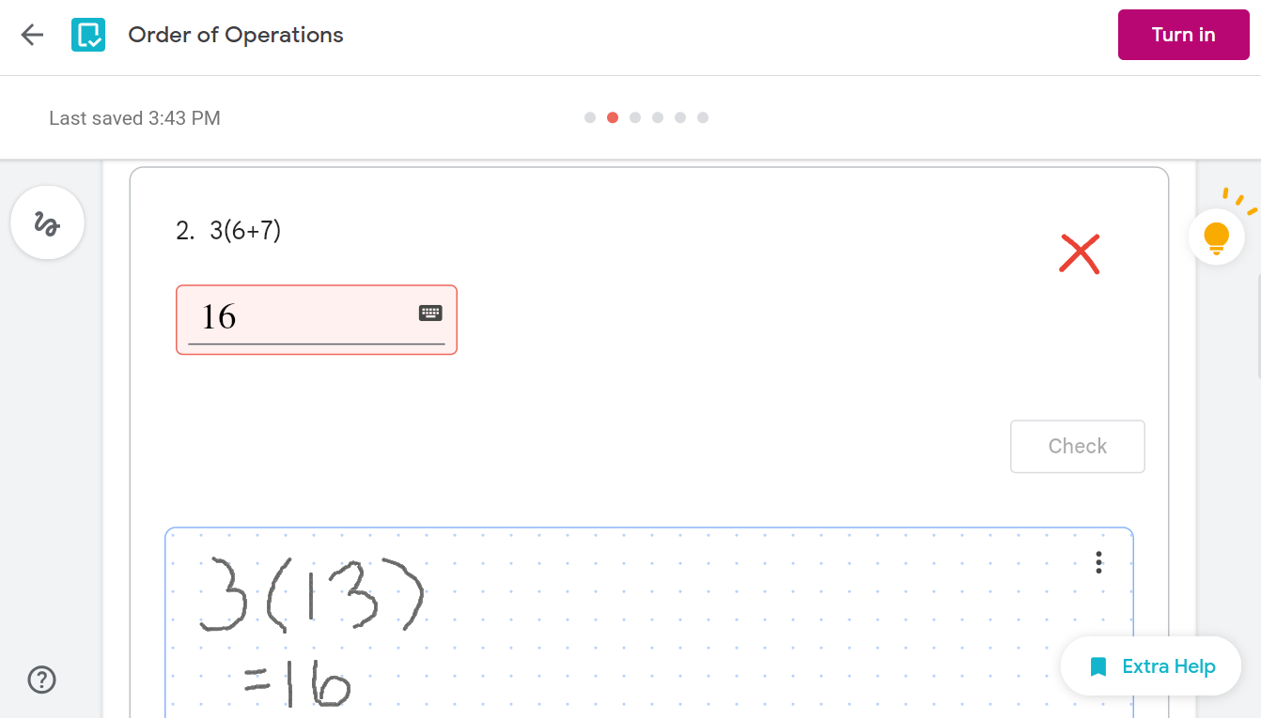




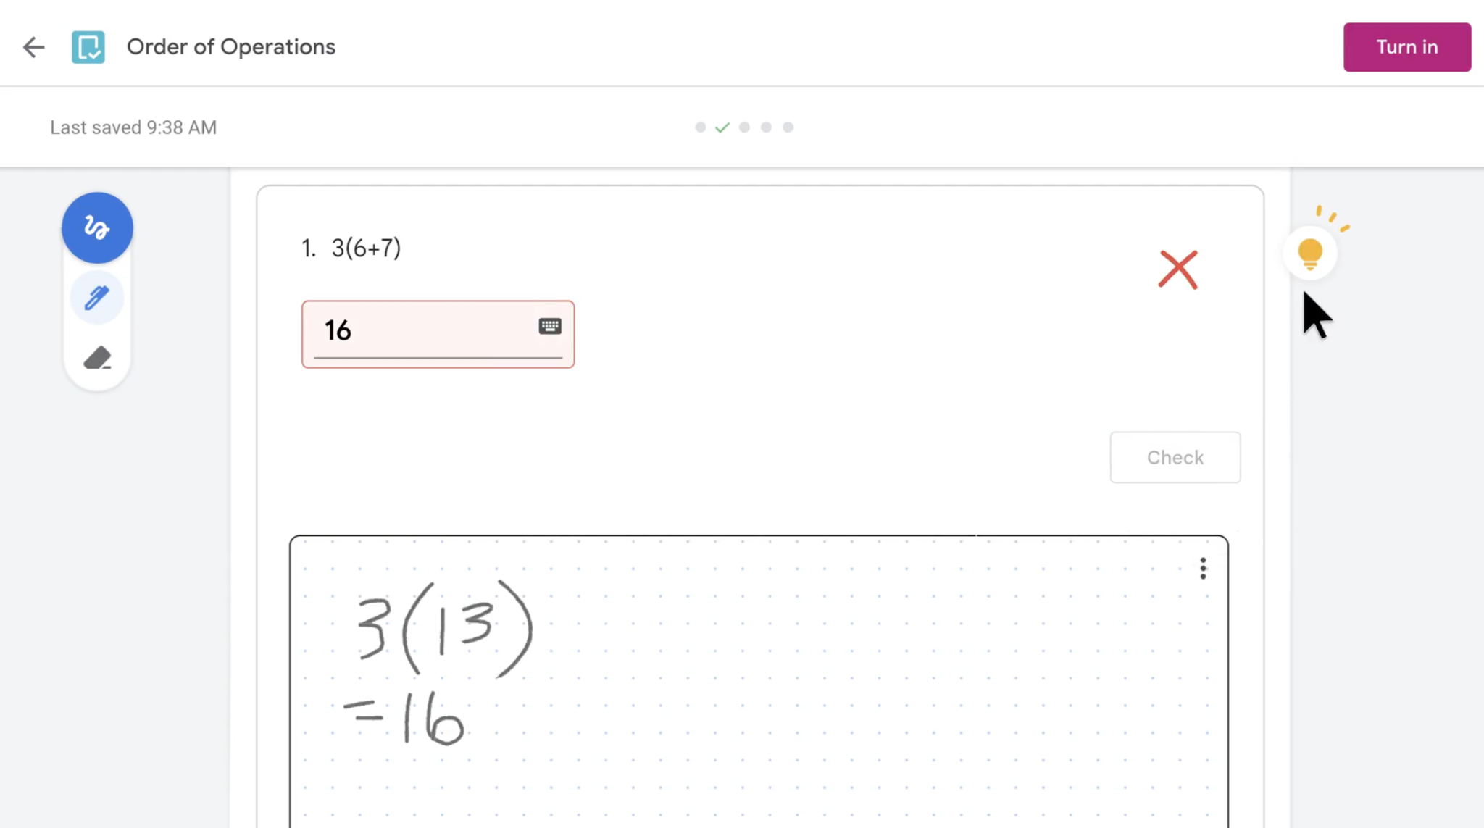
Overview
The student experience
Light bulb
Inking tool
If you provided skills help, the light bulb will turn solid yellow to notify your students
Students can use a mouse, stylus, or their finger to use the pen and eraser
Show your work
Extra help
Students can show their work using the notepad
If you provided skills, students can click on resources to access skill cards and videos to scaffold their thinking
Notes:
“You can try the inking tool, show your work in the notepad, and see what hints and resources are available.”

Slide 28
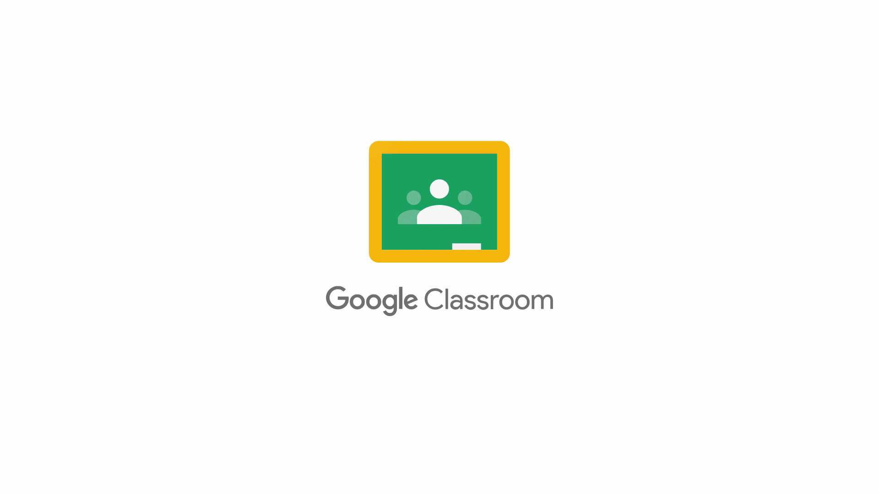

Enable more seamless student work within Classroom
Students can access practice sets within their Classroom by simply clicking on an assignment that has a practice set attached.

Slide 29
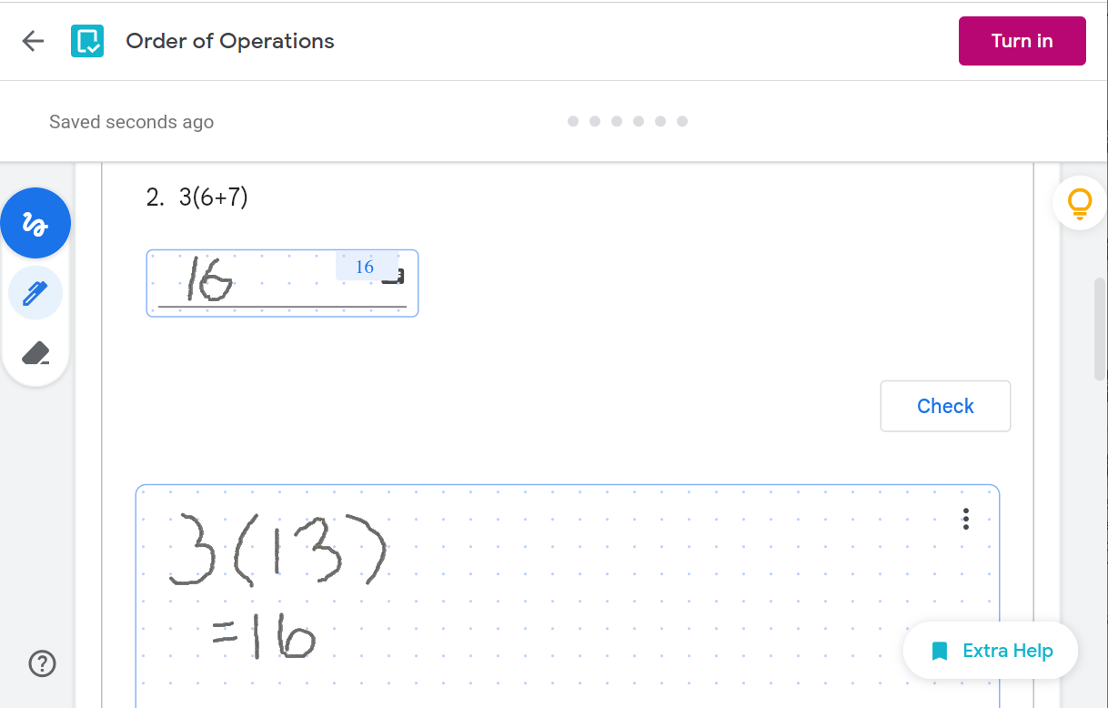

Interactive lessons that capture student thinking
Empower students to demonstrate their understanding of concepts.
Students can leverage the unobtrusive
inking tool, found to the left of each problem.
When the inking tool icon is clicked, the pencil and eraser options can be used to manually write in answers.
Optionally, the notepad icon allows students to work out problems.

Slide 30
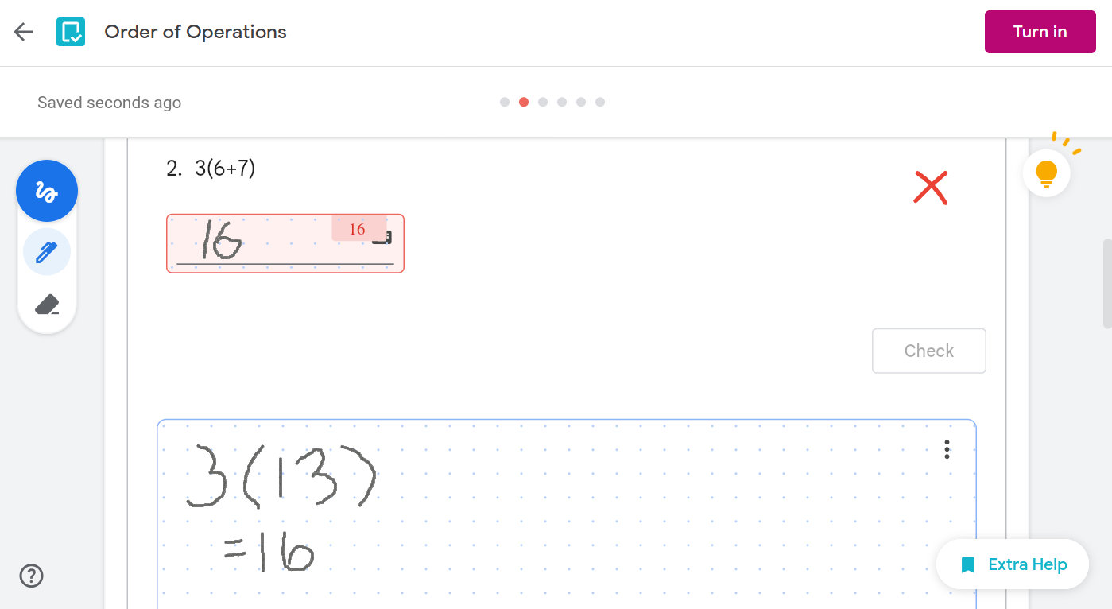

Inspire critical thinking and student agency
Give students opportunities to conceptualize, reason, evaluate, and reflect on their answers when you provide point-of-use support.
Students can click on the light bulb to activate accessible hints and resources provided to them.
Real-time remediation helps scaffold student learning and improve engagement, self-confidence, and student motivation.

Slide 31
Reviewing student work

Slide 32
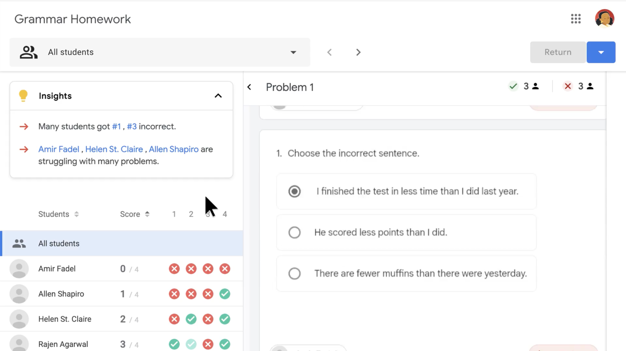

Holistic insights for informed decisions
Insights provide an overview of the class strengths and areas of need to inform next steps. At a glance, educators can save time by:
Inferring big ideas and insights for the whole class and individual students
Reviewing problem-by-problem results
Viewing individual student scores and performance summaries

Slide 33
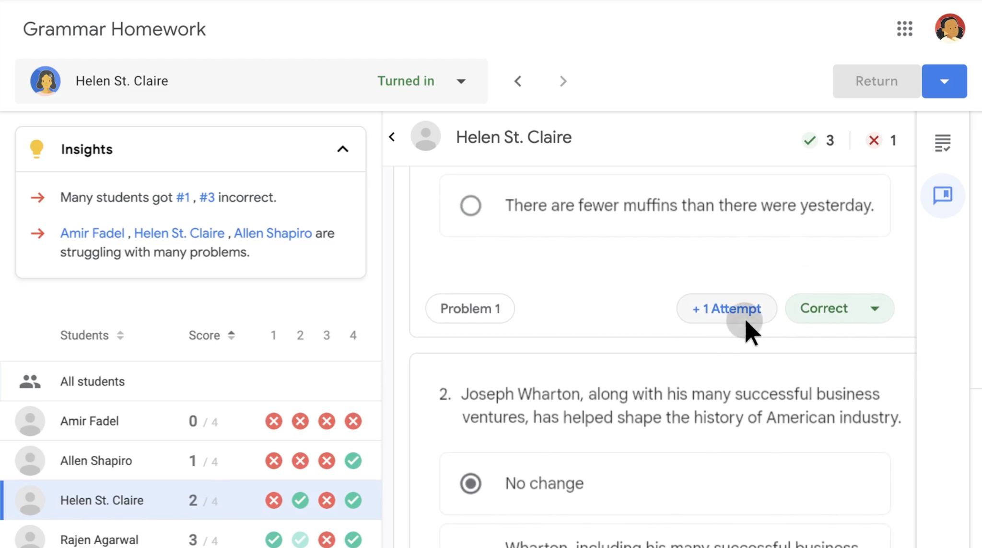

Overview
Insights
Holistic view of class performance to provide an overview of the class strengths and areas of need
The number of problems answered correctly vs. incorrectly
Displays the number of attempts the student took to answer the problem
The number of attempts will be indicated in the green circle
Notes:
This is important information for teachers as their are evaluating how students are doing and what they might need to address as far as using resources and hints for example

Slide 34


See results in Classroom
1
Sign in to Google Classroom
Select a Class, then go to the Classwork tab
Click an Assignment and select View assignment
From the assignment page, select Class insights
2
3
4

Slide 35
Provide students with tailored instruction
From assignment insights, click on a student to access the completed assignment for that student. Educators can then evaluate if small group, 1:1 remediation, or other acceleration opportunities are needed by reviewing:
The number of attempts made on a problem
Correct answers in green and incorrect answers in red
Unanswered – or incomplete – problems

Slide 36
Providing feedback
Notes:
# of practice sets you have created
Things enjoying
Things you wish
# of folks you trained

Slide 37
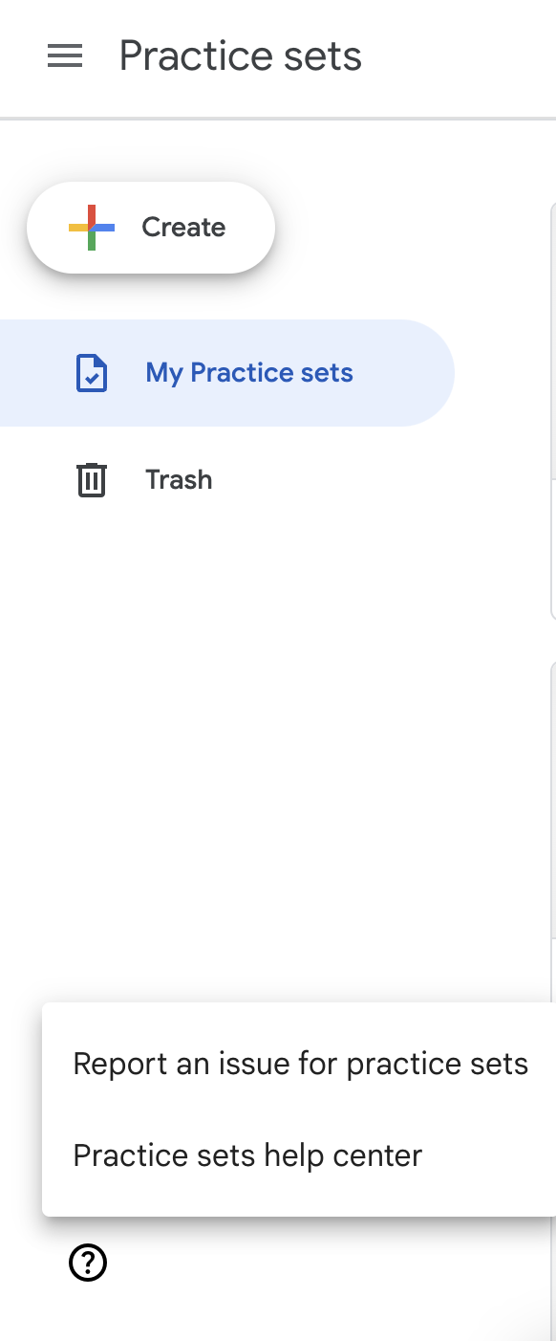
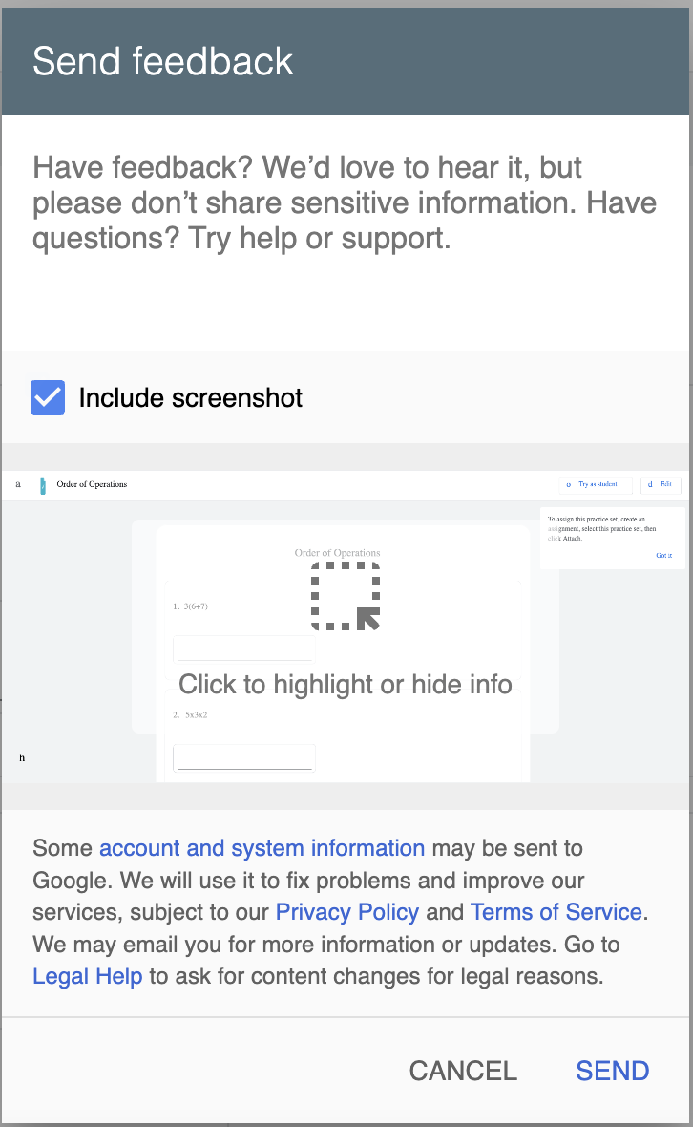
Provide feedback
We’d like to hear from you. Please provide feedback to us directly via the Send feedback user tool within Classroom:
Within practice sets, click the (?) icon and select Report an issue for practice sets
Please include screenshots when possible
Note: In addition to in-product feedback and surveys, we will be doing check-in surveys through Google Forms and in-depth interviews through Google Meet. The first check-in survey will be in early May, where you’ll also be able to express interest in participating in an interview about your experience using practice sets. Stay tuned.

Slide 38
Thank you

Slide 39
Educator ‘show and tell’
OPTIONAL
Notes:
# of practice sets you have created
Things enjoying
Things you wish
# of folks you trained

Slide 40
Educator ‘show and tell’
Let other educators know about the practice set feature you are most excited about by sharing one of the following social messages on your social channels and including the hashtag #GoogleClassroom or #GoogleEdu.
Tell colleagues about practice sets
Which practice set feature are you most excited about?
If you are a teacher, how do you envision using practice sets in your classroom?
How will practice sets support your students?

Slide 41
Attn fellow teachers: Make sure you include practice sets in #GoogleClassroom in your list of time-saving tools ⏰ with autograded lessons, insights, and real-time feedback for students.
1
Social messages and assets
Have you heard about practice sets in #GoogleClassroom? Create quick, interactive assignments great for the whole class, a small group, and individuals.
2
Grab-and-go messages to use
#DYK you can create a practice set in #GoogleClassroom from an existing lesson? Import your favorite question PDFs and transform them into interactive lessons!
3
Feel free to use one of the following messages to share with your colleagues on your social channels.
#DYK that practice sets in #GoogleClassroom make it easy to create lessons, knowledge checks, homework, remediation, and more? Check it out!
4
Use a hashtag
#GoogleClassroom
Have you heard about practice sets in #GoogleClassroom? These interactive assignments are great to use for remediation and differentiation to support our individual students.
5
#GoogleEdu

Slide 42
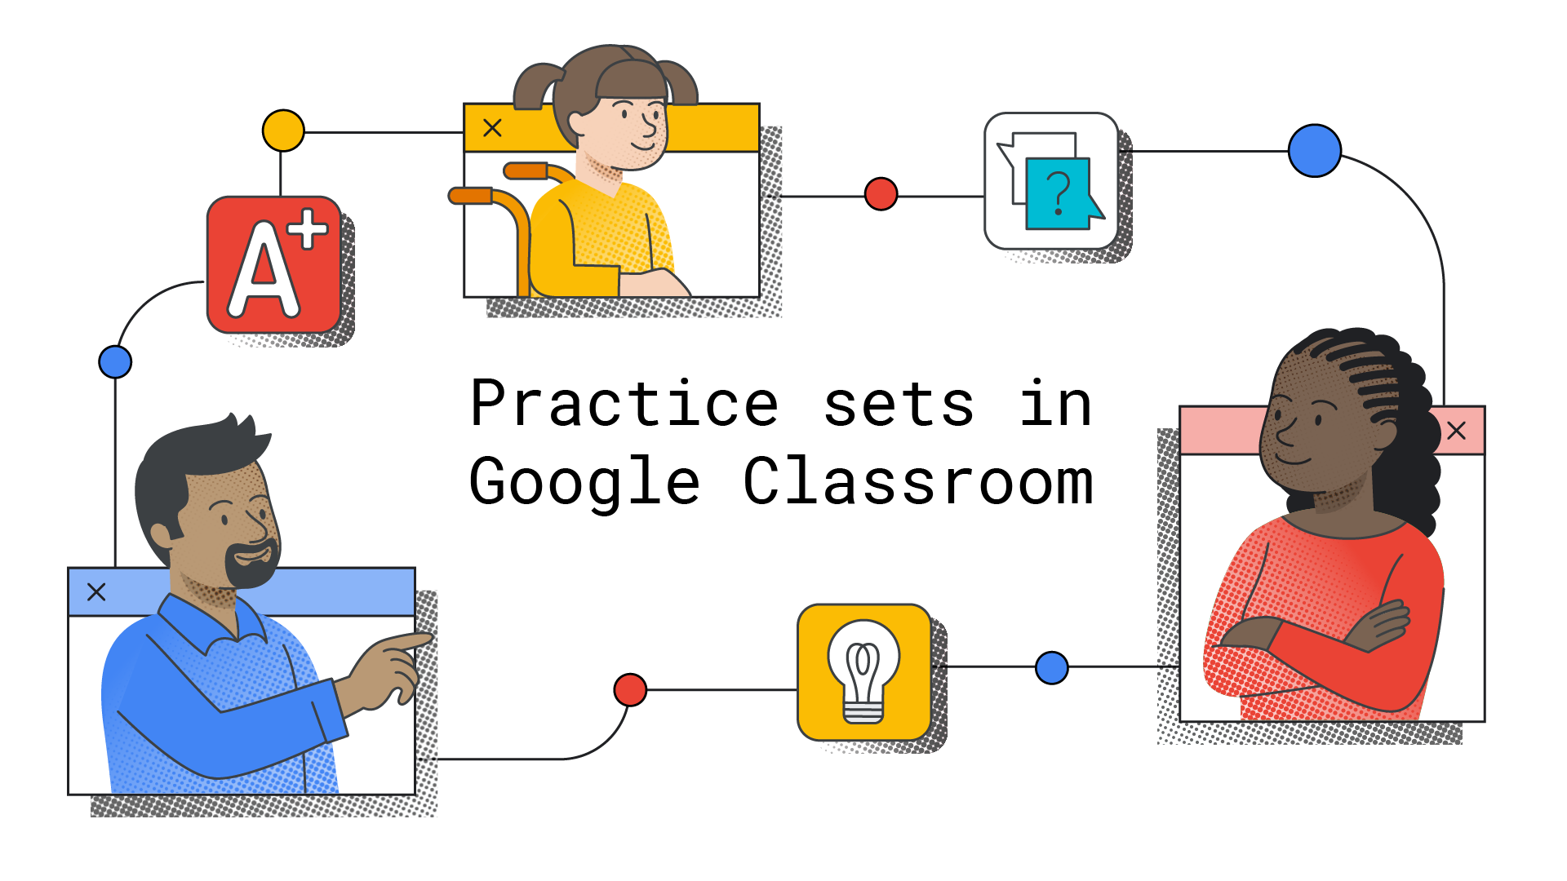
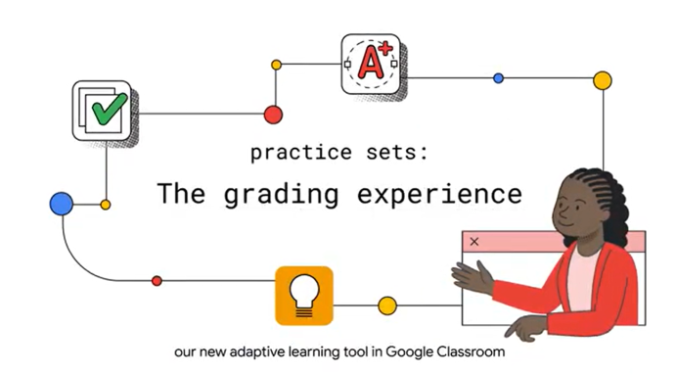
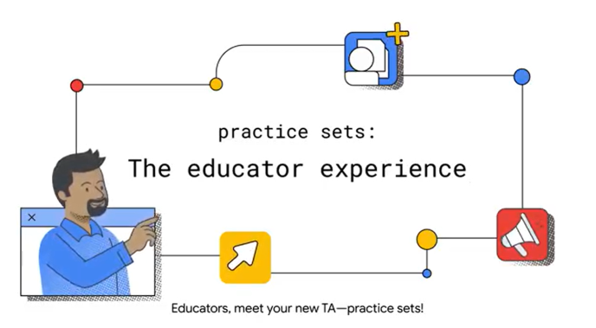
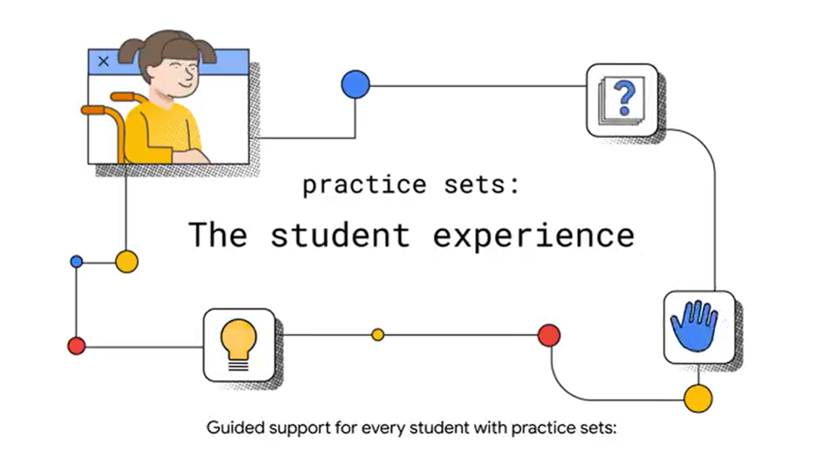
Images and resources you can use for your social posts
Introducing practice sets in Google Classroom YouTube video
Practice sets: a more personal path to learning
Let’s get personal: adaptive learning tech and education

