Slide 1
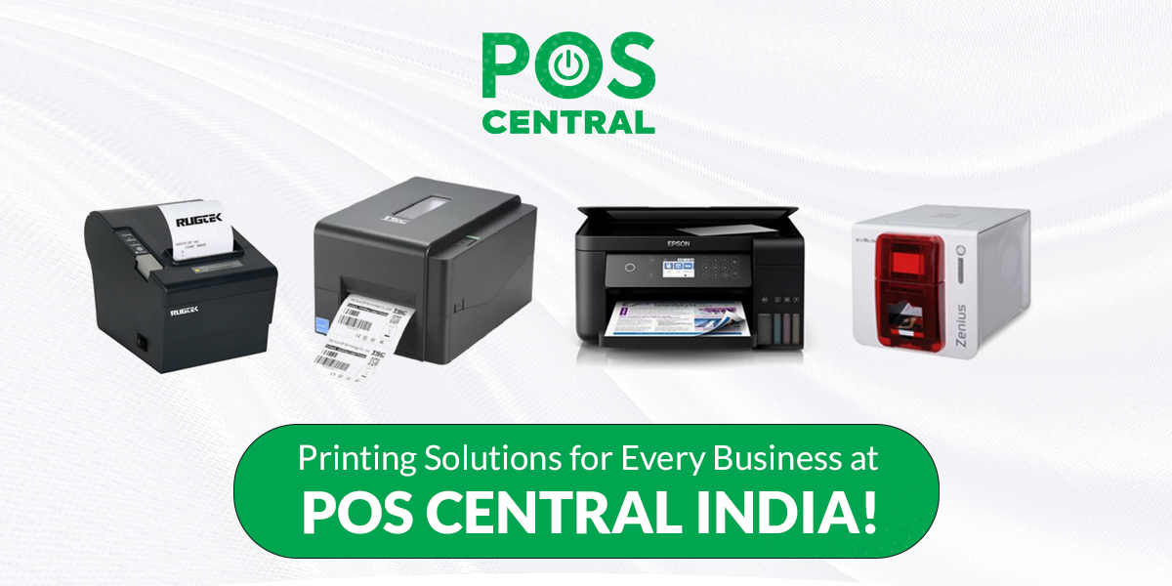
Welcome to POS Central India
Leading POS System Suppliers

Slide 2
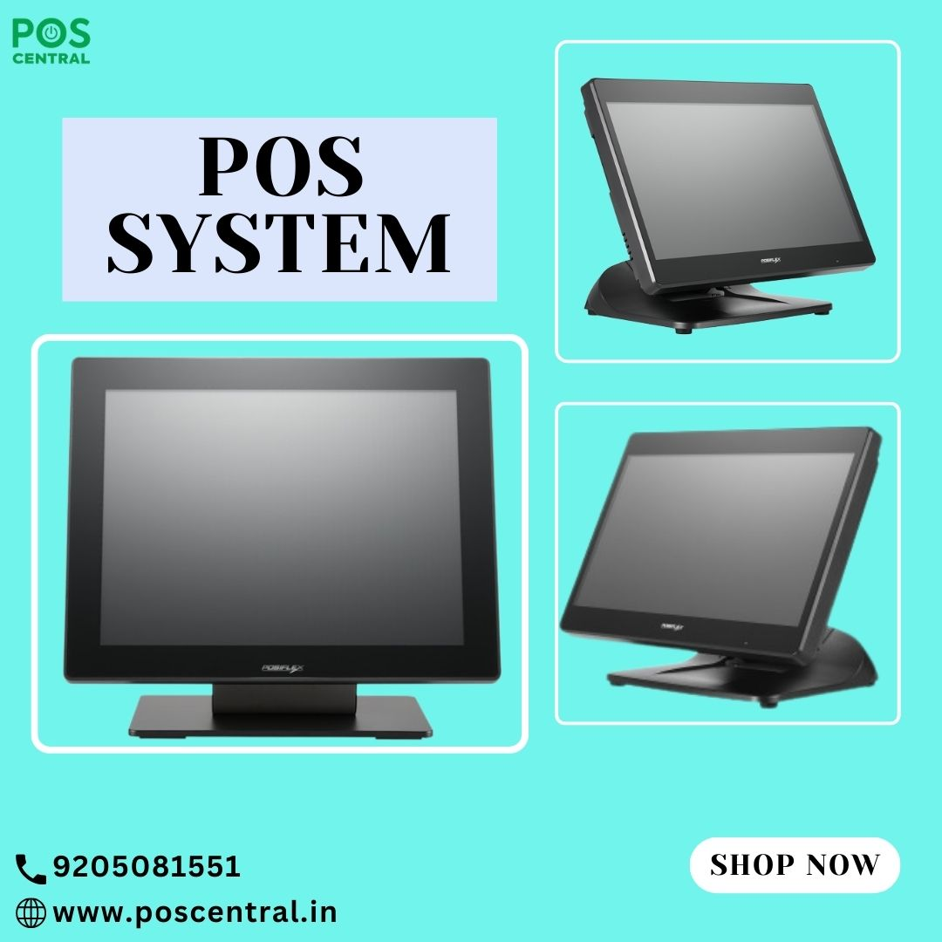
Best Retail POS Systems for Small Businesses

Slide 3
Introduction
A reliable POS system is essential for small businesses to streamline operations and improve customer experience. Without an efficient system, businesses may struggle with inventory errors, slow checkouts, and inaccurate sales tracking.
Why Small Businesses Need a Reliable POS System
Simplifies transactions and reduces checkout time.
Manages inventory efficiently to prevent stock shortages.
Provides real-time sales data for better decision-making.
Challenges Faced Without a Proper POS Solution
Manual errors leading to revenue loss.
Inefficient stock management causing overstocking or shortages.
Delayed transactions reducing customer satisfaction.
How a Budget-Friendly POS Can Help Grow Your Business
Automates sales tracking and reporting.
Improves accuracy and efficiency in daily operations.
Enhances customer experience with quick and secure payments.

Slide 4
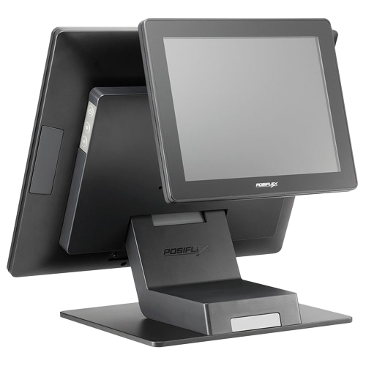
Key Features of a Budget-Friendly Retail POS System
A good POS system in India should offer essential features that simplify business operations while being affordable. Here’s what to look for:
User-Friendly Interface: Easy navigation ensures smooth transactions and reduces staff training time.
Fast & Secure Payments: Accepts multiple payment methods with encryption for safe transactions.
Simple Inventory Management: Tracks stock levels in real-time to avoid overstocking or shortages.
Sales Tracking & Reporting: Provides insights on sales trends, helping businesses make informed decisions.
Choosing the right POS system in India helps small businesses operate efficiently while staying within budget.

Slide 5
Benefits of Using a POS System for Small Businesses
Reduced Manual Errors & Faster Transactions – Point of sale systems automate billing and checkout, minimizing human errors and speeding up sales. This ensures smoother operations and improves customer experience.
Better Stock Management – Track inventory in real-time to avoid overstocking or running out of products. Point of sale systems help businesses maintain the right stock levels effortlessly.
Customer Data & Personalized Marketing – Store purchase history to offer targeted promotions and discounts, boosting customer loyalty.
Multi-Payment Options – Accept cards, digital wallets, and UPI payments for a hassle-free checkout process, improving customer satisfaction.

Slide 6
Best Budget-Friendly POS Systems Available
Top Affordable POS Solutions for Small Retailers
Small businesses need cost-effective point of sale systems for restaurants to manage sales efficiently.
Budget-friendly POS options offer essential features like billing, inventory tracking, and sales reporting.
Popular choices include touchscreen POS terminals, mobile POS, and all-in-one solutions.
Cloud-Based vs. On-Premise POS: Which One to Choose?
Cloud-based POS stores data online, offering real-time access and automatic updates.
On-premise POS works offline, ensuring security and local data control.
Choose based on business size, internet reliability, and long-term needs.
Key Features to Look for When Selecting a POS System
Easy-to-use interface for quick transactions.
Secure payment options and multi-payment support.
Inventory and sales tracking for better business insights.
Customer support and future scalability.

Slide 7
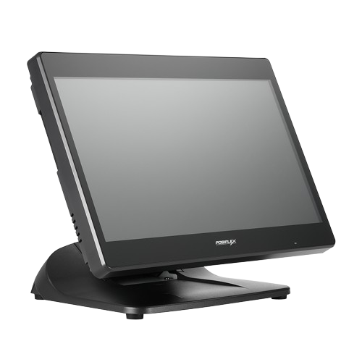
How POS Systems Help Restaurants & Retail Stores
Faster Order Processing & Table Management for Restaurants
A POS system speeds up order-taking and kitchen communication.
It helps manage table reservations and reduces wait times.
Digital menus and payment options improve customer experience.
Seamless Checkout & Barcode Scanning for Retail Stores
Quick barcode scanning ensures fast and accurate billing.
Multiple payment options improve customer satisfaction.
Reduces manual errors and speeds up checkout lines.
Automated Reports for Sales & Business Insights
Tracks sales trends and inventory levels in real time.
Generates detailed reports for better decision-making.
Useful across industries, including point of sale systems for hospitals to streamline billing.

Slide 8
POS Central India – Your Trusted POS Partner
Wide Range of POS Solutions: POS Central India offers a retail point of sale system designed for small businesses, ensuring smooth transactions and easy inventory management.
Affordable Pricing: Get cost-effective POS systems that fit your budget without compromising on essential features.
Easy Setup: Our POS systems are user-friendly and quick to install, so you can start selling right away.
Reliable Support: Enjoy 24/7 customer assistance and expert after-sales service to keep your business running smoothly.
Scalable Solutions: Choose a system that grows with your business needs.

Slide 9
How to Choose the Right POS for Your Business
Selecting the right POS system is crucial for smooth operations. Here’s how to choose the best POS systems in India for your business:
Assess Your Business Needs & Budget
  Identify daily transactions and required features.
  Choose a system that fits your budget without compromising quality.
Look for Must-Have Features & Scalability
  Ensure easy billing, inventory management, and multi-payment options.
  Pick a scalable system that grows with your business.
Consider Customer Support & Integration Options
  Opt for a POS with 24/7 support.
  Check compatibility with accounting, CRM, and e-commerce tools.

Slide 10
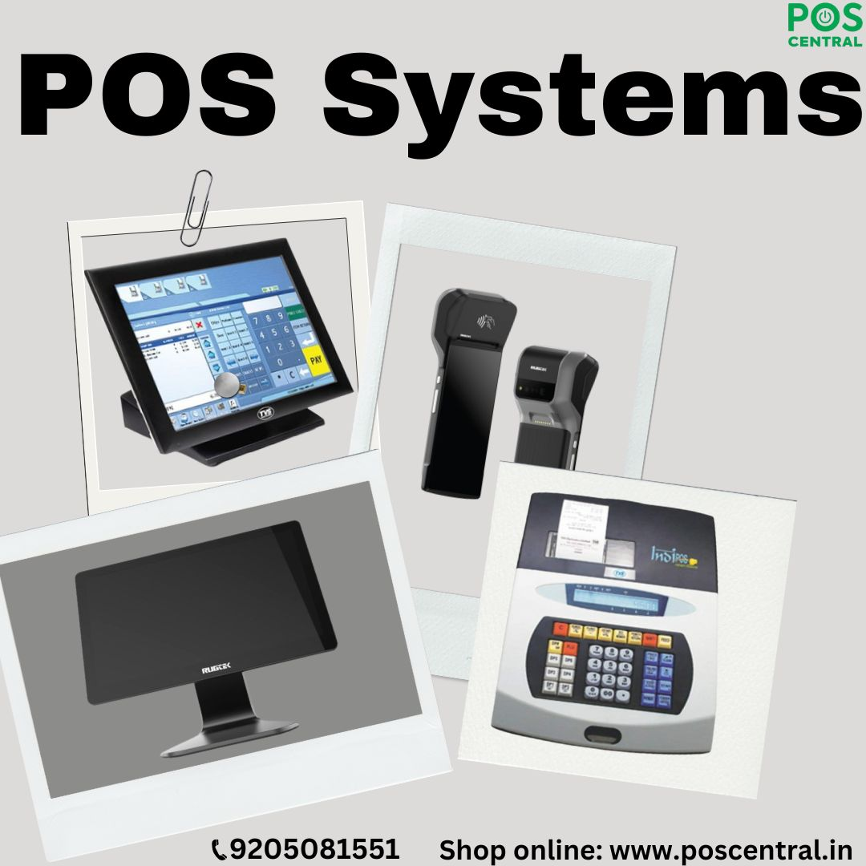
Conclusion & Call to Action
A good POS Retail System helps small businesses run smoothly by speeding up sales, managing inventory, and reducing errors.
Choosing the right POS system ensures better customer service, secure transactions, and improved business efficiency.
Investing in one of the best POS systems can help businesses save time, increase sales, and stay competitive.
Visit POS Central India to explore budget-friendly POS solutions that fit your business needs.
For more details, contact us today or visit our website to find the best POS system for your business!

Slide 11


For more information​​
Visit us :​​
Address : Unit no. 703, A-10, Sector 68, Noida, UP 201301 India​​
Website : https://www.poscentral.in/ ​​
E-Mail ID : sales@poscentral.in ​​
For any query call us @ 9205081551​​

