Slide 1
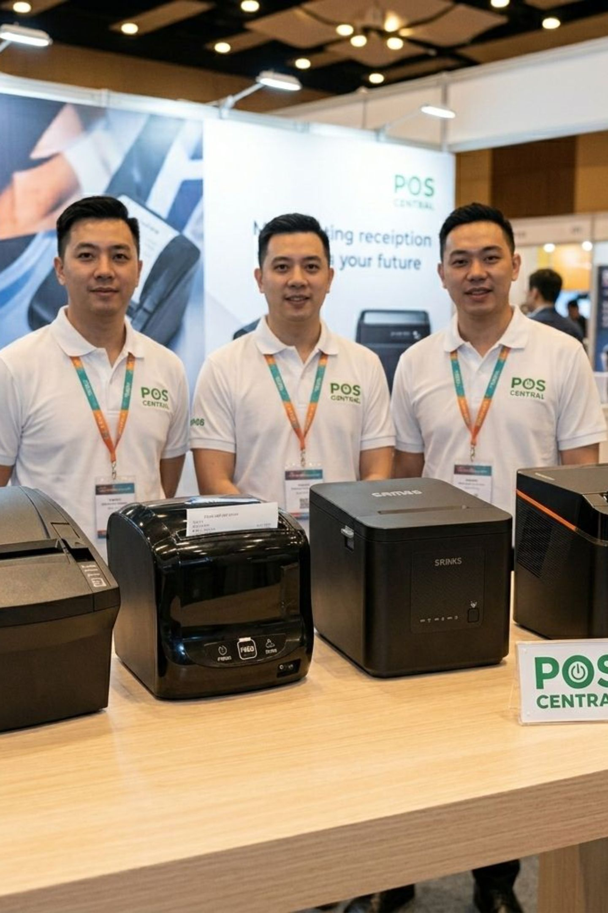
POS CENTRAL AUSTRALIA
Buy Receipt Printers: Find the Right POS Printer
Reliable receipt printing for retail, hospitality, cafés, restaurants and Australian businesses.
Fast, reliable receipt printing for smoother everyday transactions.

Slide 2

What Are Receipt Printers and Why Do Businesses Need Them?
Receipt printers are POS peripherals that produce transaction receipts, invoices, tickets, and order dockets — connecting directly with POS systems and payment workflows across retail, hospitality, supermarkets, pharmacies, and service businesses.
POS System
Transaction Processing
Receipt Printer
Printed Receipt
From checkout to kitchen, receipt printers keep transactions documented and operations running smoothly.
Retail Checkout
Cafés & Restaurants
Supermarkets
Hospitality
Service Counters
Kiosks & Mobile

Slide 3
What Features Should You Look for in a Receipt Printer?
Fast Print Speeds
Reliable Performance
Connectivity Options
Compact Design
Auto Cutter
POS Compatibility
Reduces waiting times during peak periods.
Space-efficient for smaller counters and modern POS setups.
Simplifies high-volume receipt handling.
Designed for consistent daily POS transactions.
USB, Ethernet, Bluetooth, and Wi-Fi available.
Works with your POS software and operating system.
Paper Size Options
Easy Maintenance
Common formats include 58mm and 80mm.
Thermal models require no ink or toner.

Slide 4


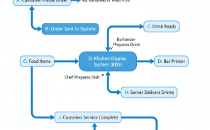
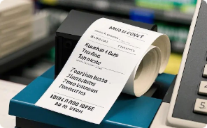
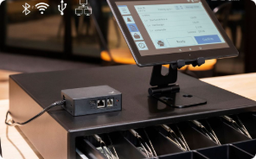
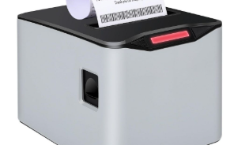

How Can a Receipt Printer Benefit Your Business?
Faster Transactions
Better Customer Experience
Smoother Operations
Lower Maintenance
Better Workflow Integration
Space Efficiency
Quick printing keeps checkout lines moving during peak hours.
Reliable printing supports everyday checkout and order workflows.
Thermal printers require no ink cartridges or ribbons.
Compact models suit smaller counters and modern POS environments.
Clear, professional receipts provide customers with transaction records.
Network, USB, Bluetooth, and Wi-Fi options fit different POS setups.
The right receipt printer should match your transaction volume, environment, POS software, and workflow.

Slide 5
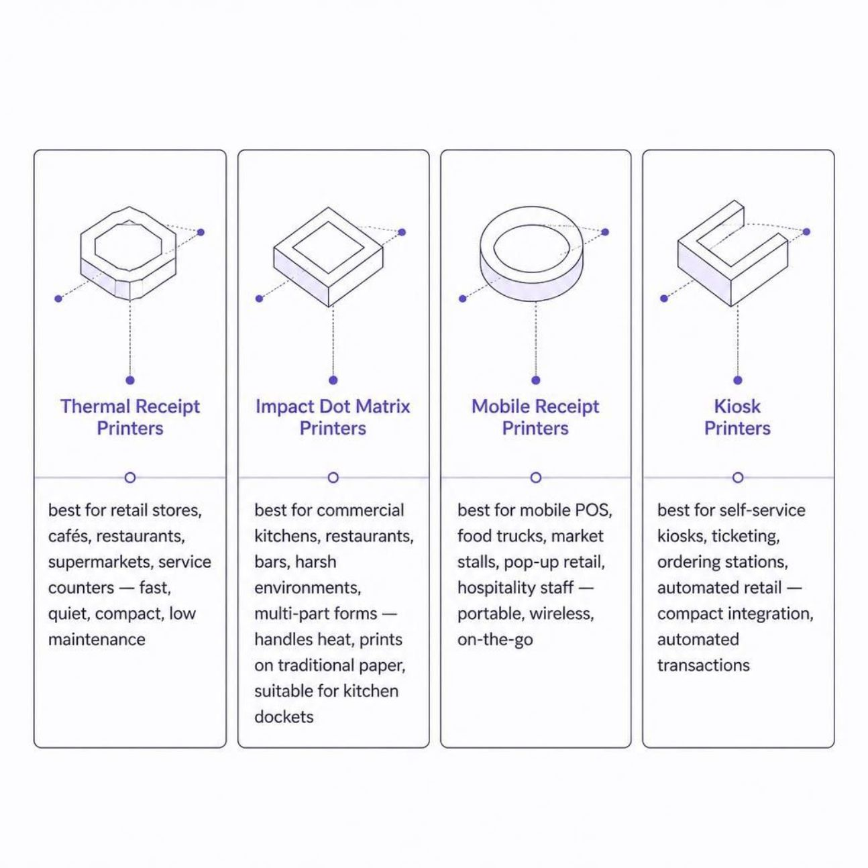
Which Receipt Printer Category Is Right for Your Business?
Choose based on where you print, what you print, and how your business operates. Each category is engineered for specific environments and workflows.
Thermal — Everyday retail and hospitality receipts
Impact — Commercial kitchens and multi-part forms
Mobile — On-the-go and pop-up selling
Kiosk — Self-service and automated terminals

Slide 6
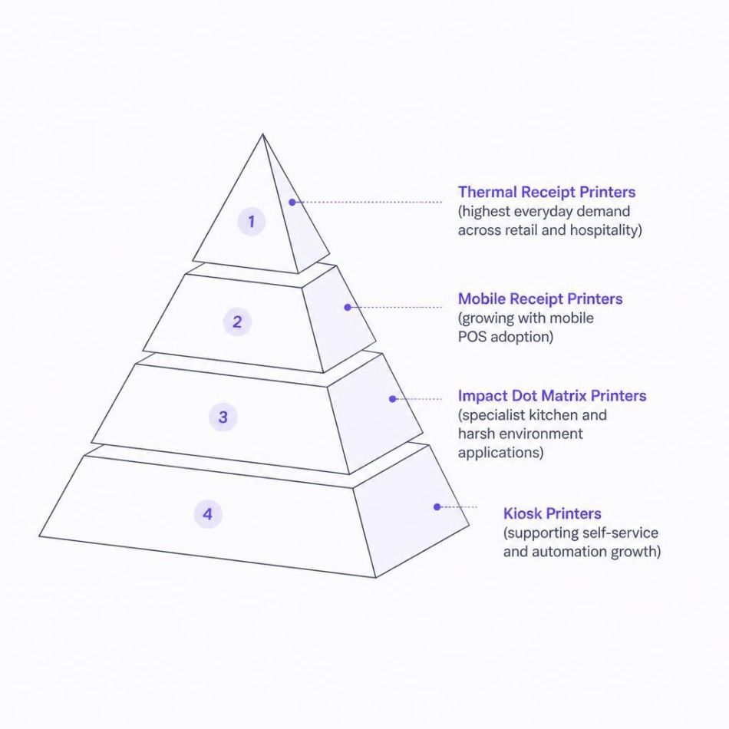
Which Receipt Printers Are in Demand in Australia?
Thermal receipt printers remain the leading choice for everyday POS transactions across Australian retail and hospitality. Their speed, quiet operation, and low maintenance suit busy checkout environments. Mobile printers are growing with tablet-based POS adoption, impact printers serve specialist kitchen environments, and kiosk printers support self-service automation.
Market direction is based on current POS and receipt-printer industry research and Australian retail printer trends.

Slide 7


Ready to Buy the Right Receipt Printer?
Choose from receipt printing solutions designed for retail, hospitality, mobile POS, kitchens, and self-service environments.
📍 Visit Us
Level 26, 44 Market St
Sydney, NSW 2000
📞 Call Us
+61 489 087 085
✉️ Email Us
sales@poscentral.com.au
Reliable POS printing for smoother business operations. — POS Central Australia

