Slide 1
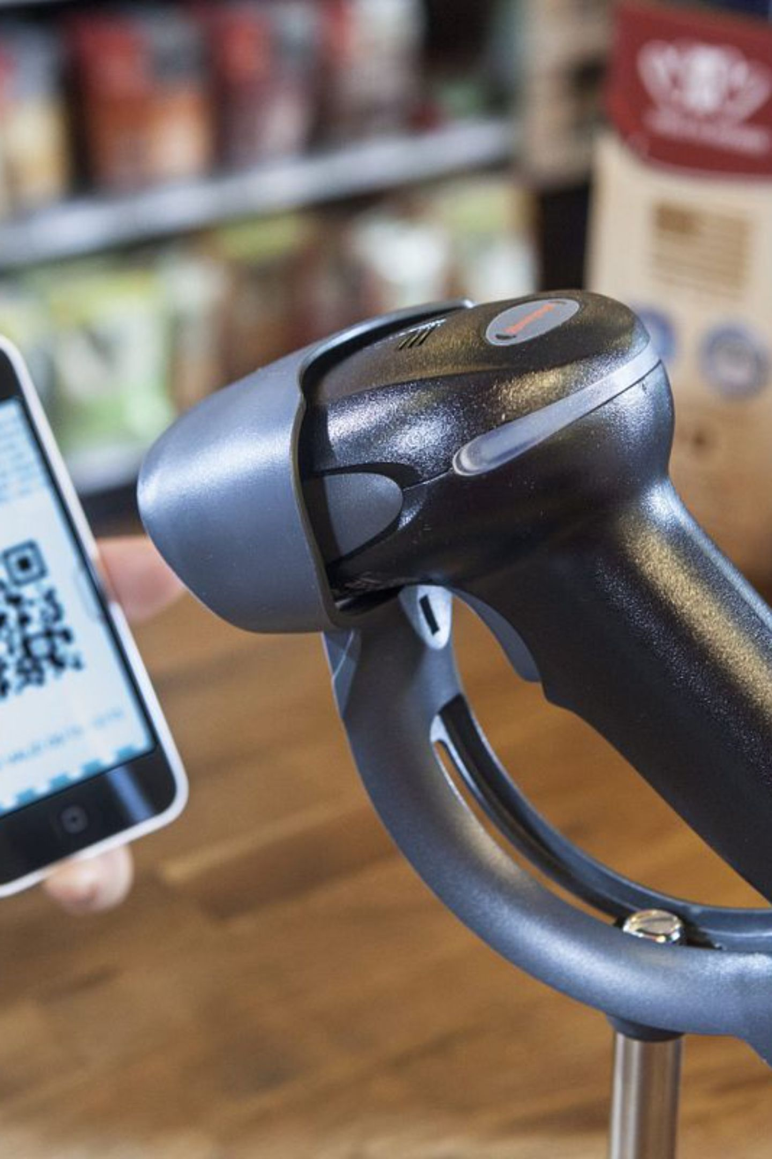

POS CENTRAL AUSTRALIA
What Makes Handheld Barcode Scanners Essential for Australian Businesses?
Practical scanning solutions for POS, inventory, retail, warehousing and everyday business workflows.

Slide 2
What Is a Handheld Barcode Scanner — and Where Is It Used?
A handheld barcode scanner captures barcode information and transfers data to a POS system, computer, or connected application — enabling faster product identification and data entry across Australian businesses.
From scanning a product at checkout to updating stock records in a warehouse, this simple workflow underpins efficient operations across retail, logistics, and hospitality.
Retail Checkout
Inventory & Stocktaking
Warehouses
Hospitality
Logistics & Tracking
Fast, accurate scanning at point of sale
Organised stock movement and dispatch
Streamlined ordering and menu workflows
Efficient stock counts and product tracking
Product identification and shipment management

Slide 3
Why Do Businesses Choose Handheld Barcode Scanners?
Barcode scanning replaces slow, error-prone manual entry with fast, reliable data capture — improving accuracy and efficiency across busy retail, warehouse and logistics workflows.
Speed
Capture barcode data in a fraction of a second
Accuracy
Reduce manual entry errors and product mismatches
Convenience
Scan at counters, shelves or workstations with ease
Inventory Control
Support real-time stock management and tracking
Workflow Efficiency
Flexible USB-connected options suit compatible systems
2D Capability
Support modern barcode formats where required
Manual Entry
Time-consuming, prone to errors, and difficult to scale across large product ranges
Barcode Scanning
Fast, accurate, and designed for high-volume retail and warehouse environments

Slide 4
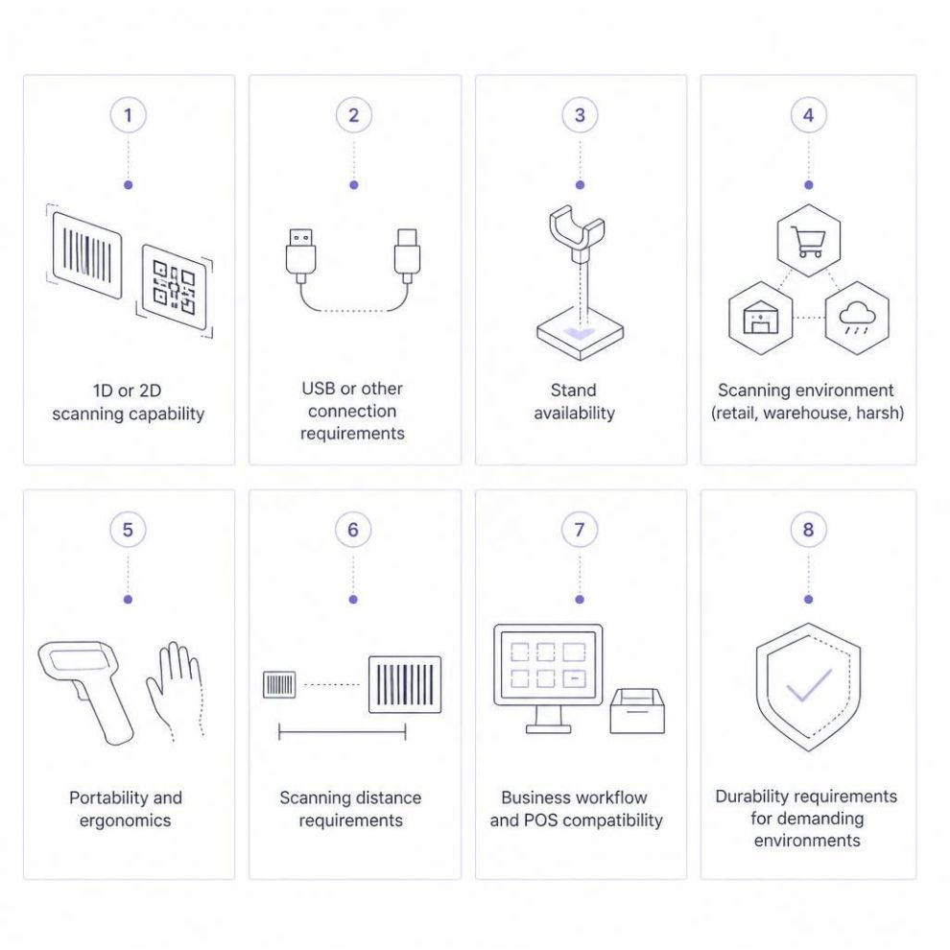

Which Handheld Barcode Scanner Features Matter Most?
Match the scanner to the barcode types, working environment, connection method and software system your business uses.
Not all scanners suit all environments. Consider your specific workflow and POS compatibility before selecting a model.

Slide 5
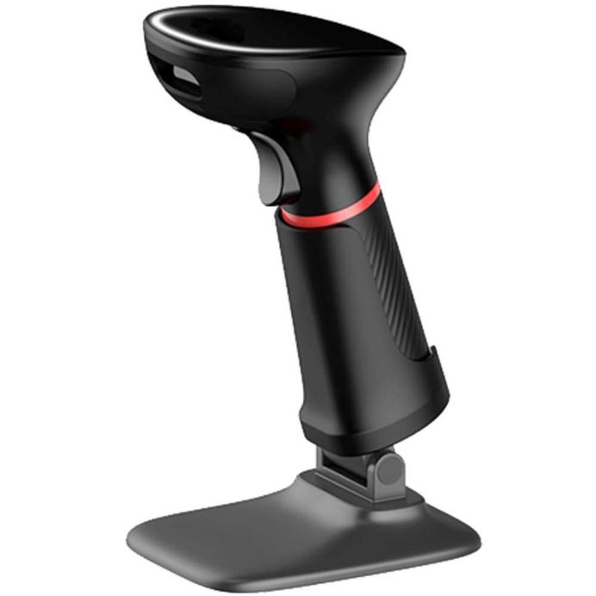
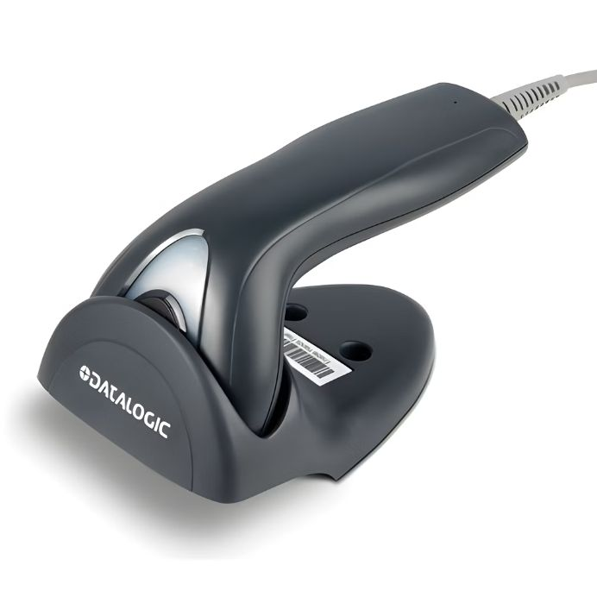
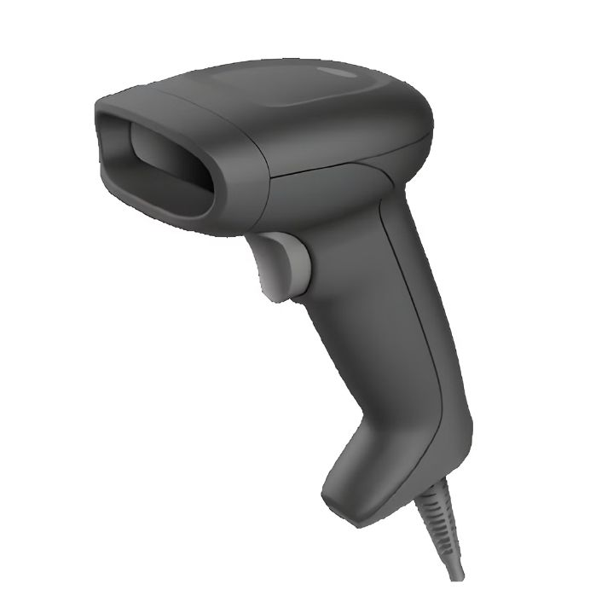
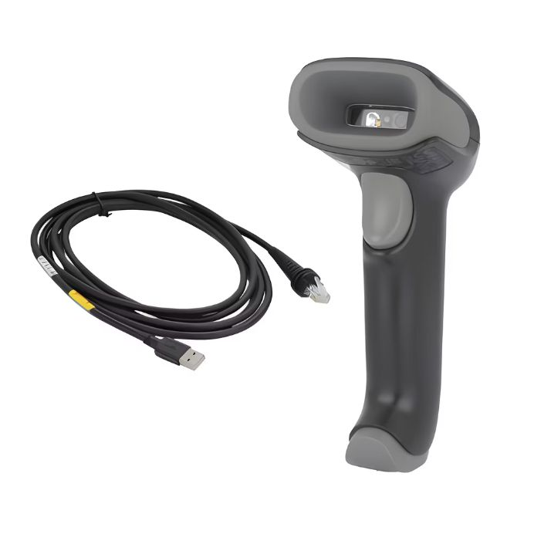
Which Handheld Barcode Scanner Fits Your Workflow?
A quick comparison of four popular models available from POS Central Australia.
Nexa Zed 2602
Datalogic Touch TD1100
Honeywell HH490
Honeywell Voyager 1470G
2D scanner
USB interface
Stand included
Save 48%
USB kit
Straightforward barcode scanning
Reliable daily use
Save 26%
2D scanner
USB interface
Stand included
Save 44%
2D scanner
USB kit
Versatile scanning
Save 26%
Product features and availability may vary. Check the individual product page for current specifications.

Slide 6
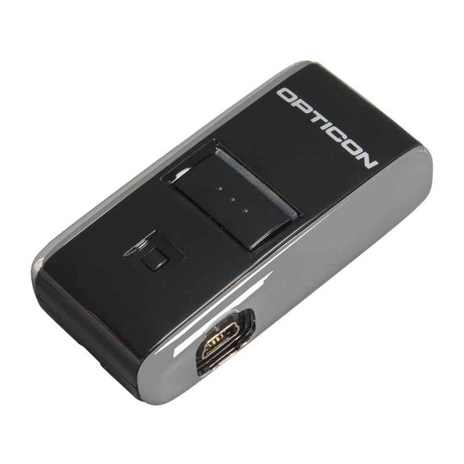
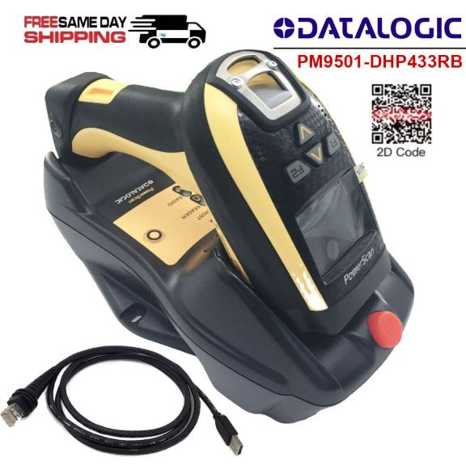
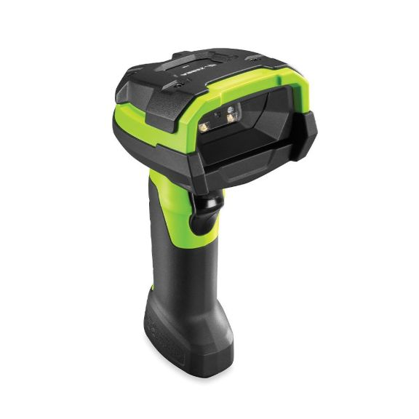
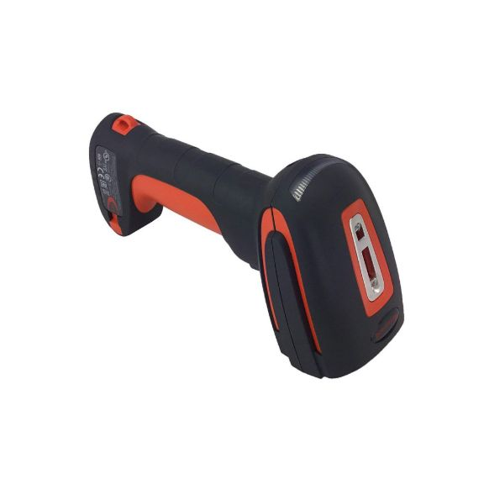
Need a Different Scanning Setup? Consider These Models
From everyday retail scanning to specialised requirements, different scanner designs support different working environments.
Opticon OPN2001
Datalogic PowerScan PM9501
Zebra DS3608
Honeywell 1980i Granit
Compact pocket memory scanner
Carry strap and USB cable included
Save 35%
2D-ER model
USB connection
2M straight cable configuration
2D-EX25 model
USB kit configuration
Built for demanding environments
2D-SR model
Charging cradle / USB kit
Robust commercial design

Slide 7
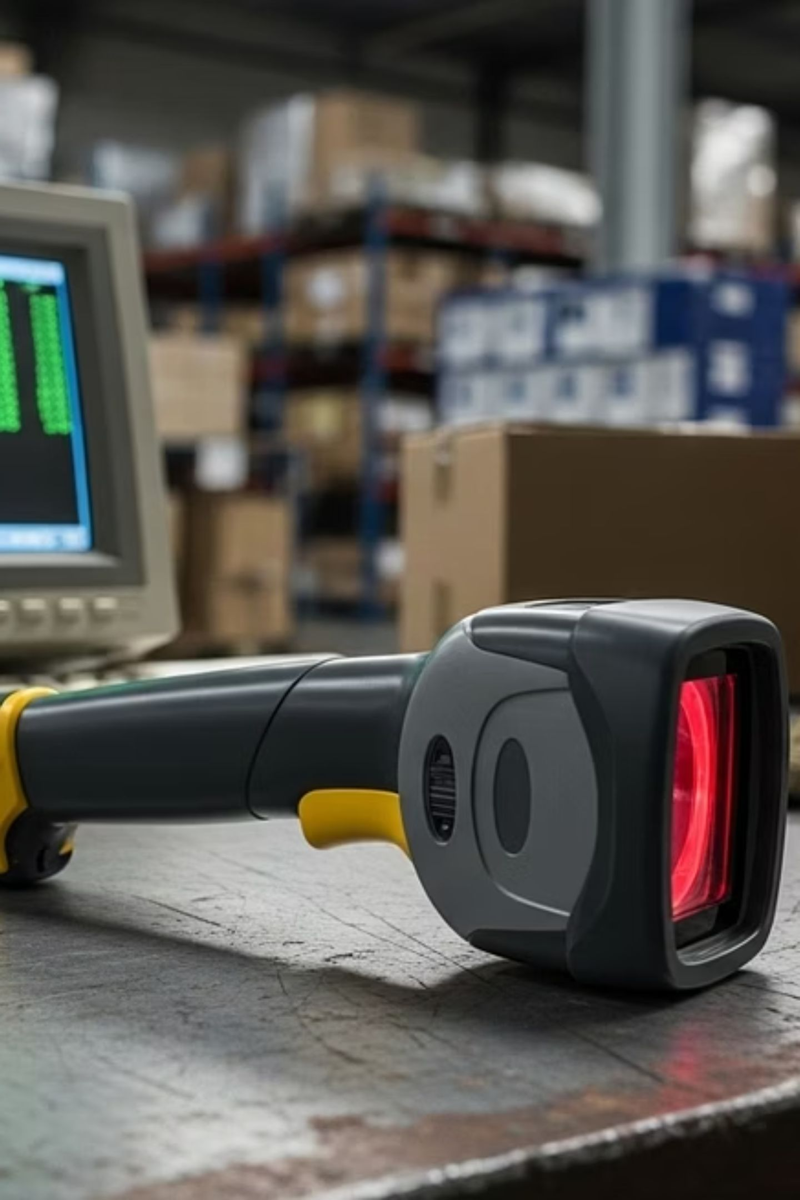
Ready to Choose a Handheld Barcode Scanner?
Browse handheld barcode scanners from POS Central Australia and compare options for retail, POS, inventory, warehousing and business workflows.
POS Central Australia
Address: Level 26, 44 Market St, Sydney, NSW 2000
Phone: +61 489 087 085
Mail: sales@poscentral.com.au

