Slide 1
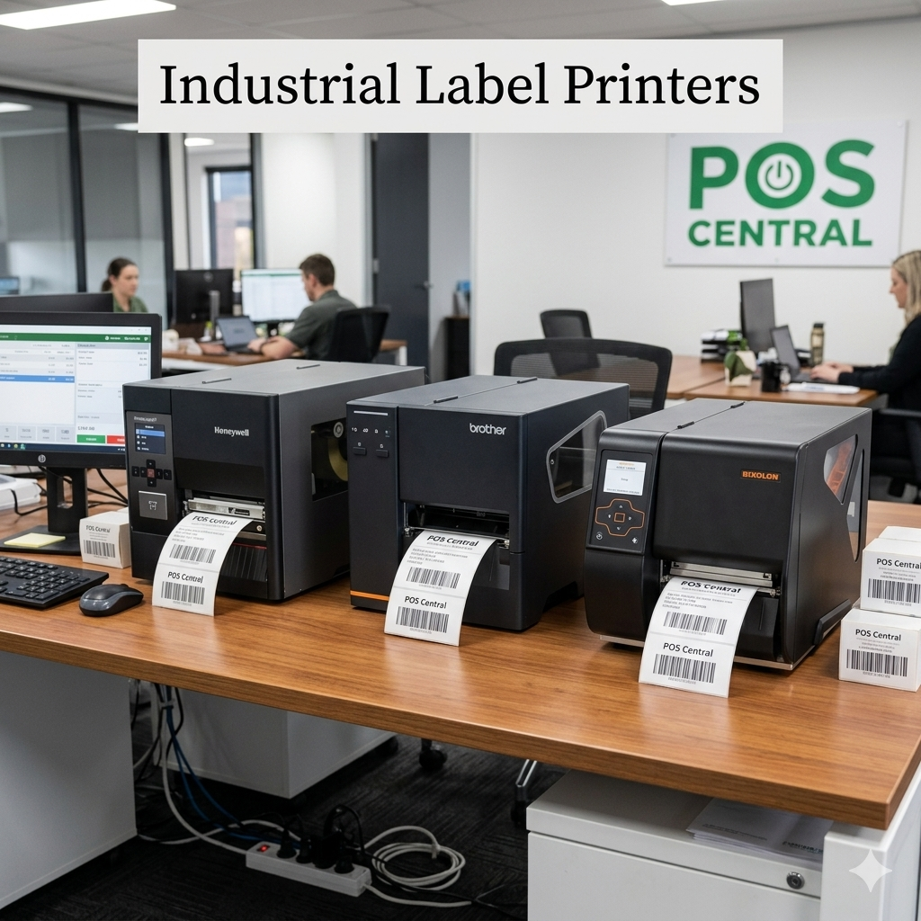
Who Supplies Industrial Label Printers
Australia-Wide ?
Australia's Trusted Source for Direct Thermal,
Thermal Transfer & Mobile/Wireless Label Printers
Buy Label Printers
Label Printers for Sale
www.poscentral.com.au
Serving Warehousing · Retail · Healthcare · Manufacturing · Logistics industries across Australia

Slide 2
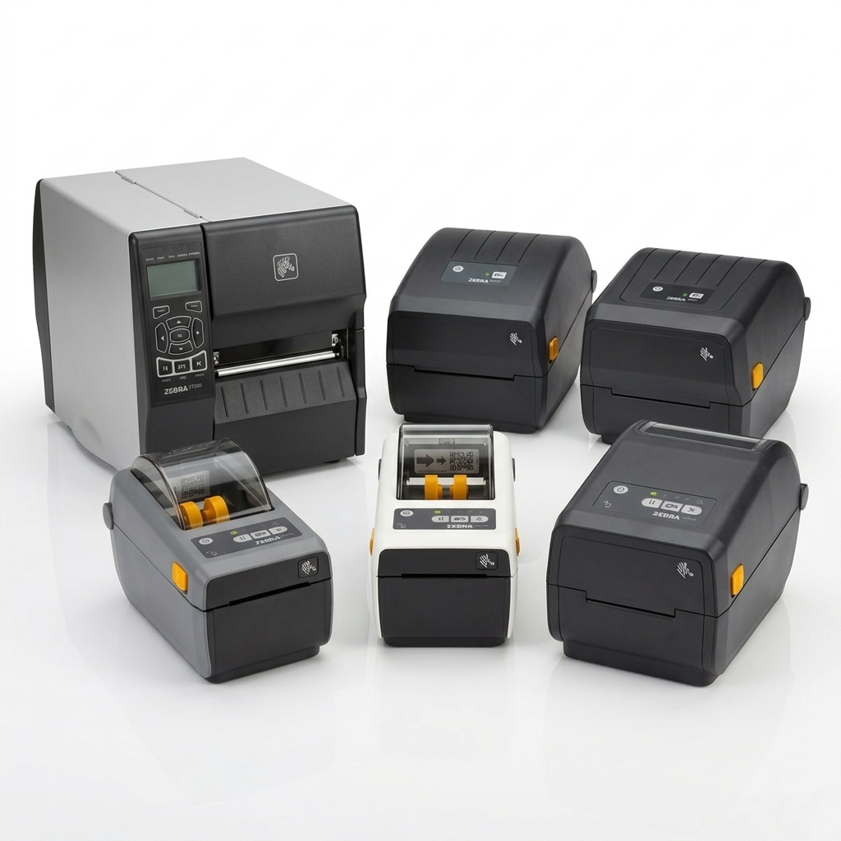
Industrial Label Printers in Australia — Built for Every Business
Whether you run a busy warehouse, a retail chain, or a manufacturing plant across Sydney, Melbourne, Brisbane or Perth — POS Central Australia offers a complete range of label printers for sale to match every operational demand.
Direct Thermal
Thermal Transfer
No ribbon — fast & low‑cost printing
Durable prints that withstand harsh conditions
Mobile / Wireless
Color & Card
Print on the move with Bluetooth & Wi-Fi
ID cards, color labels & specialty media
www.poscentral.com.au | +61 489 087 085 | Industrial Label Printers for Sale Across Australia

Slide 3
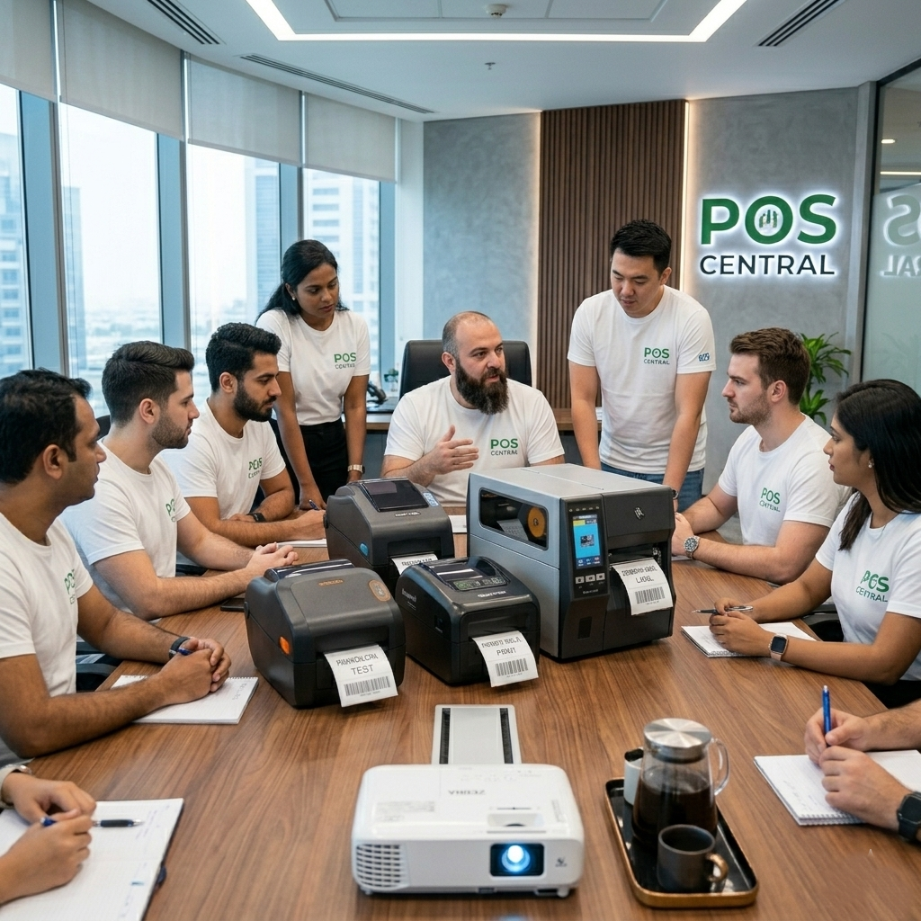
What Are Industrial Label Printers?
Industrial label printers are heavy-duty printing devices designed to handle continuous, high-volume label output in demanding environments. Unlike standard desktop printers, they support wide media widths, rugged construction, and advanced connectivity — making them essential for logistics, warehousing, healthcare, and manufacturing.
▸
High-Speed Output:
Print hundreds of labels per minute without interruption.
▸
Dual Print Methods:
Supports both Direct Thermal and Thermal Transfer Label Printers.
▸
Wide Media Handling:
Compatible with standard to extra-wide label rolls and specialty media.
▸
Robust Connectivity:
USB, Serial, Ethernet, Bluetooth & Wi-Fi options across all models.
▸
Industry Certifications:
Brands like Honeywell, Zebra, Citizen & Bixolon — trusted worldwide.
www.poscentral.com.au | +61 489 087 085 | Industrial Label Printers for Sale Across Australia

Slide 4
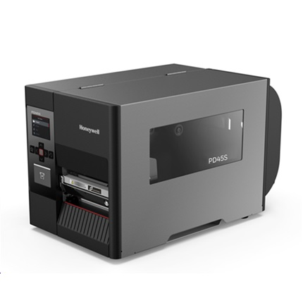
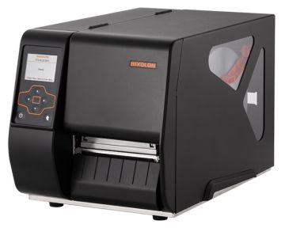
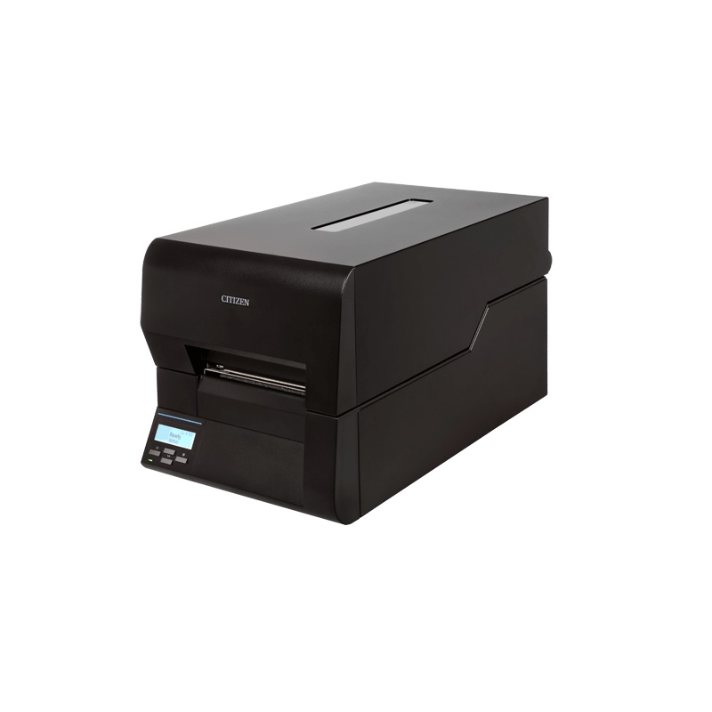
Industrial Label Printers — Featured Models
🖨 Industrial Label Printers
Buy Label Printers · Direct Thermal Label Printers · Thermal Transfer Label Printers · Industrial Label Printers for Sale
Honeywell PD45S
Bixolon XT2-40
Citizen CL-E720
203 DPI · Ethernet · Industrial
203 DPI · USB / Serial / Ethernet · TT
203 DPI · Direct Thermal or TT
Engineered for demanding environments — features high-speed printing up to 12 ips, dual-mode operation (Direct Thermal & Thermal Transfer), and robust Ethernet connectivity for seamless network integration.
A compact yet powerful Thermal Transfer Label Printer with tri-interface support. Ideal for retail shelf labels, distribution centres and light industrial workflows needing reliable label printers for sale.
Versatile industrial printer switchable between Direct Thermal and Thermal Transfer modes. Suits Australian warehouses requiring flexible media handling without changing hardware.
www.poscentral.com.au | +61 489 087 085 | Industrial Label Printers for Sale Across Australia

Slide 5
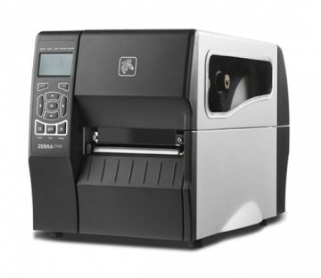
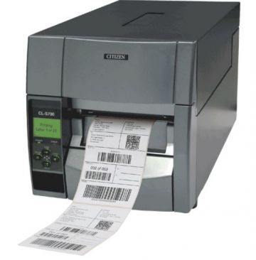
More Products & Printer Categories at POS Central
All Label Printer Categories
Zebra ZT230
203 DPI · USB / Serial / Ethernet · TT
Direct Thermal
Label Printers
Thermal Transfer
Label Printers
Mid-range Thermal Transfer Label Printer from Zebra — a trusted name in industrial labelling. Designed for medium-duty production lines needing consistent throughput and easy media loading.
Industrial
Label Printers
Wireless Label Printers
Citizen CL-S703II
300 DPI · Industrial Thermal Transfer
High-resolution 300 DPI Thermal Transfer printer for fine-detail labels — pharmaceutical, compliance, and precision inventory tags printed with clarity at industrial speeds.
Color
Label Printers
Plastic Card /
ID Card Printers
www.poscentral.com.au | +61 489 087 085 | Industrial Label Printers for Sale Across Australia

Slide 6
Get in Touch with POS Central Australia
Buy label printers, get expert advice & fast shipping across Australia
📞
🌐
📧
📍
Phone
Website
Support
Shipping
+61 489 087 085
www.poscentral.com.au
sales@poscentral.com.au
Nationwide — AU Wide Delivery
Products Available:
Industrial Label Printers
Mobile/Wireless Label Printers
Color Label Printers
High-End Label Printers
POS Central Australia | Label Printers for Sale | ABN details on website

