Slide 1
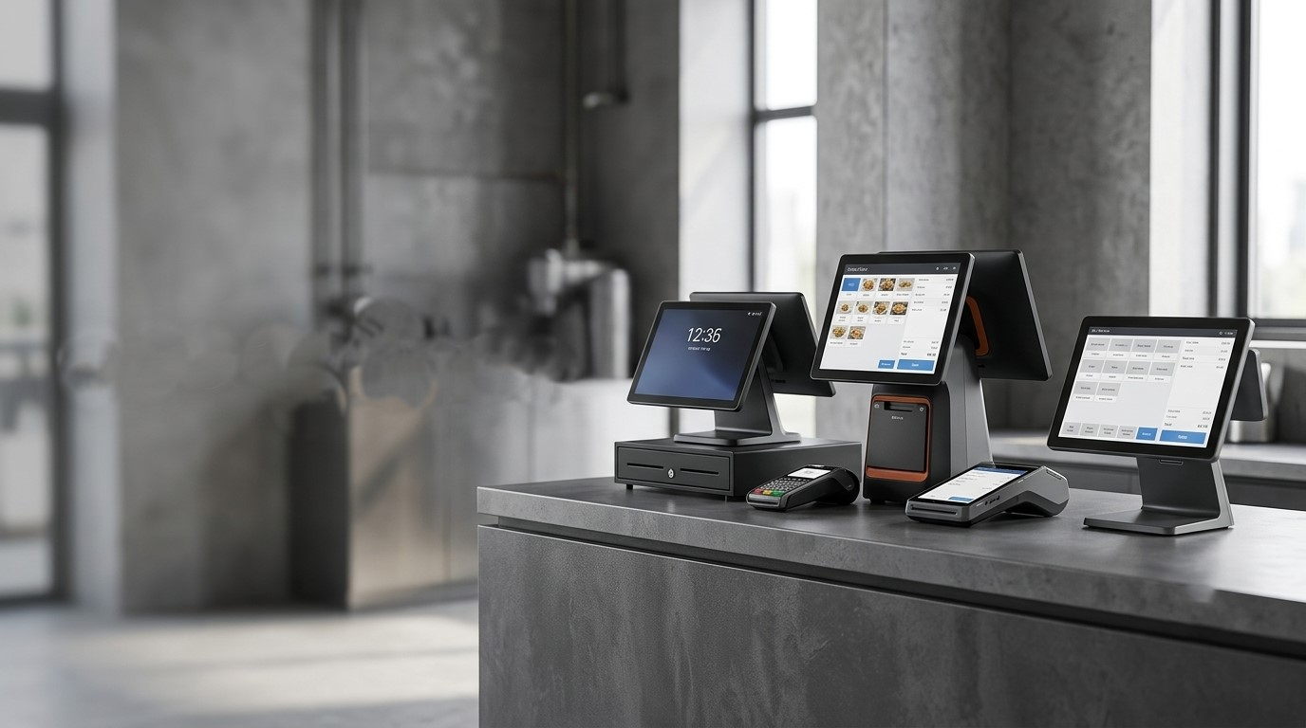


How Can the Right POS System Transform Your Business?
Smarter POS solutions for faster transactions, better management, and business success
www.poscentral.com.au | +61 489 087 085 | sales@poscentral.com.au

Slide 2
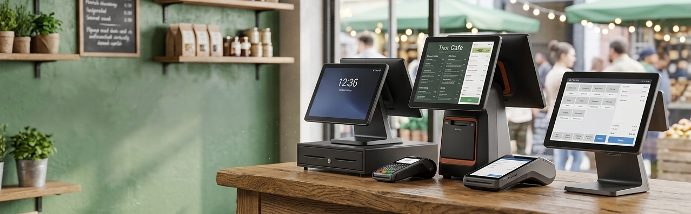
Smart POS Systems for Every Australian Business
Modern POS systems help businesses process sales faster, manage inventory, improve customer service, and increase operational efficiency. Whether you own a retail store, cafe, restaurant, supermarket, warehouse, or pharmacy, the right POS system simplifies daily operations and supports business growth.

Slide 3
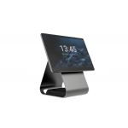
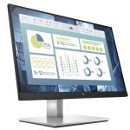
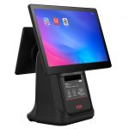
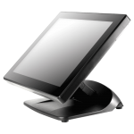
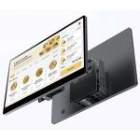

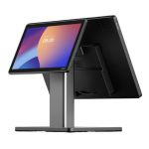
Find the Right POS Hardware for Your Business
POS Central offers a wide range of POS systems designed for different industries and business sizes.
Product Categories:
All-in-One POS Systems – Compact, space-saving business solutions.
Retail POS Terminals – Reliable checkout systems for retail stores.
Portable Data Terminals – Mobile inventory and warehouse management.
iPads & Tablets – Flexible POS for modern businesses.
Touch POS Terminals – Fast touchscreen operation.
Android POS Terminals – Affordable Android-based POS devices.
Commercial Tablets – Rugged tablets for professional use.

Slide 4
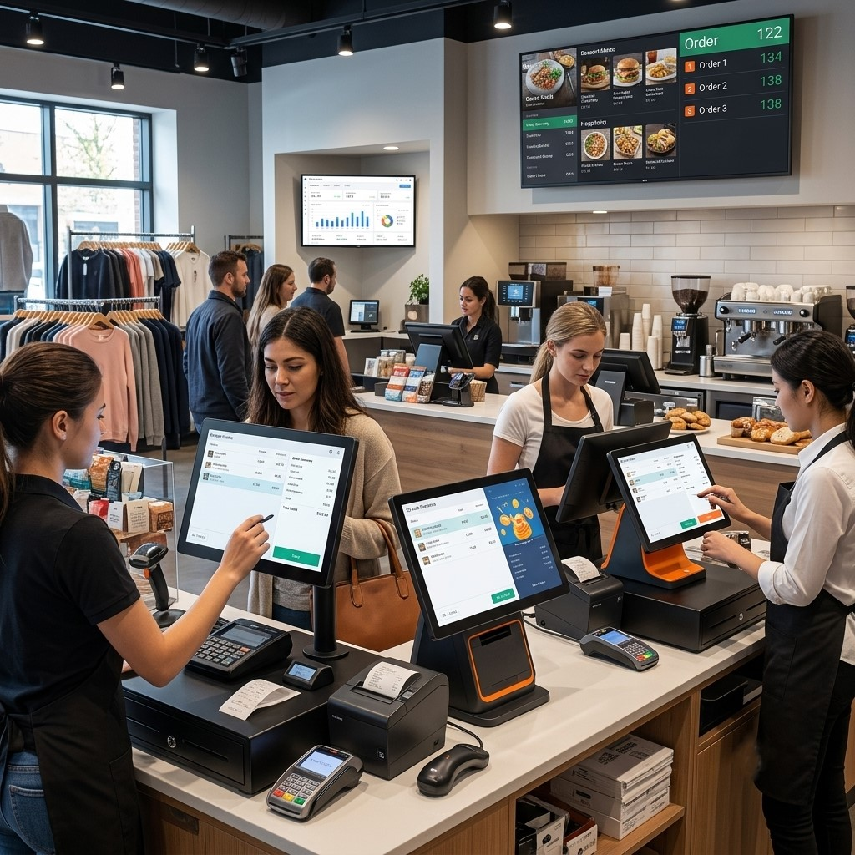
Industry-Specific POS Equipment
Choose specialised hardware that improves productivity and customer experience.
Available Solutions
Self-Service Kiosks
  Faster customer ordering
  Reduced waiting times
  Improved customer satisfaction
Commercial Scales
  Accurate product weighing
  Retail and grocery applications
  Integrated POS compatibility
Scale Accessories
  Reliable connectivity
  Enhanced weighing performance
  Easy installation

Slide 5
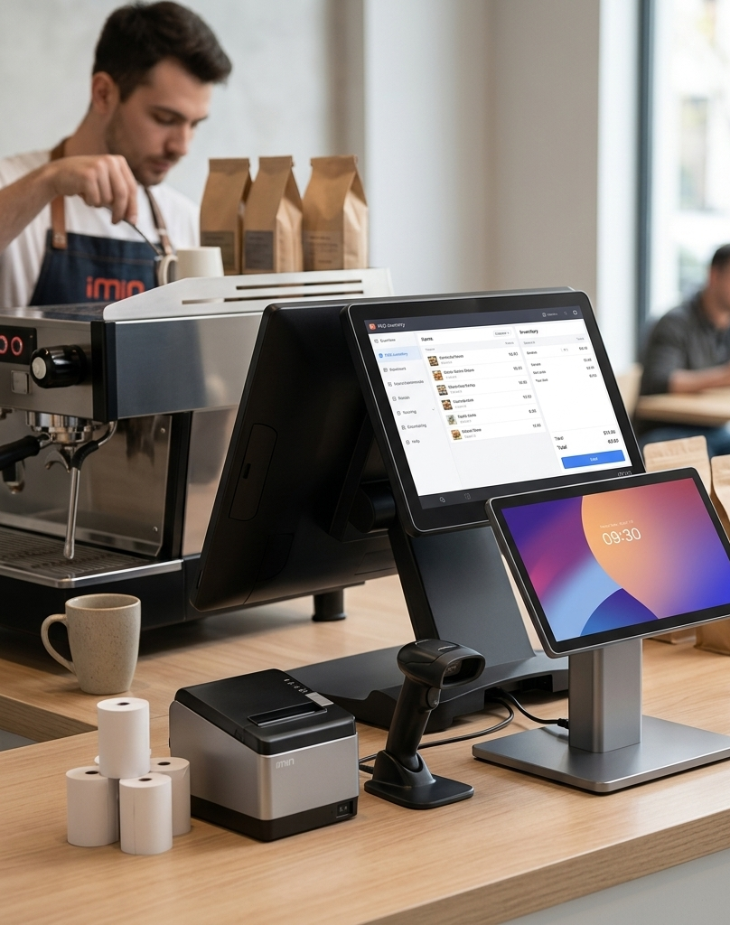
Reliable POS Systems Built for Australian Businesses
POS Central Australia offers flexible POS Systems suitable for retail stores, cafes, restaurants, and service businesses. These systems are designed to improve sales tracking, customer service, and business efficiency.
Key Features
High-performance POS hardware
Trusted industry-leading brands
Retail, hospitality & warehouse solutions
Durable commercial-grade equipment
User-friendly touchscreen operation
Fast installation and setup
Expert local Australian support

Slide 6
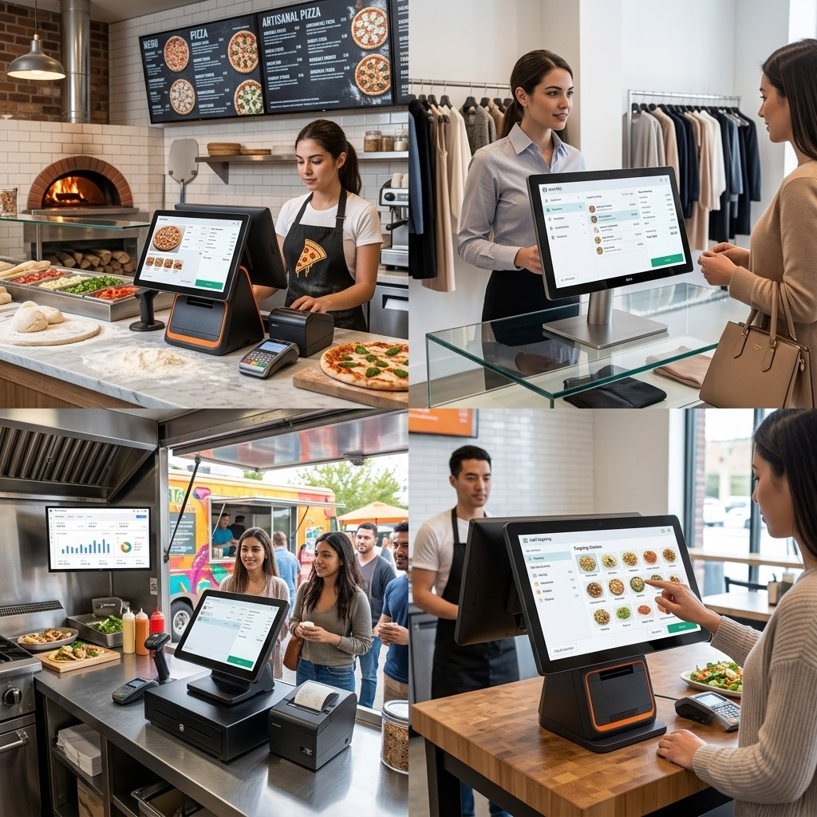
Improve Business Performance with Smart POS Technology
Modern POS technology helps businesses operate more efficiently by streamlining daily operations and enhancing the customer experience. With faster customer checkout, accurate inventory management, and secure payment processing, businesses can reduce errors while improving service quality.
Whether you're a small business or a growing enterprise, scalable POS systems support long-term success across a wide range of industries, including retail, hospitality, healthcare, warehousing, wholesale, education, government, and logistics.

Slide 7
Contact Us
Your trusted destination for reliable POS Systems and business technology solutions across Australia.
Website: POS Central AU
Address: Level 26, 44 Market St, Sydney, NSW 2000, Australia
Phone: +61 489 087 085
E-mail: sales@poscentral.com.au
THANK YOU

