Slide 1
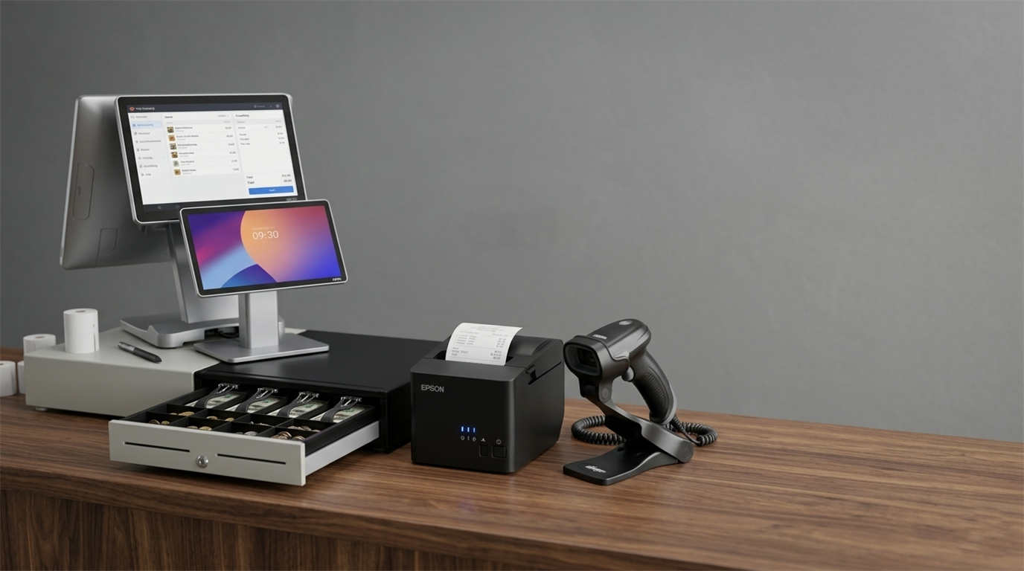

All-in-One POS Solutions for Retail, Hospitality & Warehousing in Australia
- Your Trusted POS Store

Slide 2
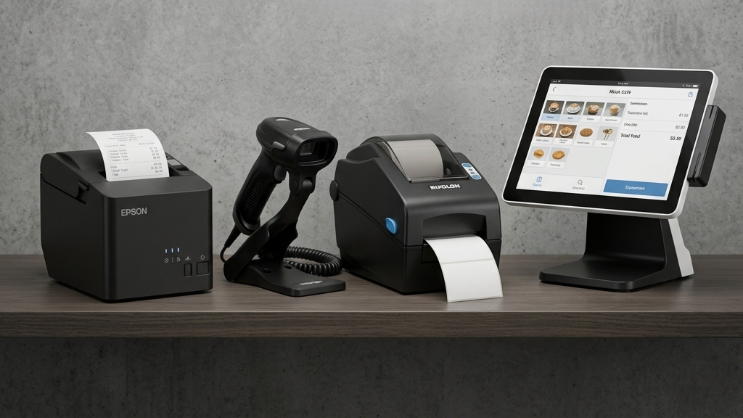
Why Businesses Choose POS Central Australia
POS Central Australia is a trusted POS shop offering advanced retail and hospitality hardware for businesses across Australia. From small retail stores to busy restaurants and warehouses, businesses rely on dependable POS technology to improve daily operations.
As a leading POS Australia supplier, POS Central provides quality products including Label Printers, Receipt Printers, Barcode Scanners, POS Bundles, POS Systems, and Cash Drawers designed for fast, accurate, and smooth business performance.

Slide 3
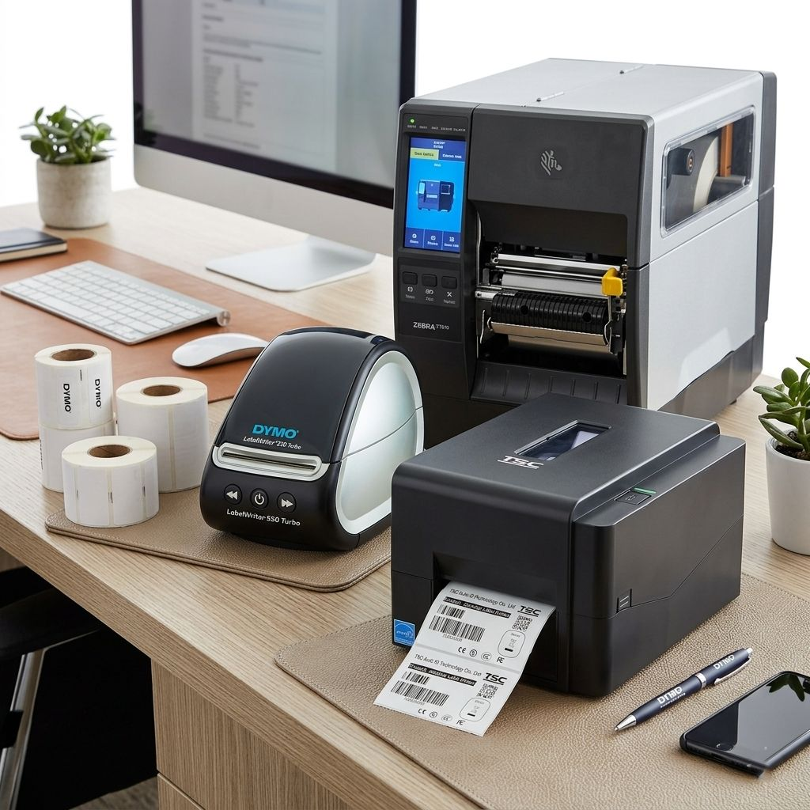
Improve Product Labelling with Reliable Label Printers
Modern businesses need clear and accurate labels for inventory, shipping, pricing, and stock control. Label printers help retailers and warehouses save time while reducing manual errors.
POS Central Australia offers dependable Label printer suitable for retail stores, healthcare, logistics, and office environments. These printing solutions support efficient workflow management and organised inventory tracking.

Slide 4
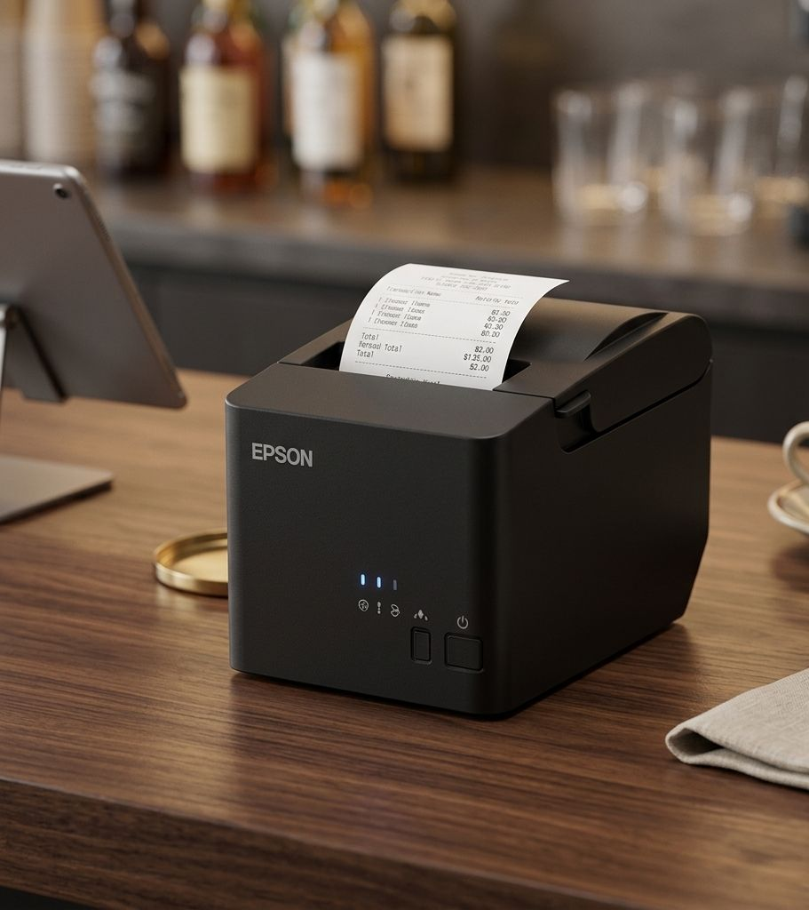
Fast Receipt Printers for Retail & Hospitality Businesses
Efficient customer service starts with reliable Receipt Printers. High-speed printing helps businesses reduce waiting times and improve checkout operations during busy hours.
POS Central Australia supplies quality Receipt Printers designed for cafes, restaurants, supermarkets, and retail stores. These printers deliver clear receipts, dependable performance, and seamless integration with modern POS systems.

Slide 5
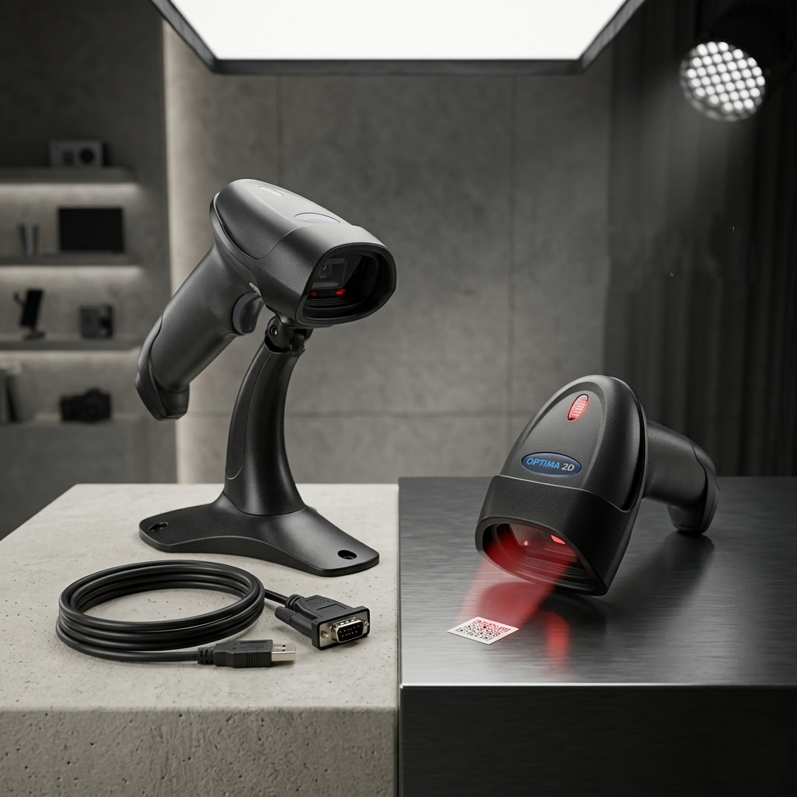
Barcode Scanners That Support Faster Daily Operations
Businesses across Australia use Barcode Scanner to improve stock accuracy, speed up transactions, and simplify inventory management.
POS Central Australia provides advanced scanning solutions suitable for retail, warehouses, healthcare, and logistics businesses. From handheld devices to wireless models, these scanners support fast and reliable data capture.

Slide 6
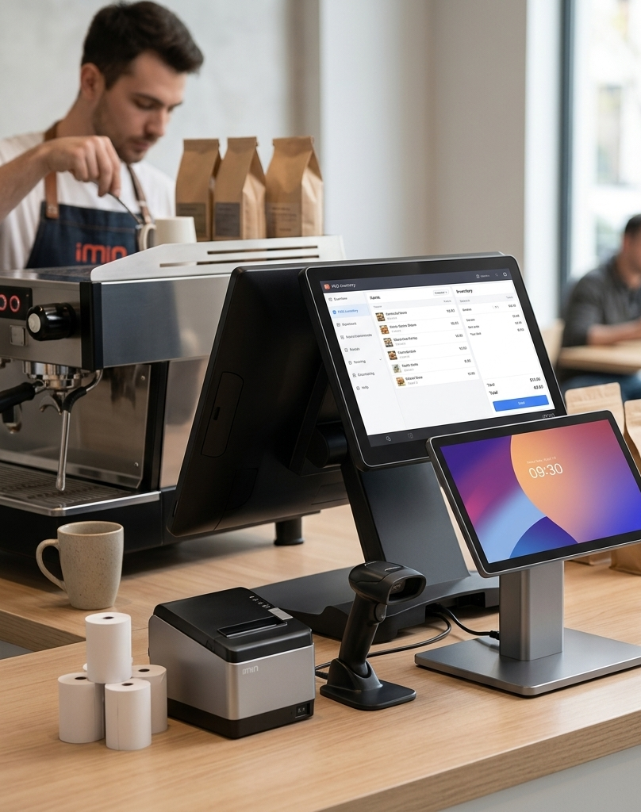
Complete POS Bundles and POS Systems for Australian Businesses
Choosing complete POS Bundles helps businesses save time while ensuring hardware compatibility. Combined solutions make setup easier and support smooth daily operations.
POS Central Australia offers flexible POS Systems suitable for retail stores, cafes, restaurants, and service businesses. These systems are designed to improve sales tracking, customer service, and business efficiency.

Slide 7
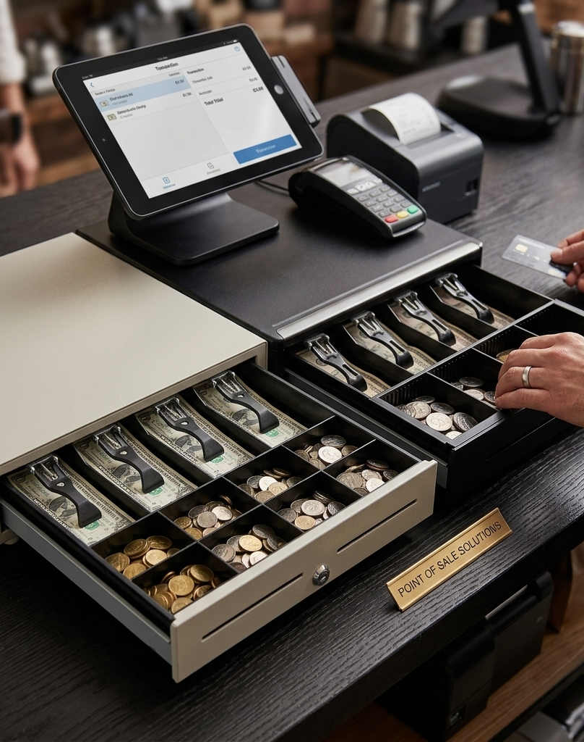
Secure Cash Handling with Reliable Cash Drawers
Durable Cash Drawers help businesses maintain organised and secure cash management during daily transactions. Reliable hardware improves checkout efficiency and supports smoother retail operations.
POS Central Australia supplies dependable cash handling solutions suitable for supermarkets, retail stores, restaurants, and hospitality businesses across Australia.

Slide 8
Contact Us
Your trusted destination for reliable POS hardware and business technology solutions across Australia.
Website: POS Central AU
Address: Level 16, 175 Pitt Street, Sydney, NSW 2000, Australia
Phone: +61 489 087 085
E-mail: sales@poscentral.com.au
THANK YOU

