Slide 1
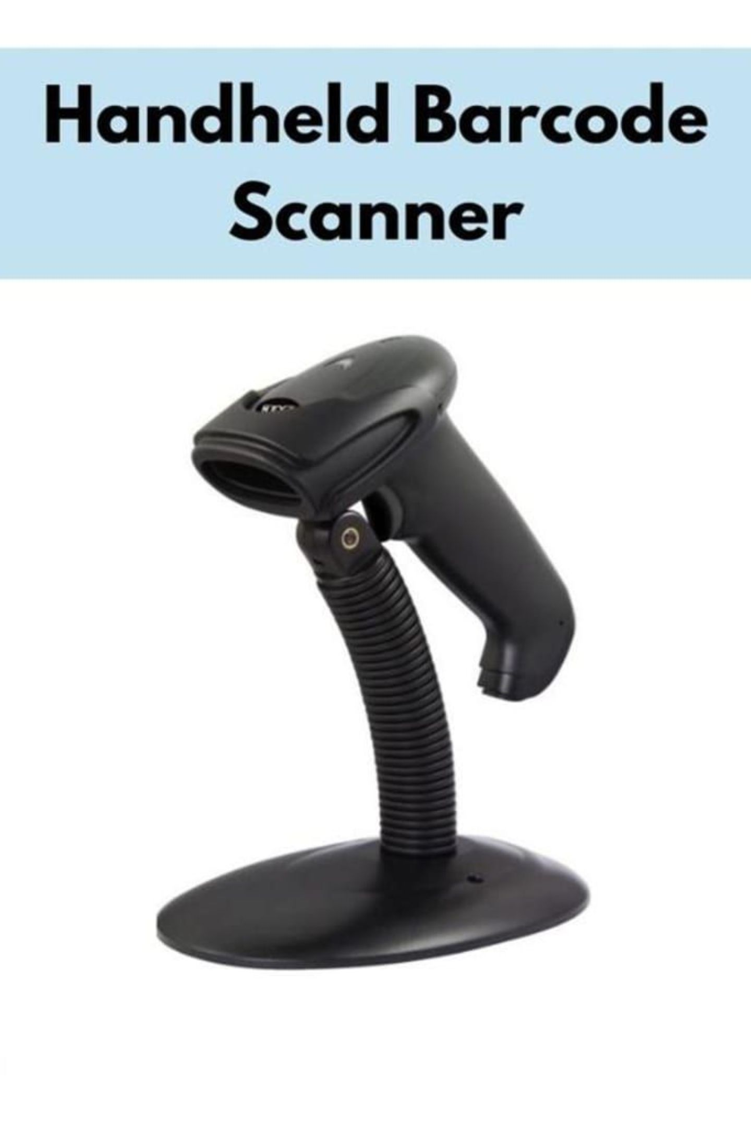
Which Barcode Scanner Gives the Best Value for Money?
A Practical Buying Guide for Australian Businesses
POS CENTRAL AU

Slide 2

Why the Right Barcode Scanner Matters
A barcode scanner is a strategic investment — not just hardware. The right choice drives efficiency, accuracy, and long-term
savings.
Faster Checkouts
Accurate Inventory
Reduce queue times and boost throughput
Real-time stock tracking and management
Fewer Errors
Better Experience
Eliminate manual data entry mistakes
Smoother transactions for customers
Higher Productivity
Long-Term Savings
Staff focus on value-adding tasks
Lower operational costs over time
Inventory
Barcode Scanner
Business Reports
POS System

Slide 3
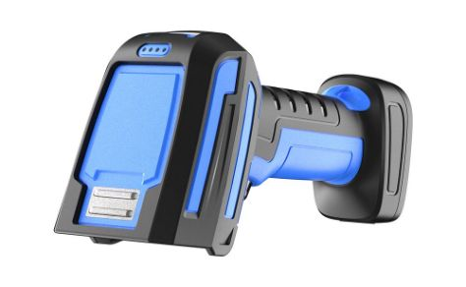
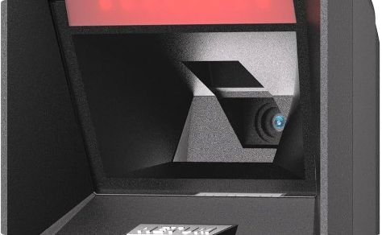
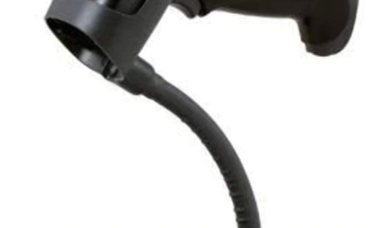
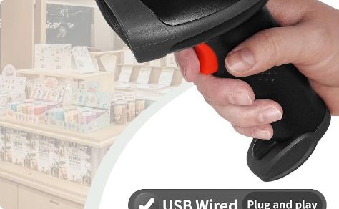
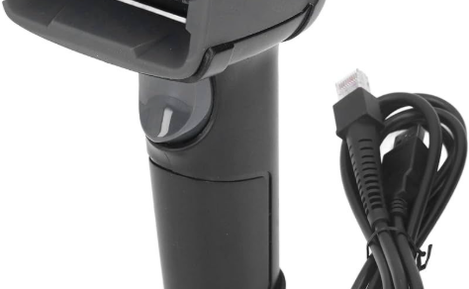
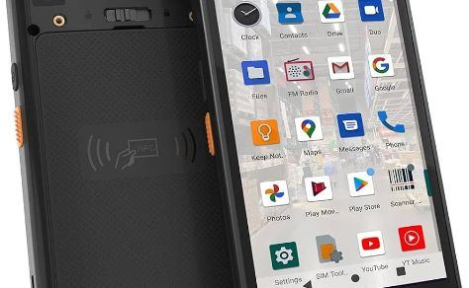
Barcode Scanner Categories & Best Use Cases
Each scanner type serves a specific purpose. Matching the right category to your environment is the first step to best value.
2D Scanner
Omni-Directional Scanner
Single Line Scanner
Cordless Scanner
Reads QR codes & 2D barcodes. Ideal for healthcare, retail, logistics.
Multi-angle scanning. Best for supermarkets, high-volume retail.
Simple, cost-effective. Suits small businesses, offices.
Wireless freedom. Ideal for warehouses, large retail floors.
Handheld Scanner
Mobile Computer
Versatile and ergonomic. Suits retail, hospitality, general use.
All-in-one device. Built for logistics, field service, enterprise.

Slide 4
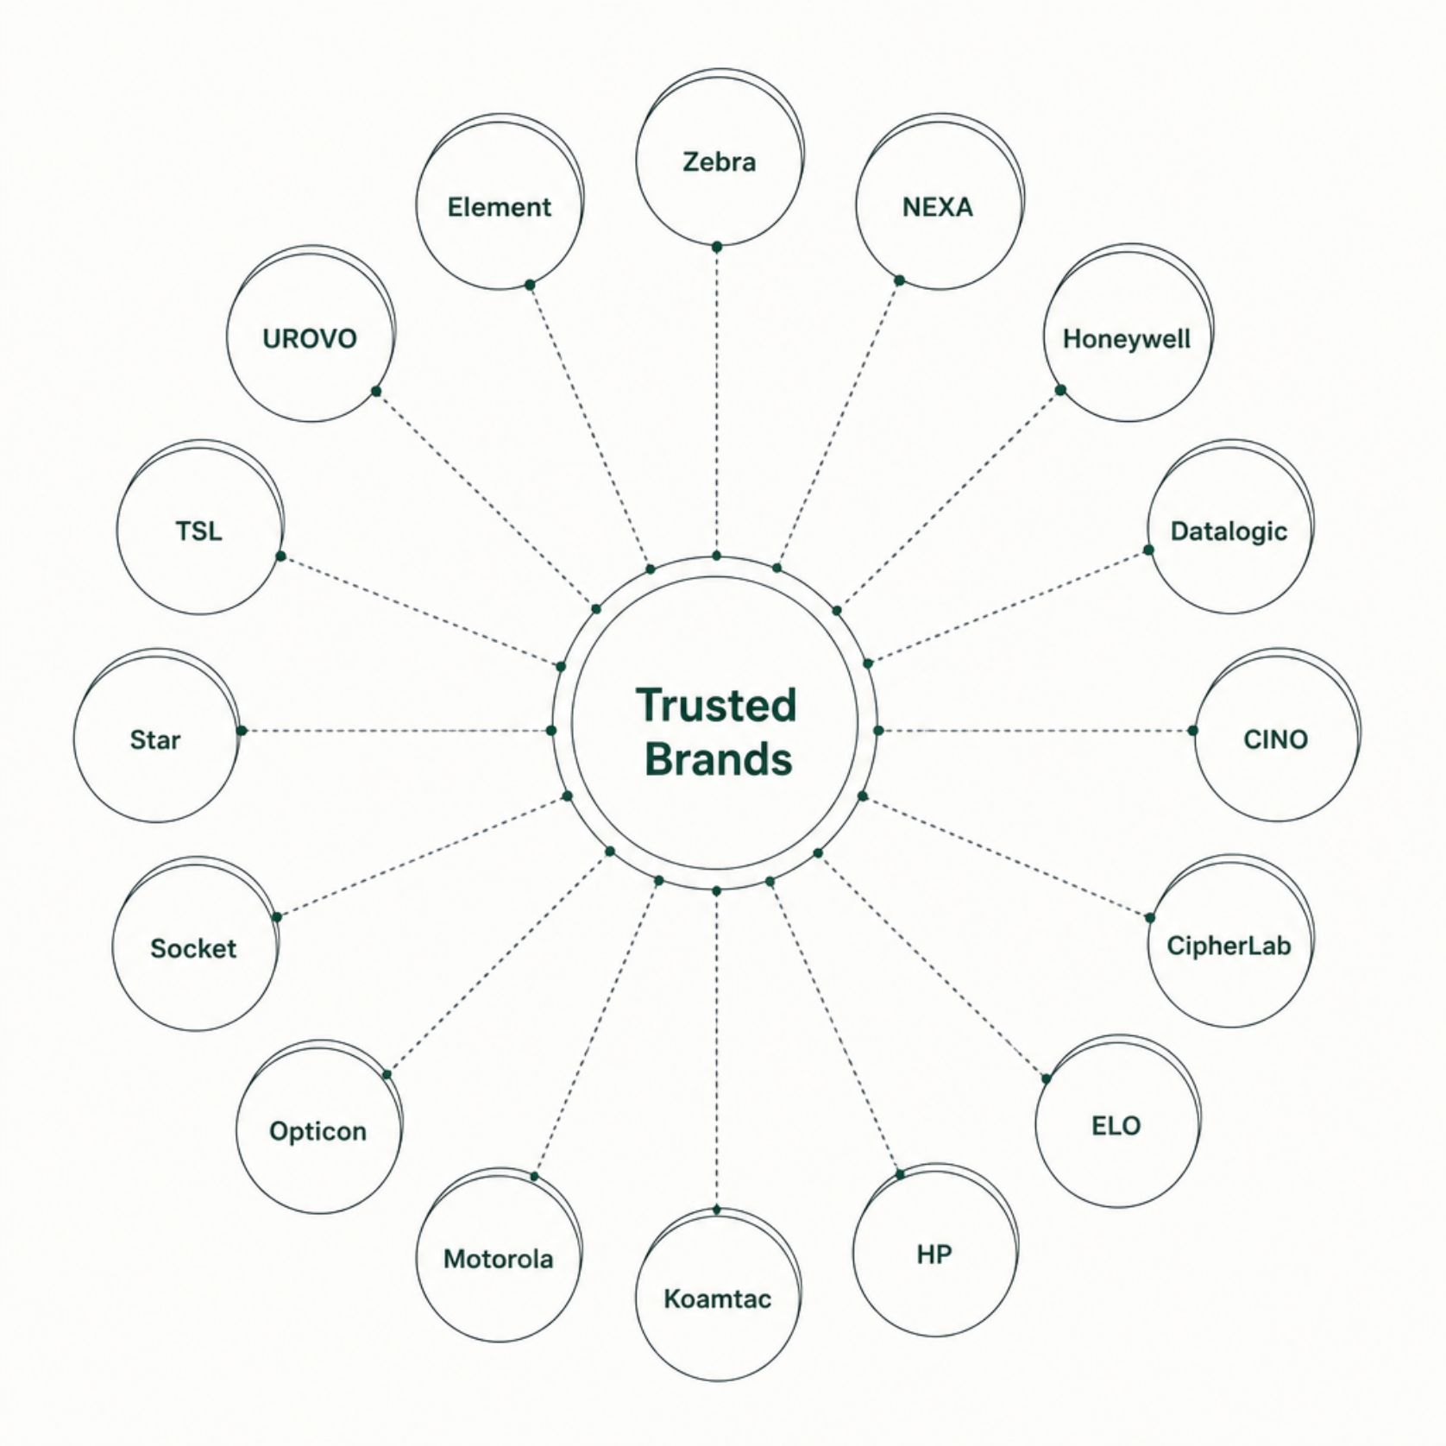
Trusted Brands Used Across Australia
Leading manufacturers specialise in different environments —
retail, healthcare, warehousing, logistics, and enterprise
mobility.
Choosing a recognised brand means access to local support, firmware updates, and proven reliability across Australian conditions.
Retail & Hospitality
Zebra · Datalogic · Honeywell · Posiflex
Warehouse & Logistics
Motorola · UROVO · TSL · CipherLab
Healthcare
Zebra · Honeywell · CINO · Socket
Enterprise Mobility
Opticon · Koamtac · NEXA · ELO · HP · Star · Element

Slide 5
Recommended Barcode Scanners
These models represent strong value across common Australian business scenarios. Compare by type, connectivity, and application fit.
Model
Type
Connectivity
Best For
Key Strength
Zebra LS2208 USB Kit
Handheld 1D
USB
Retail, POS
Reliable, durable
Nexa ZED 1600 USB
Handheld 1D
USB
Small business
Cost-effective
SA9100
Handheld 2D
Wi-Fi, BT
Warehouse, logistics
Wireless flexibility
Datalogic Touch 65 Lite USB
Omni 1D
USB
Supermarkets
Multi-angle scanning
Nexa ZED 2602 USB 2D
Handheld 2D
USB
Retail, healthcare
2D & QR support
Datalogic Touch TD1100 USB
Handheld 1D
USB
General retail
Lightweight, fast
Honeywell HH490 2D USB
Handheld 2D
USB
Healthcare, retail
Rugged, versatile
CipherLab 1000A USB
Handheld 1D
USB
Small business
Compact, affordable

Slide 6

How to Choose the Best Value Scanner
Match Scanner to Your Business
Key Buying Factors
Retail Store → Handheld Scanner
Scan Speed
Durability
Supermarket → Omni-Directional Scanner
Connectivity
Warranty
Warehouse → Cordless Scanner
Ease of Use
POS Compatibility
Healthcare → 2D Scanner
Future Scalability
Logistics → Mobile Computer
The best value scanner matches your business requirements — not necessarily the lowest price.
Small Business → Single Line Scanner

Slide 7

Need Help Choosing the Right Barcode Scanner?
POS Central Australia — Helping Australian businesses choose reliable barcode scanning solutions across retail, hospitality, healthcare, warehousing, and logistics.
🌐 Website
📞 Phone
poscentral.com.au
+61 489 087 085
✉️ Email
sales@poscentral.com.au
Explore a wide range of barcode scanners from trusted global brands — available for every industry and business size across Australia.

