Slide 1
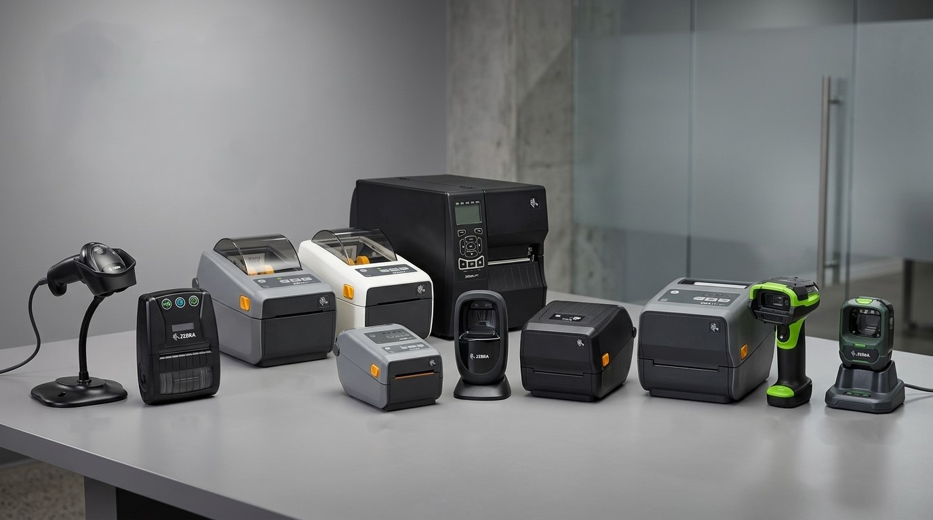


Which Zebra POS Printer Is Right for Your Store?
Genuine Zebra POS Hardware, Supplied and Supported by POS Central Australia
POS Central Australia | www.poscentral.com.au
1

Slide 2
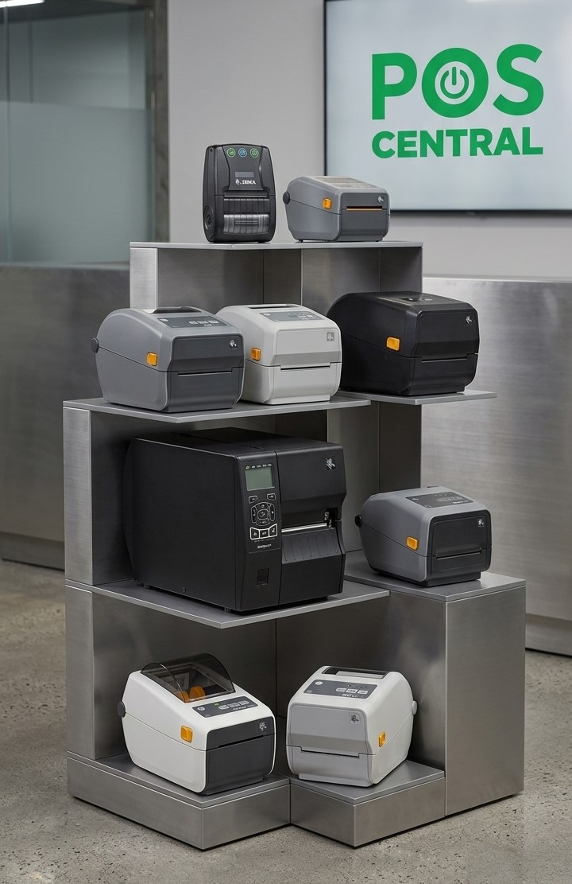
Zebra Printers at POS Central Australia: An Overview
POS Central Australia supplies genuine Zebra hardware to retail, hospitality, warehousing, and logistics businesses nationwide. As an established Sydney-based POS equipment retailer, the range is chosen to suit everyday counter use as well as demanding industrial environments.
Locally stocked zebra pos printers with fast Australia-wide dispatch
Backed by manufacturer warranty and local after-sales support
Suitable for small retailers through to enterprise supply chains
Expert guidance to match the right device to your workflow
2

Slide 3
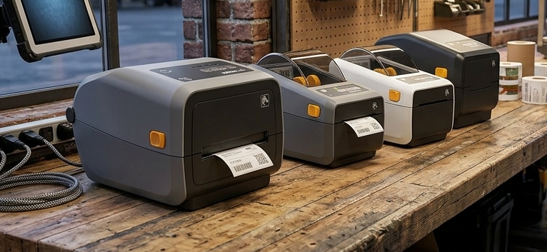
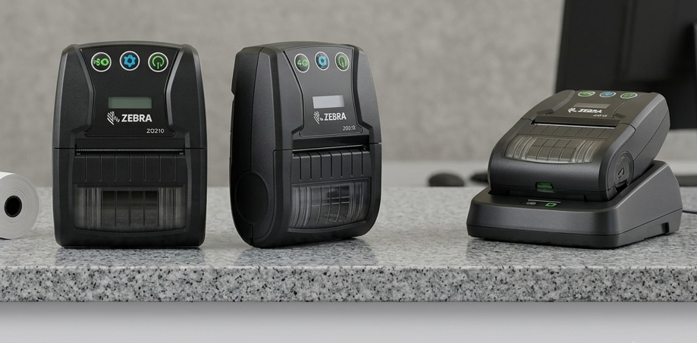
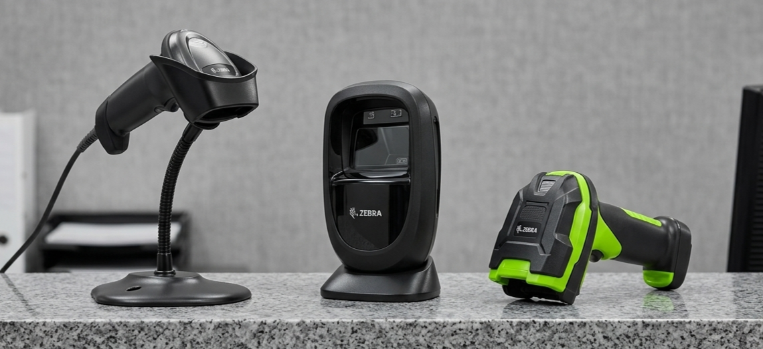
Zebra Printers Australia: Label, Receipt & Barcode Solutions
Zebra Label Printers
Zebra Receipt Printers
Zebra Barcode Scanners
Desktop and industrial zebra label printers for shipping labels and product tags
Supports thermal transfer and direct thermal printing
Ideal for asset tracking and warehouse labelling
Fast thermal zebra receipt printers for retail counters and cafes
Compact footprint suited to busy service desks
Reliable performance during high transaction volumes
Rugged zebra barcode scanners for checkout and warehouse tasks
Reads 1D and 2D codes with fast, accurate scanning
Wired and wireless models available
3

Slide 4
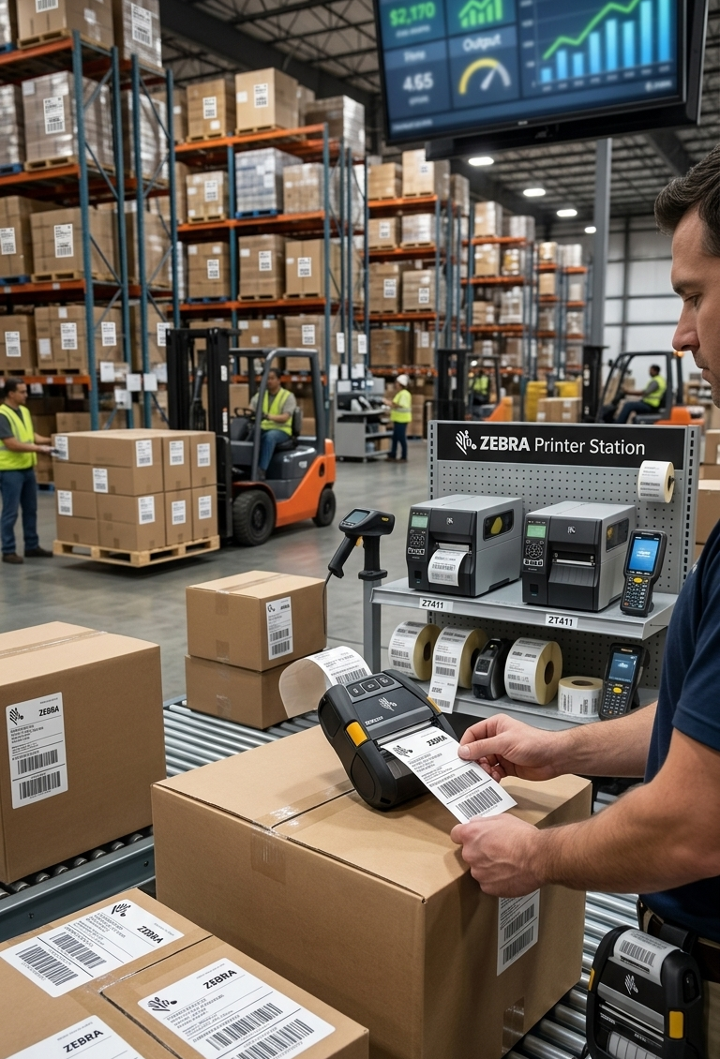
Why Zebra Is Our Most In-Demand Printer Brand
Zebra printers is consistently among the most requested equipment brands at POS Central Australia. Businesses across retail, logistics, and hospitality favour Zebra devices for their consistency, durability, and long service life.
Engineered for continuous, high-volume printing without performance loss
Rugged, industrial-grade build reduces downtime in busy environments
Wide model range covering desktop, mobile, and industrial use cases
Strong local stock availability and rising demand for zebra printers across Australian industries
4

Slide 5
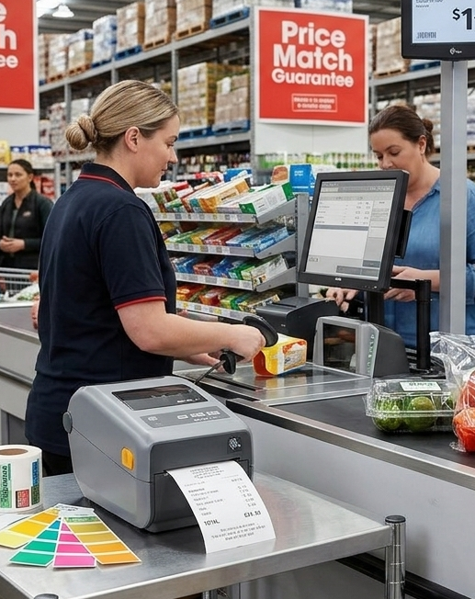
Businesses that Use Zebra Printers in Australia
Zebra devices support a broad range of Australian industries, from small retail counters to large distribution centres. Their versatility makes them a practical fit across many day-to-day operations.
Retail stores and supermarkets — price labelling and receipt printing
Warehousing and logistics — shipping labels and inventory scanning
Hospitality venues — order tickets and customer receipts
Healthcare and pharmacies — patient and product identification
Manufacturing — asset tags and quality control labels
5

Slide 6

Contact Us
Let's Equip Your Business with
the Right Zebra Solution
6

