Slide 1
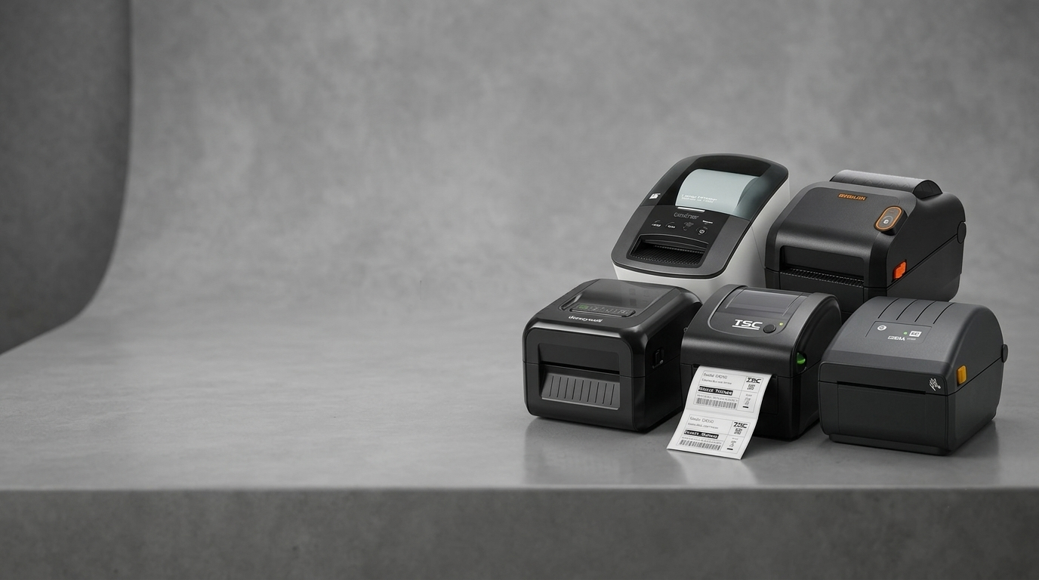

POS CENTRAL
AUSTRALIA
Complete Label Printer Guide | Buy Smart with POS Central
Australia's Most Trusted Source to Buy Label Printers for Sale – Direct Thermal, Thermal Transfer, Industrial & Mobile Solutions
www.poscentral.com.au
Nationwide Shipping | Competitive Pricing | Expert POS Support | +61 489 087 085

Slide 2
POS CENTRAL AUSTRALIA
Your Go-To Destination for Label Printers in Australia
POS Central Australia is a premier online retailer delivering high-performance label printers for sale across every state and territory. From small retailers to large distribution centers, businesses across Australia trust POS Central for label printers that combine speed, durability, and value.
200+
10+
$500+
24/7
Product Range
Top Brands
Free Shipping
Support
Label printer models
Zebra, TSC, Citizen & more
Orders shipped Australia-wide
Expert POS assistance
Why Choose POS Central for Label Printers?
Competitive label printers for sale pricing with regular specials & clearance deals
Australia-wide delivery with fast dispatch on all label printer orders
Expert pre-sales advice to match the right printer to your workflow
poscentral.com.au/printers/label-printers.html

Slide 3
PRODUCT OVERVIEW
Label Printers & Their Categories
Label printers are purpose-built output devices that produce adhesive-backed labels for barcodes, shipping tags, product identification, and compliance markings. Whether you need to buy label printers for a retail shop, warehouse, or field operation, understanding the category types ensures the best long-term investment.
Direct Thermal
Thermal Transfer
Industrial
Heat-sensitive media, no ribbon needed. Ideal for shipping & logistics labels.
Ribbon-based printing on diverse media types for long-lasting, durable labels.
Heavy-duty label printers built for 24/7 manufacturing & warehouse environments.
Mobile / Wireless
Color Label Printers
Plastic Card / ID Card
Portable, battery-powered label printers for on-the-go field workers.
Vibrant full-color output for product branding and retail merchandising.
Plastic Card & Identity Card Printers for staff IDs, access cards, and loyalty cards.
poscentral.com.au/printers/label-printers.html

Slide 4
CATEGORY 01
Direct Thermal Label Printers
Direct Thermal Label Printers use heat-activated media to produce crisp barcode labels, shipping tags, and receipts — no ink cartridge or ribbon required. They are the most cost-effective label printers for high-volume logistics, e-commerce dispatch, and food-date marking operations across Australia.
No Ribbon Required
Low Running Cost
High-Speed Output
Compact Design
Plug-and-Print Setup
Top Direct Thermal Label Printers for Sale at POS Central
Model | Resolution | Connectivity | Best For
Zebra ZD421d | 203 dpi / 300 dpi | USB, Ethernet, Bluetooth | Retail, Logistics
TSC TE244 | 203 dpi | USB, Serial, Ethernet | Warehousing
Citizen CL-S321 | 203 dpi | USB, Serial, Parallel | Retail, Food & Bev
Zebra GK420d | 203 dpi | USB, Serial, Ethernet | E-commerce Dispatch
poscentral.com.au/printers/label-printers/direct-thermal-label-printers.html

Slide 5
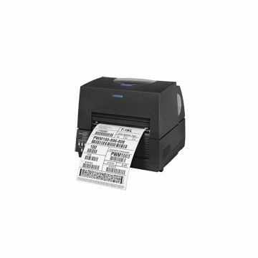
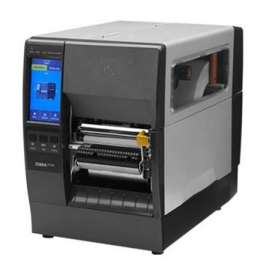
CATEGORY 02
Thermal Transfer Label Printers
Thermal Transfer Label Printers melt wax or resin ink from a ribbon onto diverse label media, producing labels engineered to withstand heat, moisture, UV, and chemical exposure. They are the preferred labelling solution for manufacturers, pharmaceutical companies, and durable goods producers seeking labels for sale that outlast the product itself.
Zebra ZT231
203/300 dpi · USB/Eth/BT
TSC TTP-244CE 4
203 dpi · USB/Serial/Eth
Citizen CL-S6621
203/300 dpi · USB/Eth
Zebra ZT411
203-600 dpi · USB/Eth/WiFi
poscentral.com.au/printers/label-printers/thermal-transfer-label-printers.html

Slide 6
CATEGORY 03
24 / 7
Industrial Label Printers
Non-Stop Duty Cycle
Industrial Label Printers are engineered for demanding, high-throughput environments where conventional desktop printers fall short. These rugged machines handle wide media widths, continuous operation, and extreme temperature ranges — making them the backbone of manufacturing plants, logistics hubs, and distribution warehouses across Australia.
⚡ Print Speed
📏 Media Width
🔍 Resolution
Up to 356 mm/s
Up to 168 mm
203 to 600 dpi
🏭 Duty Cycle
🔗 Connectivity
🏷️ Media Types
Continuous 24/7
USB / LAN / WiFi / BT
Labels, Tags, Wristbands
Popular Models: Zebra ZT600 Series · TSC MX240P · Honeywell PX940 · SATO CL4NX Plus
poscentral.com.au/printers/label-printers/industrial-label-printers.html

Slide 7
CATEGORY 04
Mobile / Wireless Label Printers
Mobile or Wireless Label Printers untether your labelling workflow. Powered by long-life batteries and equipped with Bluetooth or Wi-Fi, these compact devices empower field technicians, delivery drivers, retail floor staff, and healthcare workers to print on-demand labels wherever work takes them.
🚚
🏥
🛒
🏗️
Delivery & Couriers
Healthcare
Retail Floor
Field Service
On-the-spot address and manifest labels
Bedside patient wristband printing
Instant shelf-edge and markdown labels
Asset tags and compliance stickers on-site
Top Wireless Label Printers for Sale at POS Central:
Zebra ZQ630 Plus — Bluetooth 5 / WiFi 6, 203 dpi, IP54 rated
TSC Alpha-30L — Bluetooth 5.0, 203 dpi, ultra-compact form factor
Citizen CMP-25L — Bluetooth / WiFi, 203 dpi, linerless media support
poscentral.com.au/printers/label-printers/mobile-label-printers.html

Slide 8
READY TO PRINT SMARTER?
Buy Label Printers for Sale
at POS Central Australia
From compact direct thermal label printers to heavy-duty industrial label printers, and from ribbon-based thermal transfer label printers to wireless mobile/wireless label printers — POS Central stocks every type of label printer your Australian business needs, backed by competitive pricing, expert support, and nationwide delivery.
🌐 Shop Online
📞 Call Us
✉️ Get a Quote
www.poscentral.com.au
+61 489 087 085
poscentral.com.au/contact-us
Direct Thermal · Thermal Transfer · Industrial Label Printers · Mobile Wireless · Color Label Printers · Plastic Card / ID Card Printers
poscentral.com.au | +61 489 087 085 | Free Shipping on Orders Over $500

