Slide 1
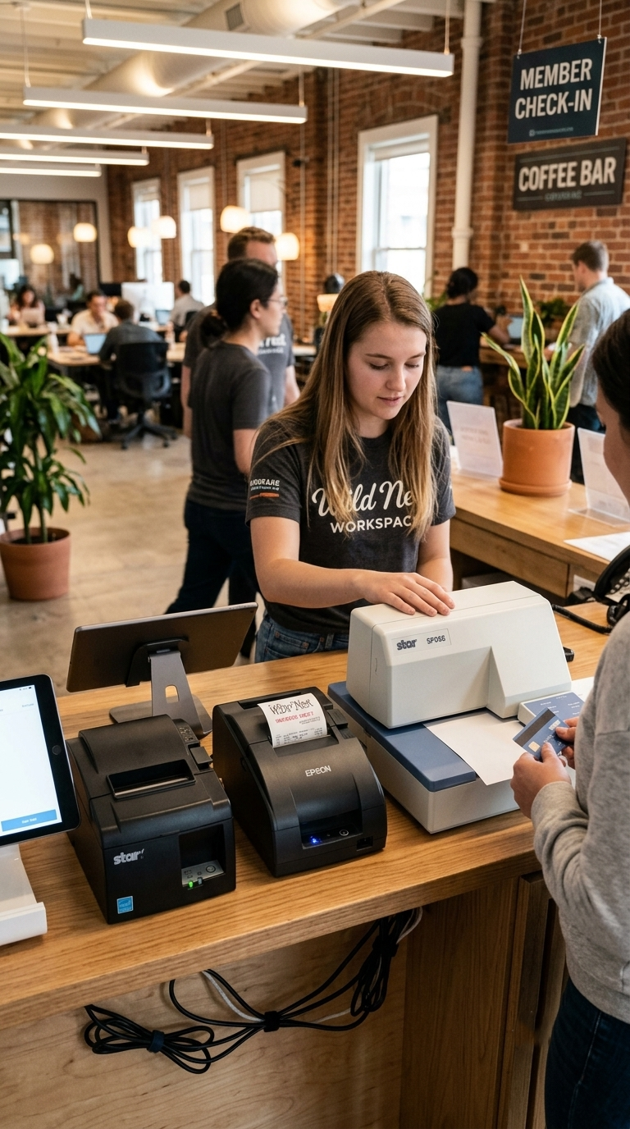

POS CENTRAL AUSTRALIA
Dot Matrix Printers for Reliable Receipts & Kitchen Orders
Reliable receipt printing for retail, hospitality, kitchens & POS environments

Slide 2


What Are Impact / Dot Matrix Receipt Printers?
Impact Receipt printers create printed characters by physically striking an ink ribbon against paper — a proven method trusted across Australian POS and hospitality environments.
How Impact Printing Works
Prints on multi-part forms and duplicate copies
Well suited to kitchens, restaurants and service counters
Handles heat, moisture and challenging conditions where thermal printing may fall short
Used for receipts, kitchen orders, invoices and transaction records
Ink Transfer
Ribbon transfers ink onto paper
Print Head Strike
Receipt Output
Print head hits the ink ribbon
Printed receipt or order produced
Ideal when durability, operational reliability and multi-copy printing matter.
This simple mechanical process delivers consistent, reliable output even in the busiest commercial environments.

Slide 3
Key Features of Impact / Dot Matrix Receipt Printers
Reliable Impact Printing
Multi-Part Printing
Kitchen-Friendly
Durable Design
Prints duplicate and multi-copy documents.
Performs where thermal printers struggle.
Built for demanding POS environments.
Consistent output during busy operations.
Flexible Connectivity
Auto Cutter Options
Compact Form Factors
POS Compatibility
Selected models include automatic cutters.
Integrates with compatible POS systems.
USB, Serial, Ethernet and Parallel options.
Mini models save valuable counter space.

Slide 4
Why Choose an Impact / Dot Matrix Receipt Printer?
Restaurants & Cafés
Reliable kitchen order printing and clear order information for busy service environments.
Retail Stores
Dependable transaction documentation and operational records at the POS.
Hospitality Businesses
Designed for continuous use with flexible connectivity for order and transaction documentation.
Multi-Part Forms
Produces duplicate copies for invoices, order records and documentation.
POS System → Printer → Receipt / Order / Business Record — a seamless workflow for reliable day-to-day operations.

Slide 5
Which Dot Matrix Printer Fits Your Business?
Product
Best For
Connectivity
Key Feature
Element RW337D
Kitchens
Eth, Ser, USB
Kitchen printing
Citizen CBM910-24P II
Compact POS
Parallel
Mini format
Citizen CBM-920-40P
Retail POS
Parallel
Compact design
EPSON TMU220IIB ETH
Retail & Hospitality
Ethernet
Auto cutter
Bixolon SRP275III
Busy Retail
Ser, USB, Eth
Auto cutter
SP742
POS Counters
Parallel
Internal PSU
EPSON TM-U220IIB
Restaurants, Retail
Serial
Auto-cutter, PSU
SP298
Specialised POS
Serial
42-column
All models available through POS Central Australia.

Slide 6
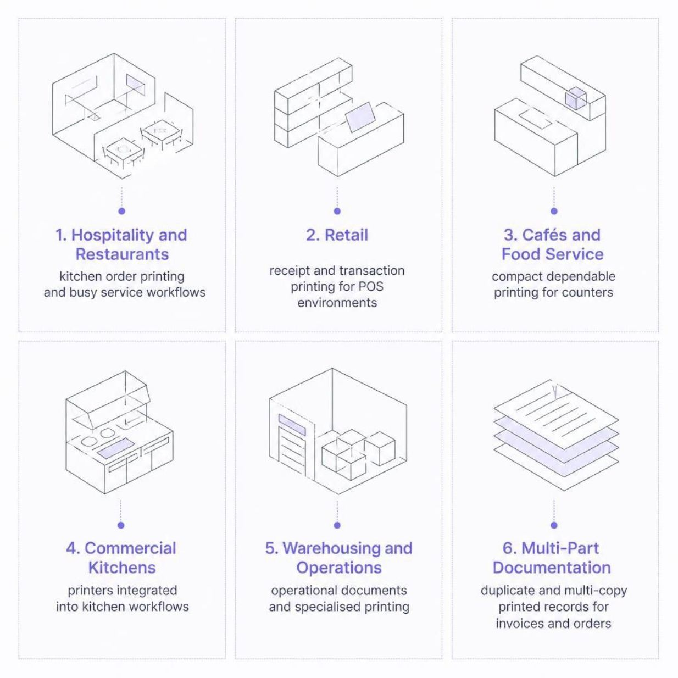

Why Australian Businesses Still Use Impact / Dot Matrix Printers
Impact / Dot Matrix Receipt Printers remain relevant across Australia because many businesses need reliable printing for demanding POS, hospitality and specialised operational environments.
From bustling Melbourne cafés to Queensland commercial kitchens and Sydney retail floors — impact printers deliver consistent performance where it counts.
Trusted across Australia for dependable, long-term POS printing.

Slide 7
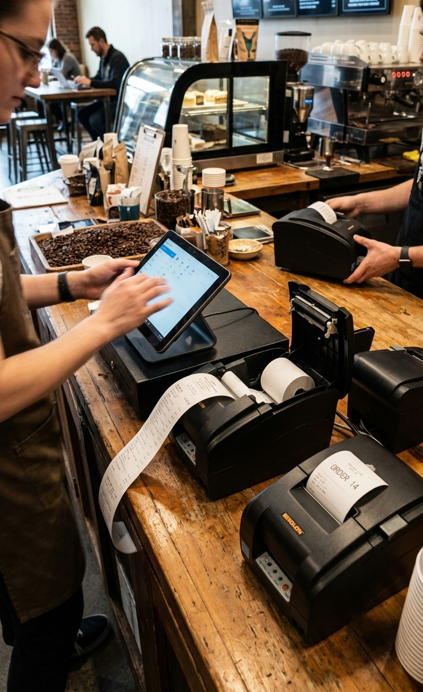


Find the Right Impact Printer for Your Business
Looking for a reliable dot matrix receipt printer for your Australian business? POS Central Australia offers a range of impact printers for retail, hospitality, restaurants, kitchens and POS applications.
📍 Location
Level 26, 44 Market St
Sydney, NSW 2000
📞 Phone
+61 489 087 085
✉ Email
sales@poscentral.com.au

