Slide 1
Point of sale systems
What Is a POS System and Why Does It Matter?
A point of sale (POS) system combines software and connected hardware to process sales and support everyday operations.
It links checkout with inventory and customer service, helping businesses keep daily activity connected as they grow.
Notes:
A POS system is more than the screen at checkout. Its usefulness comes from the software and hardware working together, with sales information feeding the operational tasks the business needs to manage.

Slide 2
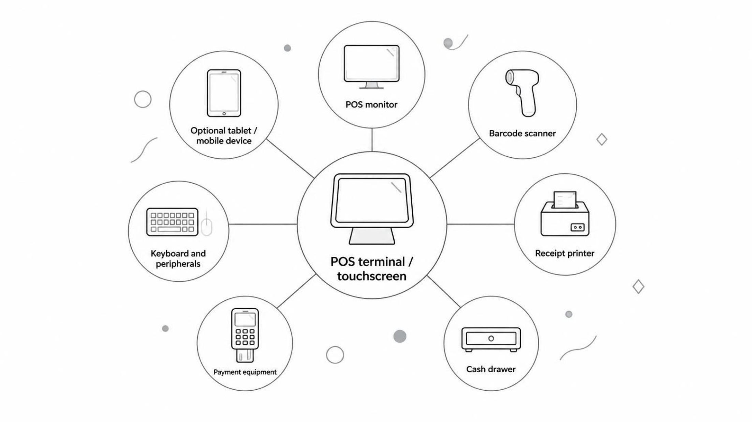
The connected setup
Which Components Make Up a POS System?
Configure the hardware around your workflow, rather than a one-size-fits-all kit.
Connections and supported peripherals depend on the chosen terminal and POS software.
2

Slide 3
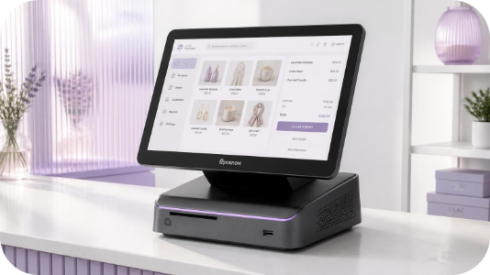
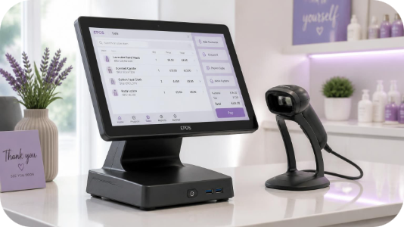
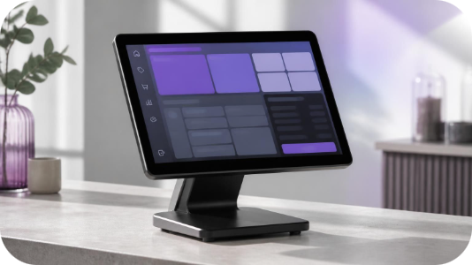
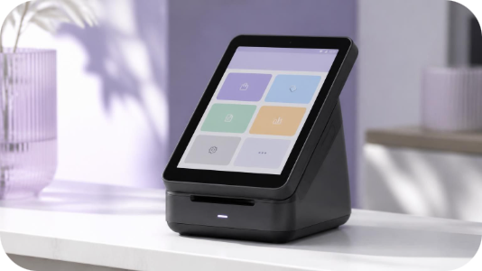
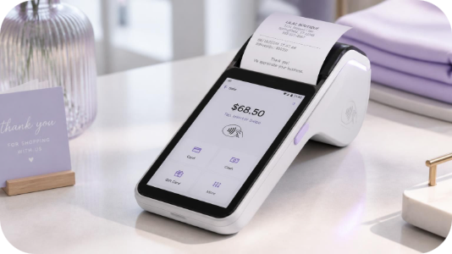
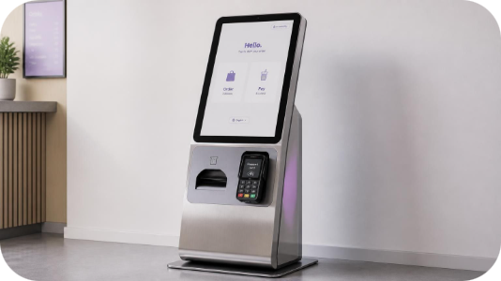
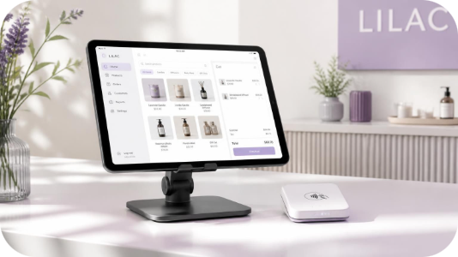
Which POS System Fits Different Business Environments?
All-in-One POS
Retail POS Terminals
Touch POS Systems
Android POS Terminals
Core components in one streamlined workstation.
A fixed checkout for everyday shop-floor sales.
Touchscreen interaction for transaction entry.
A platform for compatible business apps.
Portable POS / Mobile Terminals
POS Kiosks
Tablet-Based POS
Customer-facing ordering or self-service checkout.
A compact setup with flexible placement.
Take transactions away from a fixed counter.
3
Notes:
These categories can overlap. A touchscreen terminal may also be an all-in-one or Android-based device. Compare the complete setup, software support and physical workflow, rather than choosing on the category name alone.

Slide 4
From sale to stock record
How Can a POS System Improve Everyday Operations?
Connected hardware and compatible software can turn separate tasks into a coordinated checkout workflow.
01
02
03
04
05
06
Product
Barcode Scan
POS Transaction
Payment
Receipt
Inventory Update
Select the item.
Identify the product.
Record the sale.
Complete payment.
Provide a record.
Adjust stock in software.
Organised checkout
Operational visibility
Room to grow
Less manual entry and smoother staff workflows.
Sales information and stock records in reach.
Coordinate equipment as business needs expand.
Automatic updates depend on software features, integrations and configuration.
4

Slide 5
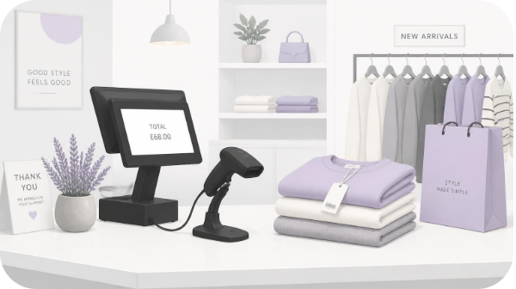
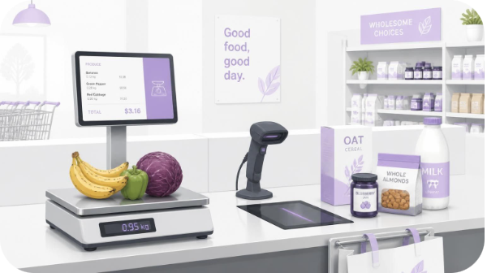
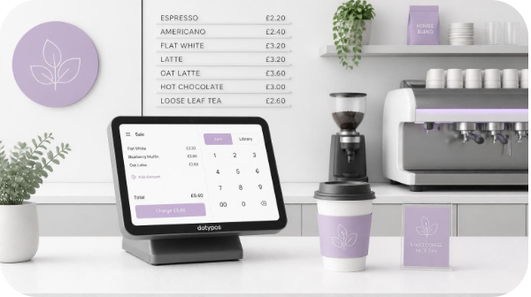
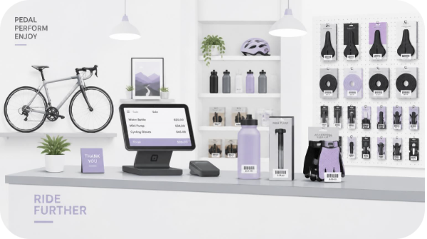
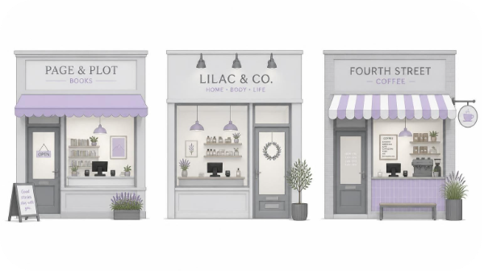
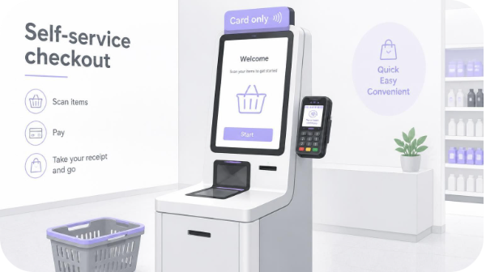
Start with the operating environment
How Do POS Requirements Change by Business Type?
Retail Store
Grocery / Convenience
Hospitality
Retail POS systems need checkout, scanning and inventory workflows.
Scanning, weighing and transaction processing need to work together.
Keep the transaction setup compact and easy to reach.
Specialty Retail
Multi-Location Business
Self-Service Environment
Access product information and choose suitable peripherals.
Check support for centralised operational visibility.
Make the customer-facing interface clear and accessible.
The right POS setup starts with the way the business operates.
5

Slide 6
A POS selection checklist
What Should You Check Before Selecting a POS System?
✓
Business size
✓
Checkout environment
Will the setup support today’s operations and future growth?
Does the hardware fit the counter space and workflow?
✓
Connectivity
✓
Software compatibility
Check USB, Ethernet, Wi-Fi, Bluetooth and other required interfaces.
Confirm support for the required POS software and apps.
✓
Peripherals
✓
Multi-location needs
Verify scanners, printers, cash drawers, displays and accessories.
Check centralised stock and operational management capabilities.
✓
Staff usability
Try the everyday tasks employees will perform throughout a shift.
6

Slide 7
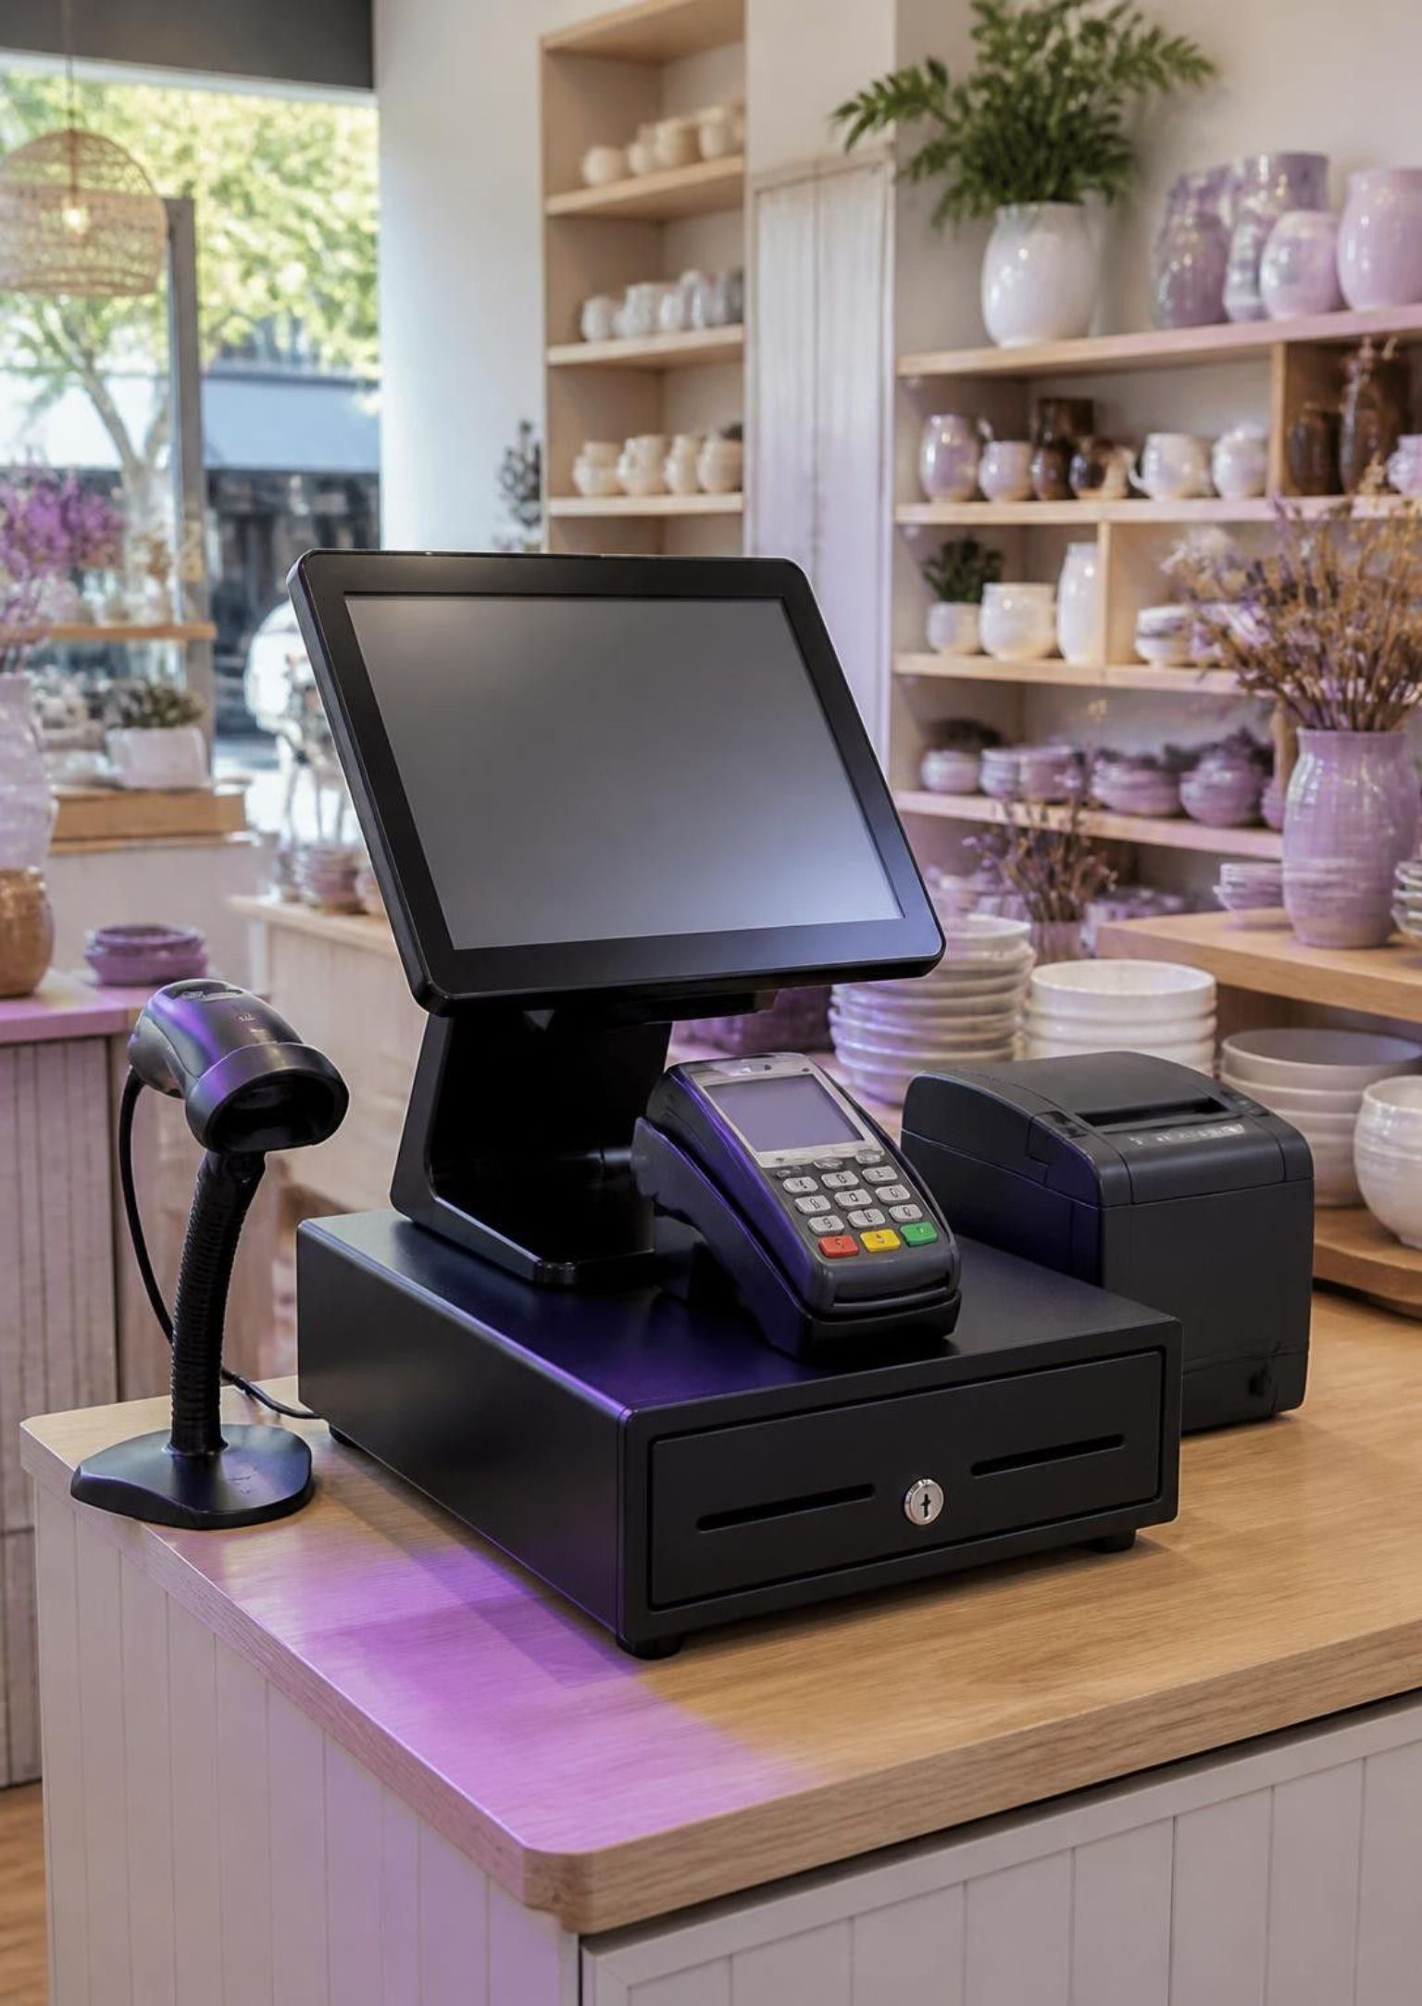
POS systems Australia
Ready to Build a POS Setup Around Your Business?
Choose a configuration around how you sell, serve customers and manage daily operations, from compact touch terminals to portable devices and kiosks.
A broad range of POS hardware and related equipment for Australian businesses.
All-in-one POS solutions for retail, hospitality & warehousing in Australia
POS Systems | POS Terminals | POS Hardware
Level 26, 44 Market St, Sydney, NSW 2000, Australia
+61 489 087 085
sales@poscentral.com.au

