Slide 1



Slide 2
8 + 2 =
10
2
6
0

Slide 3
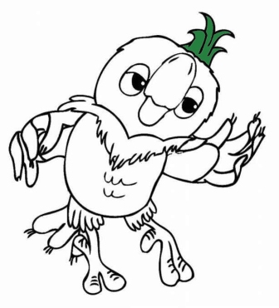
4 - 2 =
10
2
6
0

Slide 4
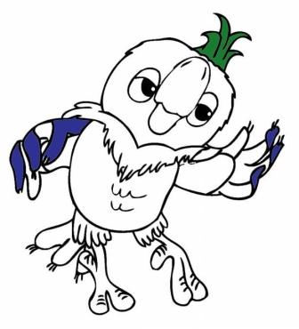
3 - 3 =
10
2
6
0

Slide 5

5 +1 =
10
2
6
0

Slide 6

9 + 1 =
10
4
5
9

Slide 7

7 - 3 =
10
4
5
7

Slide 8

6 + 2 =
10
2
8
0

Slide 9

4 - 4 =
10
2
6
0

Slide 10

6 + 3 =
9
2
6
0

Slide 11

7 - 2 =
10
2
6
5

Slide 12

Отличная работа!

Slide 13
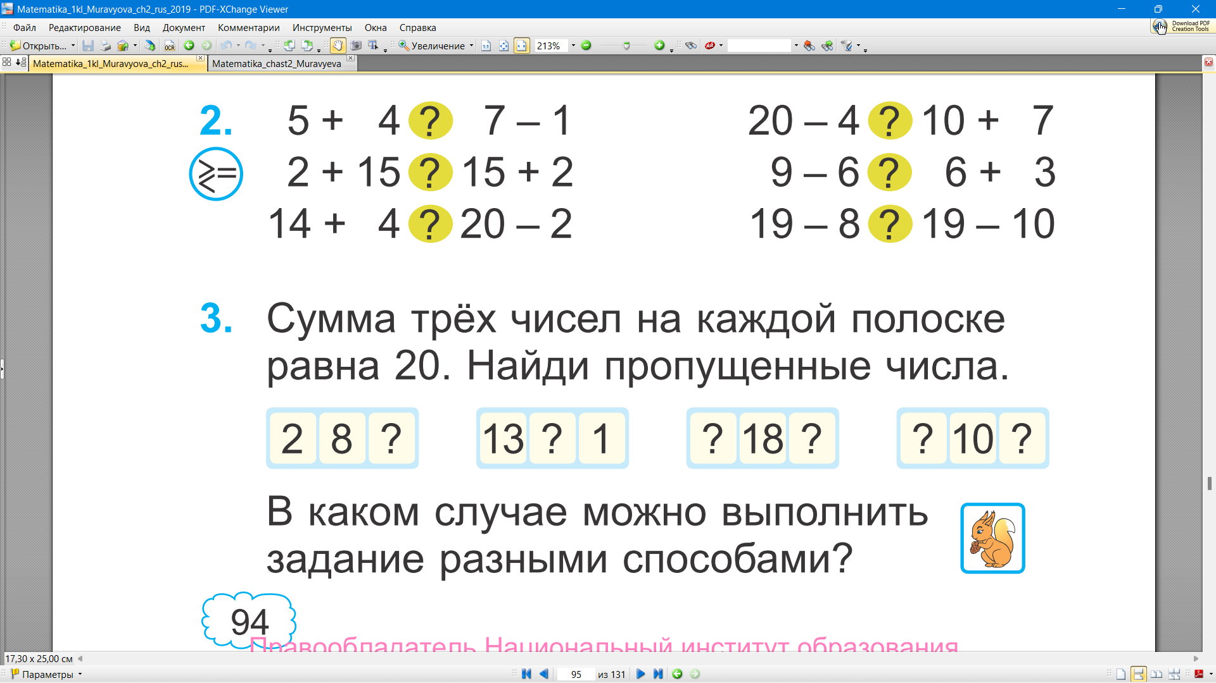
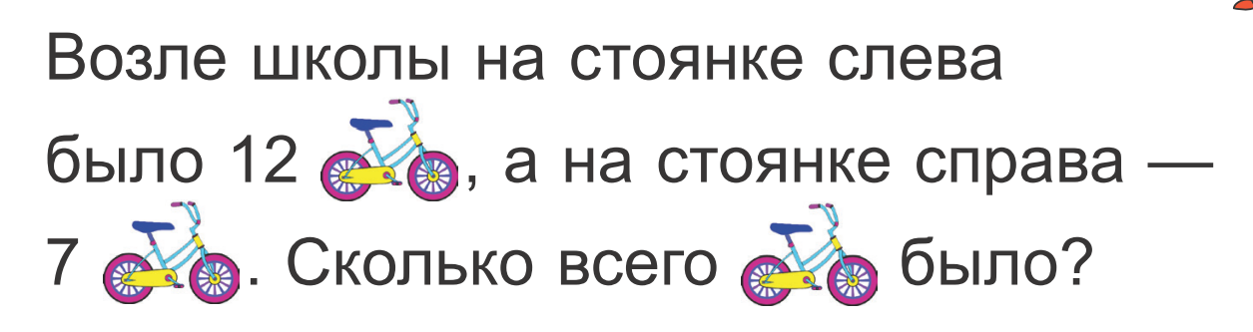
10
6

Slide 14
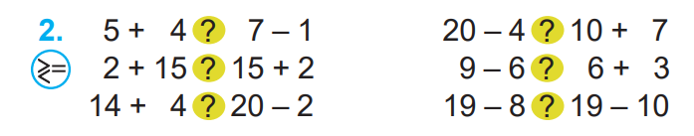
9
6
16
17
>
<
17
17
3
9
=
<
18
18
11
9
=
>

Slide 15
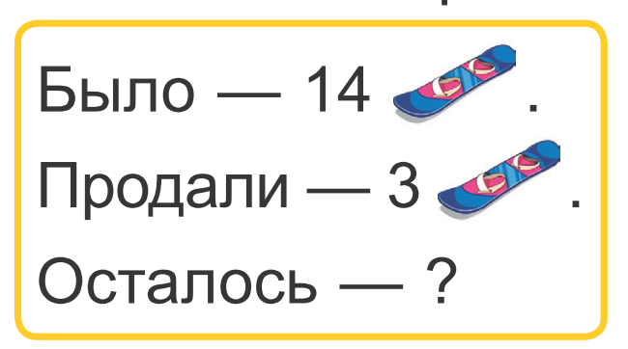
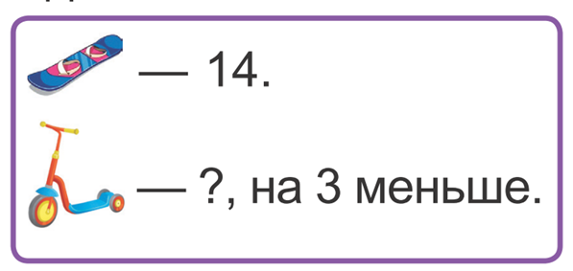

Slide 16
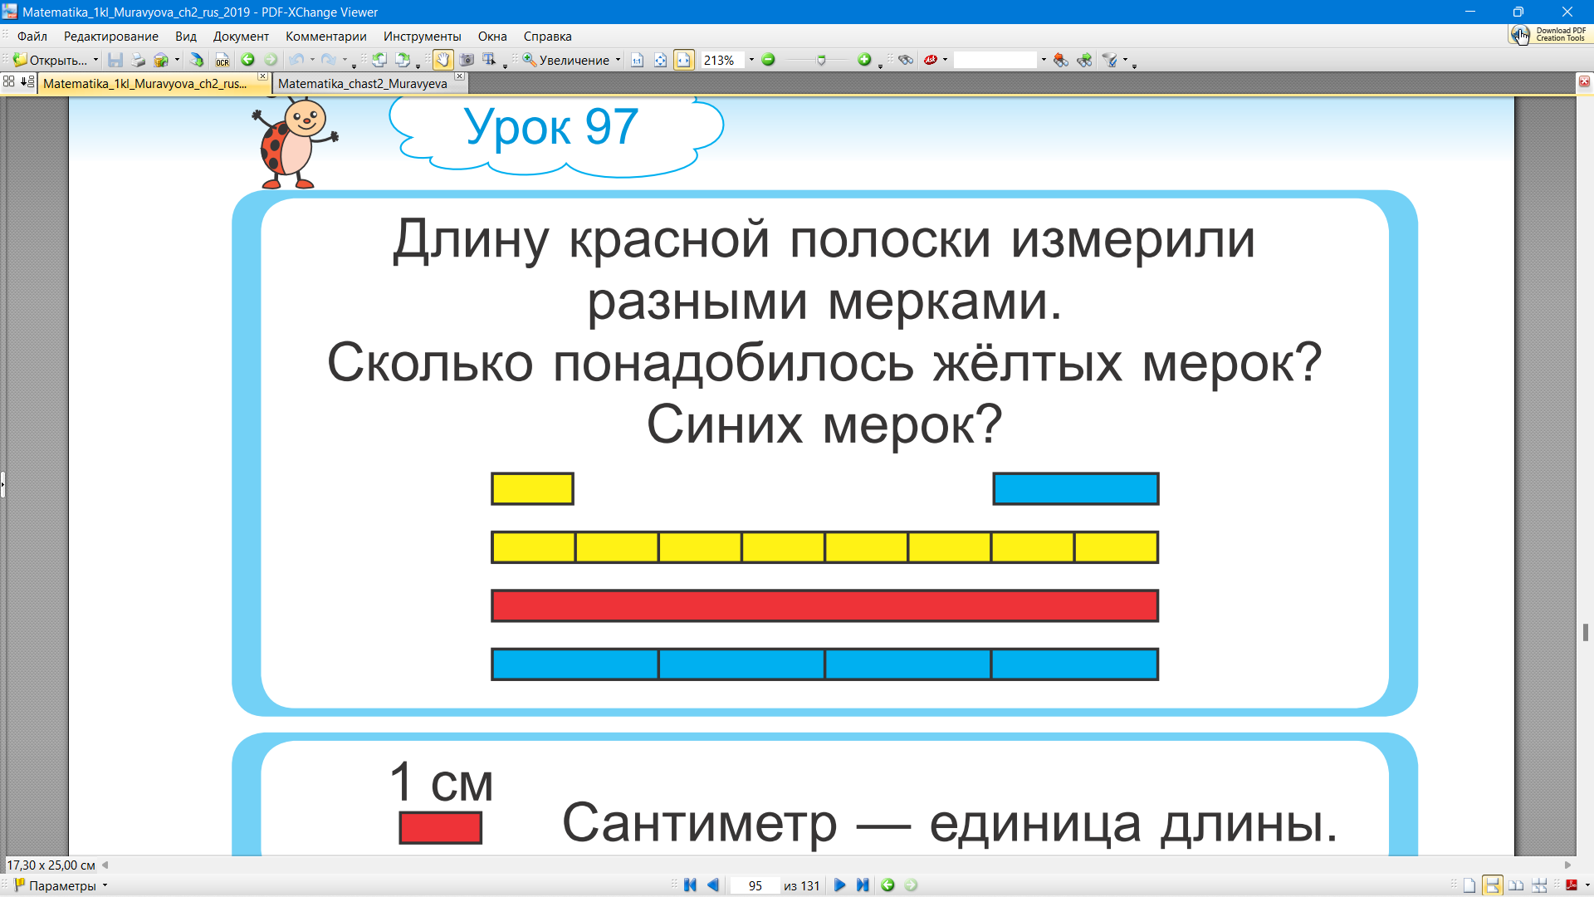

Slide 18
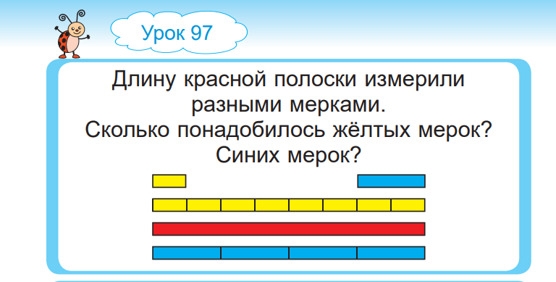


Slide 19
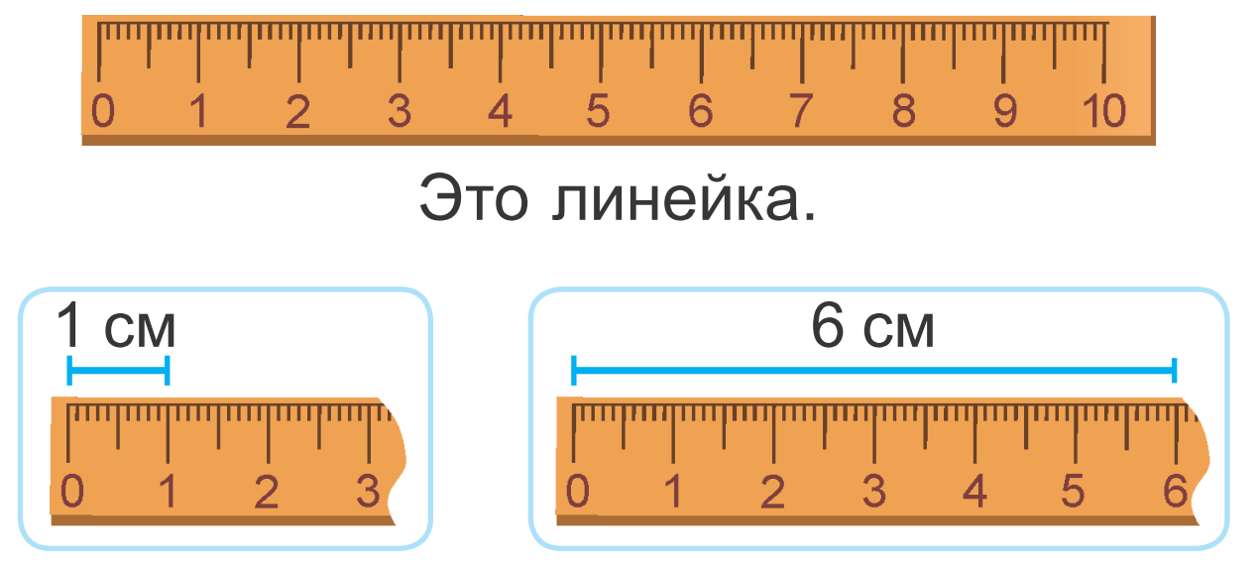

Slide 20
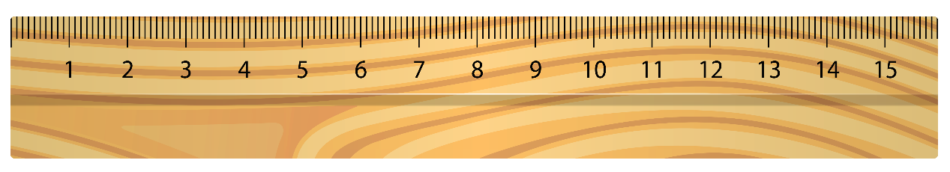
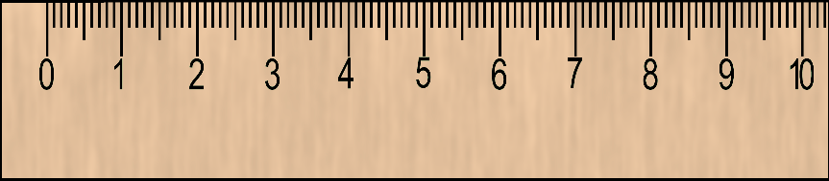
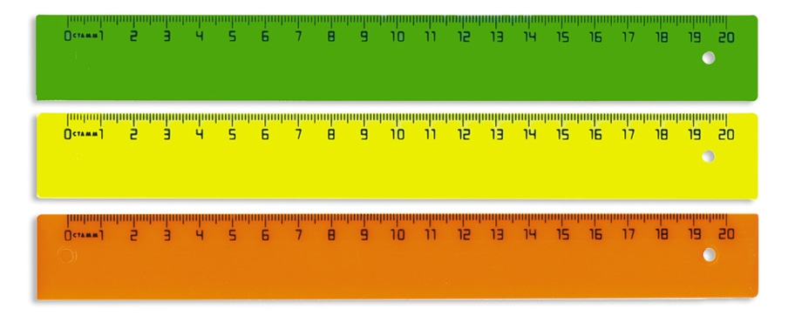
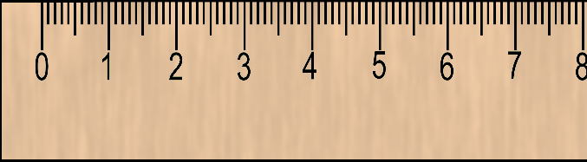

15 СМ
10 СМ
20 СМ
8 СМ

Slide 21
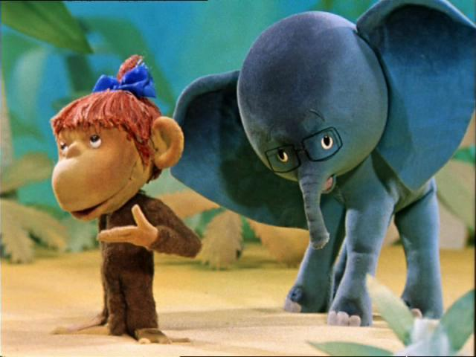


5 сантиметров
4 сантиметра
IIIIIIIIIIIIIIIIIIIIIIIIIIIIIIIIIIIIIIIIIIIIIIIIIIIIIIIIIIIIIIIIIIIII
IIIIIIIIIIIIIIIIIIIIIIIIIIIIIIIIIIIIIIIIIIIIIIIIIIIIIIIIIIIIIIIIIIIII
0 1 2 3 4 5 6
0 1 2 3 4 5 6

Slide 22

IIIIIIIIIIIIIIIIIIIIIIIIIIIIIIIIIIIIIIIIIIIIIIIIIIIIIIIIIIIIIIIIIIIIIIIIIIIIIIIIIIIIIIIIIIIIIIIIIIIIIIIIIIIIIIIIIIIIIIIIIIIIIIII
0 1 2 3 4 5 6 7 8 9 10 11 12
Какова длина отрезка?

Slide 23
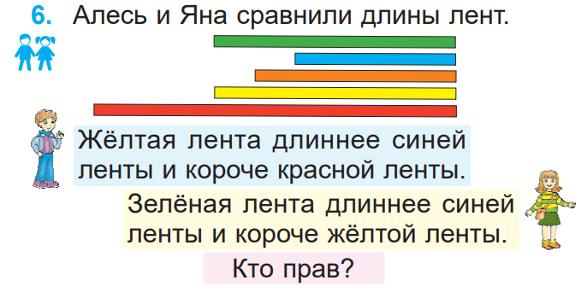
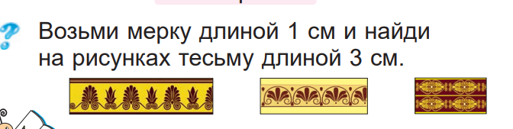

Slide 24
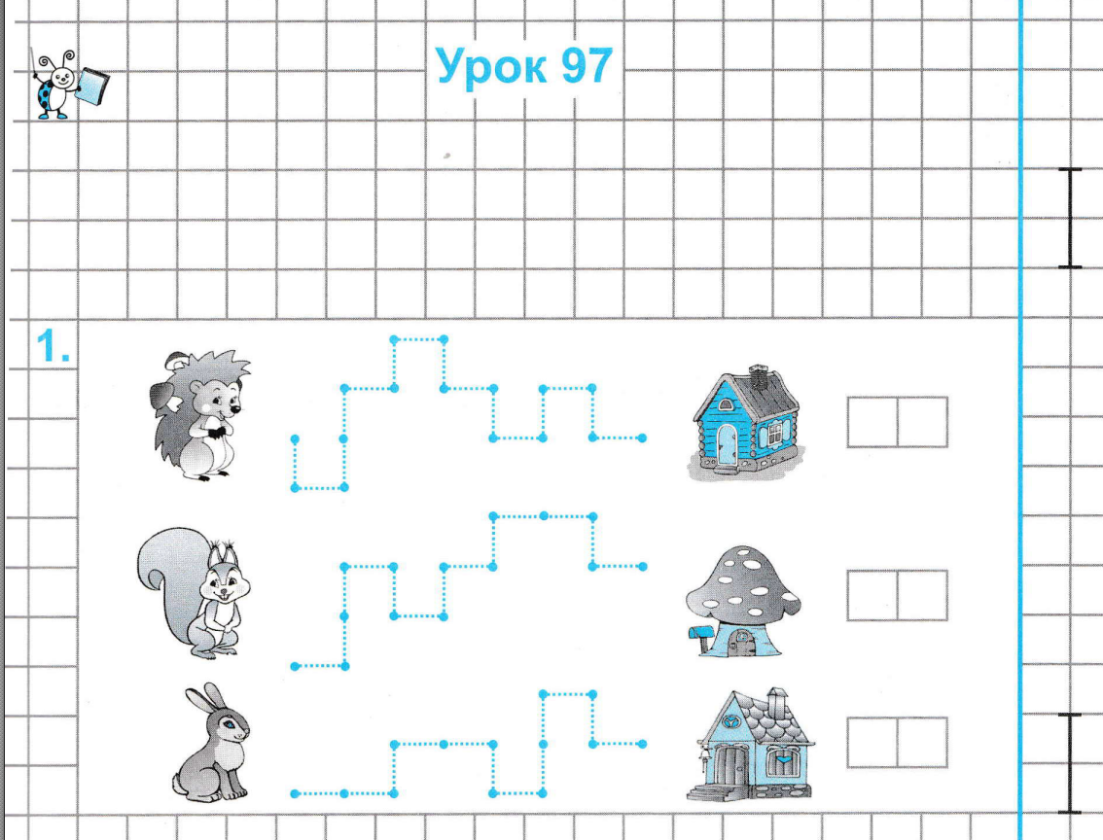
1 5 + 5 =
2 0
1 4 + 5 =
1 9
1 1 + 5 =
1 6
1 2 + 5 =
1 7
1 5
1 3
1 2

Slide 25
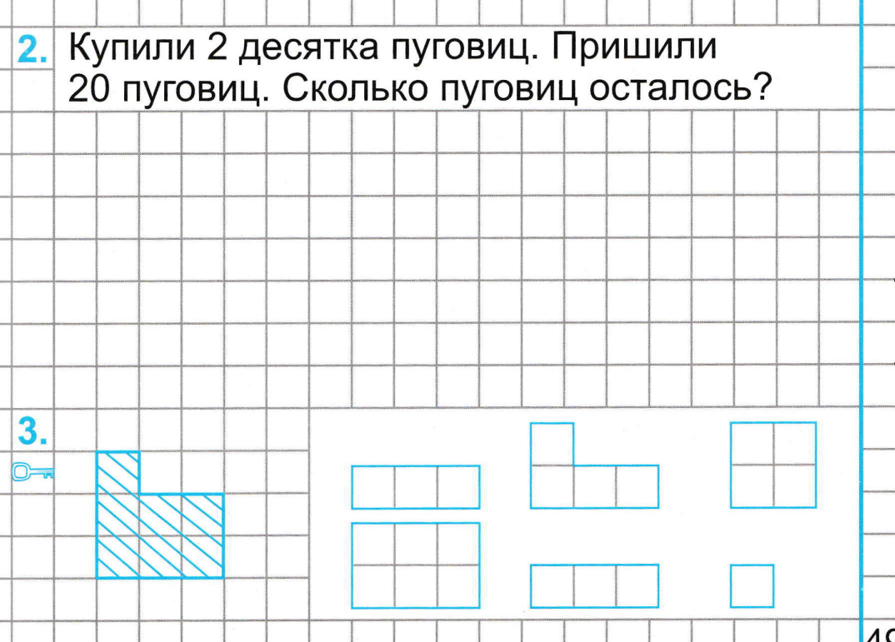


2 0 - 2 0 = 0 (п.)

