Slide 1
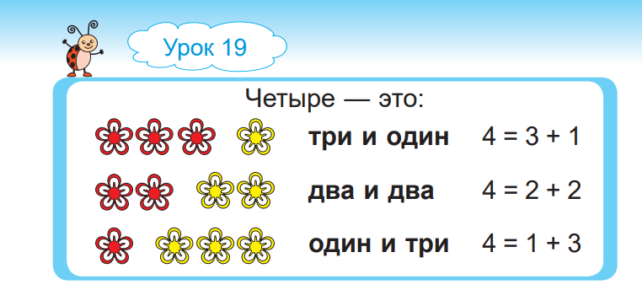

Slide 2
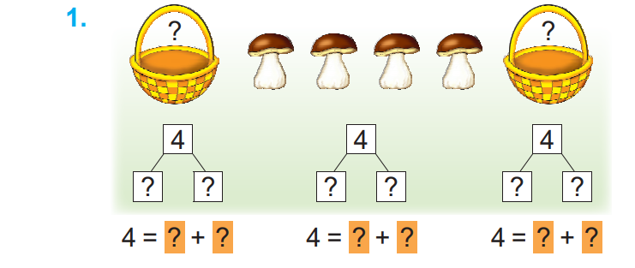

Slide 3


Slide 4


Slide 5
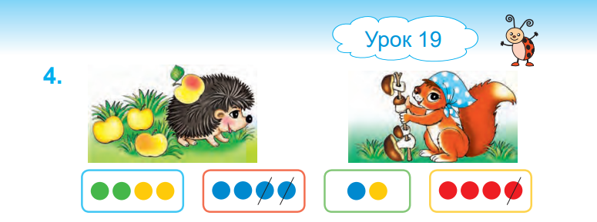

Slide 6


Slide 7


Slide 8

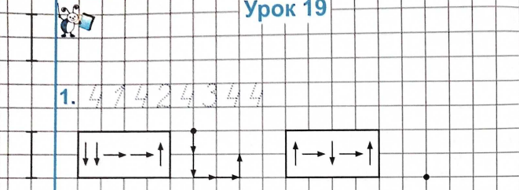
2
<
4
3
=
3
4
>
1

Slide 9
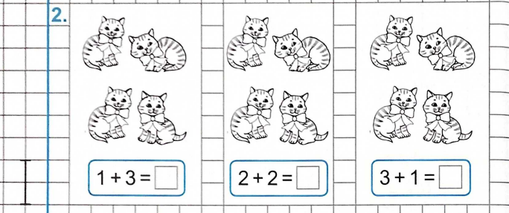
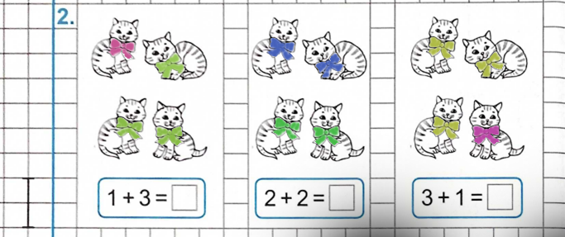

4
4

Slide 10
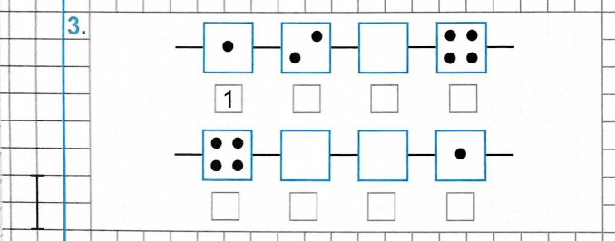
2
3
4
4
3
2
1

Slide 11

1
+
1
=
2
4
-
1
=
3

