Slide 1



Slide 2
7 + 2 =
9
2
6
0

Slide 3
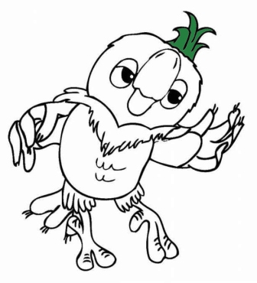
14 - 2 =
10
12
6
0

Slide 4

10 - 3 =
10
2
6
7

Slide 5

15 +1 =
10
2
16
0

Slide 6

19 + 1 =
20
4
18
19

Slide 7

17 - 3 =
10
14
5
7

Slide 8

16 + 2 =
10
2
18
0

Slide 9

14 - 4 =
8
2
6
10

Slide 10

6 + 3 =
9
2
6
0

Slide 11

17 - 2 =
10
2
6
15

Slide 12

Отличная работа!

Slide 13
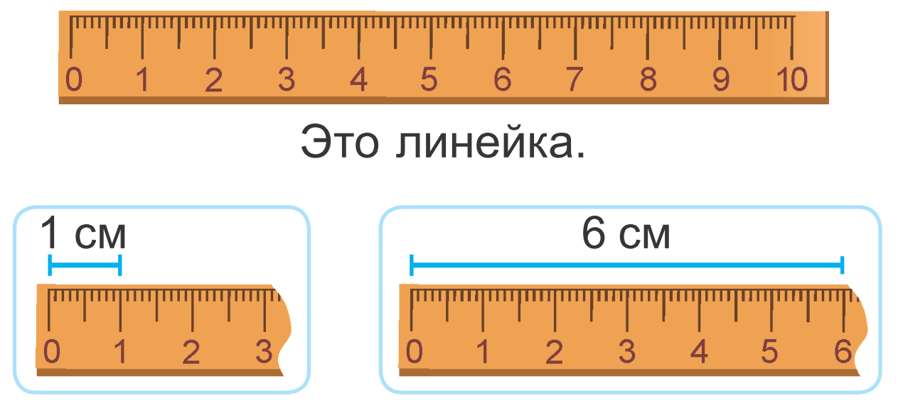

Slide 14
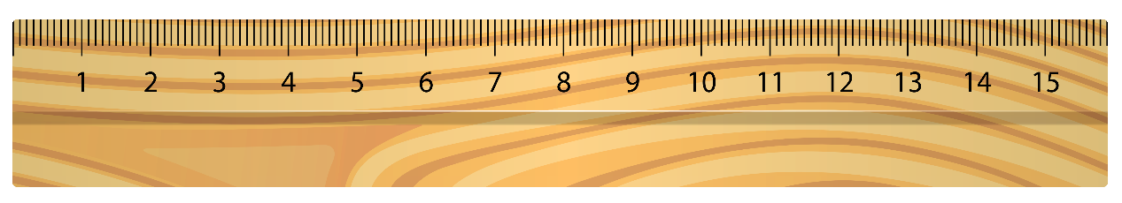
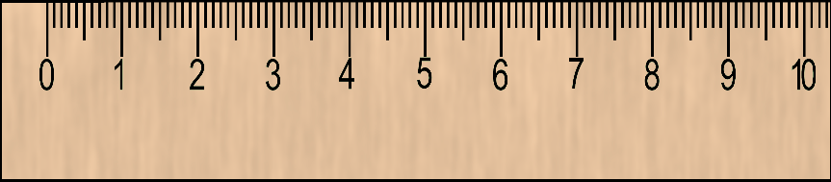
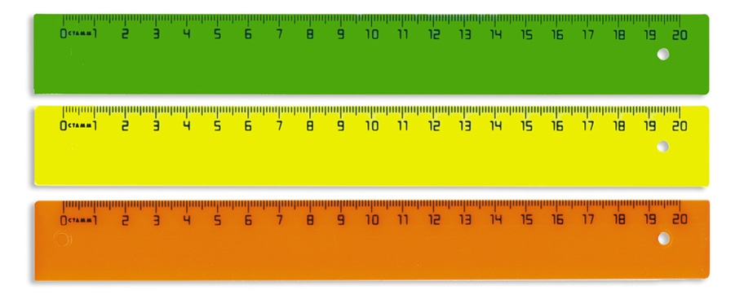
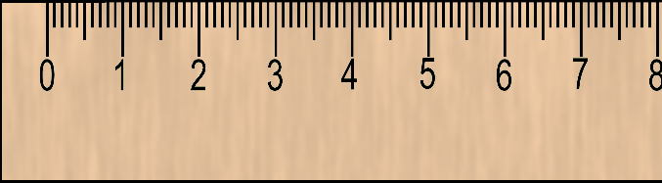

15 СМ
10 СМ
20 СМ
8 СМ

Slide 15
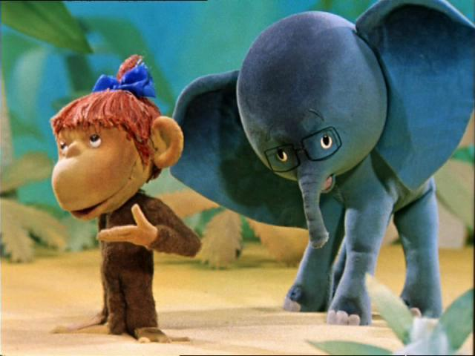


4 см
6 см
IIIIIIIIIIIIIIIIIIIIIIIIIIIIIIIIIIIIIIIIIIIIIIIIIIIIIIIIIIIIIIIIIIIII
IIIIIIIIIIIIIIIIIIIIIIIIIIIIIIIIIIIIIIIIIIIIIIIIIIIIIIIIIIIIIIIIIIIII
0 1 2 3 4 5 6
0 1 2 3 4 5 6

Slide 16

IIIIIIIIIIIIIIIIIIIIIIIIIIIIIIIIIIIIIIIIIIIIIIIIIIIIIIIIIIIIIIIIIIIIIIIIIIIIIIIIIIIIIIIIIIIIIIIIIIIIIIIIIIIIIIIIIIIIIIIIIIIIIIII
0 1 2 3 4 5 6 7 8 9 10 11 12
Какова длина отрезка?

Slide 17
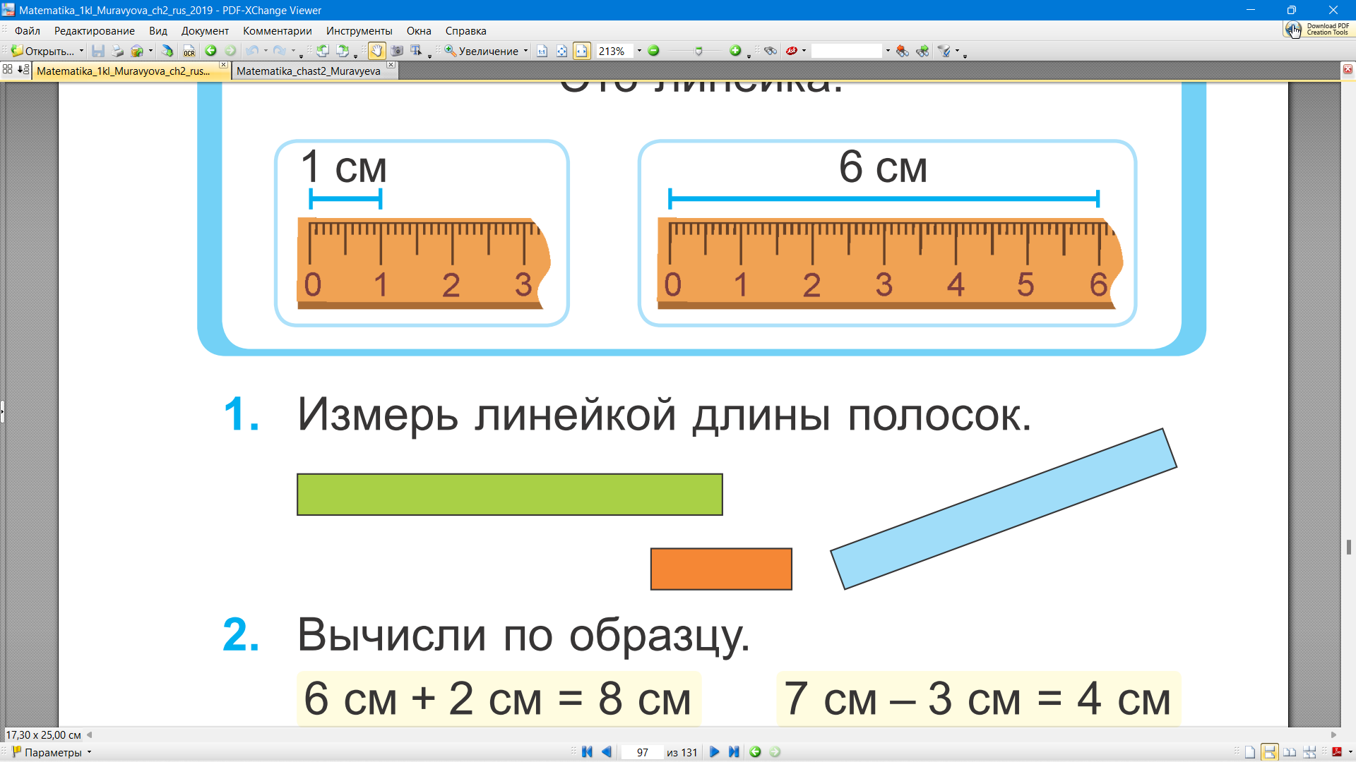

Slide 18
IIIIIIIIIIIIIIIIIIIIIIIIIIIIIIIIIIIIIIIIIIIIIIIIIIIIIIIIIIIIIIIIIIIIIIIIIIIIIIIIIIIIIIIIIIIIIIIIIIIIIIIIIIIIIIIIIIIIIIIIIIIIIIII
0 1 2 3 4 5 6 7 8 9 10 11 12

Slide 19
IIIIIIIIIIIIIIIIIIIIIIIIIIIIIIIIIIIIIIIIIIIIIIIIIIIIIIIIIIIIIIIIIIIIIIIIIIIIIIIIIIIIIIIIIIIIIIIIIIIIIIIIIIIIIIIIIIIIIIIIIIIIIIII
0 1 2 3 4 5 6 7 8 9 10 11 12

Slide 20
IIIIIIIIIIIIIIIIIIIIIIIIIIIIIIIIIIIIIIIIIIIIIIIIIIIIIIIIIIIIIIIIIIIIIIIIIIIIIIIIIIIIIIIIIIIIIIIIIIIIIIIIIIIIIIIIIIIIIIIIIIIIIIII
0 1 2 3 4 5 6 7 8 9 10 11 12

Slide 21
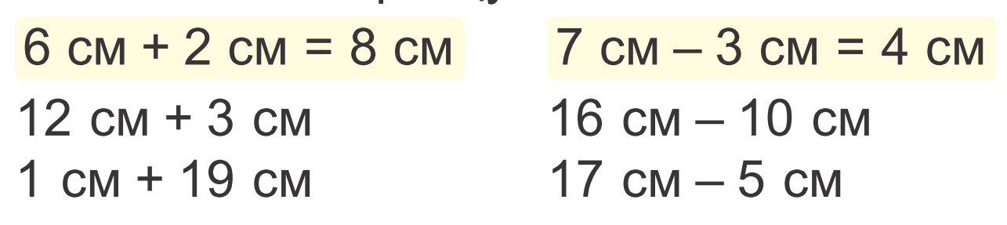
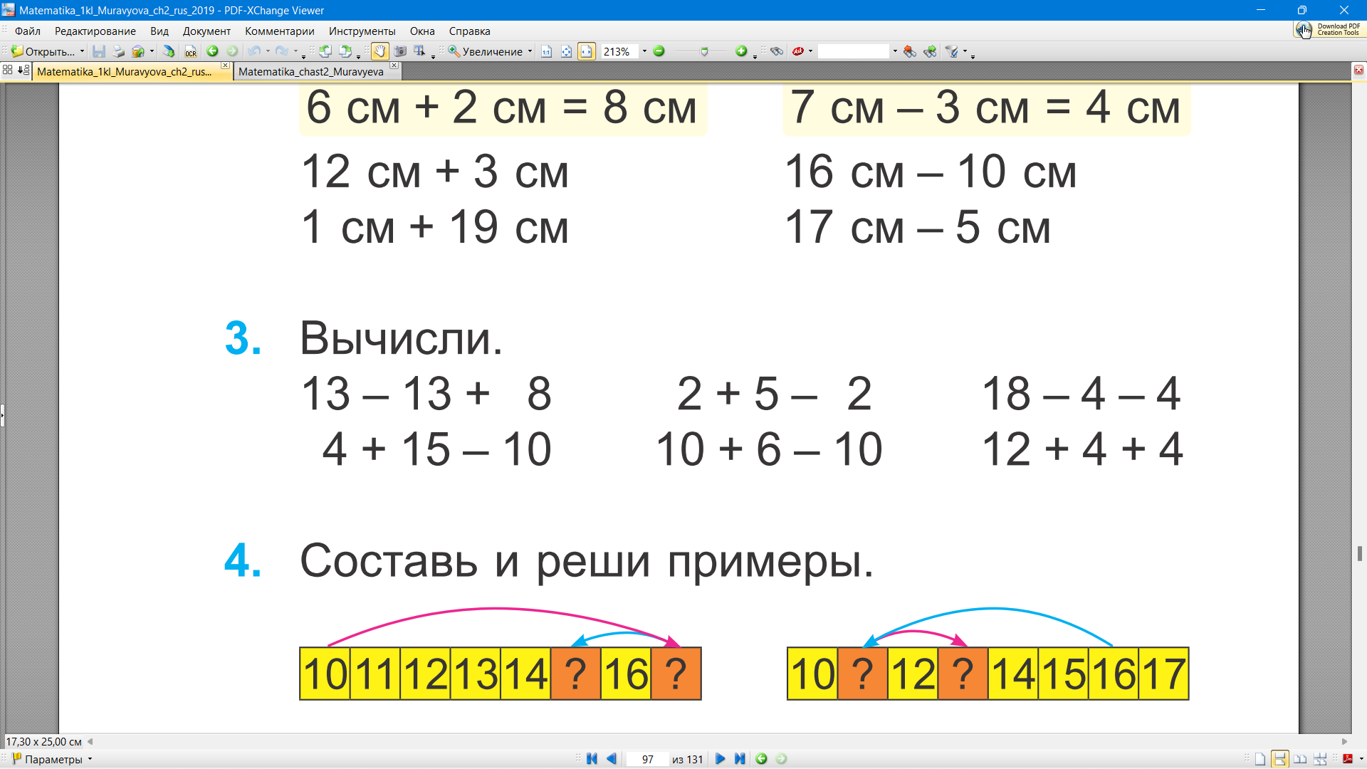
= 15 см
= 6 см
= 20 см
= 12 см
0
7
14
= 8
= 5
= 10
19
16
16
= 9
= 6
= 20

Slide 22
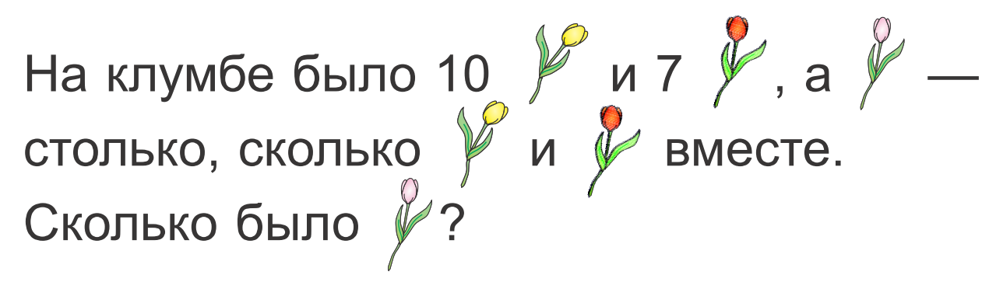
10 + 7 = 17 (т.)

Slide 23
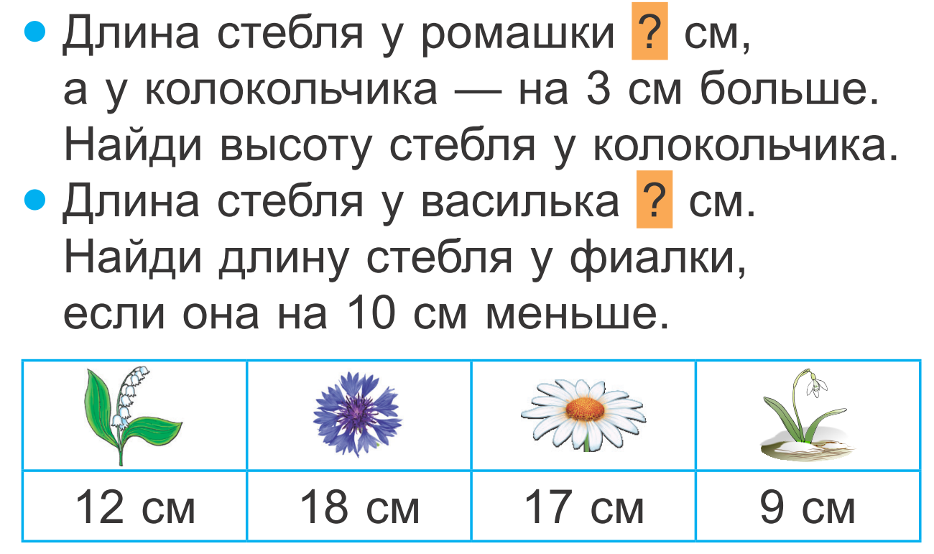
17
18
17 + 3 = 20 (см)
18 – 10 = 8 (см)

Slide 24
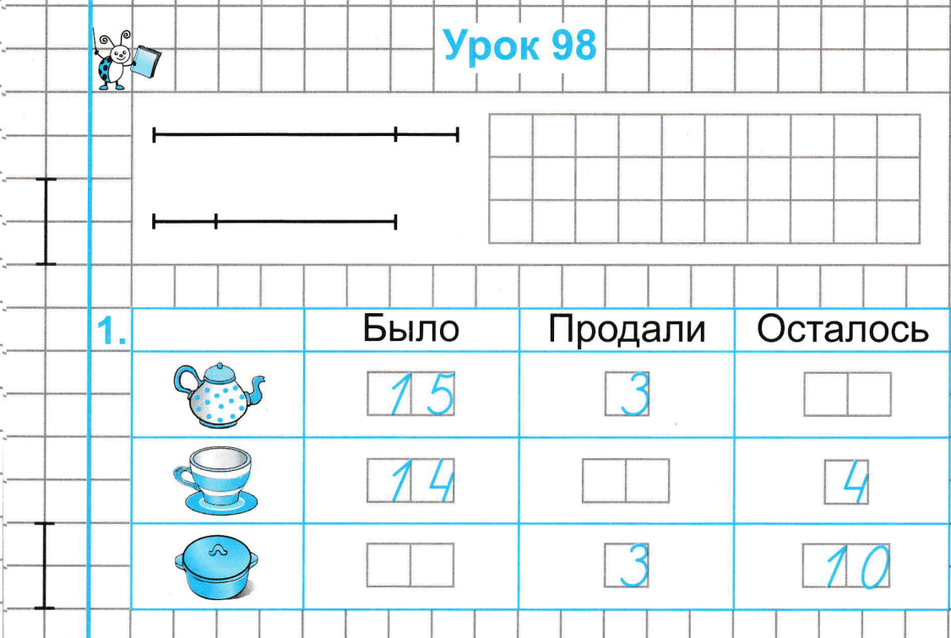

1 2
1 0
1 3

Slide 25
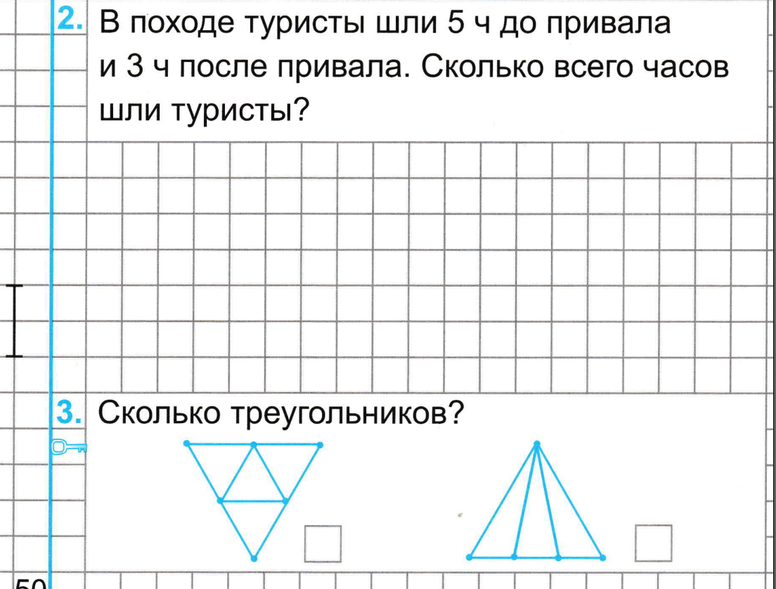



5
6

