Slide 1
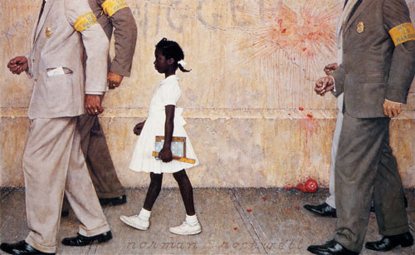
“The Problem we all live with” by Norman Rockwell
-1964-

Slide 2
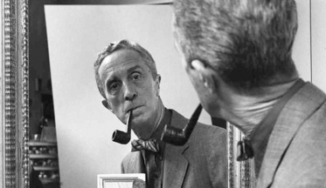
1-Who was Norman Rockwell ?
Click on this link , read the first paragraph and note down basic information :
https://en.wikipedia.org/wiki/Norman_Rockwell

Slide 3

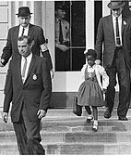
2-Who was Ruby Bridges ?
*Read the first paragraph and note down basic information about Ruby Bridges :
https://en.wikipedia.org/wiki/Ruby_Bridges
*Then watch this extract from the Disney movie « Ruby Bridges » and anwer the questions :
https://www.youtube.com/watch?v=akYXhyN0cLY
1-Why are there so many policemen ?
2-How is she dressed? Why ?
3-How do the other parents, the people around them react ?
4-Imagine Ruby’s feelings .

Slide 4

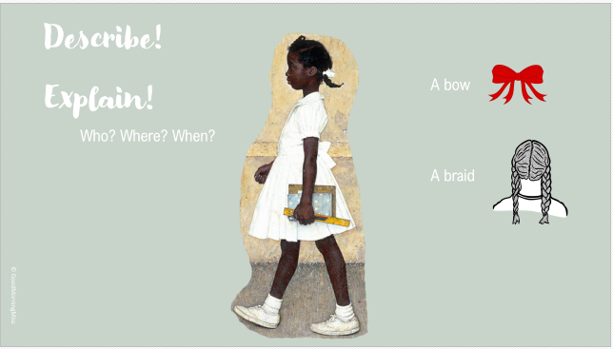
Now in your copybook describe the painting step by step :

Slide 5

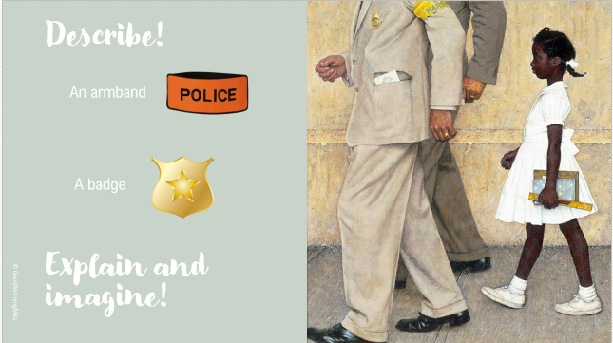

Slide 6

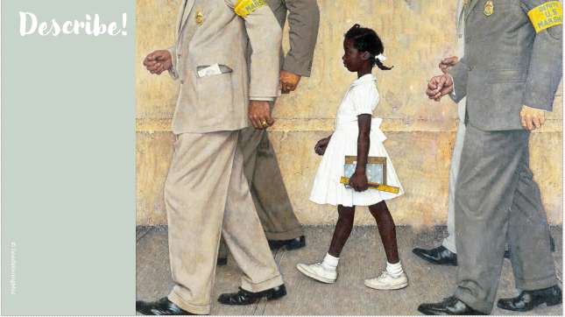

Slide 7

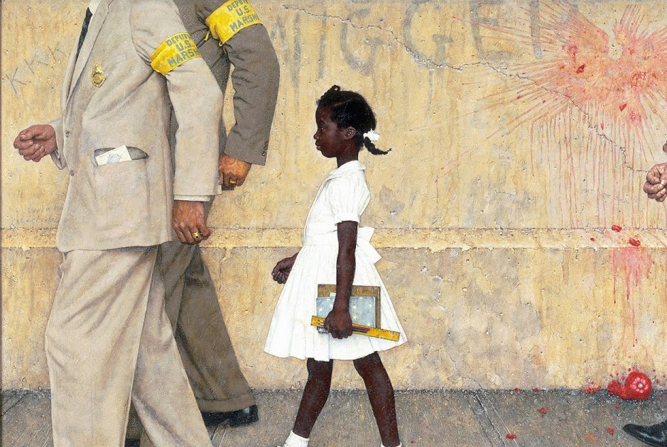
What are the two new details ? Explain

Slide 8
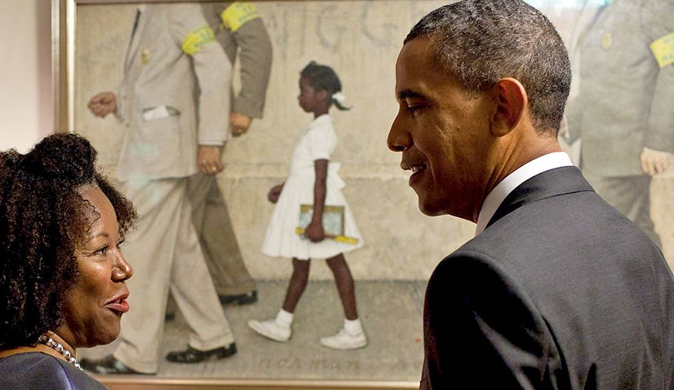
Watch this video and answer the questions :
https://www.youtube.com/watch?v=BCsJ-24MdZc
1-What are Ruby Bridges and Barack Obama looking at ? Where are they ?
2-What lesson does Ruby say she learnt that day in school?
3-At the beginning of the video what did Barack Obama tell her ?
4-Can you explain and develop a little?
5-Imagine Ruby’s feelings at the moment .

Slide 9
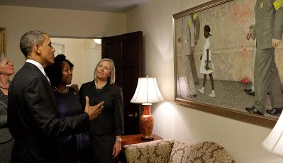
To conclude , answer these questions :
What have you learnt about the painting ? Think of the historical context.
What is your opinion about it ? Do you like it or not and why ?
Do you think it is/was efficient to make people think ( efficace pour faire réfléchir les gens) ?

