Slide 1

lawn and garden maintenance service
Welcome to Jims Mowing Melbourne West

Slide 2
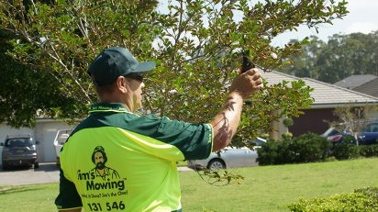
Professional Lawn Mowing Services in Point Cook
we are happy to represent lawn mowing point cook in your town and giving you fully supportive services. just search , inquire and book our team and you get our team at , your door.

Slide 3
Get Lawn Mowing Hoppers Crossing
Get great lawn mowing Hoppers Crossing services here with us at Jim’s Mowing; we offer highly professional services at great deals so you enjoy hassle-free without breaking your budget.
So give us a call, we are crossing your city of lawn mowing hoppers crossing, we are waiting to give you 100% satisfied results about mowing. Easy service, beneficial results and reliable feedback were always essential in growing our lawn mowing business.

Slide 4
High-quality lawn and garden maintenance service
Our expert and certified lawn specialists and highly prepared teams can assist you with accomplishing an extravagant, green lawn that is normally more impervious to disease, bugs, and weeds. Jim’s mowing lawn specialists are prepared to help, regardless of whether you need to treat lawn your current lawn, have issues developing grass, or simply need to learn your alternatives. We are consistently here to help you. We will help you to make your garden more delightful. Our ensured lawn service specialists will work for hand in hand with you to build up a lawn administration routine that precisely meets your particular necessities and needs.

Slide 5
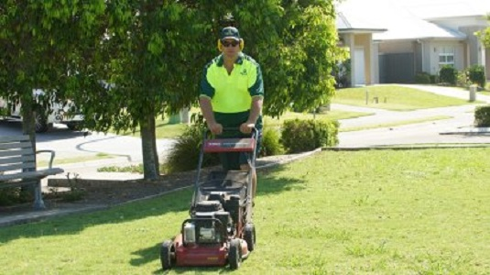

Slide 6
Thank You
Contact Details
Business Name: Jims Mowing Melbourne West
Phone Number: 131 546
Website: https://www.jimsmowingmelbournewest.com.au/

